Slide 1
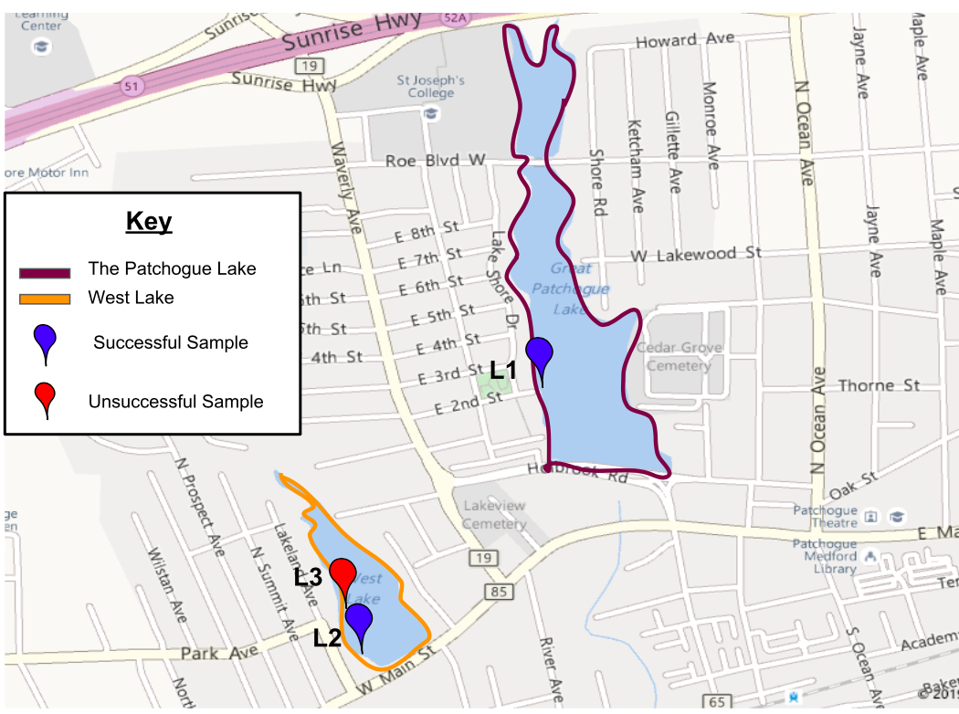
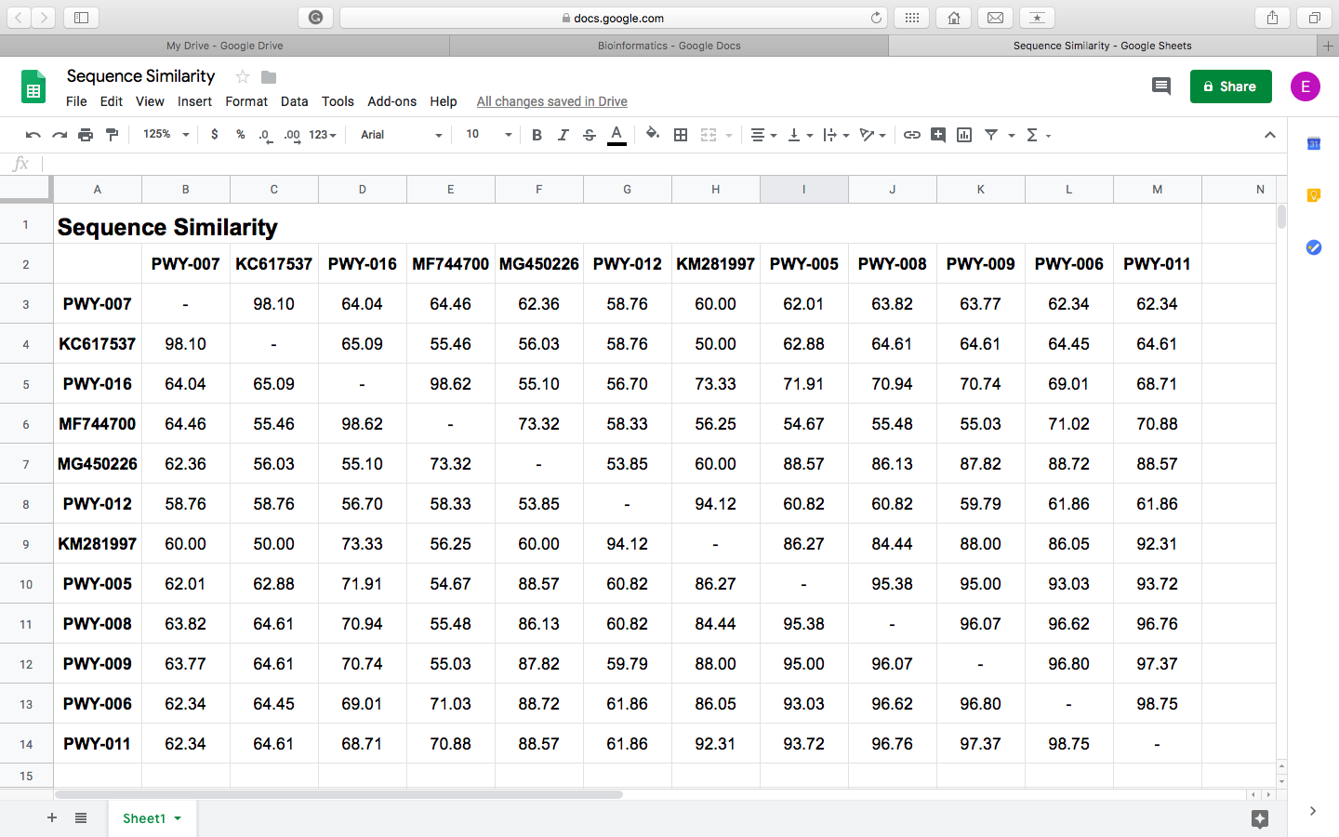
The Biodiversity of Water Mites in Freshwater Ecosystems
Data Tables & Figures
Map of Patchogue Lake and West Lake
Sequence Similarity of Collected and Known Samples
When comparing PWY-006, PWY-009, and PWY-011 (From L1) to the reference sequence MG450226.1|cyclopidae_sp., all three of the samples were genetically similar ranging from 87.82 to 88.72%
When analyzing PWY-005, PWY-007, PWY-008, PWY-012, and PWY- 016 (From L2), there were four different species identifications ranging from 86.13 to 98.62% sequence similarity
Sample PWY-005 recorded an 88.57% sequence similarity and PWY-008 showed an 86.13% similarity with the known reference MG450226.1|cyclopidae_sp.
KC617537.1|chydorus_brevilabris. showed a 98.10% similarity with sample PWY-007, while PWY-012 demonstrated a 94.12% similarity with KM281997.1|cyanea_tzetlinii.
Sample PWY-016 from West Lake was determined to be most closely related to reference MF744700.1|macrocyclops_sp. with a similarity of 98.62%.
Figure 1.
Water mite samples were collected in three marked locations (L)
L1 was taken from Patchogue Lake, which is located directly next to Sunrise Highway, a main road with heavy automobile activity.
L2 and L3 were taken from West Lake, a more residential area.
L3 was located directly off of a boat ramp and resulted in no visible water mite specimens.
Table 2.
Water Quality of Patchogue and West Lake
Table 1.
 | Patchogue Lake | West Lake
Temperature | 12°C | 13°C
Dissolved Oxygen | 6 | 8
Nitrogen | 20 ppm | 5 ppm
Phosphate | 2 ppm | 2 ppm
Coliform | Positive (yellow) | Positive (yellow)
pH | 7 | 7
Results From MUSCLE in DNA Subway
DNA Subway indicated four distinct groups present in the lakes- cyclopidae, macrocyclops, chydorus brevilabris, and cyanea tzetlinii
PWY-005, PWY-006, PWY-008, PWY-009, and PWY-011 (from mainly L1) are genetically similar to the known sequence MG450226.1|cyclopidae_sp.
The known sequence MF744700.1|macrocyclops_sp. correlates with sample PWY-016 (from L2)
Sample PWY-007 (from L2) shows a correlation with the known sequence KC617537.1|chydorus_brevilabris.
The known sequence KM281997.1|cyanea_tzetlinii correlates with the collected sample PWY-012 (from L2).
The orange line on Figure 2 indicates the separation between sample sequences from L1 and L2 (L1 is below the line, L2 is above the line)
The ideal nitrogen levels for a freshwater lake is from 1-5 ppm. Therefore, the water quality data shows that there is a significant amount of nitrate pollution evident in L1 specifically.
Excessive amounts of nitrogen are unfavorable for aquatic organisms because it usually causes overstimulation of growth of aquatic plants and algae, using up dissolved oxygen needed for the water mites.
There is a substantial amount of coliform in both L1, L2, and L3 supported by the positive indicator in the water quality test.
Considering that these freshwater lakes are located in a generally residential area, it is likely that runoff from rain on roads and backyards brought chemicals, fertilizers, and fecal matter into the bodies of water.
Figure 2.

Slide 2
Research Question
Conclusions
To what extent is the biodiversity of water mites in freshwater lakes affected by water contamination?
The collected data shows slight differences between the DNA sequences of the water mites from the two individual lakes
The continuous boat concentration in L3 could cause a significant amount of contamination and decrease the overall water quality, therefore creating an unfavorable environment for water mites to inhabit
Possible causes of decreased quality of water could be increased nitrogen and coliform levels. Considering that these freshwater lakes are located in a generally residential area, it is likely that runoff from rain on roads and backyards brought chemicals, fertilizers, and fecal matter into the bodies of water.
The data displayed various single nucleotide differences that could indicate evolutionary alterations of the genetic code in the water mites
The lower sequence similarity consistently present between the collected water mites and the known sequences are evident of genetic variation of the cyclopidae species over time due to contamination.
Unlike L2, the samples taken from L1 are very similar, showing the lack of biodiversity in the population, and there was only one common species present in both lakes
Being that there was less biodiversity and abundance of water mites in freshwater ecosystems that are highly polluted, my hypothesis was supported
Conclusions
Conclusions
Hypothesis
There will be less biodiversity and abundance of water mites in freshwater ecosystems that are highly polluted.
Rationale
More than 844 million people in the world do not have access to safe drinking water in their day to day lives (World Economic Forum)
Water mites are a relatively neglected indicator of biodiversity and pollution (Goldschmidt, 2016)
Yet, water mite assemblages are thought to be excellent bioindicators as they offer a vast range of research opportunities looking into the effect that pollution and eutrophication have on human health in the local environment
Methods
The water quality of Patchogue and West Lake was tested to indicate the levels of pollution through the analysis of dissolved oxygen, nitrogen, phosphate, coliform, and pH levels
Secondarily, the abundance of the species was analyzed to determine if pollution was a factor affecting the wellbeing of these organisms. The water mites were collected with a bucket and then inspected using a dissecting scope for confirmation
Next, the water mites were isolated in microcentrifuge tubes (1.5 mL) containing 96-100% ethanol to preserve the DNA. Using a dissecting scope and a microscopic camera, the organisms were photographed and documented into the DNALC database
DNA isolation was conducted
Using both PCR amplification and gel electrophoresis, each sample was analyzed to determine which were sufficient to send in for sequencing and analysis through bioinformatics
The individual samples PWY-005 to PWY-016 (excluding PWY-010, PWY-013, PWY-014, and PWY-015) were then analysed in DNA Subway to evaluate the single nucleotide base differences between the DNA sequences
Implications
Water mites can be used as bioindicators due to their high abundance, restricted mobility, clear positioning in an environment, and sensitivity to environmental stressors (Gedhart, 2002)
Analysis of water mites in freshwater lakes provides detailed information on the ecological situation of the overall community.
Since only a small region of DNA, less than a 2000 base pairs were sequenced, it would not be possible to accurately attribute the level of pollution found at these locations to the mutations displayed by the Single Nucleotide Polymorphisms
Although lakes have not been commonly examined in the past, these results, as well as other research, have demonstrated that water mite assemblages in lakes are affected by an increase in touristic exploitation, environmental chemicals, and eutrophication.
Future steps from this study would be to expand the sample size by collecting variations of water mites across Long Island, as well as increasing the size of the genomic region being sequenced. In this way, it would be possible to garner further evidence to corroborate the effect of harmful pollutants on the biodiversity within species, which may later provide a basis on studies regarding human health.
Bibliography
Gerhardt, A. (2002). Bioindicator species and their use in biomonitoring. Environmental monitoring, 1, 77-123.
Goldschmidt, T. (2016). Water mites (Acari, Hydrachnidia): powerful but widely neglected bioindicators – a review. Neotropical Biodiversity.
World Economic Forum. (n.d.). The Water Crisis. water.org. Retrieved from
https://water.org/our-impact/water-crisis/

