Slide 1
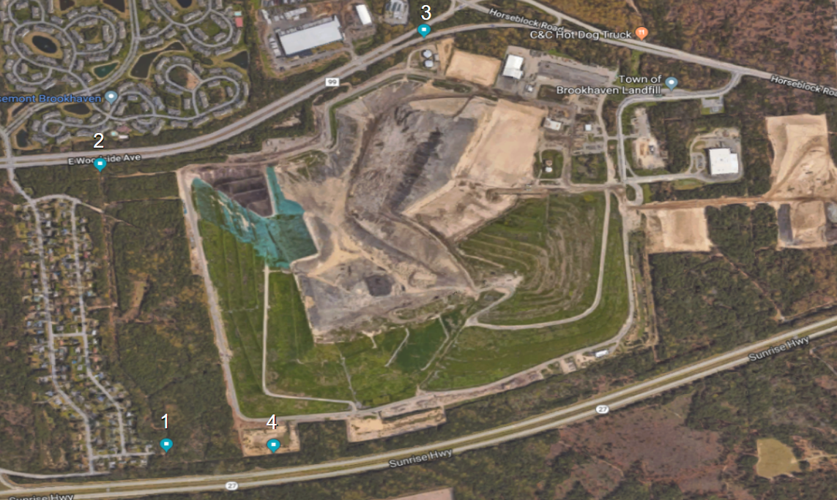
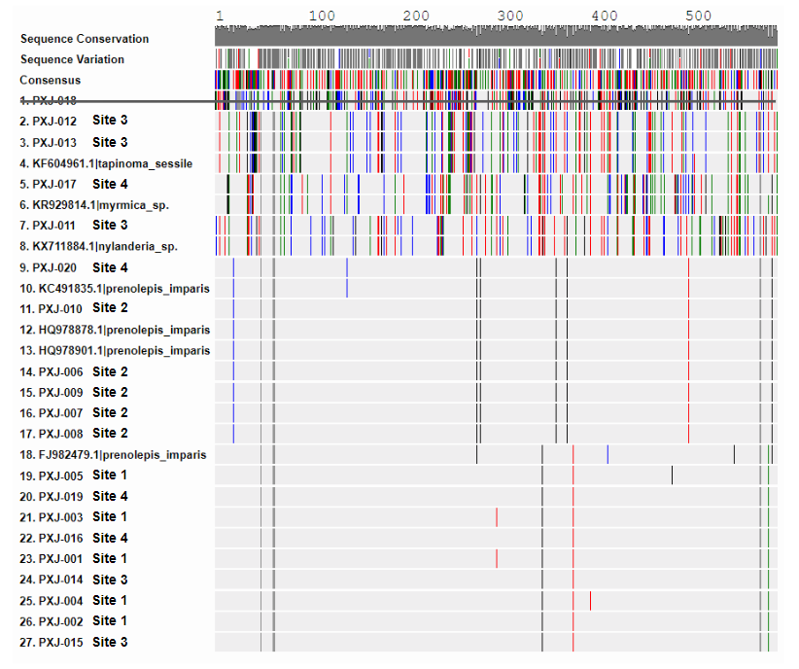
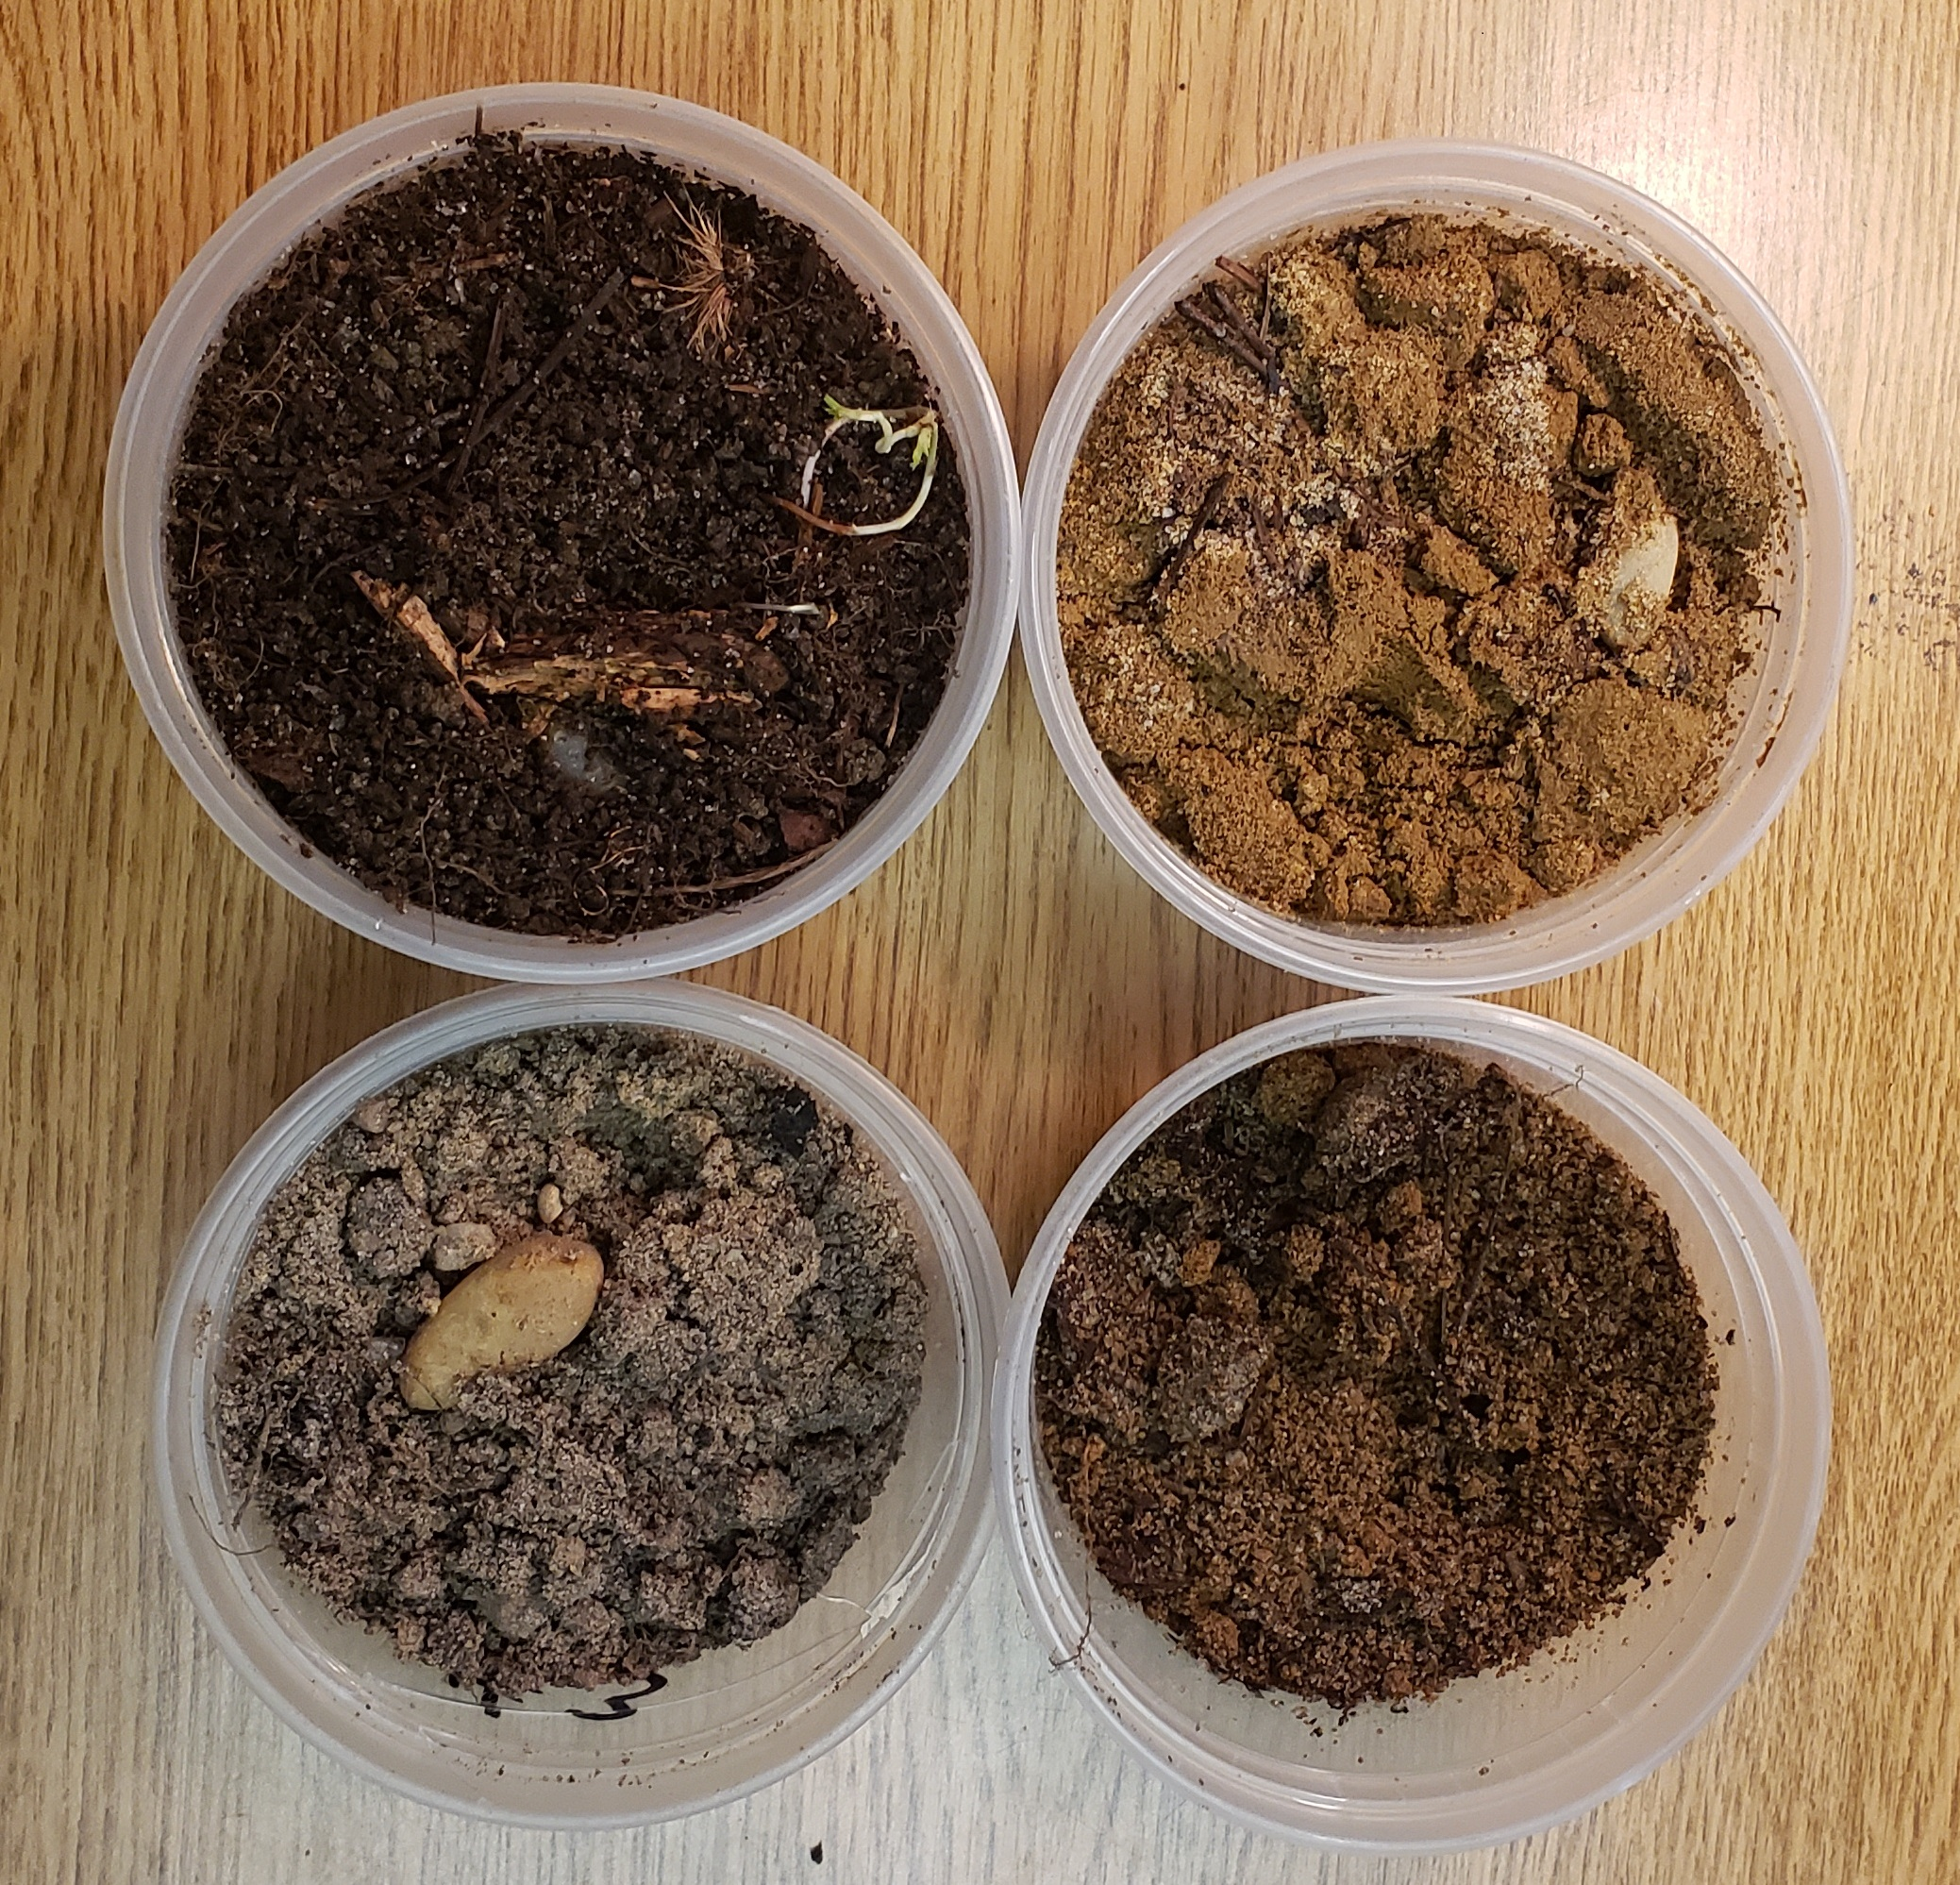
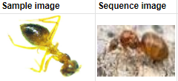
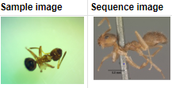
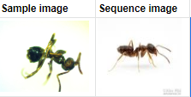
The Biodiversity of Ants in the Brookhaven Town Landfill
Data Analysis
Collection sites of the Brookhaven Town Landfill
Results of MUSCLE analysis from DNA Subway
Figure 1.
Each marked location shows where ant samples were collected from.
Sites 1 and 2 were both considered non-polluted.
Site 3 was the most polluted because lies in close proximity to a leachate filtration system.
Site 4 is closer in proximity to the landfill than sites 1 and 2, and is therefore more polluted.
Figure 3.
From site 1, all samples were sequenced as FJ982479.1|Prenolepis_imparis.
Site 2 contained sequence HQ978878.1|Prenolepis_imparis, matching to PXJ-007, while the other 4 samples were matched to the HQ978901.1|Prenolepis_imparis sequence.
Site 3 was the most diverse out of the 4 sites:
PXJ-011 corresponded to sequence KX711884.1|Nylanderia_sp.
PXJ-012 and PXJ-013 were matched to the sequence KF604961.1|Tapinoma_sessile.
PXJ-014 and PXJ-015 were sequence FJ982479.1|Prenolepis_imparis.
Site 4 contained less biodiversity than site 3
PXJ-016 and PXJ-019 were both matched to the FJ982479.1|Prenolepis_imparis sequence.
PXJ-020 was linked to the sequence KC491835.1|Prenolepis_imparis
PXJ-017 was linked to the sequence KR929814.1|Myrmica_sp
PXJ-018 was disregarded.
The four different soil samples taken
1
2
3
4
Figure 2.
Soil from site 1 had a Ph of 4. It was the most fertile.
Soil from site 2 had a Ph of 7. This soil is visibly the most barron. The soil smelt like rotten eggs, indicating that there was H₂S in it.
Soil from site 3 had a Ph of 8.5
Soil from site 4 had a Ph of 5
Physical differences between collected ants and their sequenced image
Figure 4.
Figure 5.
Figure 6.
All imparis species are represented by the sequence image on the right.
Most samples of imparis look like PXJ-001 (on the right) except for:
PXJ-007, having extra stripes
HQ978901.1|Prenolepis_imparis variants had a solid black abdomen.
Sample PXJ-011 on the left represents ⅕ different species identified from site 3.
On the right is the image for sequence KX711884.1|Nylanderia_sp
The sample is noticeably darker than the Nylanderia ant.
Samples PXJ-012 and PXJ-013 are represented by the left side image.
On the right is the image for sequence KF604961.1|Tapinoma_sessile
The samples have black leg stripes and a solid black abdomen whereas the sequenced image has neither.

Slide 2
Research Question
Conclusions
To what extent do land pollution and ground toxins affect the biodiversity of ants in locations surrounding the Brookhaven town landfill?
From site 1, all samples were sequenced as FJ982479.1|Prenolepis_imparis, indicating that there was only the imparis species at this site.
Site 2 also had only imparis ant species, however sample PXJ-007 matched to sequence HQ978878.1|Prenolepis_imparis, while the other 4 samples were matched to HQ978901.1|Prenolepis_imparis.
Site 3 was the most diverse site out of the 4. It contained three different species, supporting the notion that pollution could cause increased levels of biodiversity.
Site 4 contained less biodiversity than site 3, but had more than sites 1 and 2. Because of its close proximity to the landfill, it is reasonable to believe that it is more polluted than the first two sites.
This also supports that pollution can increase biodiversity.
The Ph values from sites 1-4 were recorded as follows: 4, 7, 8.5, 5.
No connections can be drawn between Ph and biodiversity.
Because the more polluted sites had more biodiversity in ant species, my hypothesis was rejected.
Hypothesis
I hypothesize that the toxicity of the Brookhaven Town landfill will cause very low levels of biodiversity in ants.
Rationale
Land pollution from landfills include leachate, carcinogens and heavy metals such as nickel, lead, and cadmium. H₂S is also common in many landfills.
Ants are known to easily accumulate heavy metals that can be harmful to living creatures (Vaverková,2012). Because of this, ants are good bioindicators of pollution (Eeva,2004).
By using DNA Barcoding to identify ant species, the biodiversity of an area can be assessed.
Once the biodiversity and pollution levels of the four sites are established, then possible relationships can be concluded.
Methods
Four different collection sites labeled 1-4 were used to collect ants and soil.
Each site had a certain number of ants collected from them, and from each site, five ants were selected at random to be studied. (n=20 total ants).
Ants PXJ-001 through PXJ-005 were from site 1, PXJ-006 through PXJ-010 from site 2, PXJ-011 through PXJ-015 from site 3, and PXJ-016 through PXJ-020 from site 4.
It is important to note that site 3 is considered to be most polluted because it was about 6 meters from a leachate filtration system and stank of H₂S.
Ants were then isolated in microcentrifuge tubes (1.5 mL) containing 96-100% ethanol to preserve the DNA. Using a dissecting scope and a microscopic camera, the organisms were photographed and documented into the DNALC database to be later used.
After that, DNA from every sample was isolated using a silica extraction method.
Then, PCR amplification and gel electrophoresis was used to determine which samples could be sequenced.
All samples were analyzed in the DNA Subway to evaluate nucleotide base differences between the DNA sequences and their corresponding species.
Sample PXJ-018 was excluded from the study because it was sequenced to be the parasite wolbachia.
Soil Ph values were recorded by making solutions out of the soil samples.
Implications
Ants are frequently used as bioindicators because they can easily accumulate heavy metals, they are abundant, and are easily caught (Eeva, 2004).
The biodiversity of ants from each site can be established by sequencing them to determine both their species and their Single Nucleotide Polymorphisms.
The polymorphisms suggest that the ants from the more polluted sites have mutations due to the differences from their species.
Because a small region of DNA (about 600 base pairs) was sequenced, the correlation between increased pollutants and genetic biodiversity is not necessarily due to the pollution.
This study was limited because there were no soil tests conducted to determine if toxic substances such as heavy metals and H₂S were in the soil.
Future steps from this study would include examining the toxins found within the tested ants and the soil samples in order to create a more direct correlation between said toxins and the biodiversity of ants. Once this correlation is more evident, connections can later be drawn to human health.
After testing ants and soil for various pollutants and using larger populations of species such as Prenolepis imparis with varying levels of toxins could also create a more direct correlation.
Soil tests using mass spectrometry to measure the toxicity of each site would be necessary to determine the relationships between pollution and biodiversity.
Bibliography
Vaverková, M., Toman, F., & Kotovicová, J. (2012). Research into the Occurrence of Some Plant Species as Indicators of Landfill Impact on the Environment. Polish Journal of Environmental Studies, 21(3), 755–762. Retrieved from http://search.ebscohost.com/login.aspx?direct=true&db=a9h&AN=76625276&site=ehost-live
Eeva, T., Sorvari, J., & Koivunen, V. (2004). Effects of heavy metal pollution on red wood ant (Formica s. str.) populations. Environmental Pollution, 132(3), 1-7. https://doi.org/10.1016/j.envpol.2004.05.004

