Slide 1
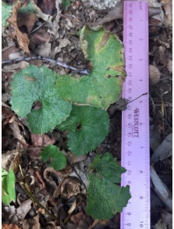
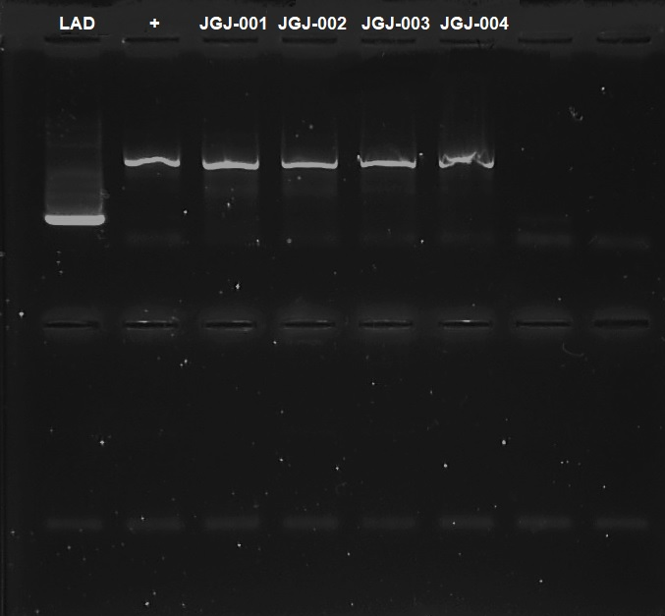
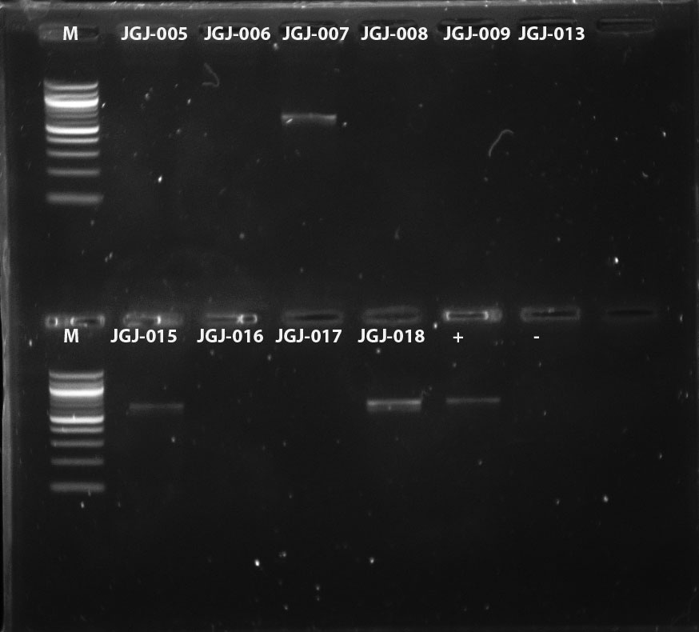
Biodiversity Study of Invasive and Native Plant Species in Tenafly Nature Center
Authors: Lauren Aslami³ and Sabrina Li³
Mentor: Dr. Christine Marizzi ^{1,} Mrs. Anat Firnberg³
¹ Harlem DNA Lab; ³ Tenafly High School
Abstract
Materials and Methods
Conclusion
Invasive species have become a worldwide issue. They dominate space and resources, effectively killing native species. This study examined the native and invasive species of the Tenafly Nature Center and attempted to discover the advantages of invasive species over native ones. Eighteen native and invasive samples were collected from the TNC. The DNA from these samples were isolated, amplified with Polymerase Chain Reaction (PCR), and identified using the Blue line of DNA Subway. Sequence relationships and species were determined using phylogenetic trees and BLAST sequences respectively. Seven samples were identified with BLASTN, and the rest were identified phenotypically. Common advantages between the invasives that were also determined. These traits include rapid, smothering growth, origin from Eastern Asia, and chemical defenses. Many samples were categorized as vines, which allowed them to climb up and cover other plants. These characteristics explain the success of certain invasive species.
COLLECTION
Collected leaves for easier DNA extraction, fallen leaves for native plants
ISOLATION
Sample size of 10-20 mg
AMPLIFICATION
2 μL of each sample were placed into PCR tubes
IDENTIFICATION
Samples were bagged and labeled with sample number, GPS coordinate, and time of collection
Preserved through freezing
18 samples total
300 μL of lysis solution and pestle were used to grind sample
Incubated, centrifuged, and washed several times, supernatant was removed each time
Added PCR reagents 225μL Taq mix + 10.5 μL primer mix
Loaded into gel, ran gel to check for proper isolation
SEQUENCING
Successfully isolated samples were sent to Genewiz for sequencing
7 samples were successfully isolated
DNAsubway.org was used to identify the species, specifically BLASTN
Samples that were unable to be isolated were identified phenotypically
Added 3 μL silica resin to bind to DNA
Did PCR to amplify rbcL gene
7 samples and 5 species were identified genotypically: Alliaria petiolata, Celastrus orbiculatus, Wisteria sinensis, Lyonia ovalifolia and Ilex opaca
The other samples were phenotypically identified: 7 were invasive, 9 were native and 1 was non-native
The invasive species shared several similar characteristics
Three invasive species were vines, allowing them to rapidly grow, latch onto natives and block sunlight
Alliaria petiolata releases allopathic chemicals (glucosinolates and their hydrolysis products), which affect the mycorrhizal potential of soil
All have quick gestational periods, allowing them to grow quicker than native species and take over resources
All of these species, with the exception of Alliaria petiolata, are natively found Eastern Asia
These characteristics seem to appear in invasive species and not in native species
Results
Introduction
References
Invasive species are alien species that cause harm to native species and local environments
The Tenafly Nature Center (TNC) is threatened by many invasive plants that are overtaking the preserve
Invasive species
compete with native species for sunlight, nutrients, and space
lack major predators and competition
impact consumers, such as insects, animals, and humans
At TNC, invasive species have dominated the pathways and trails. After covering the pathways and clear patches, invasive species start engulfing the areas inhabited by native species until they cover the area
We hypothesize that there will be a large number of invasive species, and they will share features such as a quick gestational period that allow them to take over areas they are not native to.
Executive Order No. 13112 (1999). Executive Order 13112: Invasive Species. Retrieved from https://www.gpo.gov/fdsys/pkg/FR-1999-02-08/pdf/99-3184.pdf
NJ Invasive Species Strike Team (2016). Invasive Map. Retrieved from http://www.njisst.org/invasive-map.htm
Pennsylvania State University (2014). What Makes Invasive Plants so Successful?. Retrieved from http://ecosystems.psu.edu/research/centers/private-forests/news/2014/what-makes-invasive-plants-successful
State of New Jersey Department of Environmental Protection (2009). New Jersey Invasive Species Council. Retrieved from http://www.nj.gov/dep/njisc/
Tenafly Nature Center (2017). Ecology of Tenafly Nature Center. Retrieved from http://www.tenaflynaturecenter.org/Ecology-of-Tenafly-Nature-Center#Checklists
Figure 1: This figure shows the DNA sequence of the rbcl gene of JGJ-001, which is garlic mustard (Alliaria petiolata) and the quality of its DNA.
Figure 2: This figure shows the DNA sequence of the rbcl gene of JGJ-018, which is American holly (Ilex opaca) and the quality of its DNA.
Alliaria petiolata
Celastrus orbiculatus
18
Image 1: Picture of JGJ-001, Garlic Mustard
(Alliaria petiolata)
Image 2: Picture of JGJ-018, American Holly
(Ilex opaca)
Figure 3: This figure shows the genetic similarity between the samples from the first round and the plants they were identified to be.
Image 3: Picture of gel from Trial 1 (1/13/2018)
Wisteria sinensis
Acknowledgements
Hypothesis
Ilex opaca
We would like to thank our Science Research teacher, Mrs. Anat Firnberg, as well as Dr. Christine Marizzi, Dr. Allison Cucco and Dr. Melissa Lee at the Cold Spring Harbor Lab and the Harlem DNA Lab. We would also like to thank the Tenafly Nature Center for their help with the collection.
Lyonia ovalifolia
Figure 4: This figure shows the genetic similarity between the samples from the second round and the plants they were identified to be.
Image 4: Picture of gel from Trial 2 (2/10/2018)

