Slide 1
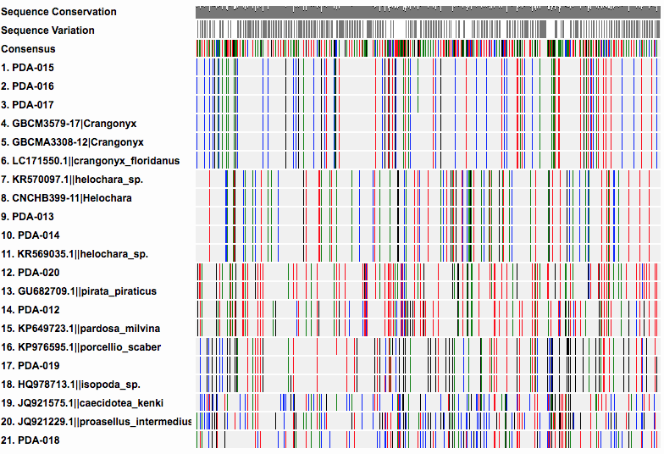
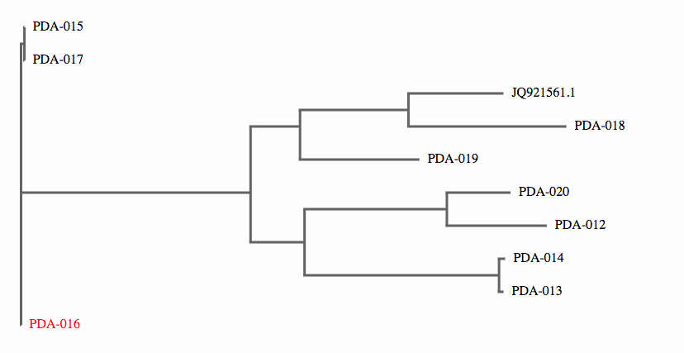
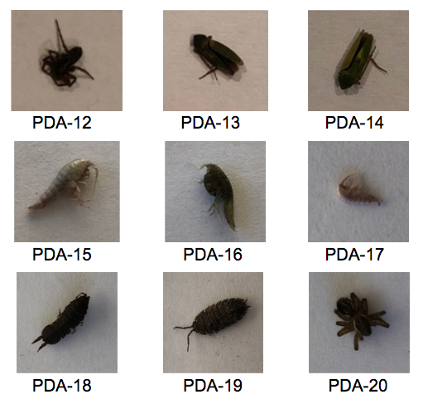
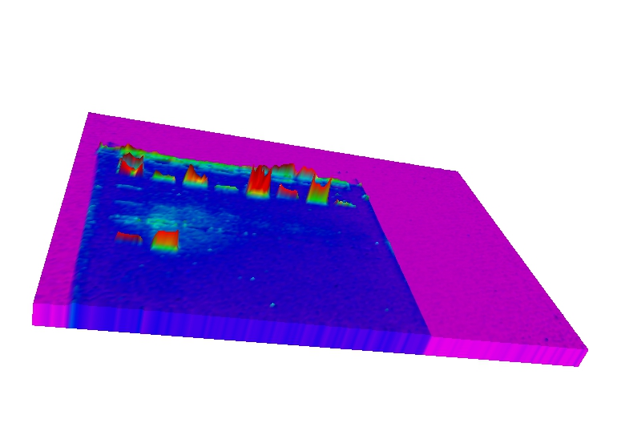
Comparing The Biodiversity of Macroinvertebrates of Man-Made and Natural Ponds
Authors: Heather Abbene and Stephanie Ross
Mentor: Frederick Feraco ¹
¹ Walt Whitman High School
Figure 2: To the left the Phylogenetic tree showing how closely each sample is related. This shows that there is biodiversity in Heckscher Park
Table of Sequences Results
Species ID | Species name | Origin Location
PDA-012 | Pardosa milvina voucher | can be found in the United States
PDA-013 | Helochara delta | Native to the united states
PDA-014 | Helochara delta | Native to the united states
PDA-015 | Crangonyx floridanus | Distribution Widely distributed in the eastern and east-central United States,
PDA-016 | Crangonyx floridanus | Distribution Widely distributed in the eastern and east-central United States,
PDA-017 | Crangonyx floridanus | Distribution Widely distributed in the eastern and east-central United States,
PDA-018 | Unknown | unknown
PDA-019 | Porcellio scaber voucher | considered native to mainland Europe
PDA-020 | Pirata piraticus | The species is widespread in much of Britain
Figure 1: The image above shows the similarities in DNA patterns between the different organisms.
FIgure 4: Below shows images of our gels that we created through BIO RAD GEL-DOC EZ imager.
Figure 3: Above shows images of the sample collected at Heckscher Park
Materials and Methods
The collection of samples were done in the beginning of december and mid march at heckscher park and southards pond. Samples were collected from the surface of the pond as well as the outer edges of the pond. Once collected, they were played in ziplock bags and then stored in the freezer at Walt Whitman High School.
To extract the DNA from our samples we followed the Cold Spring Harbor Laboratory protocol and attended the open BLI workshops. By using the LCO1490/HC02198 invertebrate primer we were able to replicate the CO1 gene using the thermal sampler. Following we conducted our gel electrophoresis and achieved adequate sampling to send to get barcoded. In our final step we used DNA subway to analyze the samples and compare DNA.
RESULTS
According to our data, the many of the macroinvertebrates we obtained were originally native to the US. But two of the macroinvertebrates are native to Europe; the Porcellio scaber voucher and the Pirata piraticus. The Porcellio scaber voucher, also known as Common rough woodlice, are considered native to mainland Europe. This species has spread throughout the world, including onto isolated islands such as Hawaii and Marion Island (located between Africa and Antarctica) and is found on every continent, not including Antarctica. Their dispersal has been facilitated by humans, as they can easily be transported via leaf matter and wood. P. scabers is a detritivore - it mainly feeds on dead matter and excreted waste but a larger group can start to work its way through live plants as well, causing problems for any gardens they inhabit. Also the Pirata piraticus is native to Europe, it is also found in some locations in the United states, including california, Washington and Nevada. It is usually associated with marshy places and near to water where it hunts along the banks and on the water's surface thanks to water repellent hairs on its legs. Both the Pardosa milvina voucher and the Pirata piraticus are types of wolf spiders found near wet marshy lands.

