Slide 1
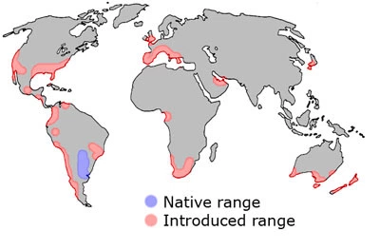
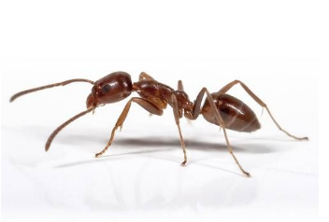
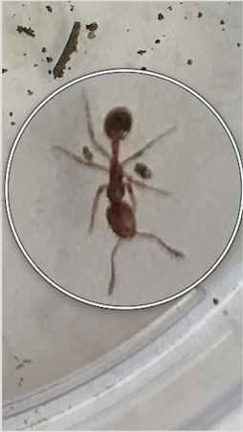
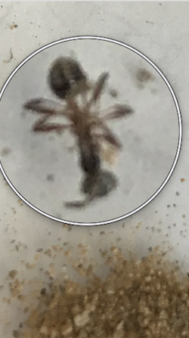
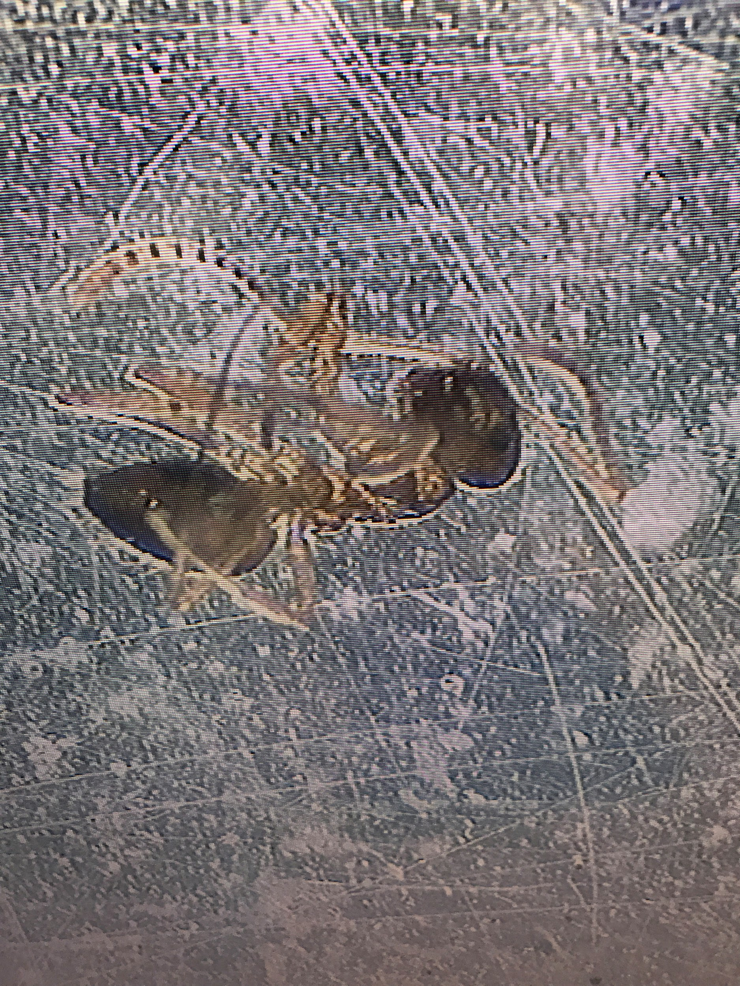
Long Island Invasive Formicidae Species and Where They Exist
By: Ethan Halle, Daniel Kulesa and Eliot Yoon
Materials and Methods
For this experiment, many different materials and items were needed. The likes of which includes containers, a functioning refrigerator, a thermocycler, a gel electrophoresis chamber, fruits (as a bait for ants), a microcentrifuge, a water bath, a gel imager and a Carolina DNA extraction kit.
To make this project work, we collected samples from different types of environments all over Long Island. These environments included anywhere from dry dirt baseball fields to swampy wetlands. This provided us with the diversity needed to draw our conclusion. At these locations, we used apple slices to attract ants to a certain location. When we returned, these apples were often times infested with ants that most oftenly belonged to the same species. We would then count the ants that were present and collect one for sequencing. When we ran into multiple ants of the same species, we would count the species and not collect what we saw. Next, we would record down what we found and undergo the DNA extraction protocol.
Results
22 ants of species A were found
The majority of species A (18/22) were found in areas near or in areas susceptible to human intervention. We were unable to confirm what species A was through barcoding. However, using pictures that I have taken, I have strong confidence that species A is Linepithema Humile, a common invasive species.
16 ants of species B were found
The majority of species B (10/16) were found in areas near or in areas susceptible to human intervention. We were also unable to confirm what species B was through barcoding. Using pictures that I have taken, I have strong confidence that species B is a black carpenter ant, another common invasive species.
10 ants of species C were found
All ants found of species C were found in areas not susceptible to human intervention. Due to this, and comparisons to common invasive species, we are lead to believe that this is a native species
Species A
Species B
Species C
Notes:
Talk C++ when more room

