Slide 1
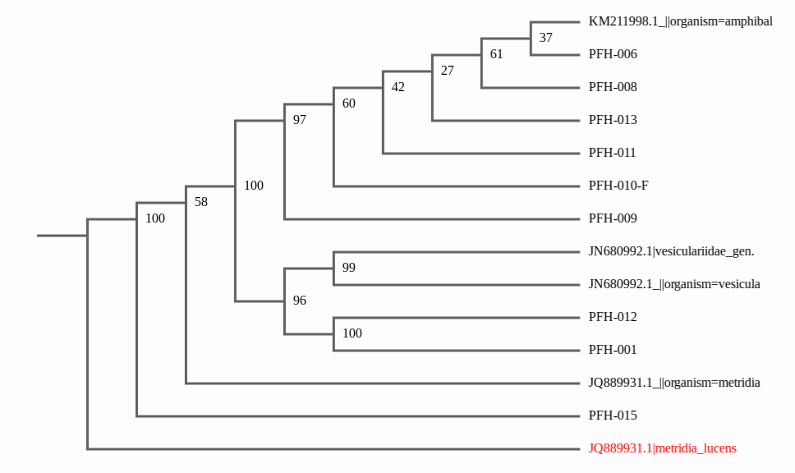
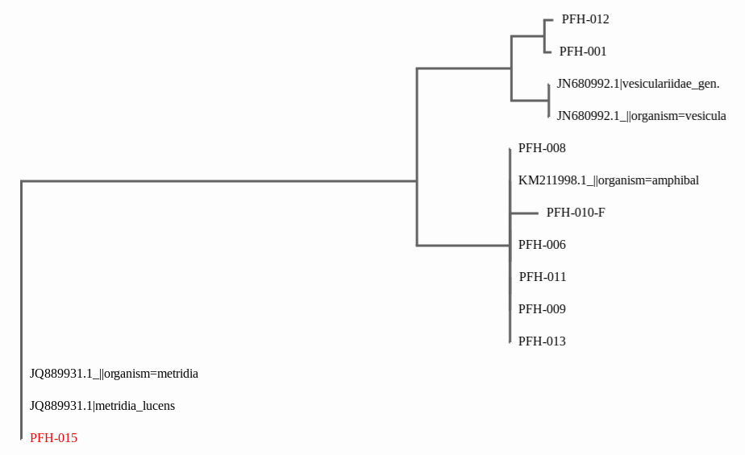
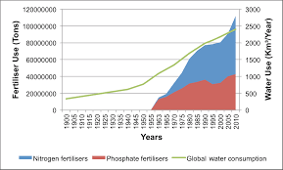
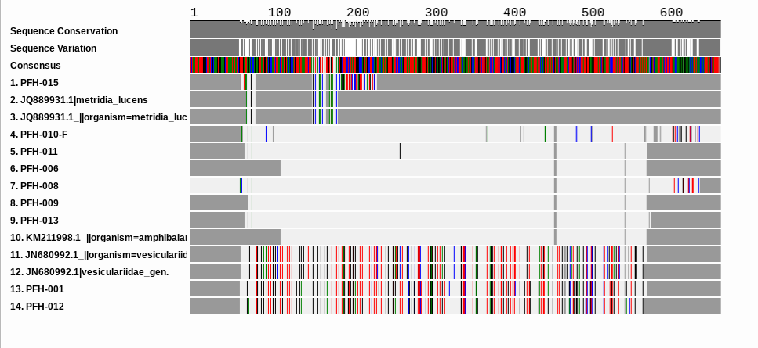
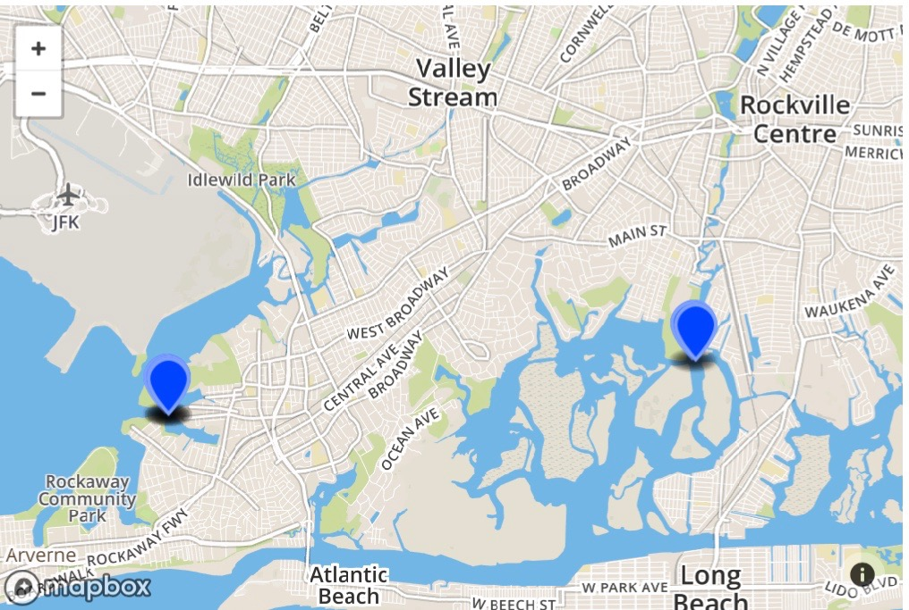
The Effect of Nitrogen Pollution on Barnacle Biodiversity by Kayla Sakayan and Natalie Ugenti
Abstract
Across Long Island, nitrogen pollution is a significant issue caused mainly by human activities including but not limited to, sewer and septic waste treatments, the increased use of fossil fuels, and excess fertilizer applied to crops and fields (The EPA). Barnacles are a type of arthropod belonging to infraclass Cirripedia in the subphylum Crustacea. Often times, they attach themselves to man-made objects, emphasizing the importance of studying these organisms to determine the detrimental effects of human activity on them, including nitrogen pollution (Science Daily). How does the amount of nitrogen in bodies of water affect the biodiversity of barnacles? We hypothesize that if there is an excess amount of nitrogen in bodies of water, then the biodiversity of barnacles will decrease because unhealthy nitrogen levels lead to the uncontrollable growth of algae, referred to as an algae bloom. Exponentially growing algae populations limit biodiversity by taking away precious nutrients and resources barnacles need to thrive. If water quality and conditions are fair, the biodiversity of this species will remain high and/or increases. The bays of the South Shore are not well flushed which leads to the accumulation of nitrogen pollution. We were connected with James Browne who collected the barnacles instead of us obtaining a license to gather samples. The samples consisted of a variety of barnacles from each area with different physical features. Using the “isolating DNA” protocol we performed steps 1-18 as listed on the barcode guide. The “amplifying protocol”, was applied with the invertebrate cocktail primer (LCO1490/HC02198) alongside the profile steps initial, denaturing, annealing, extending, and final at the specific temperatures for this primer. Then, to analyze the DNA we referred to the steps 1-12 under the section “analyzing PCR products” on the DNA barcoding 101 website. Our results supported our hypothesis that nitrogen pollution decreased the biodiversity of barnacles. This is shown through our findings because we barcoded fifteen different barnacle samples from two different location, but only had correct matches for a single species, amathia evilinae, as identified by DNA Subway and BOLD Systems. Our data suggests that due to a limited biodiversity of barnacles, nitrogen pollution is a serious problem that is responsible for damaging variations within marine life.
Tables of Preliminary Data/Collection Locations
Phylogenetic Tree: Philip NJ
Phylogenetic Tree: Philip ML
General trend of Nitrogen Pollution from the 20th century until 2010
Sample collection locations (Jamaica Bay, Reynolds Channel)
Notes:
Talk C++ when more room

