Slide 1
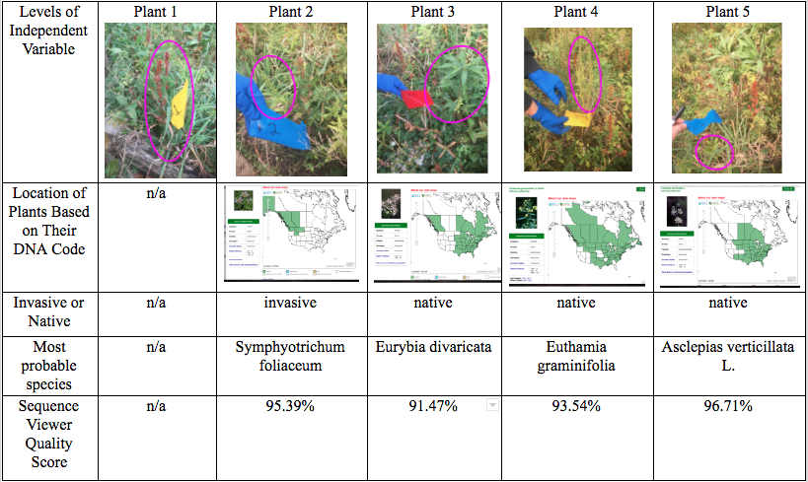
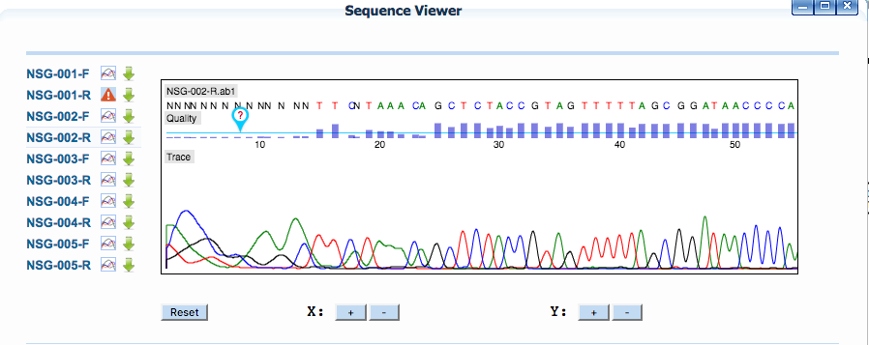
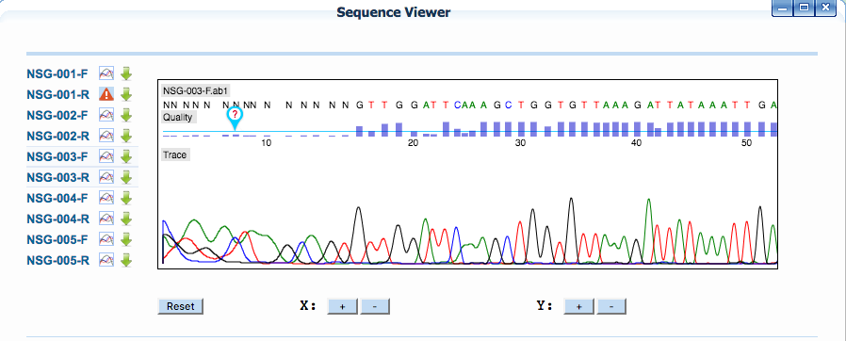
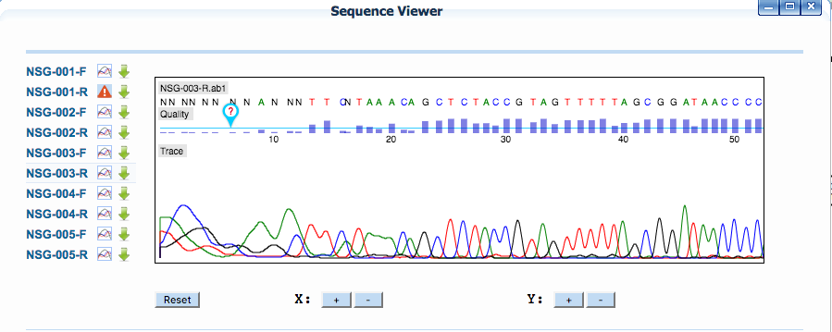
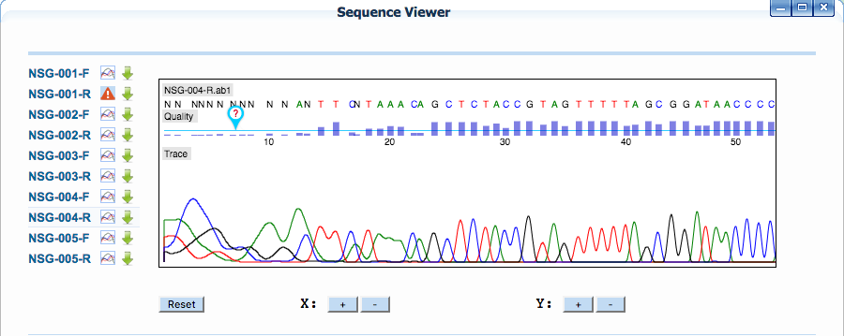
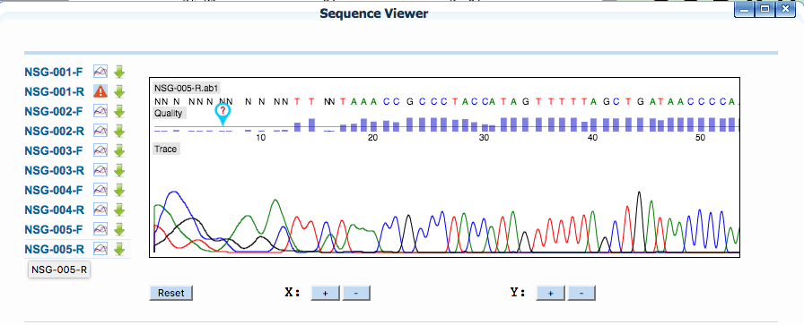
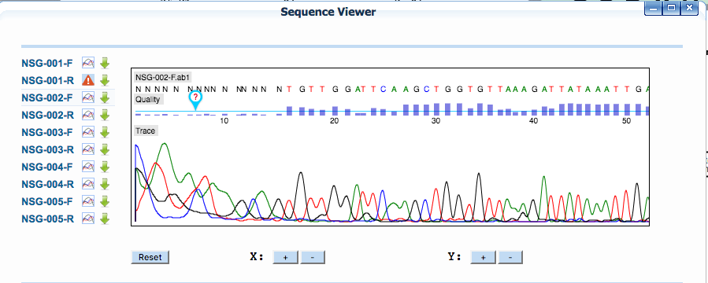
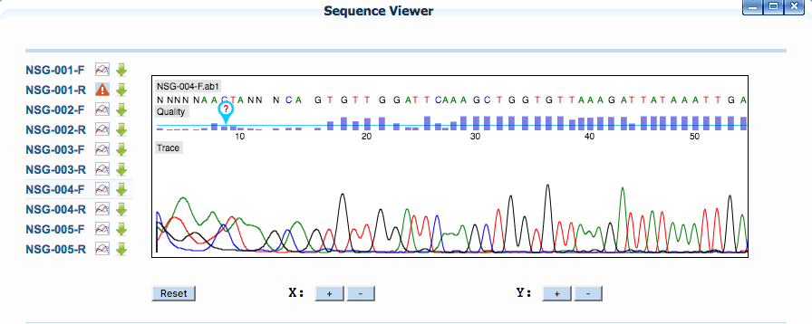
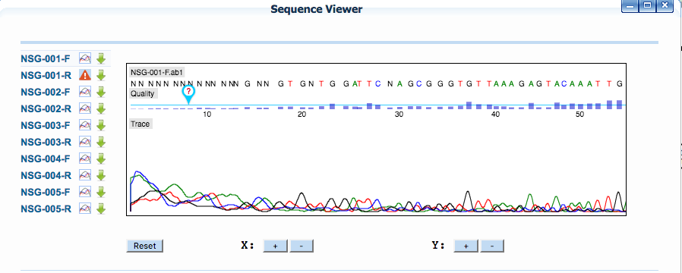
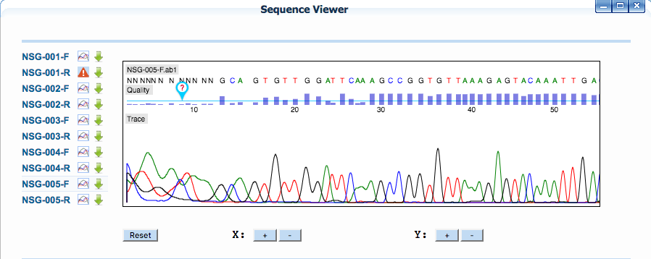
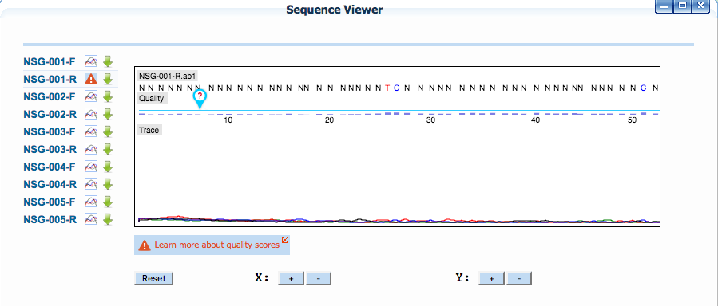
DNA Barcoding Unknown Plants at Carpenter Farm Park To Determine Whether They Are Invasive or Native
Colby Goldsmith. Gretel Huber, Fred Feraco
Collection & Results
Graphs of Preliminary Data
Initial Sample Obervations
Sample One | Sample Two | Sample Three | Sample Four | Sample Five
red-brown leaves, has a stiff stem that branches off into the leaves, seems to have small ovate-shaped leaves | green leafy plant, with medium-sized lanceolate-shaped leaves that grow right on the stem. These leaves have medium-sized ridges. the top of the plant does not seem to have flowers | green leafy plant, short stem with many leaves the leaves are relatively large with small ridges. They are elliptical shaped leaves. | Small, light green, bristle-like leaves, attached to tall, relatively stiff, stems. | Has four-leaves that stem off the main stem. Light green, medium-length leaves. Is a monocot. Leaves are elliptical.
Relationship Tree
Notes:
Talk C++ when more room

