Slide 1
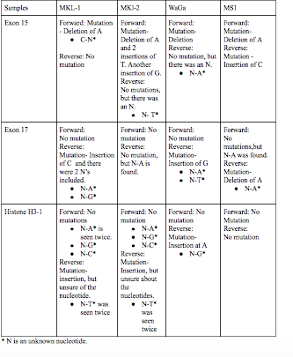
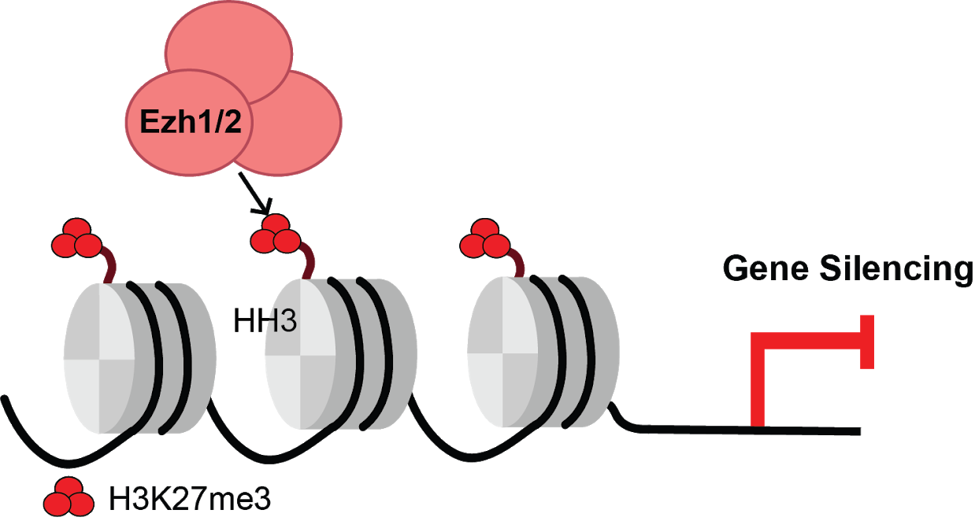
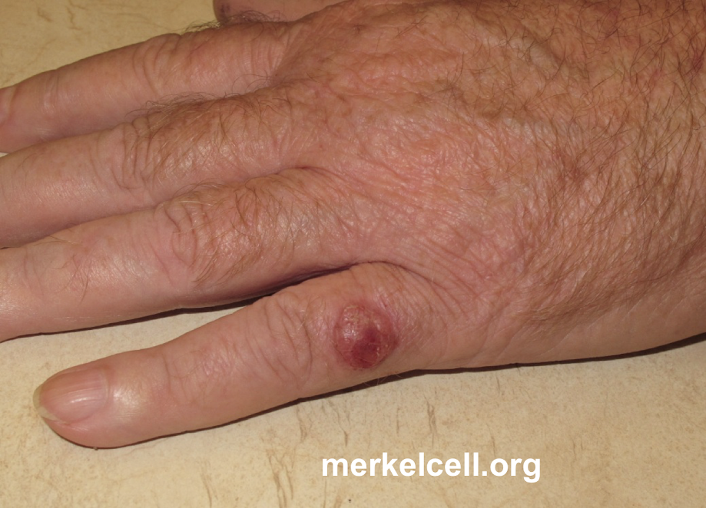
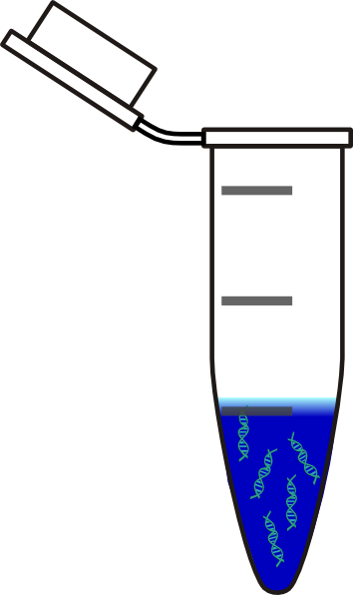
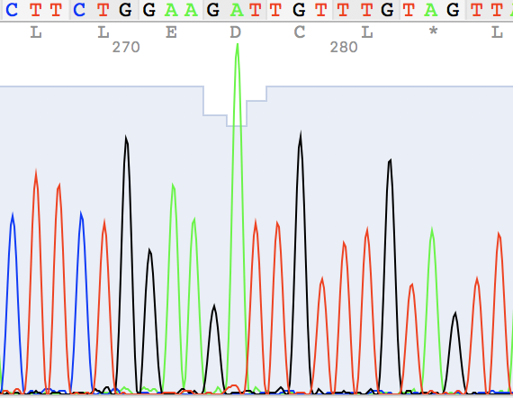
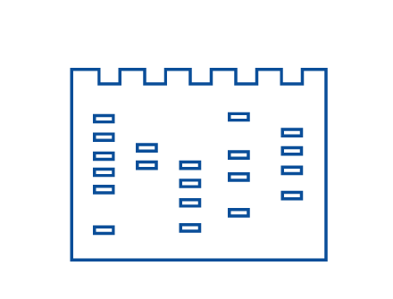
Finding Mutations In EZH2 And Histone H3 In Merkel
Cell Carcinoma
Funded by:
Genesis De Los Santos,¹ Fariha Fawziah, ¹ and Elena Ezhkova²
1 : Manhattan Center for Science and Mathematics 2: Icahn School of Medicine at Mt. Sinai
Abstract
Histone H3 and EZH2 may play a significant role in Merkel Cell Carcinoma (MCC) since there is evidence of EZH2 and histones having inconsistent concentration in MCC. We will be focusing on the methyl transferase activity of Ezh2 as a part of the polycomb complex. Ezh2 deposits three methyl groups on lysine 27 of the histone H3 tail (H3K27me3). There is a high concentration of EZH2 in Merkel Cell Carcinoma. Also, H3K27 has a low concentration in Merkel Cell Carcinoma⁴; It is believed that the H3K27me3 mark is important for developmental genes. This may convey that either EZH2 or the tail of histone H3 are mutated, such that the H3K27me3 mark cannot be transferred to the histone. Because H3K27me3 has a low concentration in Merkel Cell Carcinoma and EZH2 has a high concentration, we hypothesize that there is a mutation in histone H3 tail and/or in EZH2. The most essential materials are PCR machine, gel electrophoresis, and nanodrop. We compared different types of Merkel Cell samples and looked for mutations. We have found that the mutations match for some patients.
Introduction
Merkel Cell Carcinoma (MCC) is a rare type of skin cancer that appears as a flesh-colored or bluish-red lump, often on your face, head or neck; it is very deadly once detected.¹
Histones are proteins that condense and structure (package) the DNA of eukaryotic cell nuclei into units called nucleosomes. Histones are the main proteins in chromatin (a combination of DNA and protein which makes up the cell nucleus). Their main functions are to compact DNA and regulate chromatin, therefore impacting gene regulation.
One way to modify histones is acetylation when an acetyl (COCH3) group changes the charge on the histone proteins to neutral which increases gene expression.
The Enhancer of zeste homolog 2 (EZH2) codes for a type of enzyme called a histone methyltransferase which can suppress the activity of certain genes.
Our research will help understand more about the cause of MCC and add on to the research regarding it. We hypothesize that there is a mutation in histone H3 tail and/or in EZH2.
Materials & Methods
DNA EXTRACTION
PCR AMPLIFICATION
Results
We could see that there are mutations for Exon 15 in all of the patients. We could see a pattern in mutations in exon 15 where in all the forward strands there is a mutation by deletion of A. The only discrepancy is that in the reverse strands of Exon 15 there’s no mutation except a mutation by insertion of C in MS1. In exon 17 there’s no mutation for the forward strand. The same thing occurs for histone H3-1. In exon 17 there are 2 patients with mutations in the reverse strand by insertion, but of different nucleotides. In one patient, there’s a mutation in the reverse by a insertion of A for Histone H3-1.
Insertion of c
Ezh2 Ex 17
Insertion of G
Insertion of T
Insertion of G
Ezh2 Ex 15
Histone H3
Here is a diagram of methyltransferase EZH2 depositing H3k27me3 on histone h3.
Discussion
Different patients have the same mutations, but they also have individual mutations. We don’t know for sure what the mutations mean in our case.
However, the mutations in Exon 15 could cause the shortening of the protein which could affect the sequences.
The mutation in Exon 17 could cause a shift in the sequence, so the translation of the DNA could’ve been affected. The same goes for histone H3-1.
These mutations could affect the methylation of the protein in the MCC cells. These are possible effects that the mutations in our case could occur. This could lead to further investigations.
Also since the mutations are different, it emphasizes how personalized treatment can be important.
References
Merkel cell carcinoma, by Mayo Clinic on August 8, 2017 https://www.mayoclinic.org/diseases-conditions/merkel-cell-carcinoma/symptoms-causes/syc-20351030
Histones: Function & Types, by: Shannon Compton http://study.com/academy/lesson/histones-function-types-quiz.html
Panagiotis N., Aristotelis T., Pieter V., Jelena N. Genetic Inactivation of the Polycomb Repressive Complex 2 in T-cell Acute Lymphoblastic Leukemia, Nature Medicine, pages 298–303 (2012) https://www.nature.com/articles/nm.2651
Reduced H3K27me3 expression in Merkel cell polyoma virus-positive tumors by Klaus J Busam, Melissa P Pulitzer, Daniel C Coit, Maria Arcila, Danielle Leng, Achim A Jungbluth, and Thomas Wiesner. https://www.ncbi.nlm.nih.gov/pubmed/28281550
Acknowledgements
The authors would like to acknowledge Carmit Bar, who is a phD student from Dr. Elena Ezhkova’s lab, Christine Marizzi who is the director of DNA Learning Center, Cold Spring Harbor Laboratory and Mount Sinai Hospital.
What a MCC tumor looks like
MKL1 MK2 WaGa MS1
F
R
H3
EXON 15
EXON 17
CUT PCR PRODUCT
CLEAN UP AND SEND FOR SEQUENCING

