Slide 1
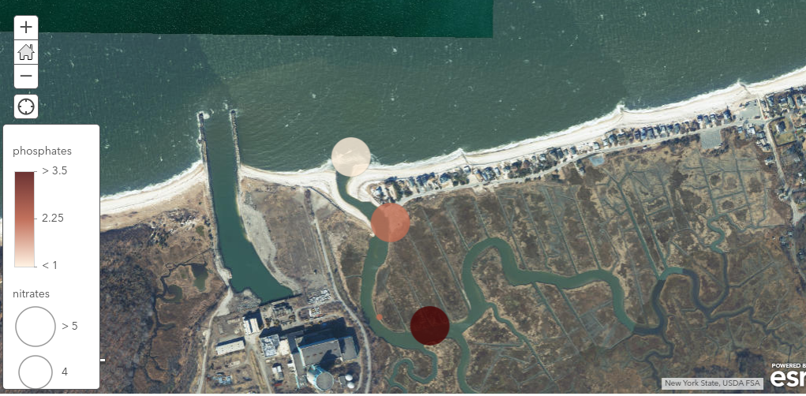
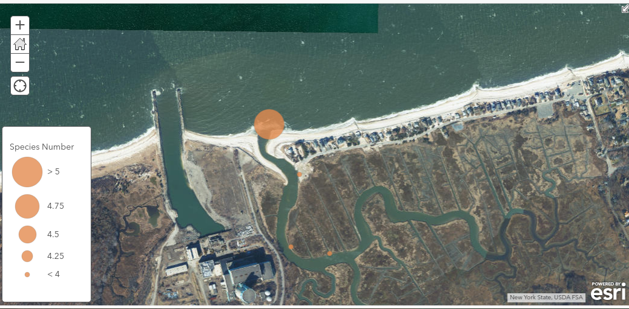
Using DNA Barcoding to Evaluate Seaweed Biodiversity in Shoreham-Wading River, New York
Jahdeba Williams & Munchachi Eguziem
Mentor: Victoria Hernandez
William Floyd High School
Abstract
Anthropogenic influences are known to have a significant role in the cause of a changing ecosystem. Between 1973 and 1984 the Wading River nuclear power plant, a general electric nuclear boiling water generator, was built. The generator was later decommissioned in 1989 due to community riots. In construction of the generator, the ecosystem was altered to increase water accessibility by dredging and widening of the inlet (MacCalion, 1995). It is believed that the dredging and the widening of the inlet increased the flow rate and changed other properties, including salinity and nutrient presence. However, that cannot be confirmed due to lack of previous data. This project aims to use DNA barcoding to analyze current seaweed biodiversity in this anthropogenically influenced environment and identify if any species are bioindicators for potential contamination. Data indicates that the region farthest from the power plant contained the highest biodiversity. However, this may be due to salinity differences or increased flow rate.
Materials & Methods
-Samples were collected and identified physically at increasing intervals from the Shoreham-Wading River Nuclear Power Plant in East Shoreham, NY.
-DNA isolation and amplification was done through the process of Polymerase Chain Reaction and amplification success was be analyzed using gel electrophoresis.
-The gene isolated and amplified was rbcL.
-Samples that showed successful amplification, were sent for sequencing to Genewiz. DNA subway was then be used to analyze and identify the species of seaweed.
Results
It cannot be concluded if the power plant has influenced the biodiversity of seaweed. However, the most probable cause for the highest biodiversity of seaweed present at the region farthest from the power plant is due to that sites access to the Long Island Sound (Bracken et al., 2013). A previously published study confirmed that at a rocky shore region, similar to the Long Island Sound, numerous factors influenced the range of species present and in turn this influenced other abiotic and biotic factors.
Acknowledgements
The authors would like to thank Cold Spring Harbor DNA Learning Center for funding this project, William Floyd High School and Stony Brook’s Science and Technology Entry Program administration for supporting students throughout the process and Victoria Hernandez for her mentorship and support.
References
Bracken, M. E., & Stachowicz, J. J. (2006). Seaweed diversity enhances nitrogen uptake via complementary use of nitrate and ammonium. Ecology, 87(9), 2397-2403.,McCallion, K. F. (1995). Shoreham and the rise and fall of the nuclear power industry. Greenwood Publishing Group,Bracken, M. E., & Williams, S. L. (2013). Realistic changes in seaweed biodiversity affect multiple ecosystem functions on a rocky shore. Ecology, 94(9), 1944-1954,.
Laboratory, C. S. (n.d.). Using DNA Barcodes to Identify and Classify Living Things. Retrieved May 28, 2019, from https://www.dnabarcoding101.org/files/using-dna-barcodes.pdf.
Saeed, S. M., & Moustafa, Y. T. (2013). The seaweed (green macroalgae), Ulva sp. as bioindicator of metal pollution in the Mediterranean Coast, Alexandria region, Egypt. Egyptian Journal of Aquatic Biology and Fisheries, 287(1827), 1-25.
Suedel, B. C., Kim, J., Clarke, D. G., & Linkov, I. (2008). A risk-informed decision framework for setting environmental windows for dredging projects. Science of the total environment, 403(1-3), 1-11.
Van Patten, M. S. (2006). Seaweeds of Long Island Sound(Vol. 39). Connecticut Sea Grant College Program University of Connecti.
Xiao, W. L., Motley, T. J., Unachukwu, U. J., Lau, C. B. S., Jiang, B., Hong, F., ... & Kennelly, E. J. (2011). Chemical and genetic assessment of variability in commercial Radix Astragali (Astragalus spp.) by ion trap LC− MS and nuclear ribosomal DNA barcoding sequence analyses. Journal of agricultural and food chemistry, 59(5), 1548-1556.
Figure #1- Levels of Phosphate and Nitrates
Figure #3- Biodiversity and Species Richness
Figure #2- Cladogram of Seaweed Samples are Reference Organisms
Figure #4- DNA Barcode of Seaweed Samples are Reference Organisms
Discussion
As seen in figure 3 and figure 4, species richness and biodiversity are highest farthest from the power plant and relatively consistent at all other regions, refuting the hypothesis that as distance increased, biodiversity of seaweed would increase. Although it is not clear on if the distance from the power plant affected the biodiversity of the seaweed it can be stated that the furthest point from the power plant had an increase in biodiversity, however this can be due to the higher dissolved oxygen, higher ph, or higher flow rate and tidal influence from the Long Island Sound. All other regions in close proximity to the power plant had less than 4 species of seaweed present which may be due to the high nitrates and low pH found at two of the sites.
Previous studies discovered that seaweed enhances the uptake of nitrogen and nutrients however, seaweed type also influences the influence on nitrogen (Bracken et al., 2006). This is important to state as our results are consistent with these findings with the exception of phosphate presence. As seen in figure 1, there are high nitrates and low phosphates in the region with the highest biodiversity. However, figure 1 demonstrates that there are also high nitrates in other regions containing a lower biodiversity.
Overall, it cannot be concluded if the power plant has influenced the biodiversity of seaweed. However, the most probable cause for the highest biodiversity of seaweed present at the region farthest from the power plant is due to that sites access to the Long Island Sound (Bracken et al., 2013). A previously published study confirmed that at a rocky shore region, similar to the Long Island Sound, numerous factors influenced the range of species present and in turn this influenced other abiotic and biotic factors.
Human Health Impact
Without a vast range of seaweed species present, there is an increased risk to human health. This is evident as seaweed and algae are often used as bioindicators for pollutants, such as heavy metals. Since out of all the samples that were collected none of them were indicative of pollution present, we concluded that this region is not currently at risk for contamination. However, more studies would need to be conducted to be certain.

