Slide 1
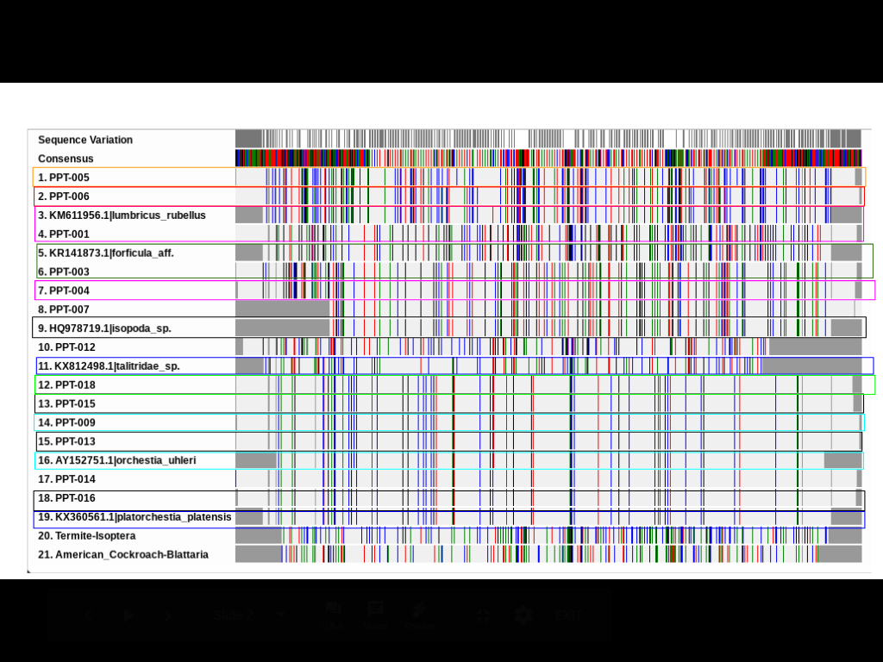
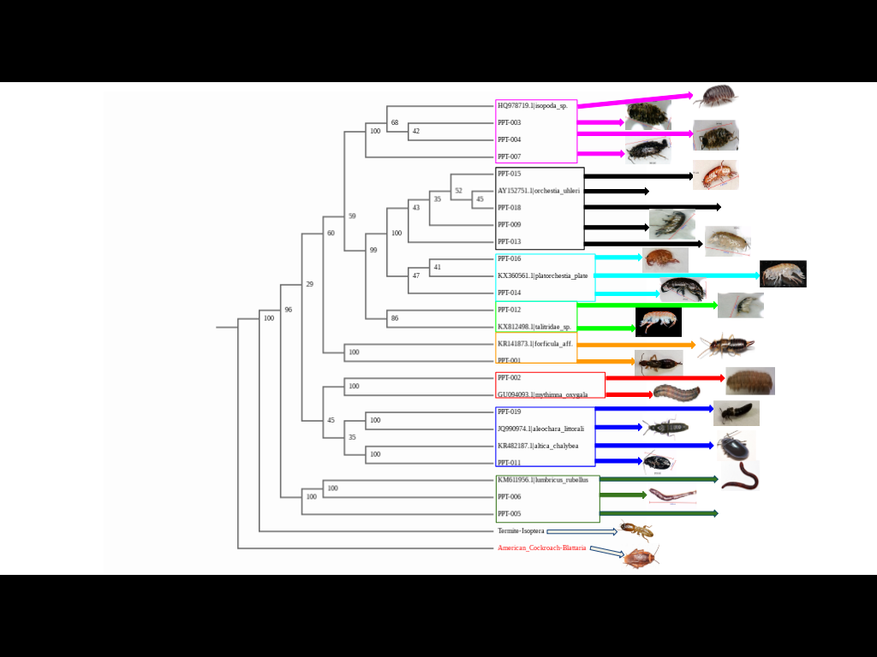
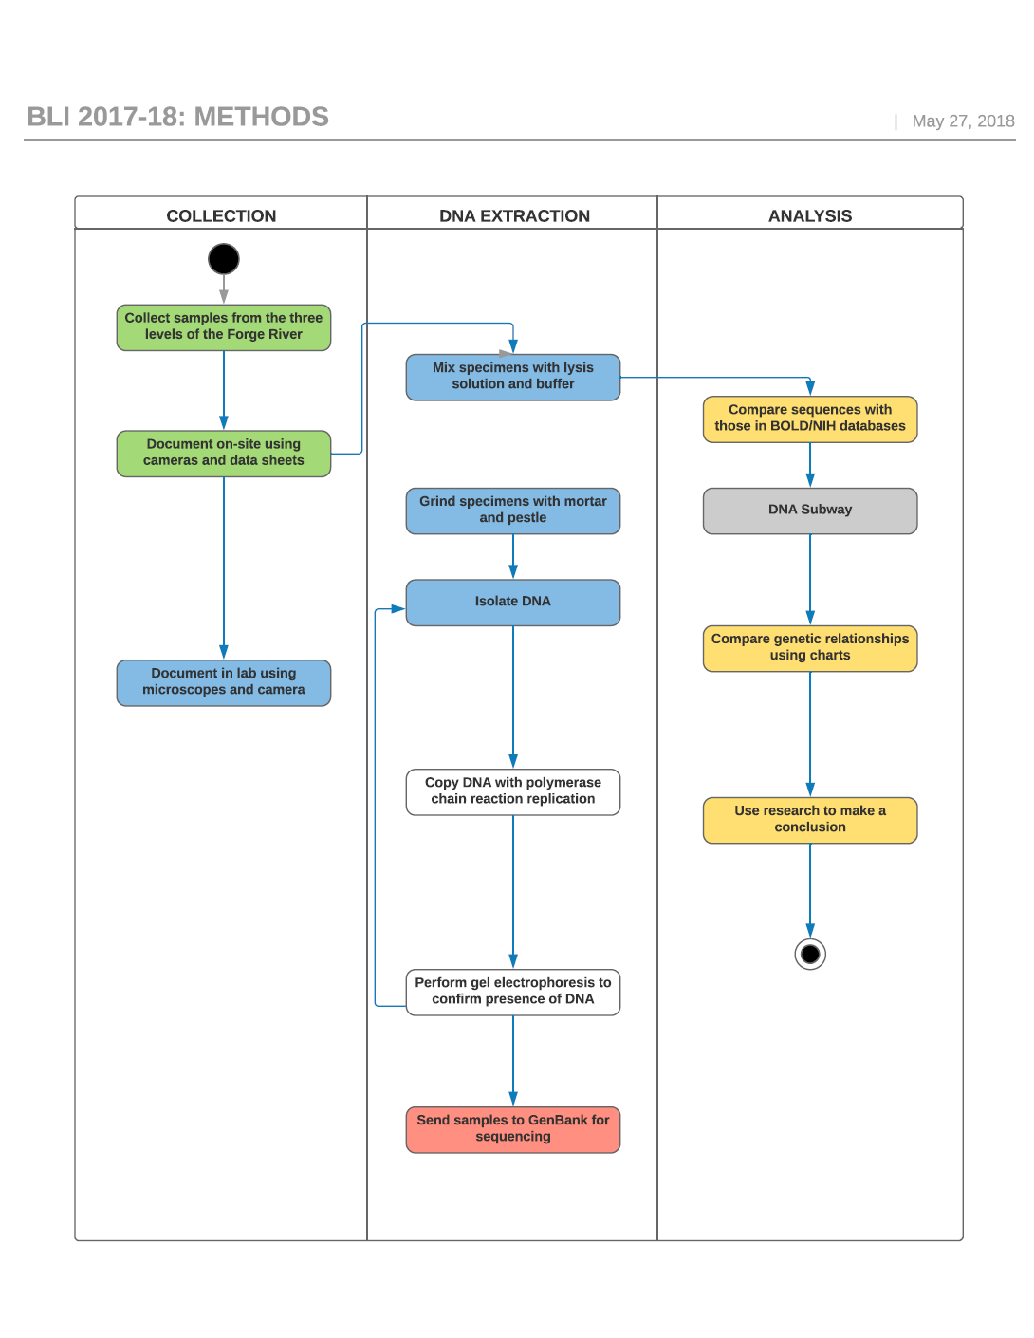
Impacts of Water Pollution on Macroinvertebrate Biodiversity
Kaitlin Caginalp and Ariana Ventura with Victoria Hernandez
Homeschooled; William Floyd High School
Results
Discussion
Although data is tentative, the variety of macroinvertebrate species is indicative of a regional trend in biodiversity. Additionally, BLAST results for sample 012 yielded over 120 mismatches, suggesting that this is a potentially novel sequence.
Acknowledgements
We would like to thank Mrs. Victoria Hernandez, Dr. Sharon Pepenella, and the DNA Learning Center.
References
Swanson, R. L., et al. "Forge River Nutrient Report." Report to the Town of Brookhaven (2009).
Swanson, R. Lawrence, et al. "What history reveals about Forge River pollution on Long Island, New York’s south shore." Marine pollution bulletin 60.6 (2010): 804-818.
Abstract:
The Forge River is one of the most polluted rivers in New York State, due to a history of duck farms being located along the river. In our research, we sought to understand what impact trace element pollution has had on the biodiversity of the Forge River through DNA barcoding. Data indicates a regional trend is present.
Introduction
The Forge River is one of the
most polluted rivers in New York State due to anthropogenic influence and duck farming.
The levels of sulfur, nitrogen,
potassium, and phosphorus impacted
biodiversity at the three sites located
along the Forge River.
Methodology
Sulfur Nitrogen
Phosphorus Potassium

