Slide 1
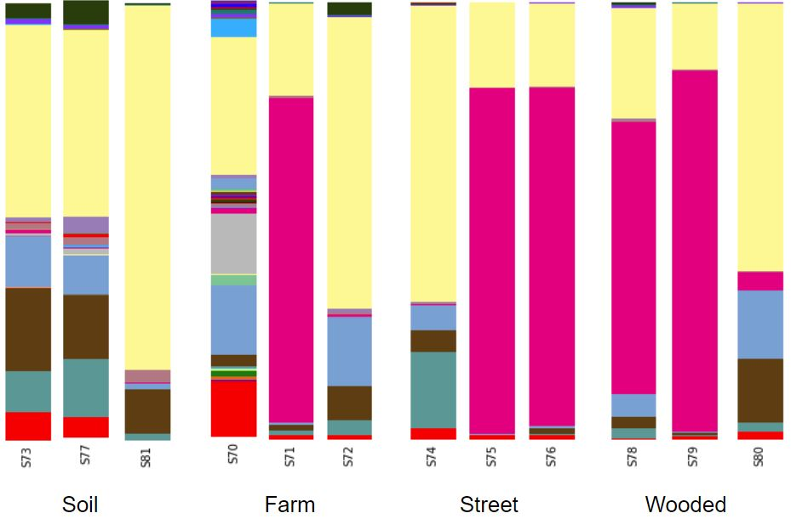
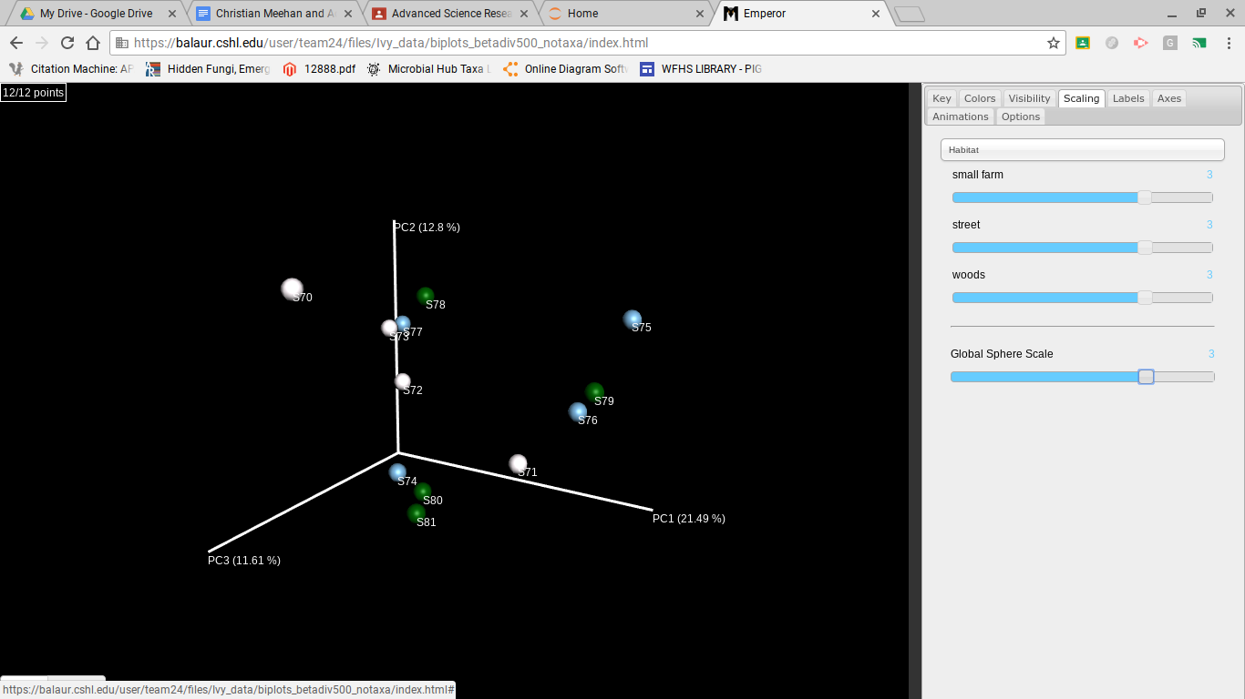
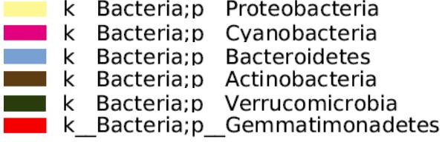
The Environmental Impact on the Microbiomes of Poison Ivy Samples Collected from Industrial, Wooded and Farm Areas
Adwoa Enin, Christian Meehan, Mrs.Hernandez
Brookhaven National Laboratory
Abstract
A microbiome is the collective genetic material of the microorganisms that resides in an environment (Adam et al., 2016).The Mo Bio protocol was used to isolate and amplify the 16S gene. Then QIIME analyses were used by taking the raw microbial DNA sequences and converting them into visualizations. The taxonomy plots reflect that the samples had varying amounts of cyanobacteria. Samples taken from the farm had the most cyanobacteria. Cyanobacteria are important providers of nitrogen fertilizer.
Research Question: Will there be a difference between microbiomes present in poison ivy located near an industrialized area, a wooded area, and a small farm?
Hypothesis: It was hypothesised that there would be a variance between microbes at each location
Introduction
A microbiome is a group of microorganisms residing in a specific location (Adam et al., 2016).
Poison ivy has been reported as the number one cause for contact skin dermatitis in the united states . Analyzing the microbiomes of poison ivy is important due to the effect microbiomes can have on the urushiol that causes the dermatitis (Mohan, et al., 2006).
Analyzing the microbiomes of plants and their surrounding soil is key because these natural remedies have provided a strong basis for modern drugs (Berg et al., 2014).
Methodology
Acknowledgements
The following organizations and individuals were crucial to the research conducted: Cold Spring Harbor Laboratory, Dr. Bruce Nash, Dr. David Micklos, Dr. Cornell Ghiban, Dr Sharon Pepenella, Dr.Cristina Fernandez-Marco and William Floyd High School’s Mrs. Hernandez
Figure 1: This taxonomy plot demonstrates the phyla present in the root systems and surrounding soil. Data indicates that prominent phyla include Proteobacteria, Cyanobacteria, Bacteroidetes, Actinobacteria, and Acidobacteria.
Figure 2: This figure demonstrates the species richness and evenness of each location. Data indicates that the small farm location had the highest overall species richness. This can be attributed to nutrients present in the location.
Figure 4: This figure demonstrates microbial diversity between samples. Data indicates that there is no considerable trends between location and microbes present in the poison ivy.
Discussion
Most samples were found to contain cyanobacteria and proteobacteria, where these phyla were both present there appeared to be a relationship between them
Cyanobacteria and proteobacteria both perform nitrogen fixation (Stal, 2015)(Chen et al., 2003). This could potentially lead to competition between samples.
The small farm location had the greatest overall species richness out of the sample locations.
Data suggests that there are no considerable trends between location and microbes present
Future Implications
It should be noted that for future trials of this project there should be a much larger sample size. Additionally, there should be more sample collection locations and the sample collection period should be extended as to see what microbes change based on temperature and season.
References:
Berg, G., Grube, M., Schloter, M., & Smalla, K. (2014). The plant microbiome and its importance for plant and human health. Frontiers in microbiology, 5.
Mohan, J. E., Ziska, L. H., Schlesinger, W. H., Thomas, R. B., Sicher, R. C., George, K., & Clark, J. S. (2006, June 05). Biomass and toxicity responses of poison ivy (Toxicodendron radicans) to elevated atmospheric CO2. Retrieved December 11, 2017, from http://www.pnas.org/content/103/24/9086.short
Berg, Mine, Sutula, Martha Factors Affecting Growth of Cyanobacteria, (2015 August)
ftp://ftp.sccwrp.org/pub/download/DOCUMENTS/TechnicalReports/869_FactorsAffectGrowthOfCyanobacteria-1.pdf
Metson, G.M., Ivanweic, D.S., Lawrence, A.B., Bennet, E.M., Childers, D.L., Cordell Dana, Grimm, N.B., Grove, J.M., Nidzgorski, White Stuart , Urban phosphorus sustainability: Systemically incorporating social, ecological, and technological factors into phosphorus flow analysis (2015 March) https://www.sciencedirect.com/science/article/pii/S146290111400197X
Metson, G. S., Bennett, E. M., & Elser, J. J. (2012). The role of diet in phosphorus demand. Retrieved from The role of diet in phosphorus demand
Berg, G. , Grube, M., Scholter , M., Smalla K., (2014, June 4) Unraveling the plant microbiome: looking back and future perspectives. Retrieved December 9, 2017 from https://www.ncbi.nlm.nih.gov/pmc/articles/PMC4045152/
Adam, E., Groenenboom, A. E., Kurm, V., Rajewska, M., Schmidt, R., Tyc, O., ... & Salles, J. F. (2016). Controlling the microbiome: microhabitat adjustments for successful biocontrol strategies in soil and human gut. Frontiers in microbiology, 7.
Nuova, R., & Loomis, R. S. (n.d.). Nitrogen and plant production. Retrieved February, 1981, from https://link.springer.com/article/10.1007/BF02180053
Kramer, U. (2000). Traffic-Related Air Pollution Is Associated with Atopy in Children Living in Urban Areas. Retrieved from https://journals.lww.com/epidem/Fulltext/2000/01000/Traffic_Related_Air_Pollution_Is_Associated_with.14.aspx/
Singh, J. S., Kumar Arun, Rai A. N., Singh D. P. (2016 April 21) Cyanobacteria: A Precious Bio-resource in Agriculture, Ecosystem, and Environmental Sustainability https://www.ncbi.nlm.nih.gov/pmc/articles/PMC4838734/
Betaproteobacteria. (n.d.). Retrieved from https://www.biology-online.org/dictionary/Betaproteobacteria
Multisward, (2013 March 1) Final report describing options for improving biodiversity in grassland-based ruminant production systems by differentiated grassland management at the farm level
https://www.multisward.eu/content/download/3188/32723/version/1/file/MultiSward-D3.7-final.pdf+&cd=1&hl=en&ct=clnk&gl=us
Stal, Lucas J(Dec 2015) Nitrogen Fixation in Cyanobacteria. In: eLS. John Wiley & Sons Ltd, Chichester. http://www.els.net [doi: 10.1002/9780470015902.a0021159.pub2]
Chen, W., Moulin, L., Bontemps, C., Vandamme, P., Béna, G., & Boivin-Masson, C. (n.d.). Legume Symbiotic Nitrogen Fixation byβ -Proteobacteria Is Widespread in Nature. doi:10.1128/JB.185.24.7266-7272.2003

