Slide 1
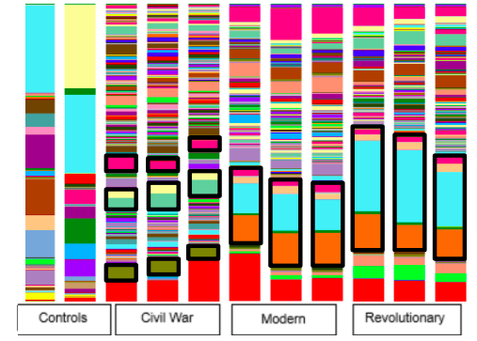
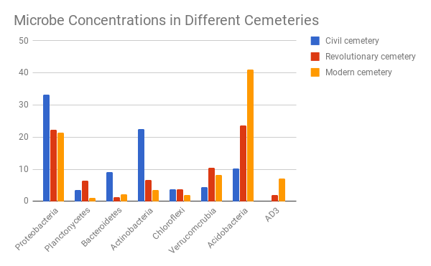
An Analysis of Soil Microhabitats in Different War Era Cemeteries
Dominick Caputo & Jason Rattansingh & Victoria Hernandez
William Floyd High School
Abstract
Previously established data indicates that cemeteries have contributed to groundwater and soil pollution (Żychowski & Bryndal, 2015). The research conducted was done through the evaluation of the 16S rRNA microbial gene and QIIME analyses using Jupyter Notebooks. The results indicate that there was a notable increase in proteobacteria and bacteroidetes in the Civil War era cemetery samples, both of which may contribute to arsenic metabolization.
Introduction
Cemeteries contain unique microbiomes that require special attention due to the risks of soil or water contamination (Żychowski & Bryndal, 2015).
Revolutionary War cemeteries used no embalming techniques, Civil War cemeteries used arsenic, and the modern cemetery use formaldehyde.
Materials & Methods Results
Figure 2: This is a taxonomy plot demonstrating predominant taxa present within cemetery soils
Figure 3: This rarefaction plot demonstrates alpha diversity of microbes within cemetery soil.
Discussion
The research question posed was: “Is there a variation in microbiomes in revolutionary, civil, and modern cemeteries?”
Our data demonstrates that there is a variation in microbiomes, which is seen because bacteroidetes are abundant in the Civil War era cemetery. Bacteroidetes are known to metabolize arsenic, which is the embalming used during the Civil War era.
References
Żychowski, J, and T Bryndal. “Impact of Cemeteries on Groundwater Contamination by Bacteria and Viruses - a Review.” Journal of Water and Health., U.S. National Library of Medicine, June 2015, www.ncbi.nlm.nih.gov/pubmed/26042963.
Acknowledgements
The authors would like to thank the staff at Cold Spring Harbor Laboratory DNA Learning Center for their unwavering support. The researchers who made this project possible are: Dr. Bruce Nash, Dr. Sharon Pepenella, Dr. Cristina Fernandez-Marco, Dr. Joslynn Le, Dr. Cornel Ghiban, and Dr. David Micklos. The authors would also like to acknowledge the unwavering support from William Floyd High School’s Administration and Research Program.
Figure 1: Bar graph demonstrating primary taxa present

