Slide 1
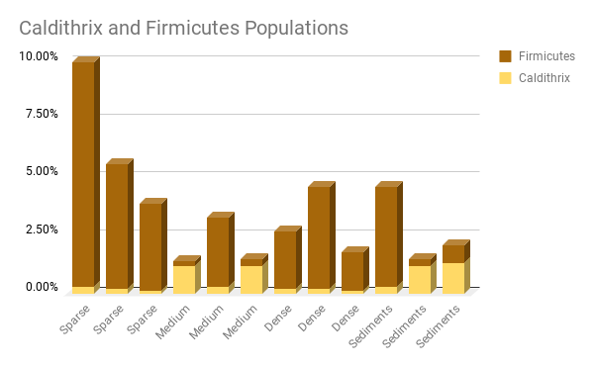
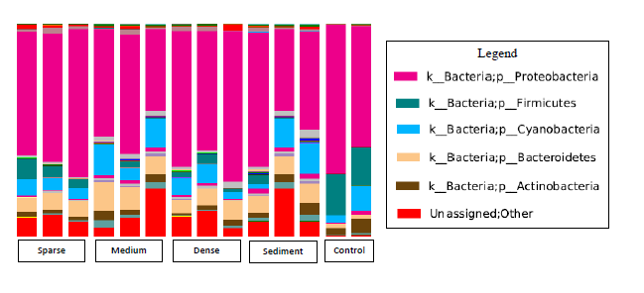
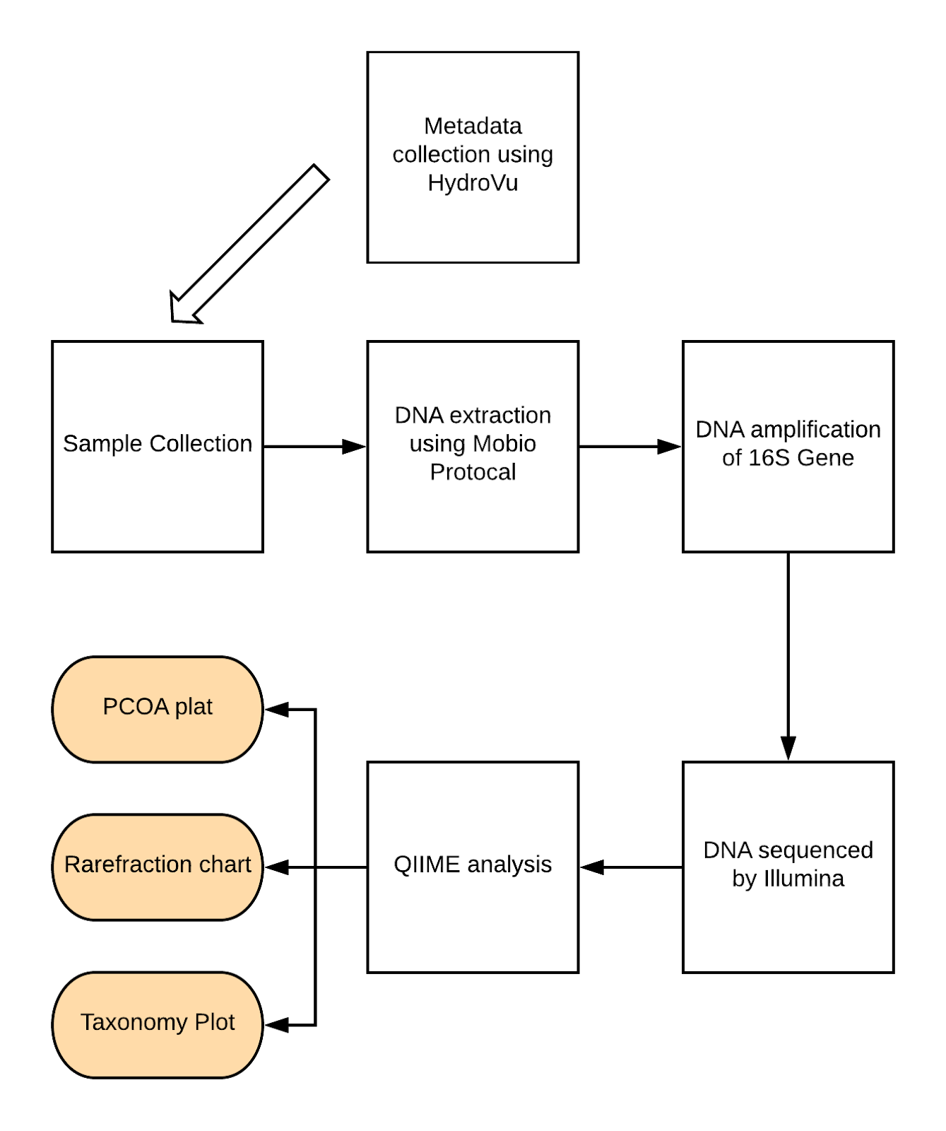
The Microhabitats within Zostera marina Patches in the Moriches
Bay, Westhampton Beach, New York
Angela Ochoa, Philip Oriuwa, Elizabeth Scianno, & Victoria Hernandez
William Floyd High School
Abstract
Zostera marina is a type of eelgrass. Properties of the Zostera can influence the microbes present, and microbes such as Stramenopiles can impact bed health, therefore qiime analyses regarding the biodiversity within beds was conducted through the use of the 16S gene. Beds with varying density and microhabitats were compared, although the hypothesis were refuted, outlying samples were found to contain evidence of eelgrass wasting disease.
Introduction
Q: Will there be a higher population of harmful bacteria in the microhabitats of sparse patches?
H: There will be a higher population of harmful bacteria in the microhabitats of sparse patches.
Zostera has decreased by 90% off of Long Island.
Zostera supports juvenile organisms, and adds to habitat complexity.
Materials & Methods Results
Discussion
The research question was: will there be a higher amount of harmful microbes in sparse sediments?
The data indicated that was no clear correlation between bed density and microbes.
There appears to be competition between streptophyta and stramenopiles.
Stramenopiles are associated with eelgrass wasting disease
References
Carroll, John M., Lisa J. Jackson, and Bradley J. Peterson. "The effect of increasing habitat complexity on bay scallop survival in the presence of different decapod crustacean predators." Estuaries and coasts 38.5 (2015): 1569-1579.
MIO BIO Laboratories, Inc, 2014
Orth, Robert J., et al. "A global crisis for seagrass ecosystems." Bioscience 56.12 (2006): 987-996.
Jensen, Sheila Ingemann, Michael Kühl, and Anders Priemé. "Different bacterial communities associated with the roots and bulk sediment of the seagrass Zostera marina." FEMS microbiology ecology 62.1 (2007): 108-117
Sullivan, Brooke K., et al. "The First Isolation and Characterisation of the Protist Labyrinthula sp. in Southeastern Australia." Journal of Eukaryotic Microbiology 64.4 (2017): 504-513.
Wojahn, John Michael Adrian. "Metagenomics and metatranscriptomics of the leaf-and root-associated microbiomes of Zostera marina and Zostera japonica." (2016)
Acknowledgements
The authors are thankful for the educational and financial support from the staff at Cold Spring Harbor Laboratory DNA Learning Center. The authors would also like to thank both Stephen Heck and Amanda Tinoco from SoMAS for helping to collect samples. The researchers who made significant contributions to the success of this project are: Dr. Bruce Nash, Dr. Sharon Pepenella, Dr. Cristina Fernandez-Marco, Dr. Joslynn Le, Dr. Cornel Ghiban, and Dr. David Micklos. Additionally, without the financial and educational support from William Floyd High School’s Research Program, this project would not have been possible. The authors also like to acknowledge: Mrs. Lisa Lackemann, Dr. Donna Watkins, Mr. Philip Scotto, Ms. Lisa Pisano, Mrs. Deborah Gurney, Mr. Kevin Coster, and Ms. Kathleen Keane.

Slide 2
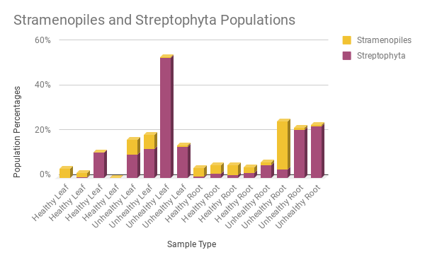
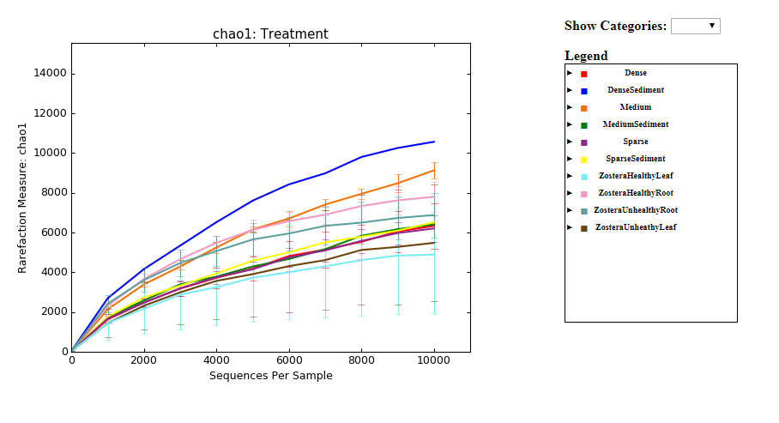
The Microhabitats within Unhealthy Zostera marina Patches in the Moriches
Bay, Westhampton Beach, New York
Angela Ochoa, Philip Oriuwa, Elizabeth Scianno, & Victoria Hernandez
William Floyd High School
Abstract
Zostera marina is a type of eelgrass that provides a habitat for a multitude of organisms. Within Zostera contains a variety of microbes which can influence a bed’s development. Beds with brown and black lesions and beds that appear healthy were sampled and analysis was conducted using qiime with the use of 16S. The hypothesis was refuted since all the beds contained Stramenopiles however several trends were seen in unhealthy and healthy roots systems.
Introduction
Q: Will there be a higher sign of wasting disease in unhealthy zostera leaves and roots?
H: There will be a higher counts of stramenopiles in unhealthy zostera leaves and roots.
Zostera has decreased by 90% off of Long Island.
Zostera supports juvenile organisms, and adds to habitat complexity.
Methodology Results
Discussion
The research question was: will there be a higher amount of harmful microbes in unhealthy samples?
The data indicates that stramenopiles were present in almost all samples.
There appears to be competition between streptophyta and stramenopiles.
There appears to be clustering in PCA based on sample type
References
Brakel, Janina, et al. "Current European Labyrinthula zosterae are not virulent and modulate seagrass (Zostera marina) defense gene expression." PloS one 9.4 (2014): e92448.
Carroll, John M., Lisa J. Jackson, and Bradley J. Peterson. "The effect of increasing habitat complexity on bay scallop survival in the presence of different decapod crustacean predators." Estuaries and coasts 38.5 (2015): 1569-1579.
MIO BIO Laboratories, Inc, 2014
Orth, Robert J., et al. "A global crisis for seagrass ecosystems." Bioscience 56.12 (2006): 987-996.
Jensen, Sheila Ingemann, Michael Kühl, and Anders Priemé. "Different bacterial communities associated with the roots and bulk sediment of the seagrass Zostera marina." FEMS microbiology ecology 62.1 (2007): 108-117
Sullivan, Brooke K., et al. "The First Isolation and Characterisation of the Protist Labyrinthula sp. in Southeastern Australia." Journal of Eukaryotic Microbiology 64.4 (2017): 504-513.
Wojahn, John Michael Adrian. "Metagenomics and metatranscriptomics of the leaf-and root-associated microbiomes of Zostera marina and Zostera japonica." (2016)
Acknowledgements
The authors are thankful for the educational and financial support from the staff at Cold Spring Harbor Laboratory DNA Learning Center. The authors would also like to thank both Stephen Heck and Amanda Tinoco from SoMAS for helping to collect samples. The researchers who made significant contributions to the success of this project are: Dr. Bruce Nash, Dr. Sharon Pepenella, Dr. Cristina Fernandez-Marco, Dr. Joslynn Le, Dr. Cornel Ghiban, and Dr. David Micklos. Additionally, without the financial and educational support from William Floyd High School’s Research Program, this project would not have been possible. The authors also like to acknowledge: Mrs. Lisa Lackemann, Dr. Donna Watkins, Mr. Philip Scotto, Ms. Lisa Pisano, Mrs. Deborah Gurney, Mr. Kevin Coster, and Ms. Kathleen Keane

