Slide 1
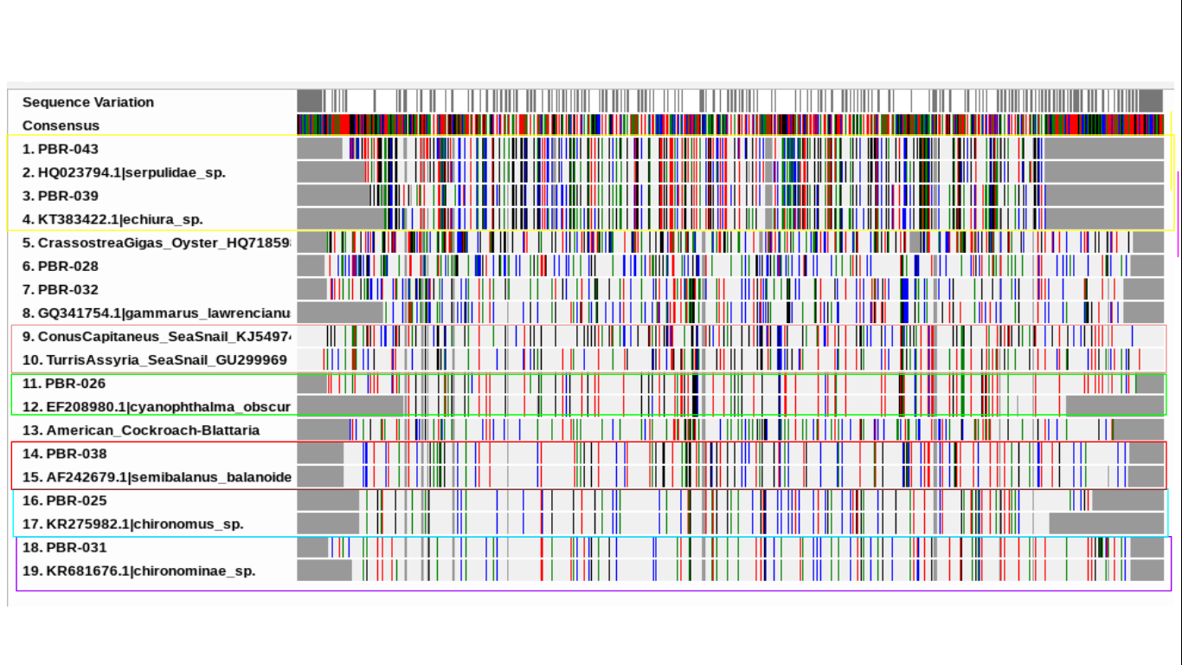
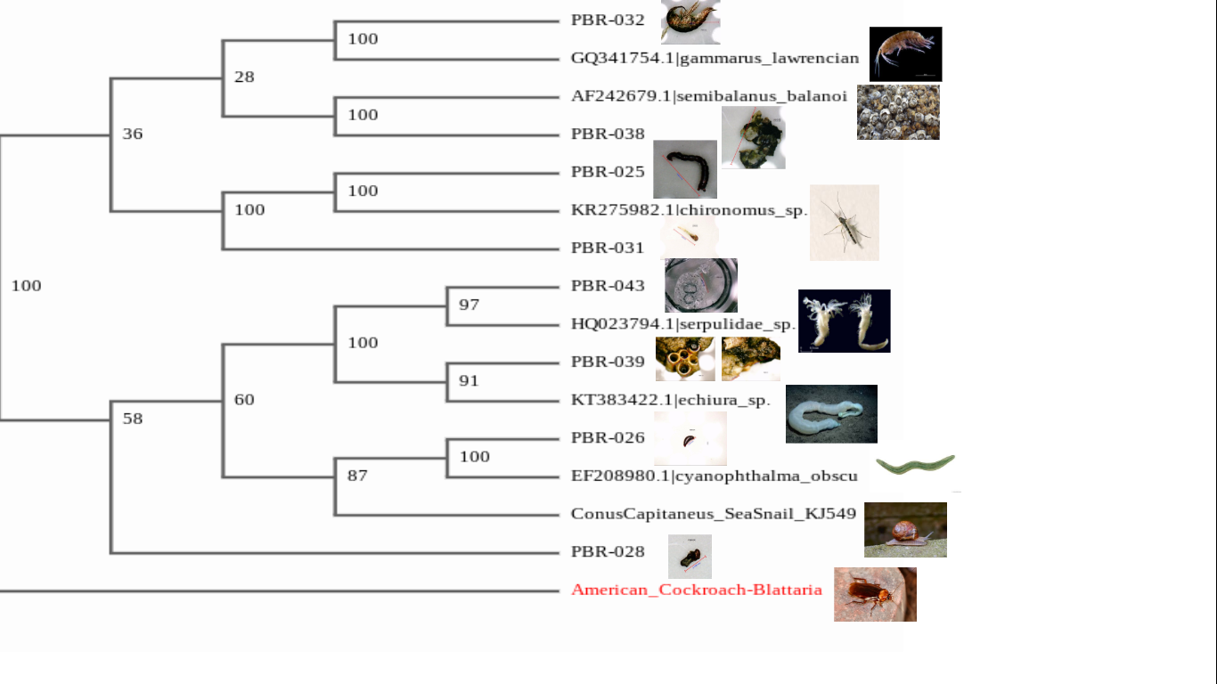
The Effects of Pollutants on the Biodiversity of Aquatic Macroinvertebrates within the Forge River Long Island , NY
C Gawlowski¹ . C Hossain¹. A O’Neal¹. L Morgan¹
Victoria Hernandez¹. William Floyd High School ¹
Abstract
The Forge River is a highly polluted waterway located in the Mastic Moriches region of Long Island, New York. Previous research has indicated that biodiversity is decreasing due to hypoxic sediments caused by industrialized farming, poultry waste, and human waste, along this river (Swanson et al, 2010). Samples of macroinvertebrates were collected from the head to the mouth of the Forge River. DNA barcoding, the method of identifying a species using a unique CO1 DNA sequence (Hebert et al, 2004) was utilized to identify the macroinvertebrates collected. Data indicates that higher biodiversity of macroinvertebrates are present in regions with higher nitrogen levels.
Introduction
Research Question: Do pollutants in waters of Forge River impact the biodiversity of aquatic macroinvertebrates?
Hypothesis: It is hypothesized that there will be decreased biodiversity in regions with high pollution present.
Macroinvertebrates- indicators of water quality and plays a critical role in this ecosystem.
The Forge River has a history of pollution from sewage, duck farming, and agriculture
Levels of nitrogen, nitrate, duck waste material and dissolved oxygen (Swanson et al., 2010) has been bioaccumulating up the food web by entering various types of organisms.
The eutrophication growth is corresponding to the rapid decrease in biodiversity because of fertilizers, discharge of phosphorus and sewage which is affecting the stability of the environment (Jaishankar et al., 2014).
Discussion
The following research question was posed : Do pollutants in waters of Forge River impact the biodiversity of aquatic macroinvertebrates? The data we have collected indicates that in regions with high nitrogen and low phosphorus there is an increase in the biodiversity of aquatic macroinvertebrates. Therefore the hypothesis was refuted. It is believed that this unexpected result is attributed to increase Nitrogen causing increased plant growth. Since more algae and plants were present, there is more food available for macroinvertebrates to feed in. Additionally, as seen in figures 4 and 5, DNA Barcoding was used to identify similarities between species.
Acknowledgements
The authors would like to thank the amazing contributors who have made this research possible, starting from the staff at Cold Spring Harbor Laboratory DNA Learning Center. The researchers who made this research a success are: Dr. Sharon Pepenella, Dr. Cristina Fernandez-Marco, and Dr. David Micklos. Within the William Floyd High School’s Administration also played a critical role in the success of this project.
References
Swanson, R. L., Brownawell, B., Wilson, R. E., & O’Connell, C. (2010). What history reveals about Forge River pollution on Long Island, New York’s south shore. Marine Pollution Bulletin, 60(6)804-818.doi:10.1016/j.marpolbul.2010.03.007.
Jaishankar, M., Tseten, T., Anbalagan, N., Mathew, B. B., & Beeregowda, K. N. (2014, June). Toxicity, mechanism and health effects of some heavy metals. Retrieved October 24, 2017, from https://www.ncbi.nlm.nih.gov/pmc/articles/PMC4427717/
(n.d.). Retrieved January 30, 2018, from https://www.lucidchart.com/users/login
Figure 2: Trend in nitrogen throughout the forge river.
Figure 1: Trend in biodiversity throughout the forge river.
Figure 3: Trend in phosphorous throughout the forge river.
Methodology
Figure 4: This is a barcode for macros collected throughout the forge river.
Figure 5: This is a cladogram for macroinvertebrates collected throughout the forge river and reference organisms within the database.

