Slide 1
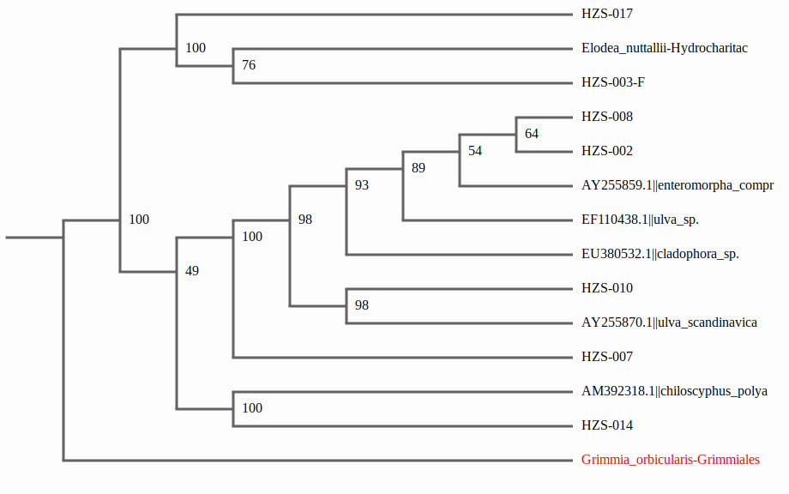
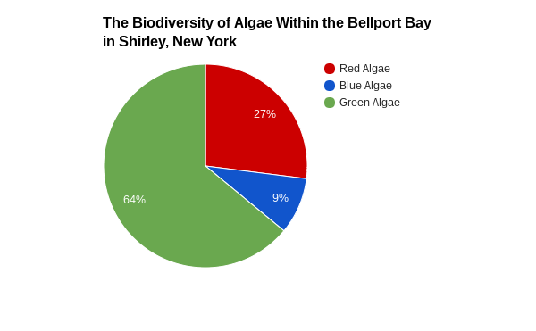
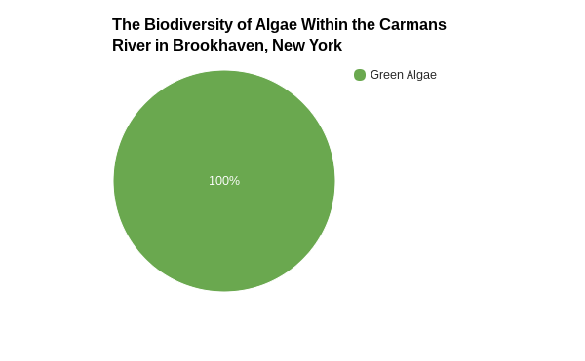
Using DNA Barcoding to Compare the Biodiversity of Algae
Between Freshwater and Saltwater Ecosystems on Long Island, NY
K. Detlefsen & J. Squicciarini & C. Meehan
V. D’Ambrosia.
William Floyd High School, Mastic Beach, NY 11951
COLD SPRING HARBOR LABORATORY’S DNA LEARNING CENTER.
Abstract
The biodiversity of algae between two separate locations was compared for differences with PCR and DNA Subway utilizing the CO1 gene from each sample. Previous research has used algae as an indicator for ecosystem health. The more species there are, the less polluted an ecosystem is. Algae is acknowledged as difficult when amplifying DNA, which is believed to be attributed to the lack of successful samples.
Introduction
Biodiversity is the variation of living organisms in an ecosystem and is an important aspect which increases food web complexity. Since 1998, biodiversity has decreased over much of the United States by nearly a third (McGrath, 1990). Biologists believe that due to unnatural destruction, 150-200 species of plant, insect, birds, and mammals go extinct a day without human knowledge that they existed prior (Palmer, 2015).
Submerged aquatic vegetation plays a crucial role in biodiversity because as primary producers of aquatic food webs; the more complex the webs, the more stable the ecosystem will become. Aquatic vegetation increases habitat complexity and provides habitats for juvenile organisms to hide from predators. This increases habitat complexity and provides the surrounding water with oxygen (Carroll, J., Jackson, L., & P.). Prior research has revealed that there is algae that can survive in both waters that have high and low salinities. Therefore, the following research question is proposed; Is there variation between the biodiversity of the Manor of St. George marine water and the Carmans River freshwater aquatic vegetation? It is hypothesised that both places may contain a broad range of biodiversity but may have similar species in both ecosystems due to their salinity tolerances.
Materials and Methodology
The materials that were used during this research project were seine nets, lysis solution, microtubes, an incubator, a centrifuge, silica resin, distilled water, pipettes, pipette tips, a thermocycler, primer mix, 2% agarose gel, 1x TBE buffer, and tac polymerase.
Cold Spring Harbor protocol was used to extract the DNA. The collection of samples took place throughout the Carmans River at Wertheim Refuge and in the Bellport Bay at the Manor of St. George. These locations were chosen for research because these locations provide plenty of samples of algae from both marine ecosystems and fresh aquatic environments. The samples were collected using the seine net and by hand. The samples must be within 10 feet of a piling in order to collect. The collection is placed within 10 feet instead of the preferred 6 inches due to the difficulty that would be encountered. The specimen were documented with a microscope camera and identified with a dichotomous key that is based on phenotypic traits. If the sample could not be identified by a key, then it was barcoded in order to identify the species and determine its novelty.
DNA extraction began with taking samples from parts of the algae. Lysis Solution was added to help break down membranes to get to the DNA. The next step was adding the specimen tissue sample in the micro-tube, proceeded by the Lysis solution. The sample was grinded and the solution was added. The mixture was incubated for 10 minutes at 65 degrees Celsius. Once completed, it was centrifuged for one minute. The supernatant was transferred to a fresh tube and treated with silica resin. It was then mixed and incubated for five minutes at 57 degrees Celsius. It was centrifuged for 30 seconds. The supernatant was then removed and wash buffer was added to the tube, which was mixed with a swirling motion and centrifuged for 30 more seconds. The remaining supernatant was removed and distilled water was added. It was then mixed by pipetting it in and out of the tube. The supernatant was incubated for five minutes at 57 degrees Celsius. The specimen was centrifuged for 20 seconds and the supernatant was transferred to a fresh tube, then stored at -20 degrees Celsius. The thermocycler was used where strict temperature control is required throughout the testing stages. This also allowed for the determination of the optimum temperature for any enzymatic activity within the algae samples. Primer mix was added and then amplified in the thermal cycler and stored at -20 degrees Celsius.
Results
Tables & Figures
Figure 3: This figure demonstrates the barcodes of the samples analyzed and reference species. The colored bars represent differences in nucleotides and grey bars represent similarities in nucleotides. The percentages indicate similarities between samples and reference organisms. Percentages of above 95% indicate that two samples are the same species. This could be attributed to speciation.
Figure 4: This figure demonstrates the evolutionary relationships between the samples and reference organisms. The data indicates that all of the samples have a common ancestor. This could be attributed to speciation.
Figure 5: This figure demonstrates the pinpointed locations of the two separate rivers where the samples were collected.
Discussion
The data collected indicates that the variation in biodiversity of both the Carmans River and the Manor of St George are minimal. This refuted with the proposed hypothesis that each location would have a high levels of biodiversity.
Through analysis of the data and use of Figures 1 and 2, it can be concluded that there is more biodiversity in the Manor of St. George when compared to the Carmans River. Red and blue algae were not located in the Carmans River, which could be attributed to low salinity tolerance levels. This illustrates that the Manor of St. George is a healthier ecosystem than the Carmans River as a higher level of biodiversity indicates that there is more sustainable live in an ecosystem. This could be attributed to the water coming into the Manor of St. George flowing from the ocean, which has greater biodiversity. The minimal biodiversity collected from each river refutes the proposed hypothesis that both locations would have high levels of biodiversity.
References
-Emily C.Dooley,August 26/2016,Town:Estimated 11,000 bunker dead in Mill pond fish kill, Newsday
-Palmer.B.(2000) There goes the neighborhood, Oxford University press
-Mcrath, K. (1990), What is Biodiversity, The Gale Group
-Anup Shah, 2014, Biodiversity, Global issues
-Saunders, G. W. (2005) Applying DNA barcoding to red macroalgae: a preliminary appraisal holds promise for future applications, THE ROYAL SOCIETY Publishing
Acknowledgements
We would like to acknowledge the following programs and scientists for contributing to this study, Cold Spring Harbor Laboratory’s DNA Learning Center, Dr. Sharon Pepenella, United States Geological Survey, DNA Learning Center’s Barcode Long Island, William Floyd High School’s Victoria D’Ambrosia, and fellow classmates Jessica Squicciarini, and Christian Meehan
Figure 1: This figure demonstrates the variation of samples found at the Manor of St. George. The pie chart indicates that three different types of algae were found at the site, including green, red-brown, and blue-green. This could be attributed to the high amount of biodiversity found in Bellport Bay.
Figure 2: This figure demonstrates the variation of samples found in the Carmans River. The pie chart indicates that there were only samples of green algae found. This could be due to the fact that there is less biodiversity found in the Carmans River than in the Manor of St. George.

