Slide 1
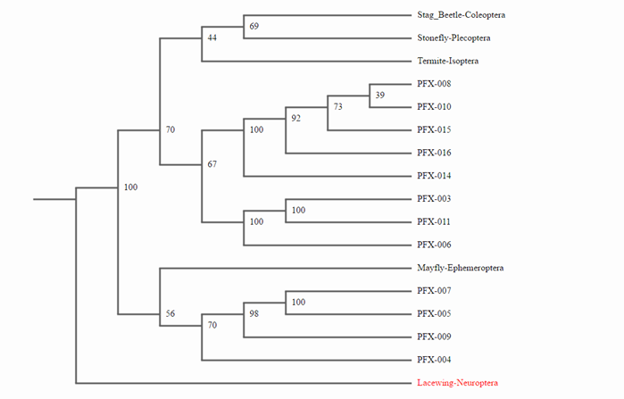
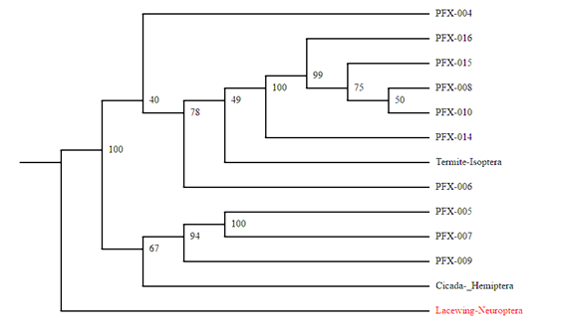
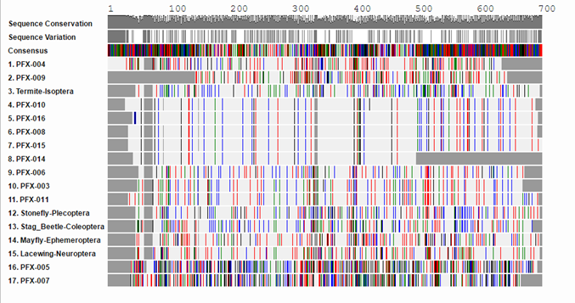
A Comparison of Macroinvertebrates Between
Well-Developed and Protected Regions of Moriches Bay, New York
S. Badzo. J. Squicciarini. & V. D’Ambrosia.
William Floyd High School, Mastic Beach, NY 11951
COLD SPRING HARBOR LABORATORY’S DNA LEARNING CENTER.
Abstract
The biodiversity of macroinvertebrates were compared between both a well-developed and a protected region of the Moriches Bay. This allowed the biodiversity of the macroinvertebrates within each ecosystem to be correlated to their ability to exist in two different settings. The DNA of ten different macroinvertebrates were compared in each region by methods of PCR and the utilization of DNA subway. The CO1 gene of these macroinvertebrates were compared to show if speciation had occurred. The data received reveals that the sample organism variety from both rivers were contrasting, in agreement to the proposed hypothesis that protected regions in the Moriches Bay would have a greater biodiversity compared to the regions that are well developed. The well developed area of the Moriches Bay was found to primarily be the home to Palaemon longirostris, whereas in the protected region of the Moriches Bay, there was more of a variety of organisms. The data of this study indicates that there is more biodiversity in well protected regions rather than in well developed regions in the Moriches Bay. This may have been due to the macroinvertebrates collected from well developed regions in the Moriches Bay may have had a high tolerance level to the weather conditions.
Introduction
Biodiversity, or the variety of organisms in a ecosystem (Miller & Levine, 2002), has decreased since the initiation of industrialization across the United States by almost one third (Palmer, B., 2015). Various organisms that have an important impact on the population in the biosphere are macroinvertebrates. The term macroinvertebrate is typically used to describe the organisms, as a result of the fact that they are relatively small, spineless and can be seen with the naked eye (De Lange, 1994). Prior to 2003, biological specimen were identified by examining features such as color, size or body parts, and shape. In 2003, Paul Herbert suggested DNA barcoding in order to decode problems related to traditional biological identification such as misidentification. Barcoding involves using a short genomic sequence from a standard part of the genome to identify the species. Barcoding would be useful when differentiating the species of Benthic macroinvertebrates, which are organisms that live on the bottom of the ocean, because errors can occur due to possible speciation, which is the formation of new species through evolution, and organisms appearing uniform (Barcode of Life, 2015). By utilizing DNA barcoding for samples of macroinvertebrates found in the Moriches Bay, an analysis of their biodiversity can be completed. The main goal is to determine if there is a variation in biodiversity of macroinvertebrates between well-developed and protected regions on the South Shore of Long Island, New York.
Materials & Methods
Twenty samples of macroinvertebrates were collected on the Moriches Bay, ten from a well-developed region and another ten from a protected region. These samples were collected by seining, finer plankton nets, and then preserved for further identification. At each location, the GPS coordinates, water quality and the number of macroinvertebrates per pull were collected. Once retrieved, these samples were photographed with a microscope camera. Pictures were taken on a piece of graph paper next to a ruler for measurement. Then, the samples were frozen at -20℃.
Polymerase Chain Reaction, or PCR, is a technique of which will be used to amplify the mitochondrial CO1 gene of each respective organism. The PCR products were analyzed by gel electrophoresis. After the gel electrophoresis was completed, the samples were sent for sequencing. The results were analyzed and compared using DNA Subway, which is a bioinformatics tool, as well as a cladogram. DNA extraction and PCR analysis allowed the DNA to be copied and sent for sequencing according to CSHL protocol. After the macroinvertebrates were sequenced, the samples from the bay were analyzed and compared using DNA subway of which was also be employed to generate a result cladogram. At the same time, each macroinvertebrate was analyzed in conjunction to the resulting genetic sequences from the previous year, as to discover if there had been an advance in biodiversity over the year.
Results
Tables & Figures
Figure 2: This figure shows the similarities between the samples ran in the form of a cladogram. The samples were compared to termites, stoneflies, mayflies, stag beetles, and lacewings. Data indicates that the samples ran are distinctly different than a termite, a stonefly, and a stag beetle. This could be attributed to the fact that these samples were found in an ecosystem that is not very diverse
Figure 3: This figure shows the similarities between the novel sequences ran in the form of a cladogram. The samples were compared to termites, cicada, and lacewings. Data indicates that the novel sequences are most likely not related to a cicada, and a termite. This could be attributed to the fact that the novel sequences were not found in the database, because they are different than the samples already in the database.
Discussion
The data received shows that the sample organism variety from both rivers weren’t very similar, in agreement to the proposed hypothesis that protected regions in the Moriches Bay would have greater biodiversity compared to the regions that are well developed. The well developed areas of the Moriches Bay was found to primarily be the home to Palaemon longirostris, whereas in the protected region of the Moriches Bay there was more of a variety of organisms. There is more biodiversity in well protected regions rather than in well developed regions in the Moriches Bay. This can be attributed to seasonal variation in dominant macroinvertebrates. The data of this study indicates that in this case, there is more biodiversity in well protected regions rather than in well developed regions in the Moriches Bay. This may have been attributed to the macroinvertebrates collected from well developed regions in the Moriches Bay may have had a high tolerance level to the weather conditions. In a warmer season, there may be more biodiversity, where macroinvertebrates can live in warmer climates.
References
Miller, K. R., & Levine, J. S. (2010). Miller & Levine Biology. Boston, MA: Pearson.
There goes the Neighborhood. Brian Palmer. (2015) Retrieved September 30, 2016 from, https://www.nrdc.org/onearth/there-goes-neighborhood
Miller, K., Levine, J., & Hall, I. (2002). Prentice Hall biology. Upper Saddle River, N.J.: Prentice Hall.
What is DNA Barcoding? (2015) Retrieved from: http://www.barcodeoflife.org/content/about/what-dna-barcoding
Group, N. W. (n.d.). Benthic macroinvertebrates. Retrieved October 19, 2016, from http://www.water.ncsu.edu/watershedss/info/macroinv.html
Acknowledgements
We would like to acknowledge the following learning centers and scientists for contributing to this study; Cold Spring Harbor Laboratory, Sharon Pepenella, United States Geological Survey, DNA Learning Center’s Barcode Long Island, and William Floyd High School’s Victoria D’Ambrosia.
Figure 1: This figure demonstrates the different aspects of DNA in the form of a barcode. The bands that are the same show similarities between the samples that were ran. The samples were compared to termites, stoneflies, mayflies, stag beetles, and lacewings. Data indicates that samples 010, 016, 008, 015, and 014 have similar band and may be closely related. Samples 003, and 011 have similar bands as well. This could be attributed to the fact that these samples may have been collected in the same bay area, showing that the biodiversity is not very diverse.

