Slide 1
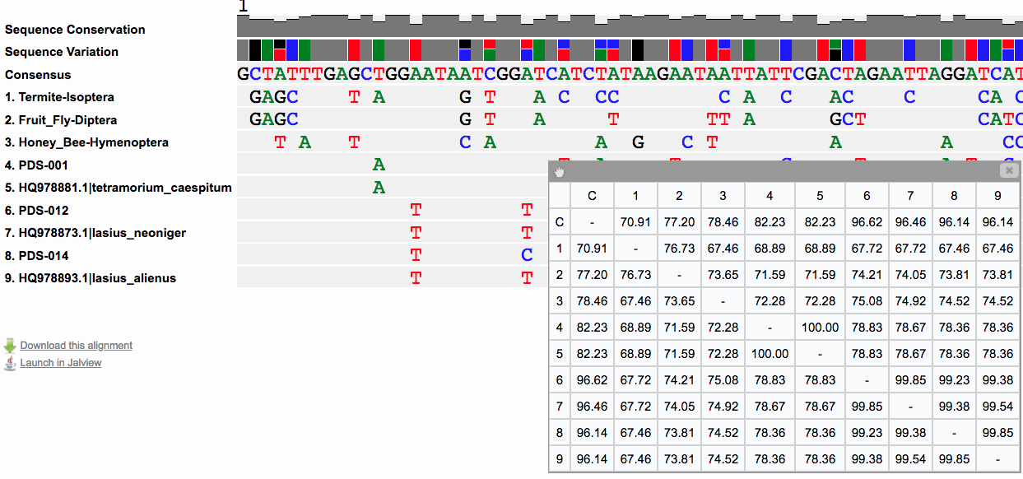
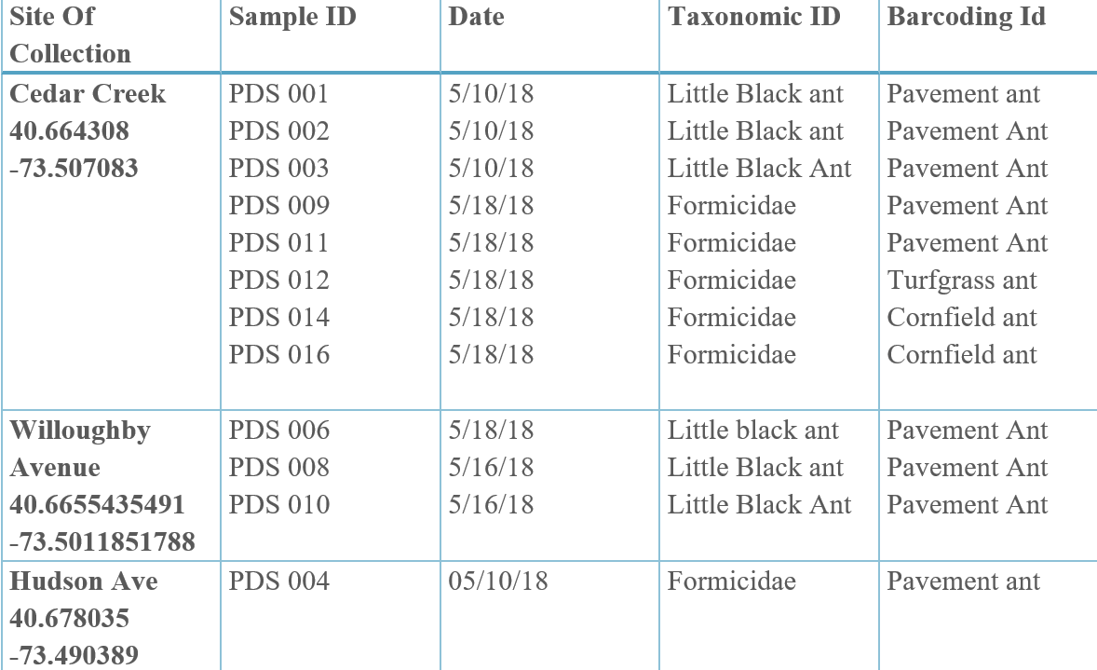
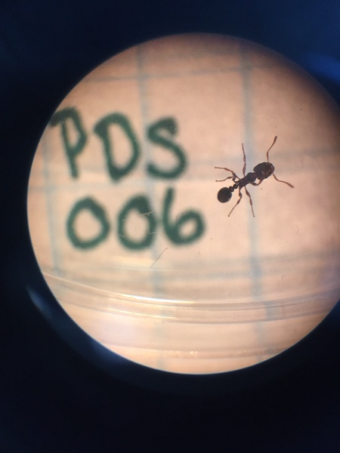
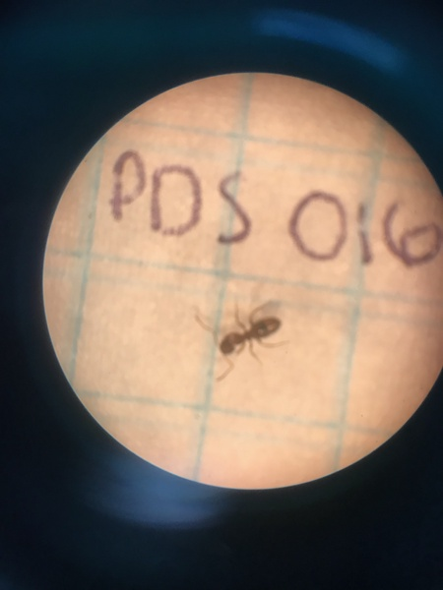
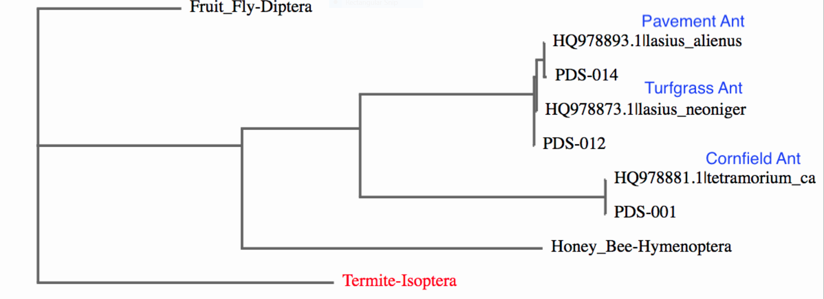
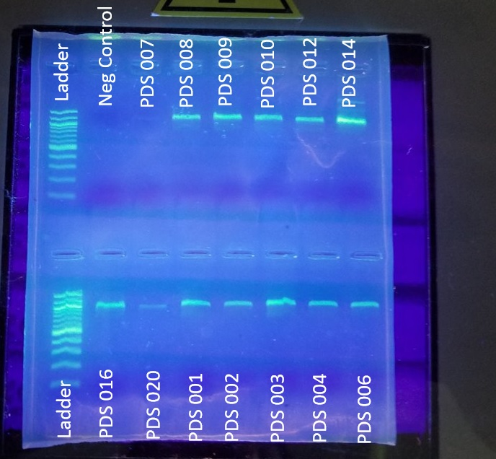
A Survey of Ants in Nassau County
Authors: Julia Galante and Onike Pinnock
Mentors: Janine Cupo and Mary Simons
Seaford High School
Abstract
Ants are able to impact the environments negatively and positively. Ants control other species that are threats to human health such as bed bugs. (6) Ants also have the ability to contaminate food and crops. They are able to transmit diseases such as salmonella, staphylococcus, and streptococcus.(2) Our objective is to determine the number of different ant species living in three different regions of Seaford. Our research question was to what extent do the environments that ants are found affect biodiversity. We hypothesized that the area with the greatest access to water would have the greatest diversity of ant species. We collected the ants by disturbing ant hills at Cedar Creek Park and two Seaford neighborhood residences, one very close to the water and the other far from the water. We were able to collect the ants by disturbing their ant hills due to the ants territorial instincts. They come out of their disturbed mounds in order to protect it.(3) After we collected and documented our samples we extracted and isolated the DNA. We then amplified the the CO1 gene by PCR. Amplified DNA was then sequenced and species identified using the bioinformatics program BLAST. Although our sample size at the residences was low we identified three species of ants in Cedar Creek Park and only one at the residences. This does not support our initial hypothesis.
Introduction
Ants have the potential to impact human health in positive and negative ways. Ants also impact the environment. They help control other insects such as bed bugs. (6) Ants can also be very harmful to human health. Ants that live in houses can contaminate food by leaving traces of feces behind. They transmit diseases such as Salmonella, Staphylococcus, Streptococcus, Shigella, and E-Coli. (2) Ants ruin houses by nesting in wood cavities of homes such as attic beams and in insulation. They also nest behind bathroom tiles, sinks, tubs, and in hollow spaces. (7) Our project goal is to identify which ant species are living near us and find out how they impact human health. We chose these locations because the house on Willoughby Avenue is close to the water and we wanted to see if this would impact which ants we found. We choose Cedar Creek Park because it is frequently visited. We wanted to see how the frequent presence of humans would impact ants. Lastly, we chose the house on Hudson Avenue as it is farther from the water and on the opposite side of Seaford.
Materials & Methods
Figure 4: Sequence Alignment with Sequence Similarity
Results
Data Table 1: Samples Collected
Figure 5: Sequence Alignment of Ant Species with Other Invertebrates
Figure 1: Pavement Ant
Figure 2: Cornfield Ant
1. Locate and disturb anthill. Collect ants, document their location and transport them back to the lab.
3. Follow DNALC Barcoding protocol to amplify the CO1 gene DNA of each sample.
5. Send amplified DNA to Genwiz for sequencing to identify the specific species of ant collected.
2. Using grid paper, measure and photograph each collected ant sample.
4. Perform gel electrophoresis to confirm that the DNA was amplified correctly.
Figure 6: Phylogenetic Tree of Invertebrates with Outgroup Species
Figure 3: PCR Gel Electrophoresis Results
Discussion
The ants that we found were pavement ants, a cornfield ant and a turf grass ant. We hypothesized that there would be greater biodiversity of ants at the residence closest to the water. Due to the difficulty of collecting ants at the houses we were not able to collect enough data to support or refute our hypothesis. We did observe a greater number of species collected from Cedar Creek Park than at the neighborhood residences. Pavement ants are seen mostly as a nuisance but studies suggest that they defend agricultural aphid pests although they don’t defend these pests as much as other species of ants. (5) This suggests that these ants do not have much impact on human health as hypothesized. Turfgrass ants and cornfield ants are not detrimental to human health although they are considered a pest. They dig small holes into turf grass and golf course tees which damage these structures. (4) At this point, our data does not support our hypothesis that the house closest to the water would have the greatest biodiversity because the greatest l biodiversity of any species, 3 distinct species, was found in Cedar Creek Park. Possibly the presence of human built structures was more of factor in impacting biodiversity than the presence of water.
Acknowledgments
A special thanks goes out to Mrs. Cupo, Mrs. Simons, Cold Spring Harbor and Seaford High School. We wouldn’t have been able to do this project without the help, support and resources that you all provided.
References
Ant - Lasius Neoniger. (n.d.). Retrieved June 2, 2018, from http://www.msuturfinsects.net/details/_/ant_8/
Barry, T. (2017, April 24). How Do Ants Protect Themselves. Retrieved May 29, 2018, from https://sciencing.com/do-ants-protect-themselves-8709450.html
Do Ants Eat Bed Bugs? Find Out What Eats Bed Bugs. (n.d.). Retrieved June 04, 2018, from https://www.orkin.com/other/bed-bugs/do-ants-eat-bed-bugs/
University of Exeter. (2011, February 4). Ants have big impact on environment as 'ecosystem engineers'. ScienceDaily. Retrieved June 2, 2018 from www.sciencedaily.com/releases/2011/01/110131133227.htm
Vitone, T., & Lucky, A. (2014, September). Pavement ant - Tetramorium caespitum (Linnaeus). Retrieved June 2, 2018, from http://entnemdept.ufl.edu/creatures/MISC/ANTS/pavement_ant.htm
Wellness, B. (2011, October 1). Can Ants Harm Health. Retrieved May 29, 2018, from http://www.berkeleywellness.com/self-care/preventive-care/article/ants
Hahn, J., & Pellitteri, P. (n.d.). What to do about household ants. Retrieved from https://www.extension.umn.edu/garden/insects/find/what-to-do-about-household-ants/

