Slide 1
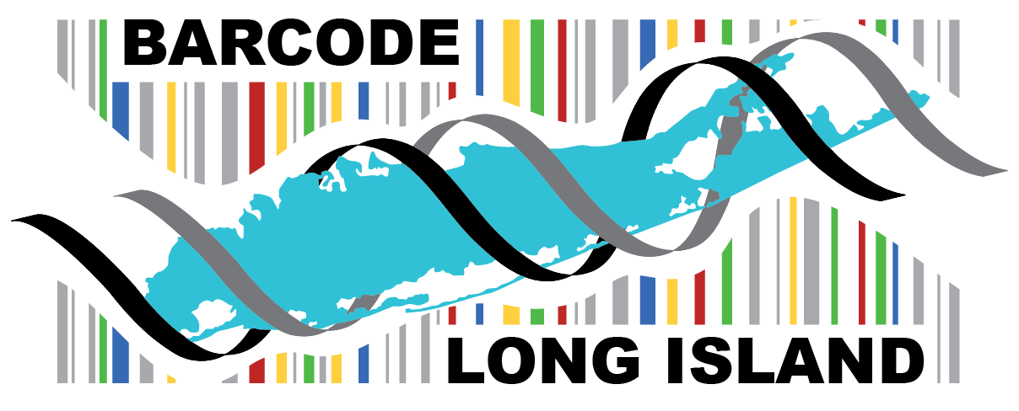
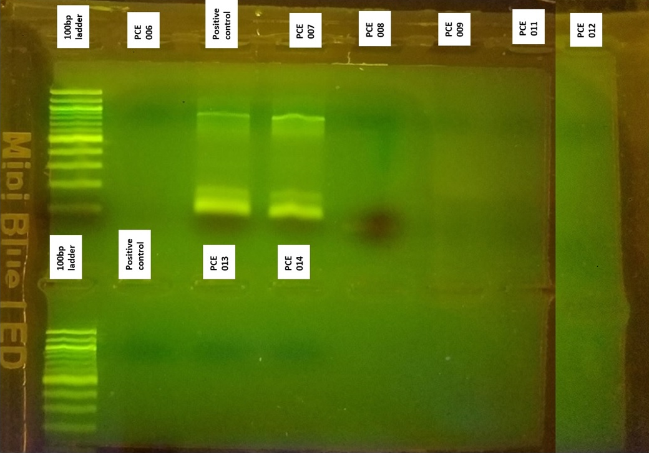
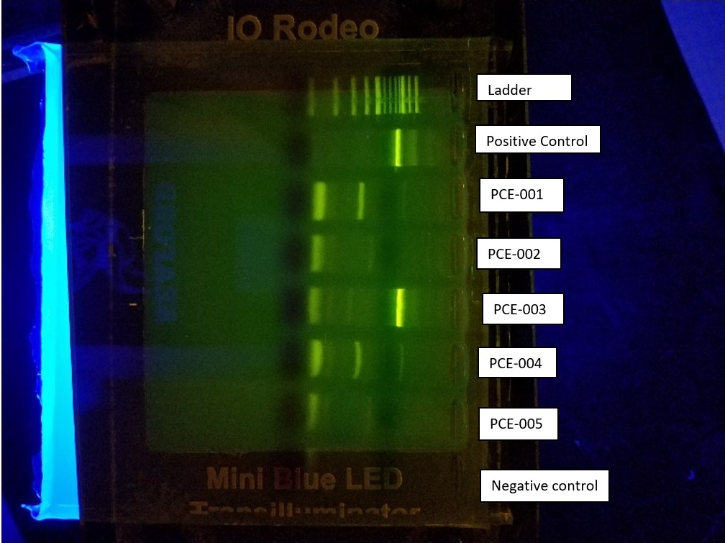
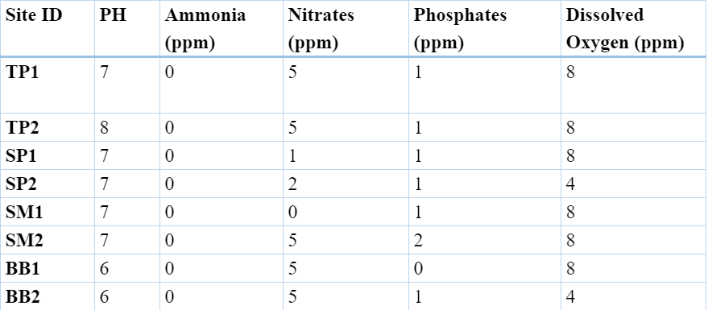
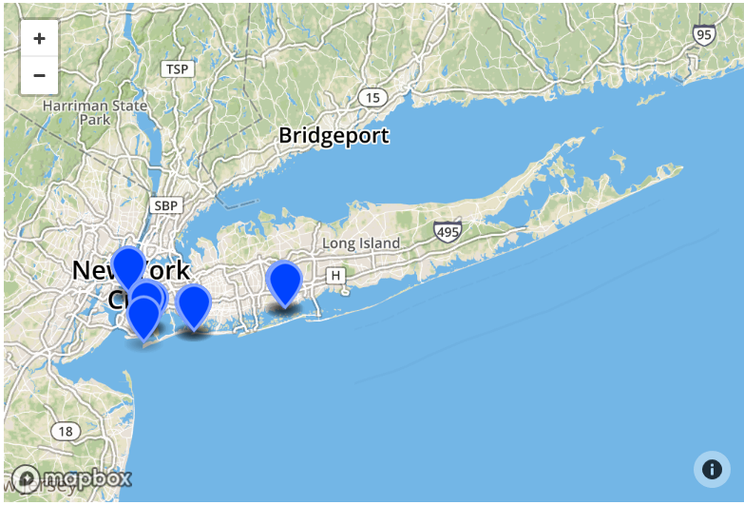
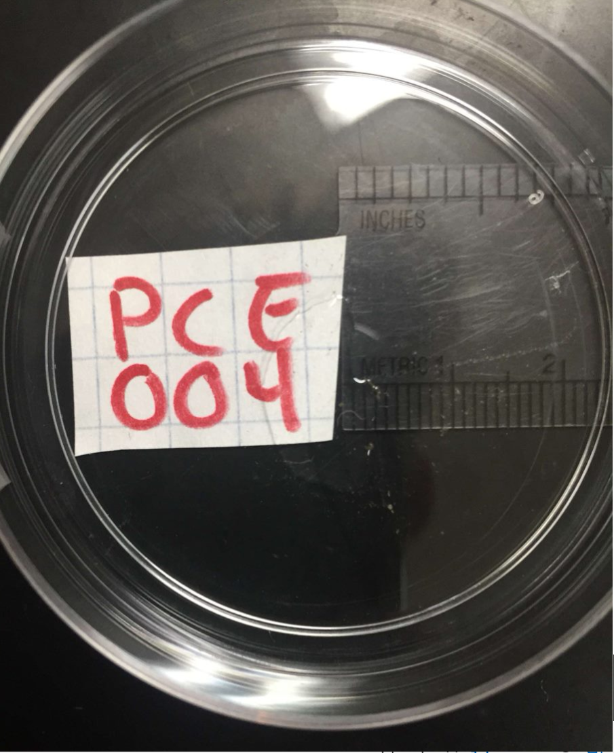
The Effect of Commercial and Recreational Boating on the Invertebrate Biodiversity of Aquatic Environments in The Greater New York Area
Authors: Turaj Mahadan, Chris Schneider and Eric Schneider
Mentors: Janine Cupo and Mary Simons
Seaford High School
Figure 3.1: Gel 1
Figure 3.2: Gel 2
Abstract
Boating has tremendous effects on surrounding ecosystems and the organisms inhabiting those ecosystems. Chemicals emitted by boats, as well as the fact that boats can transport organisms to and from aquatic area, can impact the biodiversity of that ecosystem. We hypothesized that commercial boating would have the greatest impact on the aquatic biodiversity. Local boating, we believed would still have an impact, just not as drastic as commercial boating. We then tested for pollutants as well as the invertebrate species present in the water. We collected invertebrates from areas with high recreational boating activity, high commercial boating activity, both recreational and commercial activity, and no boating activity at all. These places were Tanner Park, Brooklyn Bridge Park, Silver Point County Park, and Salt Marsh Nature Preserve, respectively. We collected two samples from each area, along with conducting tests on the water for Nitrates, Ammonia, Phosphates, Dissolved Oxygen, and pH. We then isolated DNA from our samples, ran a PCR with our purified samples, and sequenced the samples that were successful.
Introduction
Boating impacts biodiversity by introducing nonnative, and possibly invasive, species. According to Nonindigenous Aquatic Species (NAS), many of the nonnative introductions were a result of actions done after the colonization of North America. Species can be brought over from the Old World to North America as well as being brought to areas outside their native ranges within North America. An example of a species brought from Europe is the Brown Trout, Salmo trutta. The Brown Trout was first introduced into the United States in 1883 from Germany. Another example of a species brought to a different area is be the Coho Salmon, Oncorhynchus kisutch. This Salmon, native to the Pacific coast from northern California to Alaska, was introduced into the Great Lakes as early as 1920(6). The article then stated that boating was a main cause in transferring nonindigenous species into a different habitat. In addition to the introduction of non-native species, boating can affect the biodiversity of environments through the pollutants they emit and the change to water quality they cause. This can be seen in the presence of certain bioindicators due to the heavy metals emitted by boating (2). These pollutants can cause the composition of the water to change which results in certain species not being able to survive there or other species now being able to live there and out-competing the native species. We hypothesized that boating has had an effect on the biodiversity present in the aquatic environments of the Greater New York area, international commercial boating more so than local recreational boating.
Materials & Methods
Sample Collection
The use of a 150 micron plankton net to collect marine invertebrates
DNA Extraction
Specimen were grinded so DNA is easily released
PCR
After the addition of PCR reagents(DNA polymerase, buffers, nucleotides, primers), samples were then added o another tube
Water quality tests were taken at each site
A series of solutions such as a lysis solution, buffers, PCR reagents and distilled water were added to purify DNA
Samples also underwent multiple centrifugal rotations and supernatant/pellet disposals to purify and isolate DNA
The tubes were then transferred to an incubator, exposed to many cycles of temperatures to duplicate the CO1 gene
After PCR, the samples were then sequenced and loaded on to DNA subway
Figure 4: Blast results
Results
A survey of the species in the Greater New York area allowed us to see the effects of boating on the biodiversity. For our water quality tests, much of the data was constant, as seen in Figure 2.0. The only variance was seen in pH, where Brooklyn Bridge had a lower pH of 6. We also created a table to display the number of different species collected in the two areas. We collected a total of 18 samples, with only 4 being sent for sequencing; PCE 001, 003, 004, and 007. Of the four samples that were sent, three were considered low quality, with only one having a good quality sequence. Those considered to be low quality, where the average error rate was greater than 1%, were samples PCE 001, 003, and 007. For PCE 004, the quality was still very low, which was most likely because it was the wrong amplicon size, but it was able to be sequenced. Due to its poor quality, there were many mismatches in our search. Given that, it would be very hard to find evolutionary relatedness for PCE 004 due to its poor quality, as seen in Figure 4.0.
Figure 5: Sequence Results
Discussion
Due to the poor quality of the few results produced at the end of our research, we cannot determine the invertebrate biodiversity on the aquatic environments in the areas sampled. Our hypothesis is neither supported nor rejected by the results of our study. Cleaner, more sanitary and cautious approaches when doing lab work may result in better results from each sample. Also, the very small size of the invertebrates made it very hard to isolate and purify our samples. In the future, larger organisms and a larger sample size will be present to continue this research.
Acknowledgements
Special dedication to Cold Spring Harbor laboratories for the supplies they gave to us and the procedure that they provided, our mentors for their continued support and guidance and our school for allowing us to continue our research.
Table 1: Water Quality Tests
Figure 2: PCE-004
Figure 1: Collection Sites
Figure 5
References
1. Chiarelli, R. and Roccheri, M.C. (2014) Marine Invertebrates as Bioindicators of Heavy Metal Pollution. Open Journal of Metal, 4, 93-106. http://dx.doi.org/10.4236/ojmetal.2014.44011
2.Klein, Richard. "The Effects Of Marinas & Boating Activity Upon Tidal Water Ways." (2007): 1-18. Www.ceds.org. Web. 26 Oct. 2016.
3. Reuter, J.E., B.C. Allen, R.C. Richards, J.F. Pankow, C.R. Goldman, R.L. Scholl and J.S. Seyfried, 1998. Concentrations, sources and fate of the gasoline oxygenate methyle-tert-butyl ether (MTBE) in the multiple-use lake. Environ. Sci. Technol., 32: 3666-3672.

