Slide 1
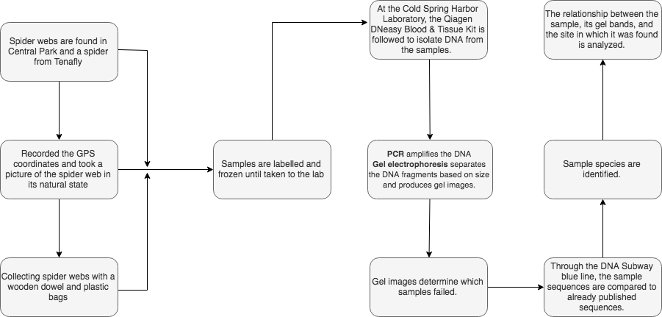
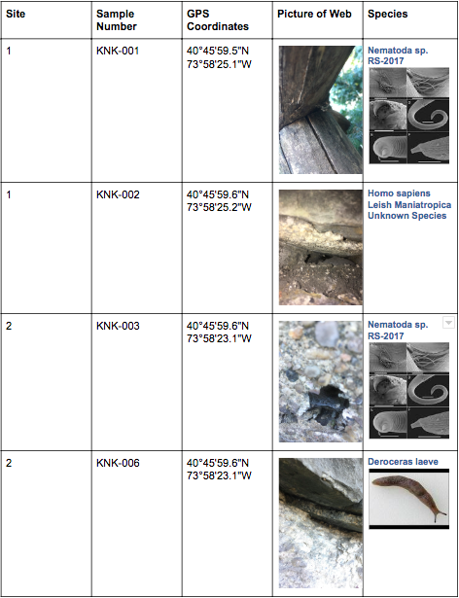
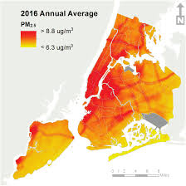
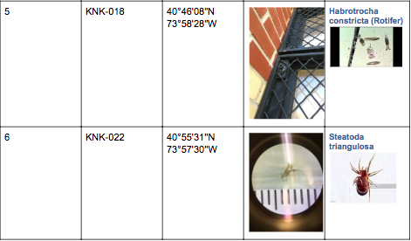
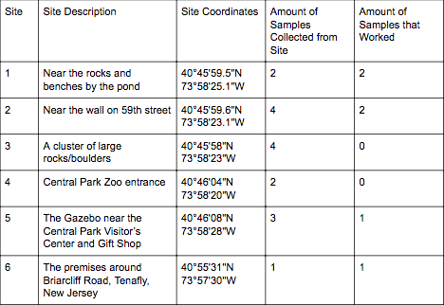
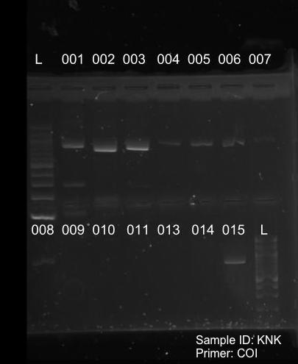
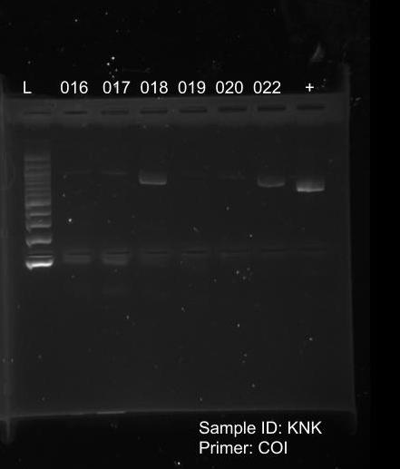
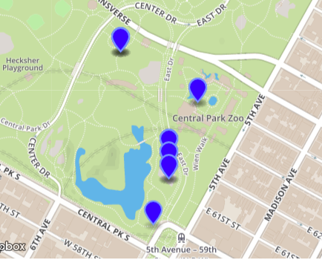
Using Spider Webs as Indicators of Air Pollution Through DNA
Barcoding to Identify Spider Species
Kristen Lee and Michael Wong
Funded by the
Thompson Family Foundation
Tenafly High School
Abstract
Vehicle emissions carry hazardous airborne particles which can influence biodiversity. Patterns between the species and environment suggest that certain spiders have more tolerance for motor vehicle pollution in comparison to others. Our plan is to determine the effects of particulate matter pollution on biodiversity through spider webs. We will measure the amount of PM 2.5, a type of fine airborne particulate matter with a diameter less than 2.5 microns. We collected and identified spider webs from sample sites including various spots within Central Park and a New Jersey site. Spider species were not detected however, other species and signs of biodiversity were found. Our experiment being conducted in an open system compared to a closed system, like a zoo may have also factored into the results of species differing from spider species. The contamination of the web from outside, uncontrolled factors may have caused failures of certain samples.
Introduction
Purpose
Discussion
Dissimilar to the research paper published by Charles C. Y. Xu, the DNA barcoding process on the spider webs we collected did not identify spider species.
It can be noted that this scientist collected the spider webs used in his experiment from a controlled setting (a spider exhibit in a zoo)
Our project was based on collecting spider webs from open sites within Central Park.
Contamination of the webs from outside, uncontrolled factors may have caused the results to identify different species of organisms, unlike Charles C. Y. Xu.
In the future, more defined information about each site of collection would be supplemental to the results.
For example, a measurement of human activity within all sites would allow for more of an explanation as to why certain sites failed to provide results while others succeeded completely.
The collection from more sites and the collection of more samples could provide more results to analyze and compare with
Collection from an enclosed, controlled site can also allow us to see if we can identify species of spiders from their spider webs.
References
[1] Römer, L., & Scheibel, T. (2008). The elaborate structure of spider silk: structure and function of a natural high performance fiber. Prion, 2(4), 154–161.
[2] Xu, C. C., Yen, I. J., Bowman, D., & Turner, C. R. (2015). Spider web DNA: a new spin on noninvasive genetics of predator and prey. PloS one, 10(11), e0142503 [3] Rybak, J., Spówka, I., Zwoździak, A., Fortuna, M., & Trzepla-Nabagło, K. (2015). Evaluation of the usefulness of spider webs as an air quality monitoring tool for heavy metals. Ecological Chemistry and Engineering S, 22(3), 389-400. [4] Adams, K., Greenbaum, D. S., Shaikh, R., van Erp, A. M., & Russell, A. G. (2015). Particulate matter components, sources, and health: Systematic approaches to testing effects. Journal of the Air & Waste Management Association, 65(5), 544-558.
[5] Xiao-Li, S., Yu, P., Hose, G. C., Jian, C., & Feng-Xiang, L. (2006). Spider webs as indicators of heavy metal pollution in air. Bulletin of environmental contamination and toxicology, 76(2), 271-277.
[6] Choresh, O., Bayarmagnai, B., & Lewis, R. V. (2009). Spider web glue: two proteins expressed from opposite strands of the same DNA sequence. Biomacromolecules, 10(10), 2852-2856 [7] Kobza, J., & Geremek, M. (2017). Do the pollution related to high-traffic roads in urbanised areas pose a significant threat to the local population? Environmental Monitoring and Assessment, 189(1), 33. http://doi.org/10.1007/s10661-016-5697-1f
Acknowledgements
We would like to thank our teacher, Mrs. Helen Coyle for helping us through the whole process of our project. We would also like to thank Dr. Christine Marizzi for not only letting us use the lab equipment, but also teaching and guiding us.We would also like to thank Dr. Melissa Lee who has helped us in the lab.
The goal of this project is to identify the effects of PM 2.5 air pollution on biodiversity through specimen identification of spider webs.
Materials & Methods
We collected spider webs along a high traffic site and ones along a low traffic site in the Central Park area, using
a plastic bag and wooden dowels.
Figure 2: Methodology
Spider webs consist of silk made by spiders for multiple applications such as:
capturing prey [1].
creating a shelter to protect themselves and their offspring [1].
an escape route away from predators [1].
The silk is produced from the three pairs of spinnerets which all spiders possess [1.]
Species of spiders that do create webs using silk, either create:
new webs on on an average of every night [1].
repair old, damaged webs [1].
In 2015, Charles C. Y. Xu demonstrated the first findings that spider webs could be a source of genetic material [2].
Spider webs demonstrate:
an ability to capture and accumulate airborne particulates [3].
a widespread availability [3].
Airborne particulates are defined by the Environmental Protection Agency (EPA) as “a mixture of solid particles and liquid droplets found in the air” [4].
An extensive usage of motor vehicles is a primary source of PM 2.5 pollution, especially in urbanized areas [5][6][7].
spider webs found in high traffic sites demonstrate higher contents of heavy metal elements in contrast to low traffic sites [7].
Results
More intense staining of a gel band in a gel image is caused by the presence of more DNA in that band.
Of all 22 samples collected, only six of the samples were able to be identified with a species of organism.
The six samples were collected as one spider and 5 spider webs.
The spider web samples matched species different from a spider species.
The spider sample identified as the spider species, Steatoda triangulosa.
Site 1 was the only site with multiple samples in which all samples collected worked
Half of the samples (sample 3 and sample 6) from site 2 worked
KNK-003’s gel band visibility was high
KNK-004, KNK-005, KNK-006 have a low-medium visibility
All of the samples from site 3 and site 4 did not work
the gel bands have the lowest visibility
Site 5 contained the spider sample
KNK-022 has a high visibility
More intense staining of that band is caused by more DNA in that band.
Tables & Figures
PM 2.5 is a fine particulate matter with a diameter of 2.5 microns or smaller and is one of the most hazardous types of particulate matter to public health [4].
they are prone to being inhaled and causing both cardiovascular and respiratory diseases [4].
Figure 3: Sample Locations and Pictures
Figure 1: Kheirbek, I. (n.d.). PM2.5 concentrations, 2016 annual average [Digital image]. Retrieved from https://www1.nyc.gov/assets/doh/downloads/pdf/environmental/comm-air-survey-08-16.pdf
Figure 5: Sample Selection of Webs
Figure 5: Sample Selection of Webs
Figure 5: Sample Selection of Webs

