Slide 1
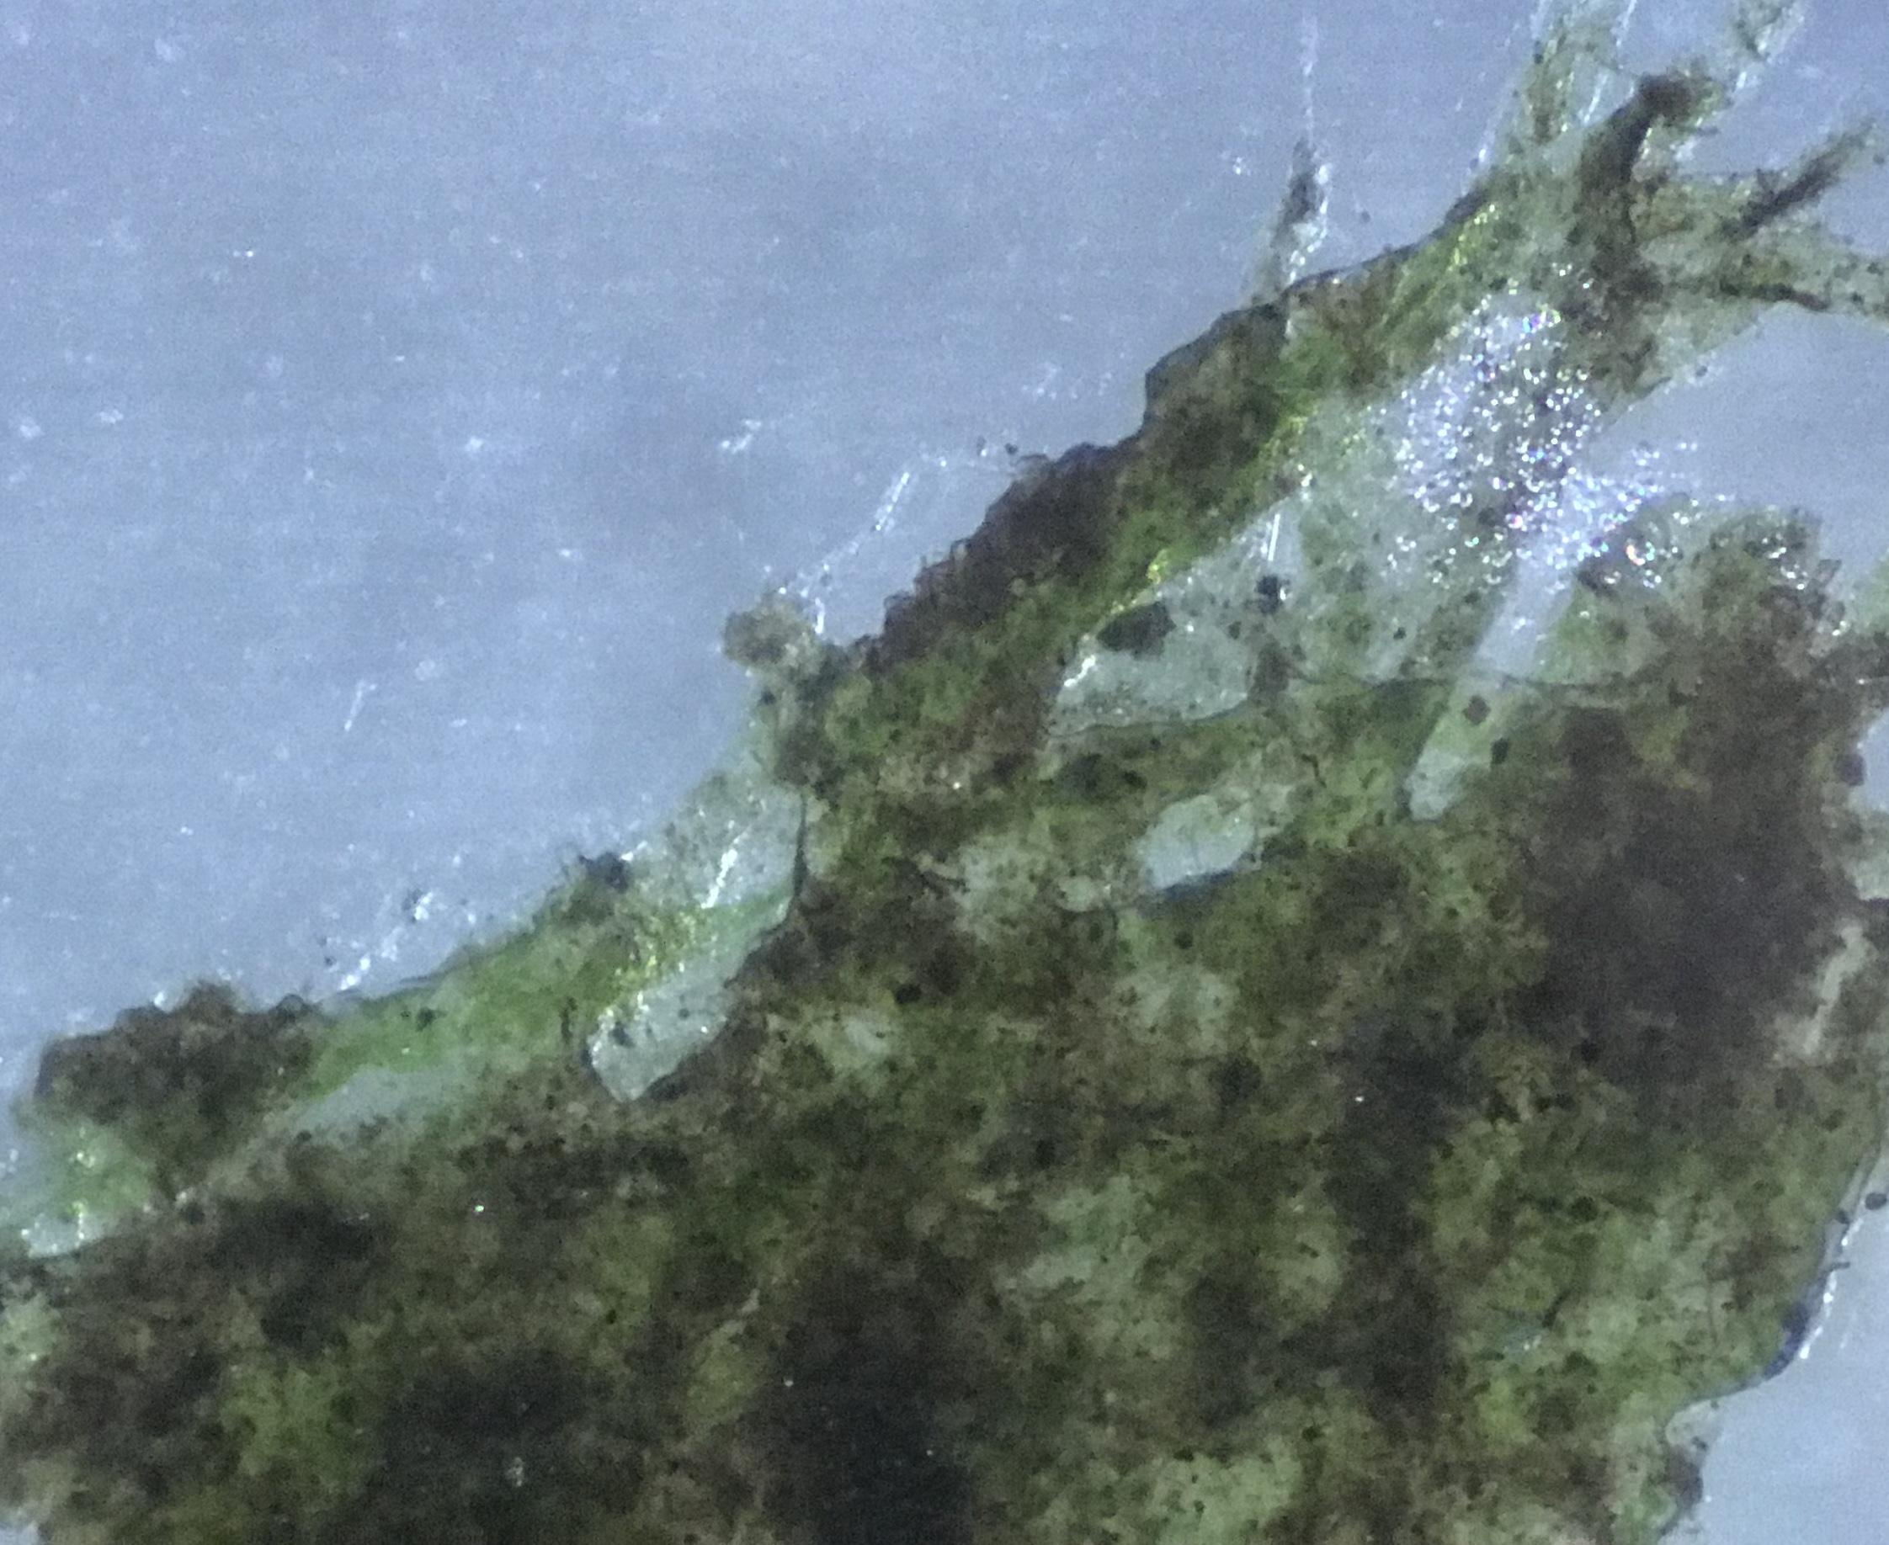
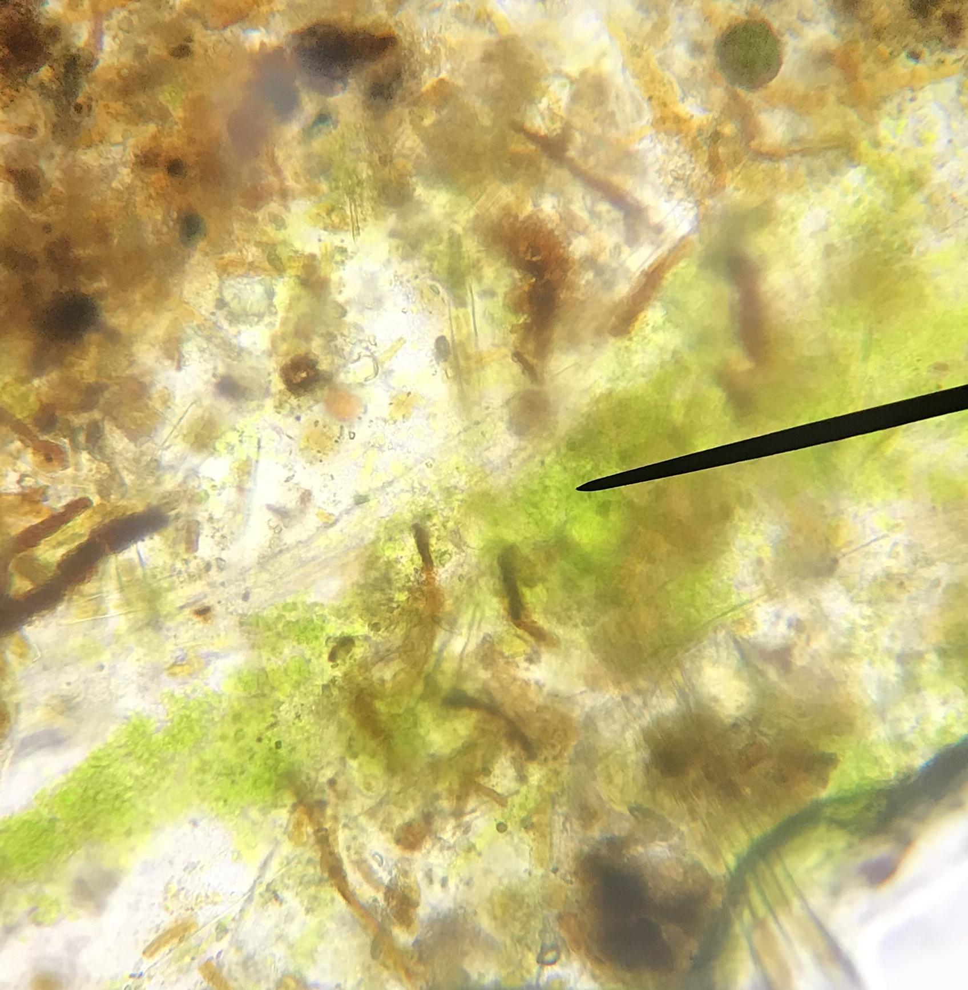
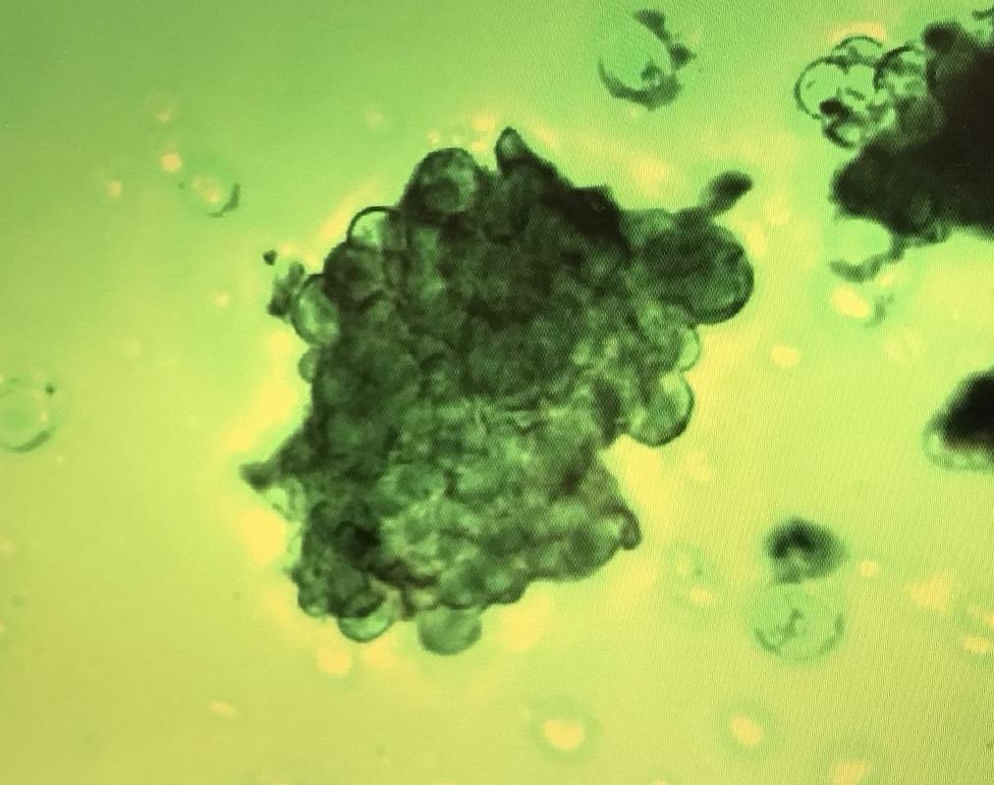
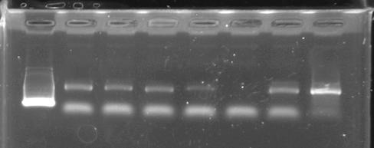
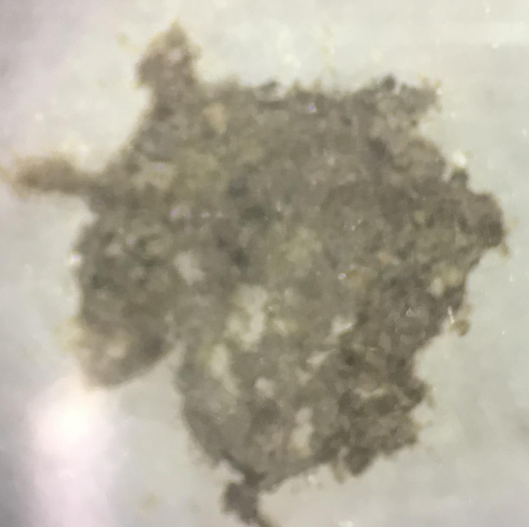
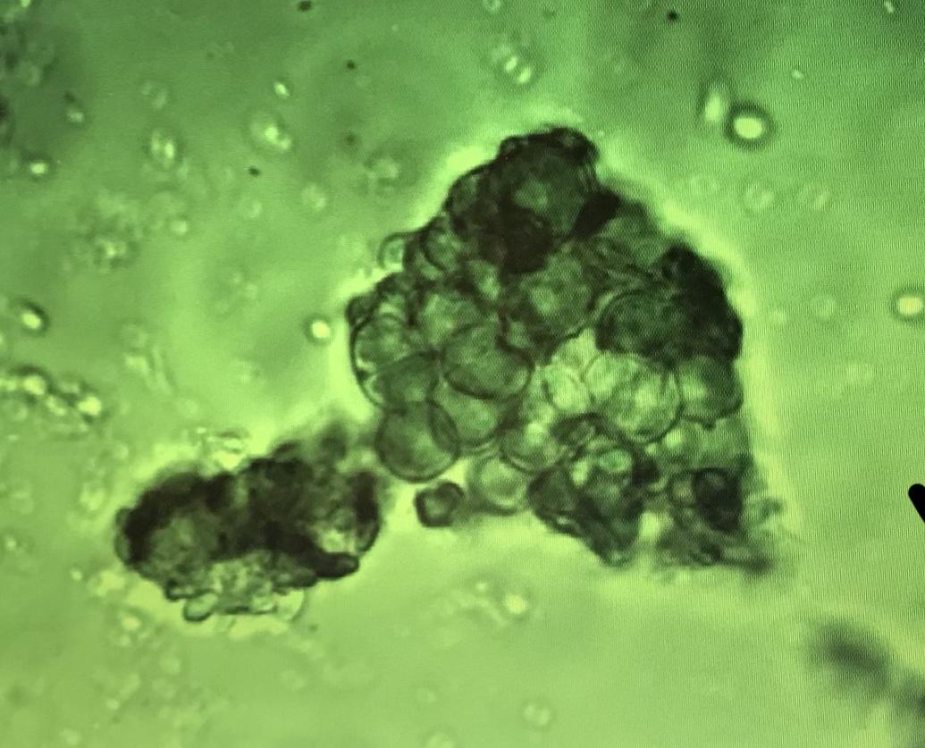
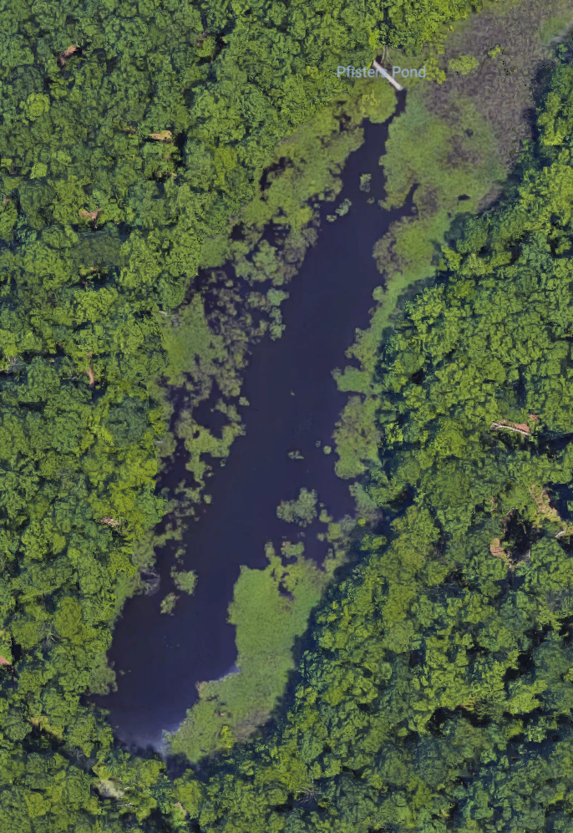
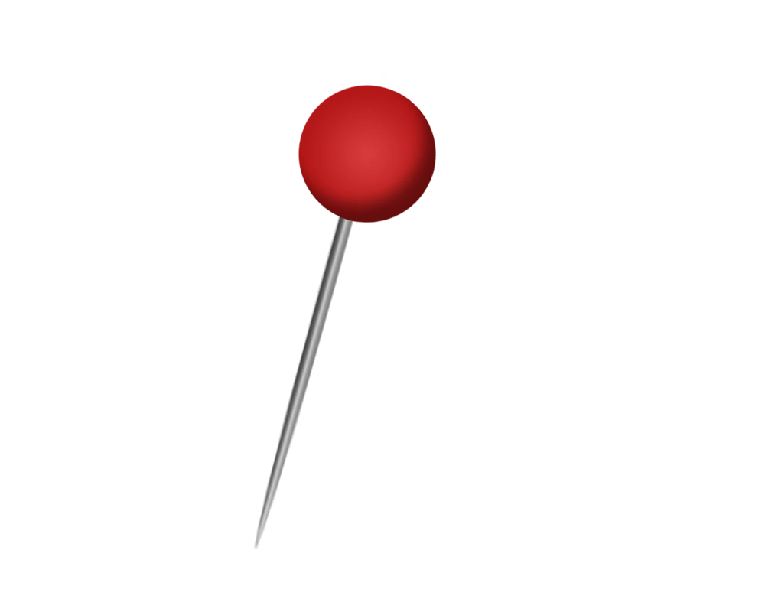
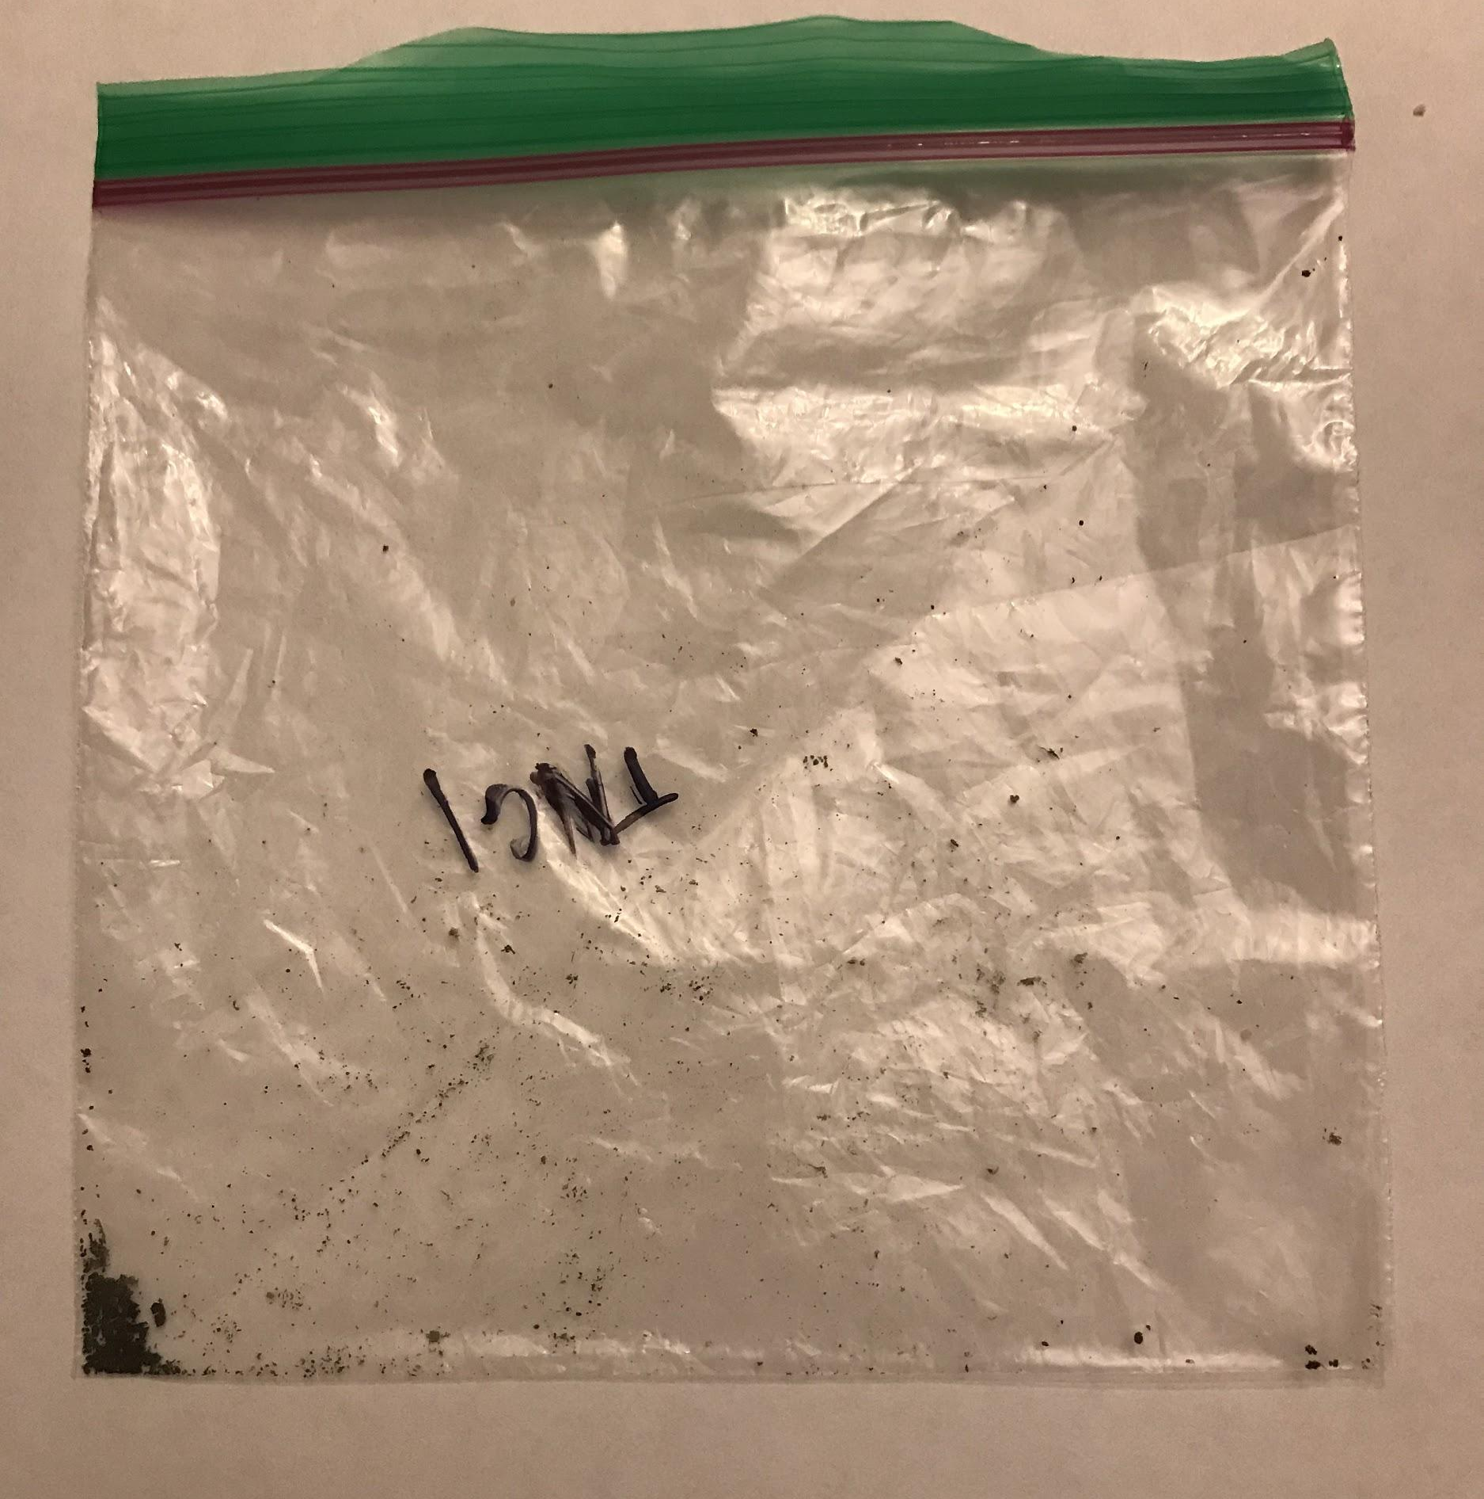
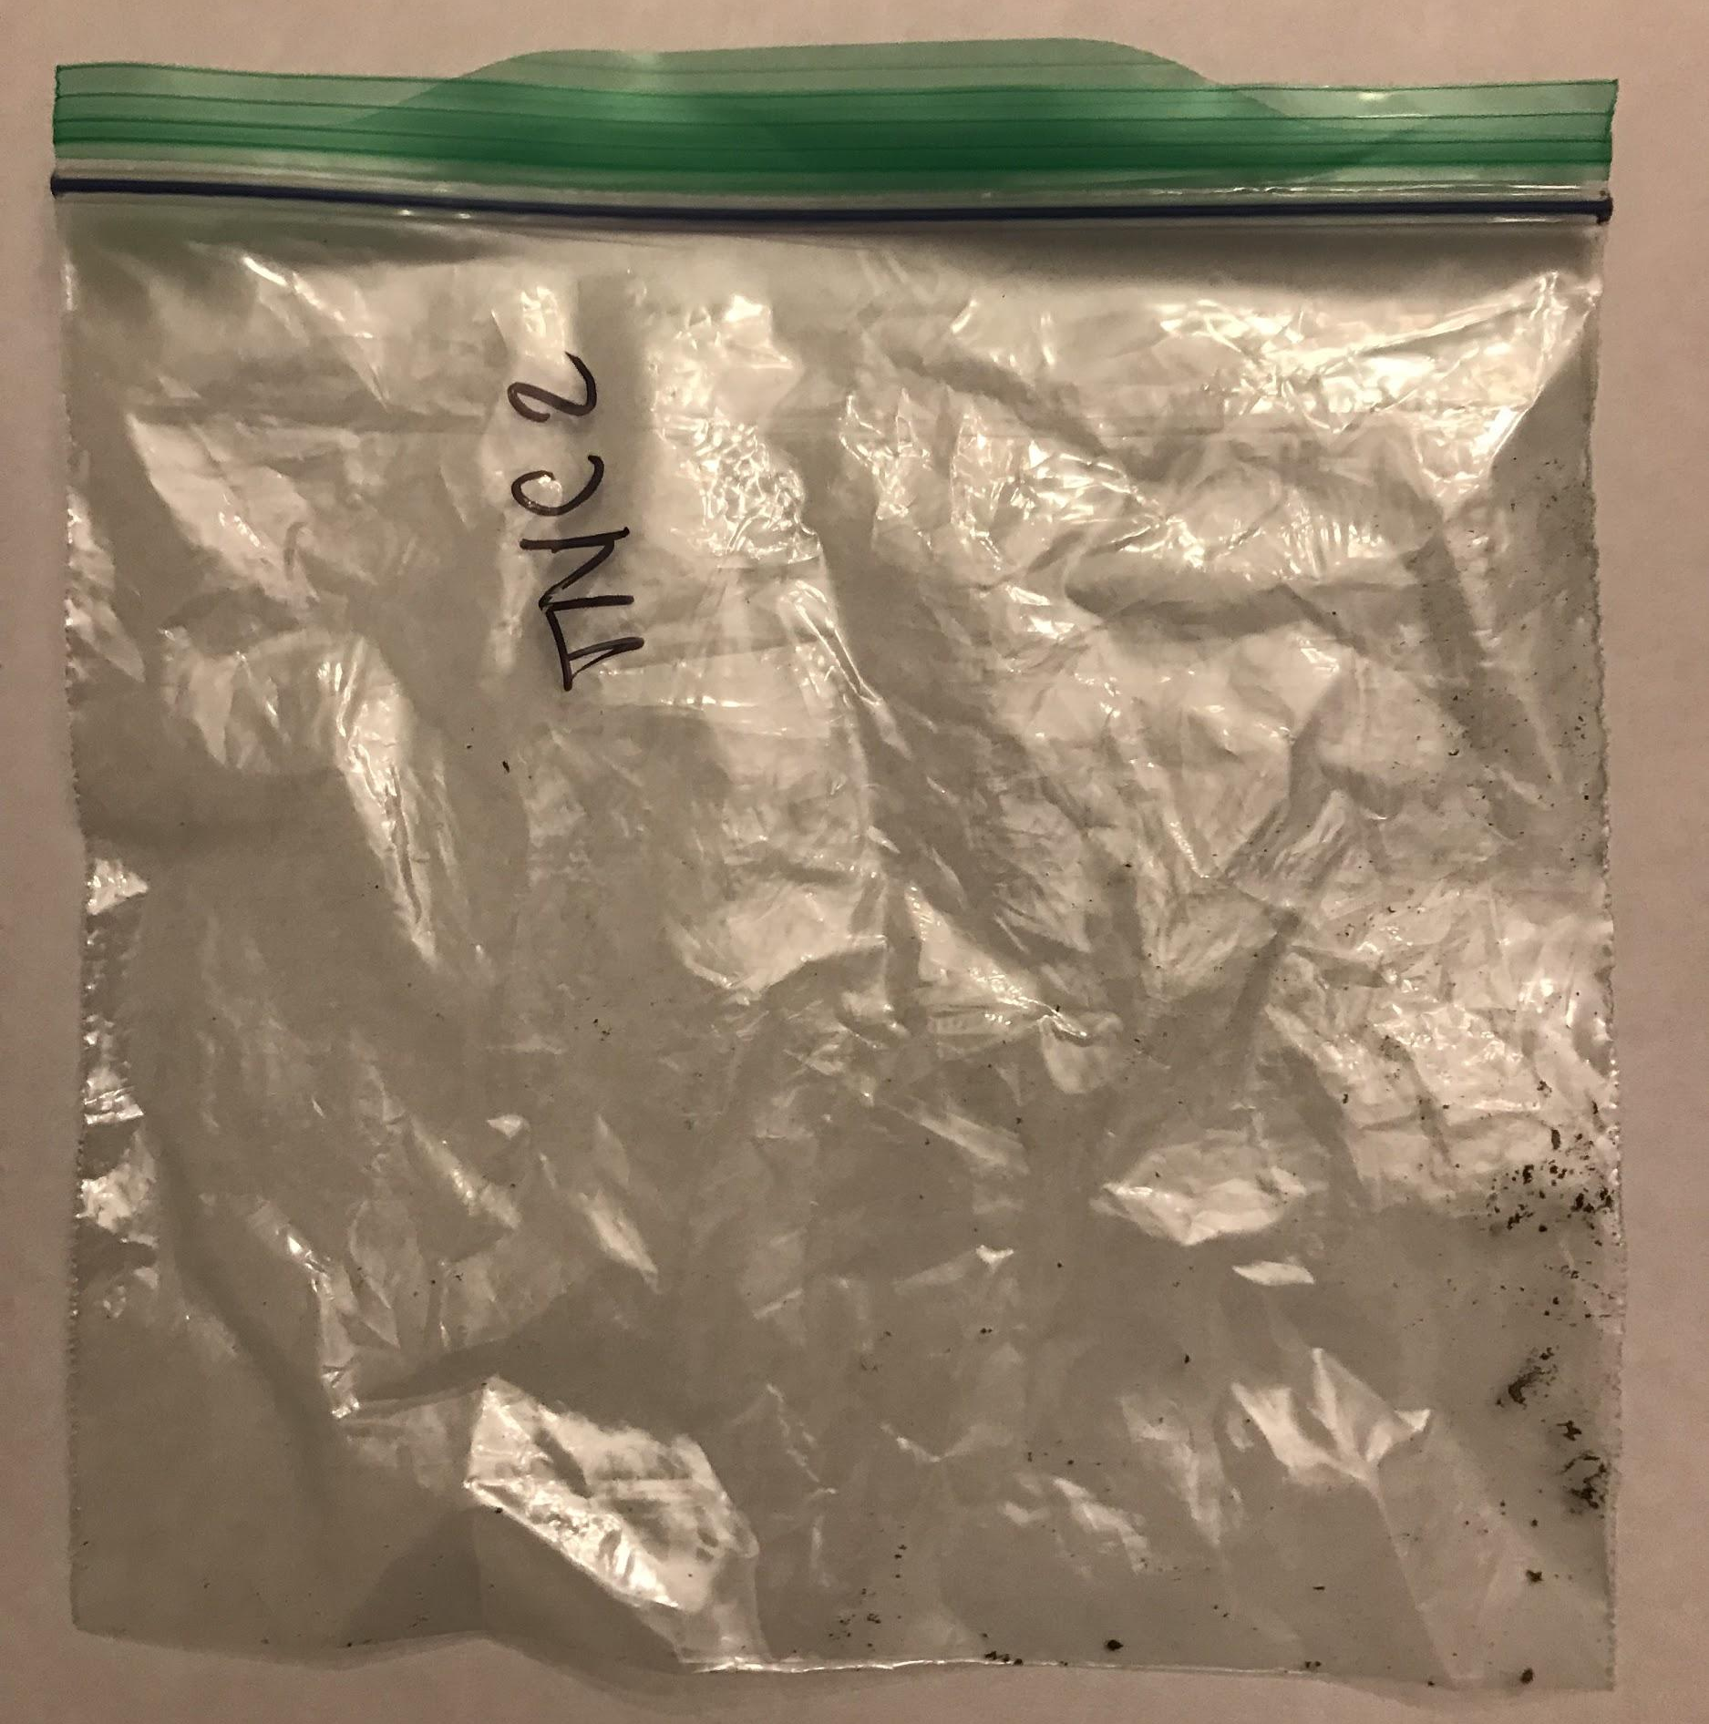
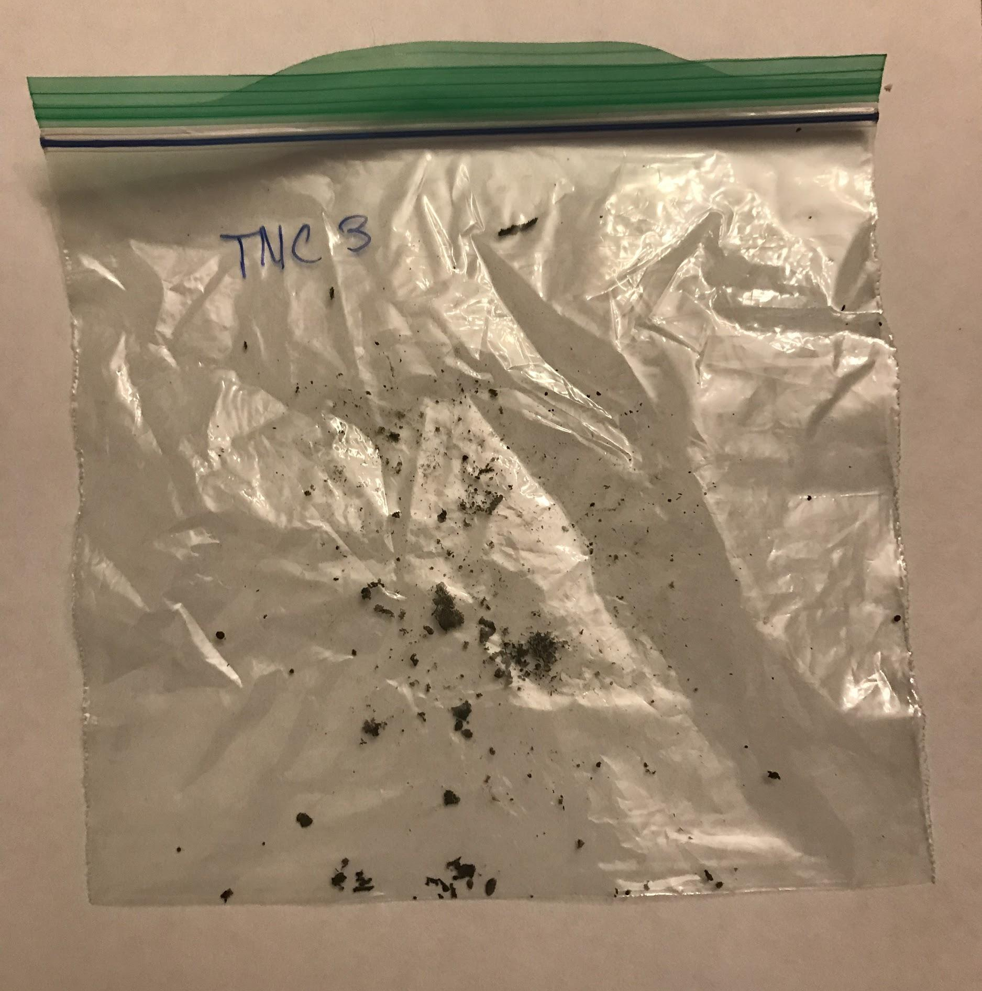
Effects of Pollution on Biodiversity of Algae in Bodies
of Water in Central Park and Northern New Jersey
(Work performed in part at an independent laboratory.)
Ethan Park and Subin (Emily) Kwen 3-8-18
Background
Methodology II
Results
Discussion/Conclusion
New York City is one the largest, busiest cities in the world, which means that water pollution could be a major problem. Many different pollutants such as nitrates and phosphates flow into different bodies of water through runoff rainfall carrying the pollutants, wastewater, and fossil fuels, which increase the amount of nitrogen in the atmosphere [1]. Algae covers a very broad group of photosynthetic organisms, such as aquatic plants and bacteria [2]. According to the Washington State Lake Protection Association, algal organisms have very specific nutrient needs, rapid reproduction rate, and very short life cycle, making it an ideal source of a water quality assessment [3]. For this project, we will be covering macroscopic algae. This both makes the collecting of samples and the actual DNA barcoding more feasible and reliable. Using the various species of macroscopic algae we collect, we will determine the levels of nitrates and phosphates, as shown by the levels the species of algae can survive in, such as how the phylum Chlorophyta can survive in less than 0.061 to .68 µmol/L of nitrates and 0.048 to 1.29 µmol/L of phosphates [4].
To support our DNA sequencing results, we identified our algae samples by microscope. We also tested water samples from both locations to figure out the nitrate and phosphate level of the bodies of water. We first mounted our samples on wet slides and viewed them under a high-powered microscope. We then used these images to identify the species of each of our samples using an online algae identification guide. We also tested our water samples from both locations to get the nitrate and phosphate levels of the individual bodies of water. With this information, we were able to compare the levels of nitrates and phosphates that each species will be able to survive in with the levels present in the water.
Our PCR results were run through the gel electrophoresis five times using different primers: TufA, plant ITS, fungal ITS, and rbcL. The gel electrophoresis worked for two of the five runs. We put the results of the fungal ITS and rbcL through the DNA Subway and got a 98% match using rbcL for the species Staurastrum crenulatum. By using a classification guide, Manaaki Whenua Landcare Research [7], for algae based on their characteristics, we were able to find that the samples from the Tenafly Nature Center belonged to the Microcystaceae family. By using an online database, the Encyclopedia of Life [8], we searched up these organisms to find the levels of each pollutant they can survive in. We were not able to find the data for Staurastrum crenulatum, but we were able to get results for Microcystaceae.
As the project was split into two parts, we will write about them in the conclusion accordingly.
The first part of the experimentation was through DNA barcoding. While we were able to pinpoint the species, with two of the three samples turning out to be non-algal, the one algae sample did not have data on it from the databases we searched through. This means that the first part of our experimentation is inconclusive and would require more data to be provided. The second part, however, provided more conclusive results. After matching the sample with its family, we were able to find the nitrate and phosphate levels. These levels matched with the levels of the water, thus proving that the algae can be used as an indicator species, assuming that there is data behind the algae readily available.
Algae Samples Under Microscope
Abstract
This project will delve into this problem, showing how exactly algae are affected through the monitoring of biodiversity. This will prove algae’s ability to function as indicators of high levels of pollutants as well as showing the pollutant levels in both New Jersey and New York.
DNA Gel Electrophoresis Results
Future Work
If we were to do this experimentation again, we would make sure to collect samples over a more diverse set of places in order to prove our hypothesis to a higher degree and collect more samples to increase the likelihood of success.
Objectives
TRIFOLD AREA – THIS GUIDE WILL BE REMOVED BEFORE PRINTING – TRIFOLD AREA – THIS GUIDE WILL BE REMOVED BEFORE PRINTING – TRIFOLD AREA – THIS GUIDE WILL BE REMOVED BEFORE PRINTING – TRIFOLD AREA – THIS GUIDE WILL BE REMOVED BEFORE PRINTING – TRIFOLD
TRIFOLD AREA – THIS GUIDE WILL BE REMOVED BEFORE PRINTING – TRIFOLD AREA – THIS GUIDE WILL BE REMOVED BEFORE PRINTING – TRIFOLD AREA – THIS GUIDE WILL BE REMOVED BEFORE PRINTING – TRIFOLD AREA – THIS GUIDE WILL BE REMOVED BEFORE PRINTING – TRIFOLD
The goal of our experiment was to find a correlation between the biodiversity of algae and the amount of pollutants in the environment surrounding the body of water. We expected that the pollution present at Central Park’s pond would greatly impact the biodiversity of the algae, as certain species have a higher tolerance to toxins than others. Compared to New York, northern New Jersey is far less polluted; therefore, we expected that the biodiversity of algae in bodies of water would be substantially greater than those of New York City’s [5].
Figure 4: Central Park Sample Gel Agarose
References
Figure 1: Algae Samples Under Microscope
Organism Type | Nitrate (NO₃) | Phosphate (PO₄)
CP1: Phragmites australis (99.8% match) | 3-4 ppm | >5.0 ppm
CP2: Fissidens viridulus (98.6% match) | 3-4 ppm | >5.0 ppm
CP3: Staurastrum crenulatum (98.1% match) | 3-4 ppm | >5.0 ppm
TNC Samples: Microcystaceae | 0 ppm | 0.25-1 ppm
[1] Sources and Solutions. (2017, March 10). Retrieved October 21, 2017, from https://www.epa.gov/nutrientpollution/sources-and-solutions
[2] Lewin, R. A., & Andersen, R. A. (2017, July 12). Algae. Retrieved October 17, 2017, from https://www.britannica.com/science/algae
[3] BRUUN, K. (n.d.). Algae can function as indicators of water pollution. Retrieved October 17, 2017, from
http://www.walpa.org/waterline/june-2012/algae-can-function-as-indicators-of-water-pollution/
[4] Chlorophyta. (2017, June 10). Retrieved October 21, 2017, from http://eol.org/pages/3893/data
[5] Air Pollution. (n.d.). Retrieved October 17, 2017, from http://www.nyc.gov/html/dep/html/air/index.shtml
[6] Using DNA Barcodes to Identify and Classify Living Things: INTRODUCTION. (n.d.). Retrieved
October 17, 2017, from http://www.dnabarcoding101.org/lab/
[7] www.landcareresearch.co.nz/resources/identification/algae/identification-guide/identify/guide.
[8] “Encyclopedia of Life.” Encyclopedia of Life, eol.org/.
Origins of Samples
CP1
CP2
CP3
TNC1
Methodology I
Macroscopic algae samples were collected, after obtaining permission from both Central Park and the Tenafly Nature Center in Tenafly, New Jersey, through the use of plastic bags and gloves. Using these, we took algae from the pond and preserved the samples in the plastic bags until we brought them into the lab for testing. These were divided into the separate areas they were collected from and we proceeded to the process of getting the barcodes, as follows: First we used a chemical in order to lyse the cells of algae and destroy all of the parts of the cell except for the DNA. This DNA was then put into the PCR, which amplified the DNA to the point in which we could put it through gel electrophoresis and get the barcode [6]. Using this barcode, we identified the species of algae through the DNA Subway and then found the levels of nitrates and phosphates that they can survive in. Once we had found the types of species of all of our samples, we could see at which level of each pollutant each species could survive in, that level being the level of each pollutant in the area.
TNC2
TNC3
Acknowledgements
Coordinates (TNC):
TNC1: 40.9247, -73.9415
TNC2: 40.9242, -73.9418
TNC3: 40.9238, -73.9419
We would like to thank the Harlem DNA Lab in New York, especially Dr. Melissa Lee and Dr. Christine Marizzi for their generous help. We would also like to thank Dr. Kennedy for his help and the use of his high powered microscope. Finally, we would like to thank our Science Research teacher Mrs. Coyle for all of her guidance.
Figure 2: Tenafly Nature Center
Sample Locations
Coordinates (CP):
CP1: 40.7947, -72.9595
CP2: 40.7947, -73.9594
CP3: 40.7947, -73.9594
Organism Type | Nitrate Levels | Phosphate Levels
Staurastrum crenulatum | ---------------------------------------------------- | ----------------------------------------------------
Microcystaceae | 0.4429 ppm - 12.3392 ppm | 0.3166 ppm - 0.6649 ppm
Figure 3: Central Park Sample Locations

