Slide 1
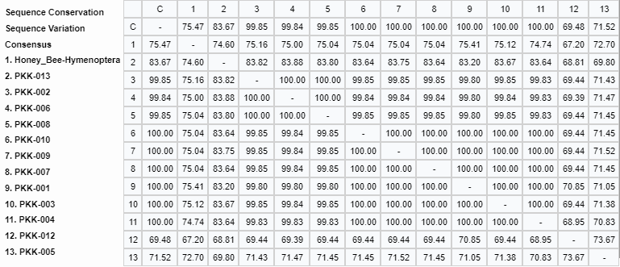
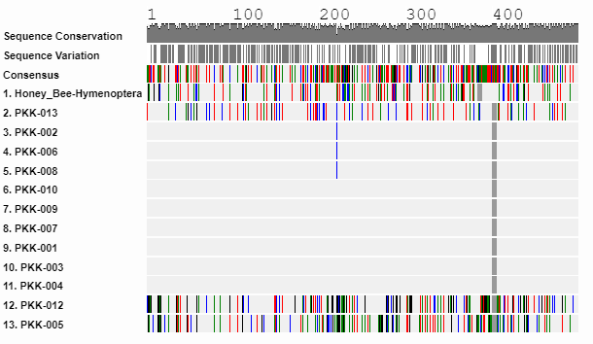
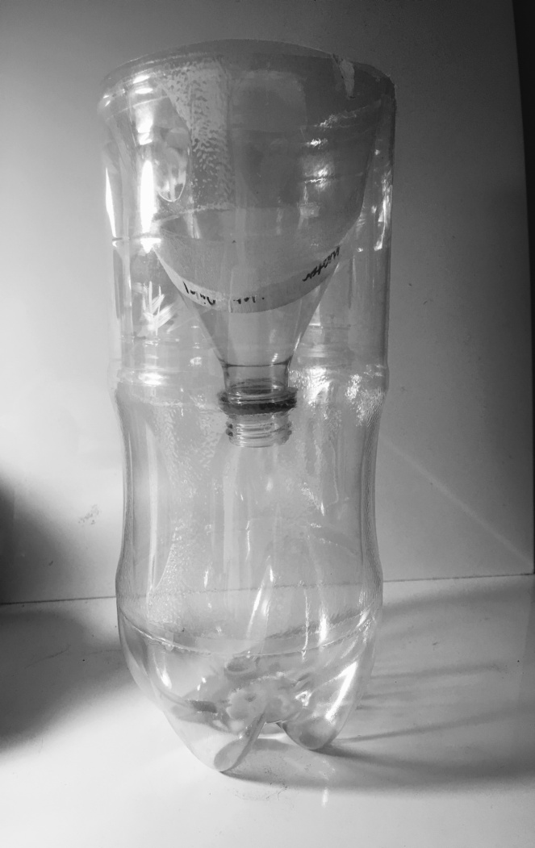
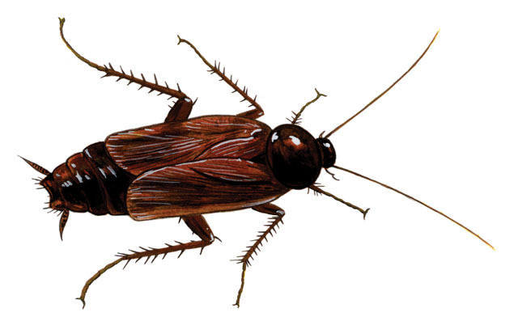
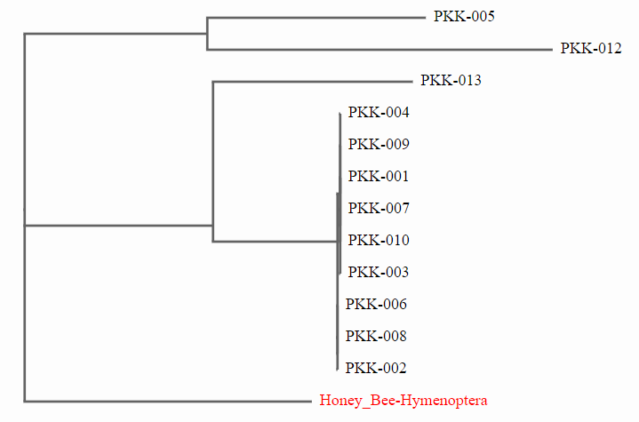
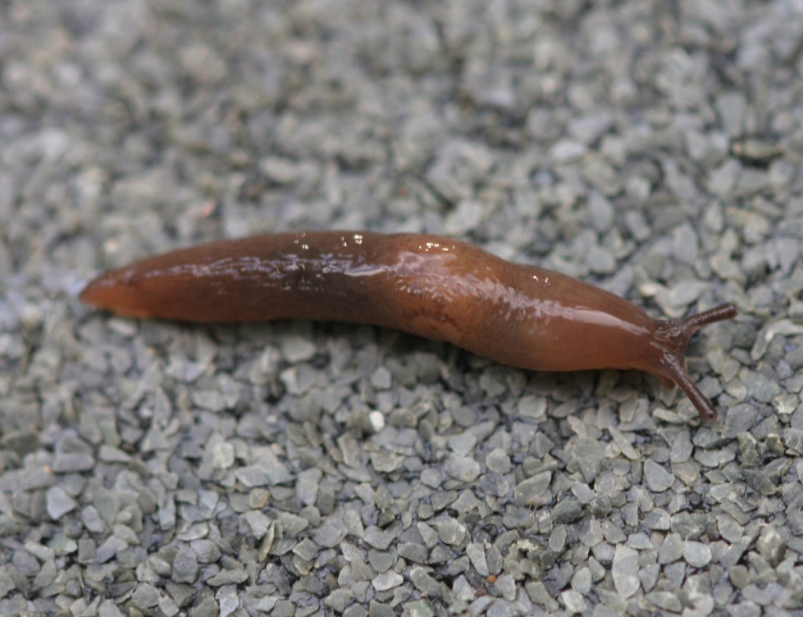
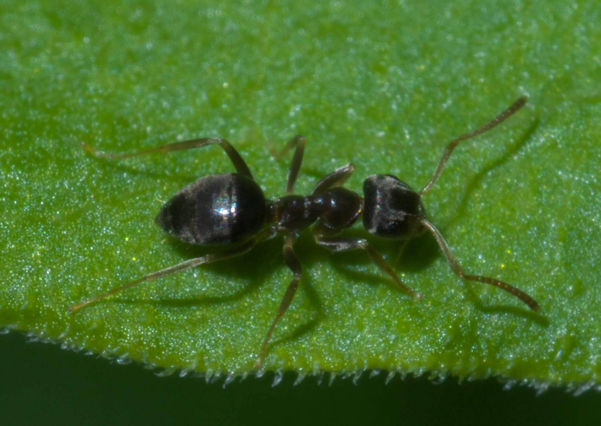
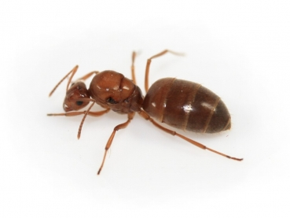
The Mosquito Hunt: Biodiversity and Mosquito Species in Queens
Authors: Amanda Ma¹, Nada Eldeeb¹,
Teacher: Dr. Jessica Cohen¹
¹ Francis Lewis High School: The Marie and Pierre Curie Science Research Institute
Abstract
Discussion
Mosquitoes pose a threat to our society in the context of spreading disease. We used a sugar and yeast solution to collect the samples. In the first trial, the traps were set up in two different locations in Queens. The insects caught were documented and the species were identified by DNA barcoding. Through this study, we analyzed the biodiversity in the area. It was found that the sugar and yeast solution worked better than the different light traps for attracting insects. By understanding the different types of mosquitoes in an area, the types of diseases that are more prone to spread can be determined and prevented. Cheap and effective traps could be used in homes on a daily basis to catch mosquitoes that are potential vectors to deadly diseases. In the second trial, however, the traps were placed in a public park in Queens. Due to proximity of the traps to the ground, the traps attracted ants instead of mosquitoes making it evident that trap placement is just as crucial as the attractants. Small honey ants (Prenolepis imparis), which were primarily collected in trial 2, are native to North America. Although they do not pose threats to humans, colonies could be established mostly outdoors near homes and may be seen as pests. Traps like the ones used in this experiment may be used to remove the ants without harming the humans nearby the way chemical methods might. Although the study was not intended to investigate if the traps can be used for ant colony extermination, it seems to be a plausible theory.
Materials & Methods
Results
We were targeting mosquitoes, but no mosquitoes were caught. From the barcoding analysis, it can be seen that two types of ants, small honey ant (Prenolepis imparis)and cornfield ant (Lasius alienus) were caught. Two other insects were caught, oriental cockroach (Blatta orientalis) and marsh slug (deroceras laeve). The barcoding data showed the two species of ants are closely related while the other insects were more distantly related. It can be seen on the phylogenetic tree that the slug was more closely related to the ants than the cockroach. Last year, in the first trial, more mosquitoes were caught and none of the insects from the second trial were collected as specimens. This could be due to the biodiversity of the locations being different. In the second trial, samples were collected from Kissena park, which has much larger biodiversity than the previous locations which were neighborhood backyards. The difference in insect species caught could also be attributed to the trap design. In the second trial, the traps were not slightly buried into the ground. As a result, most fell over and made it possible to ants to crawl in. This shows that trap placement is just as important as the types of attractants used.
Permission was obtained from NYC Department of Parks. Sample collection locations were selected based on where mosquitoes would most likely be and longitudinal and latitudinal coordinates were recorded. Samples collected were placed in labeled plastic bags and were then placed in a freezer for euthanization. DNA was then extracted from the samples and isolated. PCR was performed for amplification (COI gene). Results were then run through gel electrophoresis with a ladder to check for successful amplification before PCR projects were sent to GENEWIZ for sequencing. Bioinformatics was conducted with the blue line of DNA Subway.
Figure 2. Sequence Similarity Chart. This provided the sequence similarity between the samples.
Acknowledgments
We would like to thank Dr. Jessica Cohen, Dr. L. Wang, Dr. Marmor, Dr. X. Lin, Mr. Z. Liang, Mrs. Jaipershad, and all of the Francis Lewis High School Science Research Program for all of their support. In addition, we would also like to thank Helen Wang. Finally, we wish to thank Barcode Long Island and the Cold Spring Harbor Laboratory for giving us this opportunity.
Introduction
Mosquitoes are vectors of numerous diseases such as, the Zica Virus, Dengue Fever, and Malaria. There are approximately 3,500 different mosquito species in this world and 175 are found in the United States (Gratz, 2004). For this study we created traps (Figure 1) based on different mosquito attractants. We wanted to create an inexpensive trap that can possibly be used in the future to protect people from disease-carrying insects. Furthermore we aimed to identify the species caught by the traps, and study the biodiversity of Queens.
A common misconception is that all mosquitoes feed on blood; however, it is only female mosquitoes that feed on blood. A female can live from 2-4 weeks and begins feeding on blood 2 days after adulthood in order to produce eggs. The female mosquito lays her eggs on stagnant water surfaces during warm seasons and allows her eggs to stay dormant for about 10 to 15 years. In order to feed on blood the female mosquito uses her labrum (the straw like mouthpart) and injects her saliva into the host’s tissue. In Queens a common species of mosquitoes that can be found is Culex, which is what we hypothesized that our traps would catch it (Gratz, 2004).
The attractant that we used to create the traps was CO₂. The reason we chose CO₂ is because many studies suggest that mosquitoes are attracted to CO₂ (Patel, 2014). Some studies show that they are more attracted to CO₂ than heat, being that they were attracted to dry ice.
References
Figure 1: An image of the bottle design used to build the mosquito traps in both trials.
(2014). Using DNA Barcodes to Identify and Classify Living Things. Cold Spring harbor, August, 2017, from http://www.dnabarcoding101.org/files/using-dna-barcodes.pdf.
Life Science Staff (August 17 2012). 5 Things You Need to Know About West Nile Virus. Life Science, Received from https://www.livescience.com/22491-5-things-you-need-to-know-about-west-nile-virus.html.
Montes de oca, (May 19, 2016), Do LED lights Attract bugs.
Mosquito Trap Reviews. (n.d.). Retrieved August 30, 2017, from http://www.mosquitoworld.net/mosquito-control/trap-reviews/.
Patel, H. [Hilten Patel] (2013, April 01). Mosquito Trap. Retrieved August 30, 2017, from https://www.youtube.com/watch?v=pNjyLRQutXs.
Thomas, C. J., & Callaghan, A. (1999). The use of garlic (Alliumsativa) and lemon peel (Citrus limom) extracts as Culex pipiens larvacides: Persistence and interaction with an organophosphate resistance mechanism. Chemosphere, 39(14), 2489-2496.
Figure 3. Alignment of the samples; samples were utilized as well as BLAST results with the least mismatch scores.
Figure 4. Maximum Likelihood Model Phylogenetic Tree of Samples and Related BLAST results. The ants were closely related and cockroach and slug are seen to have evolved later from a different ancestor. The honey bee was used as an outgroup to determine how genetically different the other insects.

