Slide 1
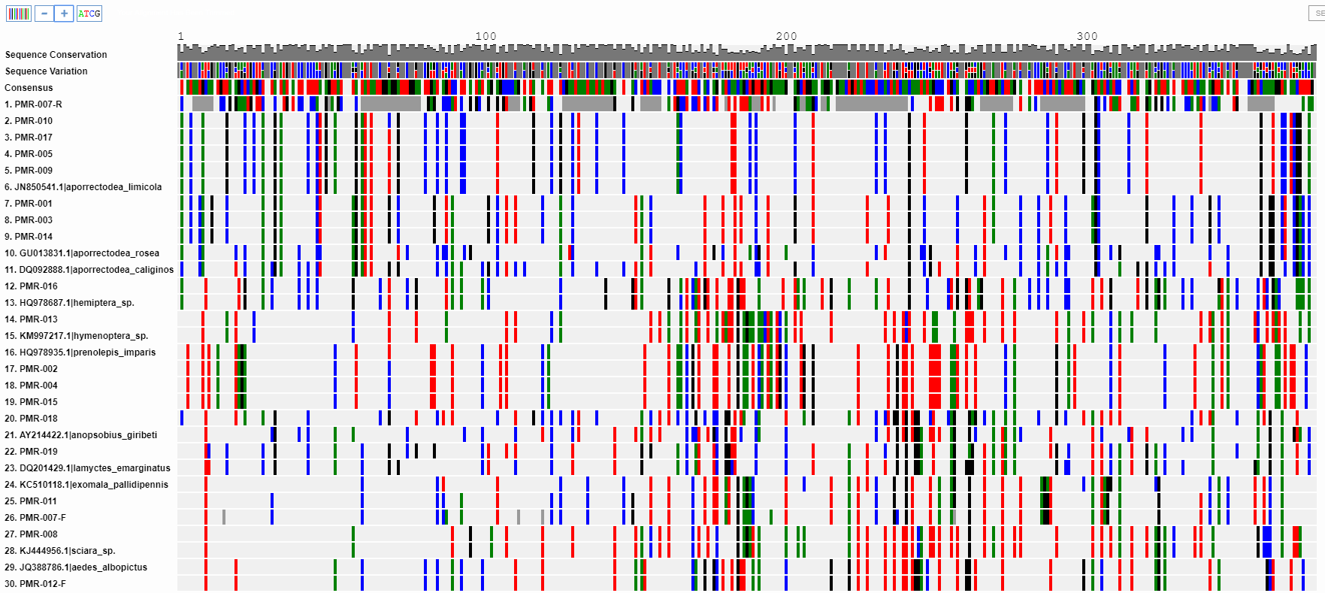
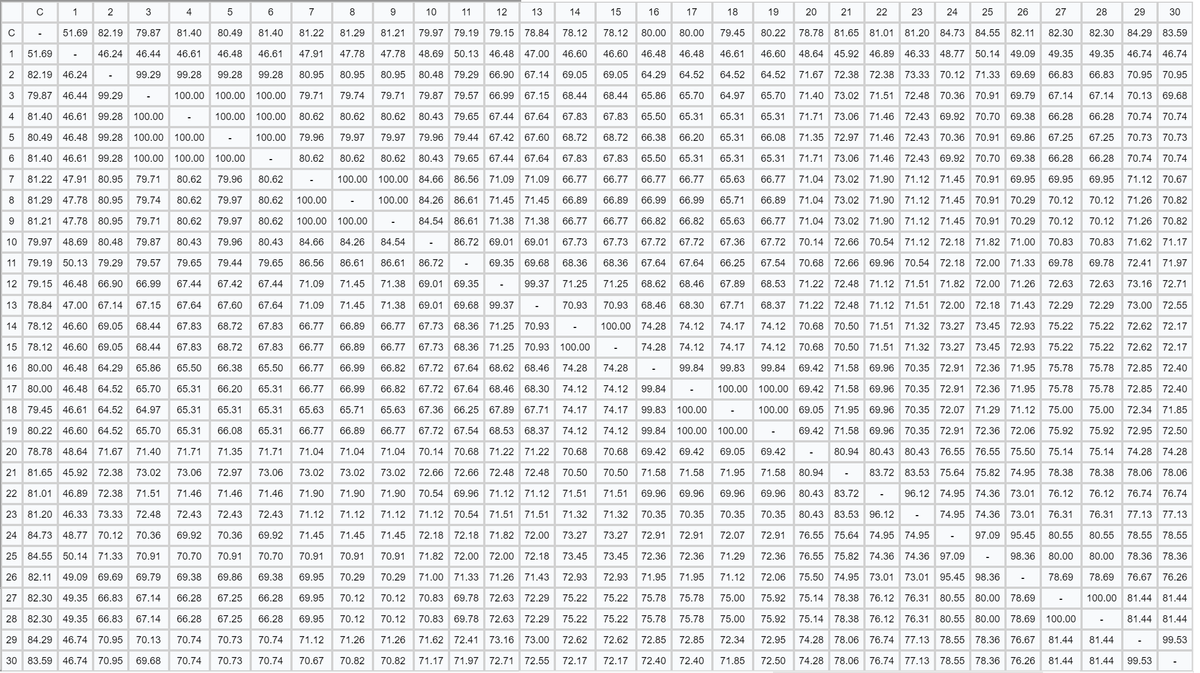
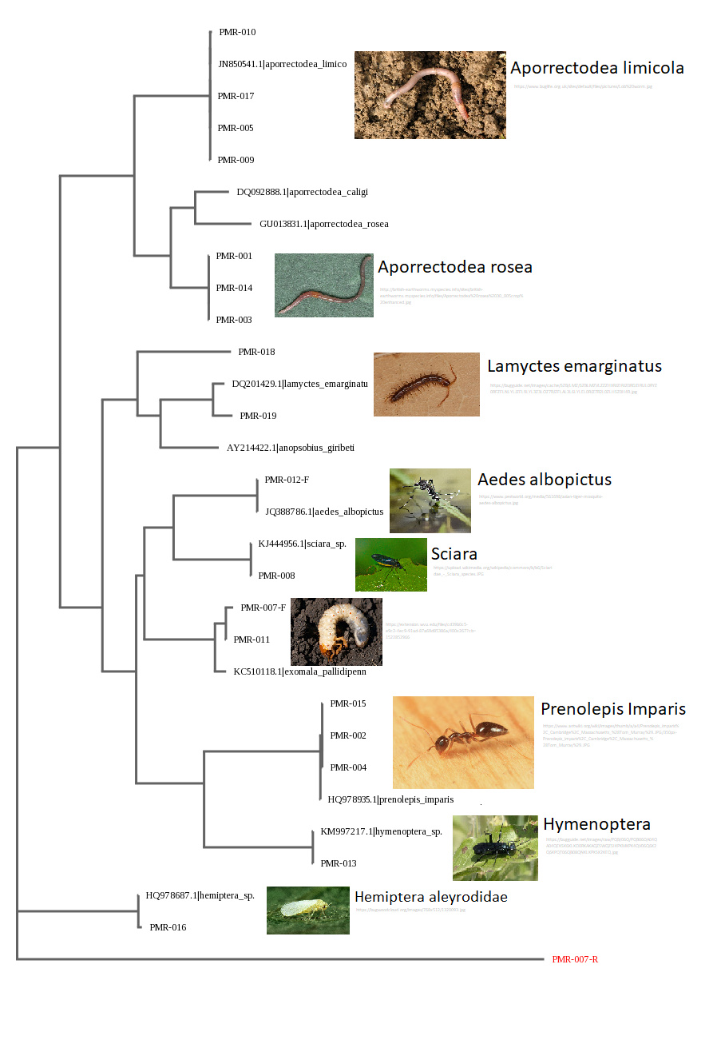
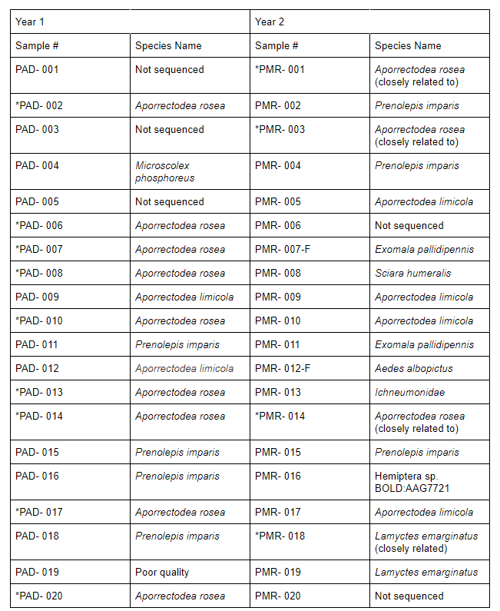
The Effect of Garden Modification on Invertebrate Biodiversity
Abstract
DNA Barcoding is the process of analyzing the DNA sequences of species. In the courtyard of Francis Lewis High School, garden beds are cleared in the fall and new flowers are planted in the spring. Our first sample collection was done during the fall, during cool weather, prior to the blooming of the annual and perennial plants. Our second collection was done in the Spring, when the surrounding plants were present and blooming. It was hypothesized that the introduction of new flora will increase the diversity of species inhabiting the area. Samples were collected before and after the replacement of flora. DNA was isolated, amplified, and PCR products were analyzed using gel electrophoresis. The sequences collected were analyzed using the blue line program on “DNA Subway” to compare relationships between our sequences to ones already established in databases such as GenBank and BOLD. The program was also used to determine if there were any novel sequences in which species’ similarity percentages were less than 95% of all genetically similar organisms. Two novel DNA sequences were discovered in invertebrate samples. One novel sequence was found in several worm samples and the other novel sequence was found in a centipede sample. It was determined that in addition to the species found during previous sample collection, more types species of invertebrates were present due to the increased leaf litter and foliage present in the garden beds.
Gina Nagib, Katrina Too, Allison Wong & Dr. Jessica Cohen
Francis Lewis High School
Discussion
This year, multiple species of invertebrates were found in addition to the ones during a previous collection. Lamyctes emarginatus (Berg & Hemerik, 2004) is a centipede that is native to North America and is closely related to the novel sample PMR-018. Due to it being a hydrophilic species, it is hypothesized that the novel sample may be due to a DNA mutation caused by soil contamination. Exomala pallidipennis was also found. Aedes albopictus, the Asian Tiger Mosquito, is a species native to Southeastern Asia. After being introduced to other countries, it is now common in North America (Scholte & Schaffner, 2007). This invasive species can carry viruses, including the West Nile virus, Encephalitis Fever, Dengue Fever, and the Zika virus (pestworld.org), making them potentially harmful to the students and faculty. A species of gnats, Sciara humeralis was also found. They are commonly found worldwide (brown.edu). Hemiptera sp. was also found.
In the first year, it was determined that a total of four different species were found in the courtyard. Three of these species were variants of earthworms and one was a species of ant. Of the worms, one was novel as there were over 80 mismatches in the DNA of already known sequences determined by BLASTN. This novel species is closely related to Aporrectodea rosea and Aporrectodea caliginosa. Two other species of earthworm were found: Microscolex phosphoreus, with little known information, and Aporrectodea limicola. Prenolepis imparis was the only ant species found. Due to the species having no hibernation period, they were found in both trials (Lőrinczi, 2016). If the species is provoked, a lethal secretion can be created to kill other invertebrates (Sorrells & Kuritzky, 2011). This behavioral trait may also explain why this was the only species of ant that was found. In conjunction, the abundant presence of earthworms indicates that the soil around the courtyard is nutrient filled and healthy for other plants to grow (Stork & Eggleton).
It was determined that a total of 11 different species were found in the courtyard. Of the 11 species found, 2 species possessed novel sequences. Almost all the species identified were native to North America, except for a potentially harmful species, the Asian Tiger Mosquito. To take precautions against this species, it is important for the school to be vaccinated and areas at risk of filling with stagnant water should be removed.
Figure 1. Alignment of sequences. PMR-007-R was set as an outgroup.
Green = Adenine, Red = Thymine, Blue = Cytosine, Black = Guanine
Figure 2. Sequence Similarity Chart. This provided the sequence similarity between samples. Sequence similarities greater than 95% suggest a match.
Introduction
Last year, twenty samples were collected, and 17 were successfully sequenced, from garden beds around Francis Lewis High School to determine invertebrate biodiversity. There was one ant and three worm species identified. Of the three species of worms, one contained a novel DNA sequence. The courtyard in Francis Lewis High School is maintained by its gardening club. In the previous spring, the gardening club placed new flowers in the courtyard and replaced many weeds and grasses. The modification of native flora in the courtyard may have an effect on the organisms in the area.
This year, we continued to sample the garden beds during warm weather and cooler weather, where there were new plants in addition to the ones present during previous collection. The emergence of perennial flowers, lack of pulling weeds, and the addition of new plants are all factors that may cause the appearance of different invertebrates. Daffodils, Hyacinths, Hosta plants emerged from the earth at the time of collection. Instead of bare soil present during last year's collection, the garden beds were covered with grasses and weeds, including yellow wood sorrel, wild violets, and garlic mustard. There was also an area of unusable soil due to accidental chemical contamination. It was hypothesized that there would be more types of invertebrates collected due to the addition of flora. It was also hypothesized that the chemical spill near one of the garden beds would result in the lack of insects collected around that area as it is known that certain invertebrates such as worms are sensitive and known to avoid soil toxins (Hodge et al., 1999).
References
“Asian Tiger Mosquitoes” Pest World: <https://www.pestworld.org/pest-guide/mosquitoes/asian-tiger-mosquitoes>
Berg, M. P. & Hemeric, L., 2004. Secondary succession of terrestrial isopod, centipede, and millipede communities in grasslands under restoration. Biology and Fertility of Soils 40: 163-170.
Herbert, P., Penton, E.H., Burns, J.M., Janzen, D.H., Hallwachs, W., 2004. Ten species in one: DNA barcoding reveals cryptic species in the neotropical skipper butterfly Astraptes fulgerator. Proceedings of the National Academy of Sciences (101): 14812–14817.
Hodge, S., Webster, K. M., Booth, L., Hepplethwaite, K. O., 2000. Non-avoidance of organophosphate insecticides by the earthworm Aporrectodea caliginosa (lumbricaidae). Soil Biology and Biochemistry 32: 425-428.
Lőrinczi, G. 2016. Winter activity of the European false honeypot ant, Prenolepis nitens (Mayr, 1853). Insectes sociaux, 63(1), 193-197.
“Phylogeny of Sciara” Brown University: Sciara Stock Center <https://www.brown.edu/research/facilities/sciara-stock/sciara-genome/phylogeny-sciara>
Scholte, E. J., & Schaffner, F., 2007. Waiting for the tiger: establishment and spread of the Aedes albopictus mosquito in Europe. Emerging pests and vector-borne diseases in Europe, 1.14: 241.
Sorrells, T. R., Kuritzky, L. Y., Kauhanen, P. G., Fitzgerald, K., Sturgis, S. J., Chen, J., Dijamco, C. A., Basurto, K. N., Gordon, D. M., 2011. Chemical defense by the native winter ant (Prenolepis imparis) against the invasive Argentine ant (Linepithema humile). PLoS One 6(4): e18717.
Stork N. E., Eggleton, P. (1992). Invertebrates as determinants and indicators of soil quality. American Journal of Alternative Agriculture 7: 38-47.
Figure 3. PHYLIP ML Phylogenetic Tree was constructed on DNA Subway. Species’ relationships are determined based off genetic similarities.
Table 1. Comparison of species from this year to last year’s collection
* Indicates a novel sequence
Materials and Methods
Sampling
Invertebrates were collected from the courtyard of Francis Lewis High School after the addition and removal of several plant types. Species were collected throughout the garden beds during autumn and spring. Using trowels, samples were taken every 5 feet around the garden. In total, 20 samples of invertebrates were collected and placed in clear plastic bags. For each sample, the longitudinal and latitudinal coordinates, sample number, and date were recorded. The 20 samples were then photographed and euthanized in the freezer.
Sequencing
DNA was extracted from samples and isolated. COI primers were added and DNA was amplified through PCR. Results underwent gel electrophoresis to determine if successfully amplified occured. PCR products were sent to Genewiz for sequencing. Once returned, a blue line DNA Subway on Cyverse was usedto compare the relationships between sequences collected and sequences that are published.
Acknowledgements
We would like to thank Dr. Jessica Cohen, Dr. L. Wang, Dr. Marmor, Dr. X. Lin, Mr. Z. Liang, Mrs. Jaipershad, and the FLHS Research Program for their support. Finally, we wish to thank Barcode Long Island and the Cold Spring Harbor Laboratory for giving this opportunity.

