Slide 1
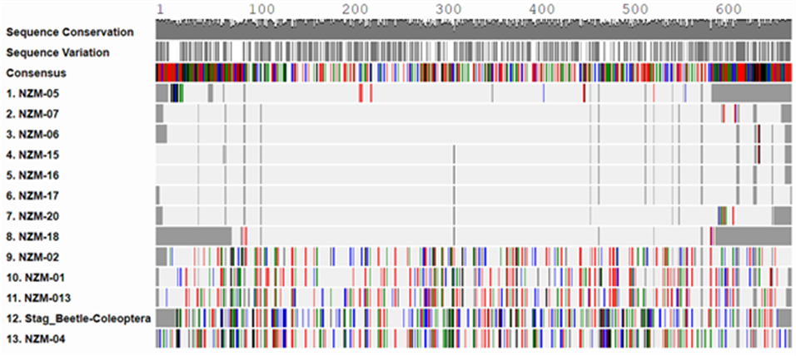
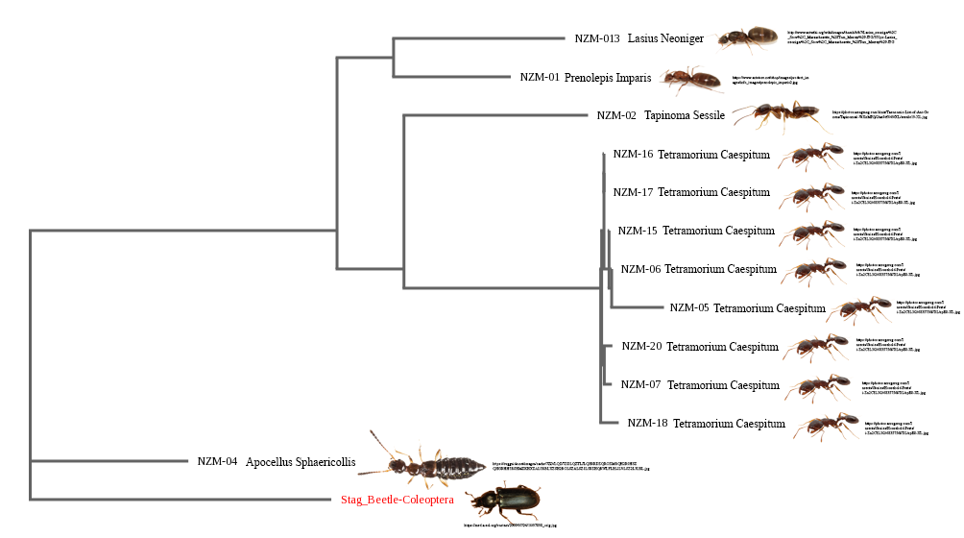
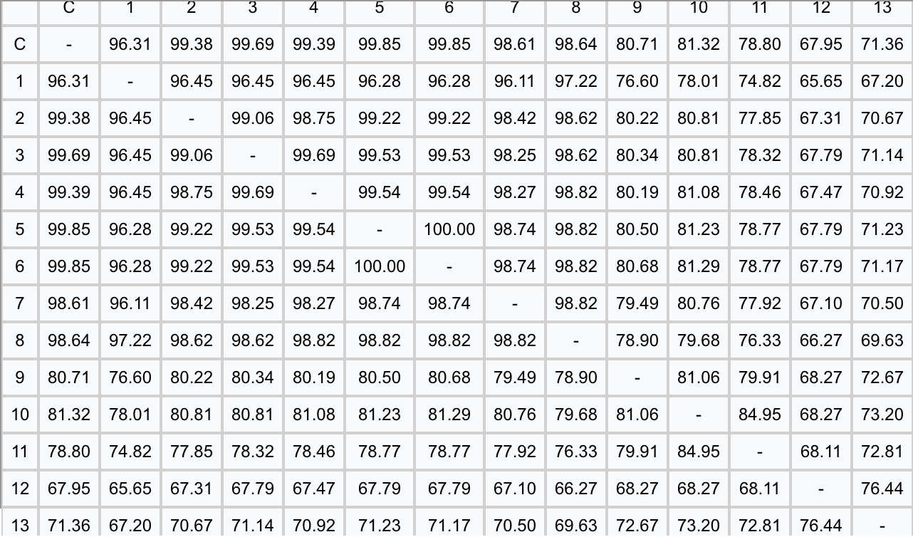
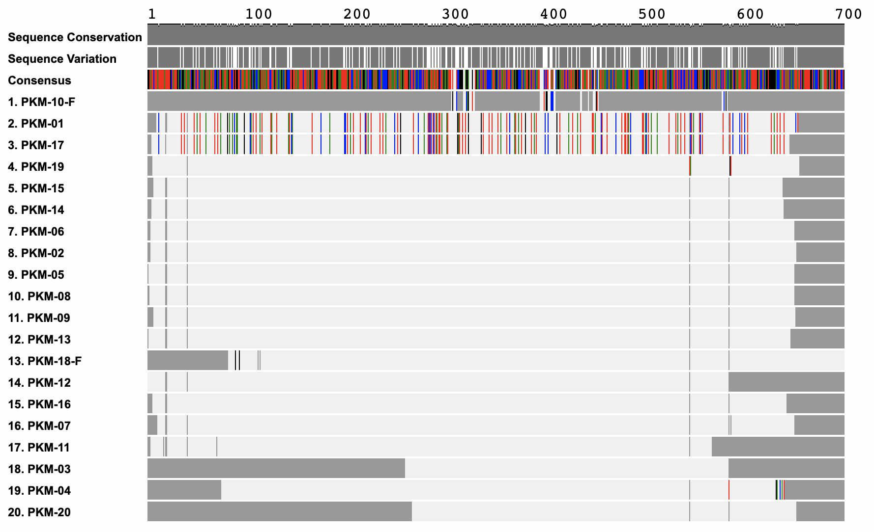
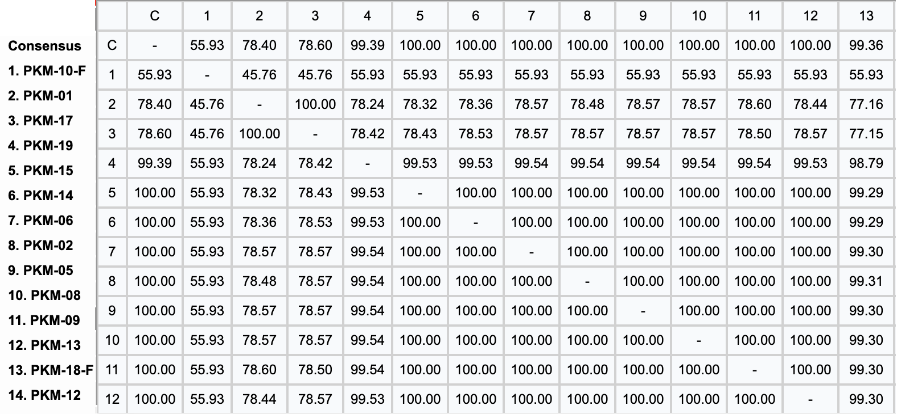
Abstract
Biodiversity is one of the most important indicators of a healthy ecosystem, and DNA Barcoding is a valuable tool, which is to investigate the genetic biodiversity of a particular area across ecological scales. Ants are an intricate part of many ecosystems, including the temperate deciduous biome, which encompasses Long Island. Cunningham Park lacks quantity and scope of published information regarding its biodiversity in the area, especially for its ant population. Through the present study, we hoped to elucidate the biodiversity of the Park’s ant population, and thus assay the ecological health of the local park ecosystem and environment. Ants were first randomly collected, DNA was extracted and the COI gene was amplified using PCR. Two different species of ants were identified, and the majority were Tetramorium caespitum, commonly known as the pavement ant. The average sequence divergences within this nonnative species were very low, averaging at merely 0.234%. This suggests that Cunningham Park has a relatively low level of ant biodiversity. Tetramorium caespitum is particularly adapted to the urbanized, low-vegetation nature of urban green spaces, suggesting it possesses evolutionary advantages that increase its fitness in a human-altered ecosystem. The very low level of intraspecies biodiversity also suggests this ant population may be unicolonial and thus dominate local ant species. Our study has wide-ranging implications for the health and potential invasiveness of the Tetramorium caespitum ant species at Cunningham Park.
Analyzing the diversity of ants at Kissena Park and Cunningham Park
Discussion and Conclusion
While the experiment did reach completion, there were a few variables that limited provided unforeseen challenges. Collecting samples was difficult because of the weather in Queens, New York. Some days it was sunny and cold while other days it was raining and in some instances even snowing. This limited the period of collection of ants. Additionally, other animals (squirrels) were attracted to our bait making it difficult to collect ants.
The experiment was performed in consecutive years. In 2018 the ants were collected from Kissena and in 2019 they were collected from Cunningham Park.
Kissena Park is diverse and contains a variety of native ant species including Prenolepis Imparis, Tapinoma Sessile, and Tetramorium Caespitum. Sample NZM-01 were identified as Prenolepis Imparis, sample NZM-02 were identified as Tapinoma Sessile, samples NZM-05, NZM-06, NZM-07, NZM-15, NZM-16, NZM-17, NZM-18, and NZM-20 were identified as Tetramorium Caespitum. Sample NZM-013 was identified as Lasius Neoniger, a species of beetle that was misidentified as an ant during collection. Out of the 20 ants sequenced in Cunningham Park, 18 of the ants were Tetramorium Caespitum and the rest were Lasius Neoniger. This reinforces the importance of DNA barcoding to properly identify species as the naked eye can misinterpret species for another due to them looking very similar. All identifiable species are found to be native to the area, which suggests that the public does not need to be currently concerned with any population causing a risk to their health or the health of the park they frequent.
Authors: Joseph Pasqualicchio, Michael Dimitrov, Kevin Naska
Teacher: Jessica Cohen, Ph.D.
Francis Lewis High School
Results
Figure 1: Alignment viewer shows where the differences are from the samples collected from Kissena Park. While the samples show some diversity, samples such as 7, 6, 15, 16, 17, and 20 are quite similar even though they do show some variation.
Figure 2: The phylogentic tree is from the samples collected from Kissena Park. It was constructed on DNA subway using PHYLIP ML. The most commonly identified species was Tetramorium Caespitum. The beetle that was collected (NZM-04) was mistakenly identified (visually) as an ant.
Introduction
Kissena Park and Cunningham Park have different ecosystems. Kissena Park includes a lake ecosystem and Cunningham Park includes a dry land ecosystem that is constantly changing due to industrialization. By collecting ants in Kissena Park and Cunningham Park and using DNA Barcoding, native and invasive species can be identified which will have an effect on thousands as to what they eat and what resources are available to them. This can answer the bigger question as to how ants affect the ecosystem around them, and by collecting in two different parks, more sufficient evidence will be provided. This brings reason to investigate the biodiversity of ants at the respective parks that the experiments were performed in (Kissena Park and Cunningham Park) as similar projects have been done around the area of Queens, New York but not the parks used in this experiment (Youngstead et al. 2015).
Acknowledgements
We would like to thank Ms. A. Dimitrova, Mr. R. Dimitrov, Mr. R. Naska, Mrs. L. Naska, Mr. V. Pasqualicchio, Mrs. L. Pasqualicchio, Mr. G.Q. Lin, and Mrs. S. Chen, Dr. J. Cohen, Dr. L. Wang, Ms. N. Jaipershad, The principal of our school, Dr. D. Marmor, and the assistance of Hao Ze Lin, Justin Kleppel, Nena Chen, and Daniel Yusupov. Lastly we want to thank Cold Spring Harbor Laboratory ad the DNA Learning Center for this opportunity.
Figure 3: Kissena Park % Similarity. The most common species of ant identified, Tetramorium Caespitum, had a moderate to low average sequence divergence, approximately 1.6%, which represents a level of intraspecies biodiversity of a relatively healthy ecosystem.
Figure 4: Alignment viewer shows where the differences are from the samples collected in Cunningham Park. All samples are shown to be the predominantly the same ant, with two ants being different.
References
BLAIMER BB, FISHER BL., 2013. How Much Variation Can One Ant Species Hold? Species Delimitation in the Crematogaster kelleri-Group in Madagascar. PLoS ONE 8(7): e68082
CARDINALE, B. J., SRIVASTAVA, D. S., DUFFY, J. E., WRIGHT, J. P., DOWNING, A. L., SANKARAN, M., JOUSEAU, C., 2006. Effects of biodiversity on the functioning of trophic groups and ecosystems. Nature 443(7114): 989.
DESALLE, R., EGAN, M.G., SIDDALL, M., 2005. The unholy trinity: taxonomy, species delimitation and DNA barcoding. Phil. Trans. R. Soc. B. 360: 1905-1916.
HERBERT, P. D. H., PENTON, E. H., BURNS, J. M., JANZEN, D. H., HALLWACHS, W., 2004. Ten species in one: DNA barcoding reveals cryptic species in the neotropical skipper butterfly Astraptes fulgerator. Proceedings of the National Academy of Sciences of the United States of America 101(41): 14812-14817.
TSUTSUI, N.D., SUAREZ, A.V., HOLWAY, D.A., CASE, T.J., 2000. Reduced genetic variation and the success of an invasive species. Proceedings of the National Academy of Sciences 97-11: 5948-5953.
YOUNGSTEAD, E., HENDERSON, R.C., SAVAGE, A.M., ERNST, .A.F, DUNN, R.R, FRANK, S.D., 2015. Habitat and species identity, not diversity, predict the extent of refuse consumption by urban arthropods. Global Change Biology 21(3): 1103- 1115.
Materials & Methods
The collection site at Kissena Park was 40.7458010 latitude and -73.8085081 longitude. The collection site at Cunningham Park was under the benches by the bathrooms next to the tennis courts. Cunningham Park Tennis Center is located at 196-00 Union Turnpike, Fresh Meadows, NY 11365. 20 total ants were collected using honey from each park. The ants were seen near a crack on the curb and the area in which the most ants were observed is where the honey patches were placed. The ants were photographed and then placed in a freezer.
DNA was isolated and the COI gene was amplified using PCR. The PCR products were run on a gel to confirm amplification was successful. The samples that produced visible bands were to Genewiz for sequencing. The sequences were uploaded on DNA Subway and by using bioinformatics, the sequences were analyzed for quality and blasted in GenBank and BOLD. Lastly, a phylogenetic tree was constructed to determine the relationship between the samples.
Figure 5: The phylogentic tree (PHYLIP ML) is from the samples collected from Cunningham Park. The most commonly identified species was Tetramorium Caespitum and the other identified species was Lasius Neoniger.
Figure 6: Cunningham Park %Similarity. The most common species of ant identified, Tetramorium Caespitum, was found in both sampled locations.

