Slide 1
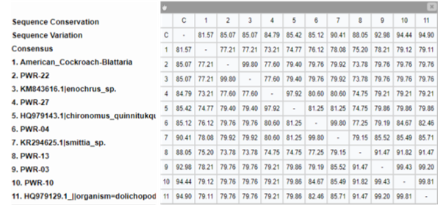
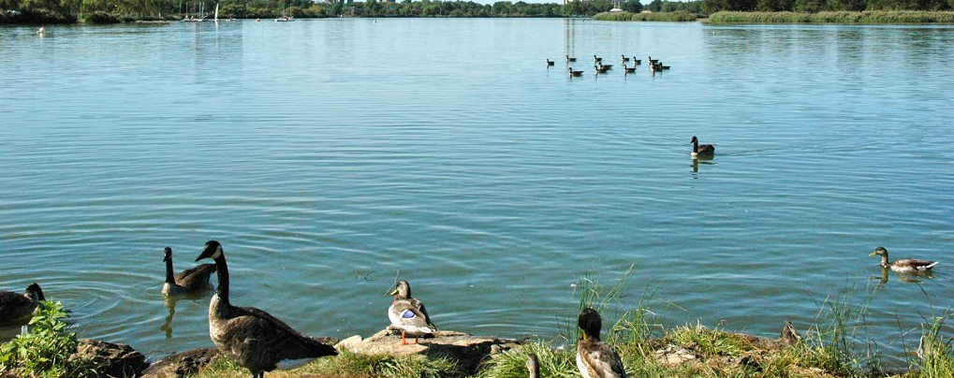
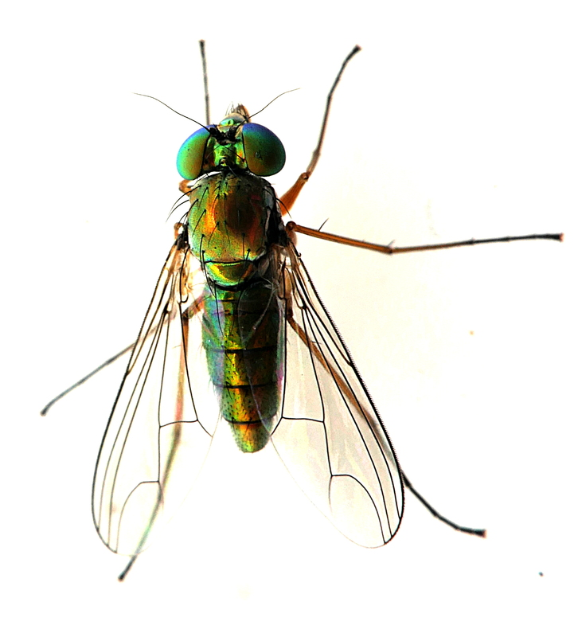
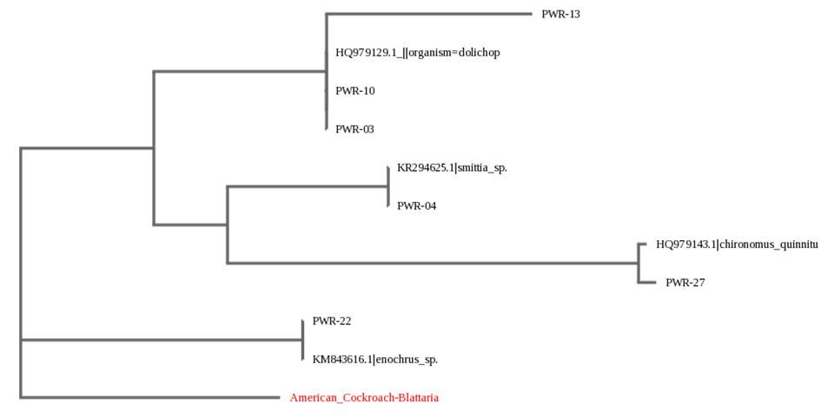
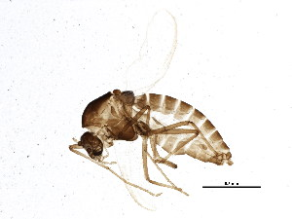
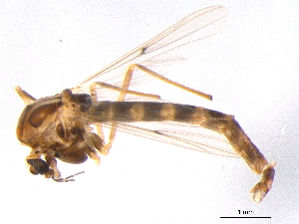
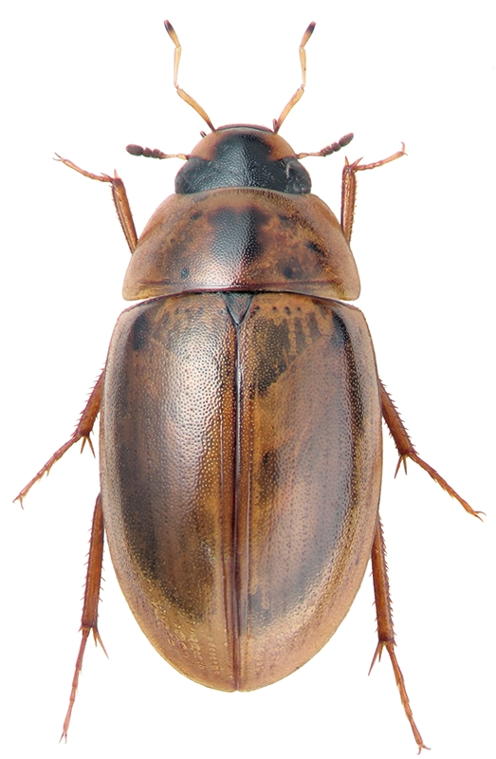
Larva of Insects! Assessing the Biodiversity of Aquatic and Terrestrial Insects near the Meadow-Willow Lake Region of Flushing Meadow Corona Park
Abstract
Authors: Helen Wang¹, Christina Cheng¹, Mei Feng Lin¹
Teacher: Dr. Jessica Cohen¹
¹ Francis Lewis High School: The Marie and Pierre Curie Science Research Institute
Discussion
Insects are difficult in terms of taxonomic identification, factors exacerbated by their divergent caste morphology, sexual dimorphism, and life cycle forms. Flushing Meadow Corona Park has two lakes—Meadow and Willow Lake—that differ in terms of public accessibility, both of which hold a variety of marine insects. The study attempted to assess the difference in biodiversity within the two lakes through DNA barcoding. Using fishing nets, a total of 28 samples were acquired though only 6 were successfully sequenced. PWR-13 was the only novel sequence found though the phred score was low, so novelty is uncertain. The others were identified as species belonging to Dolichopodidae, Enochrus, Smithia, and Chironomus. Insufficient data was collected to allow for assessment of biodiversity, but the insects served as bioindicators for water quality of the lakes. Results suggest that Willow Lake is more polluted than Meadow Lake despite its seclusion from the human population.
Of the 28 samples collected, 7 were collected from Willow Lake and the remaining 21 from Meadow Lake. Only 6 of the 28 were successfully sequenced. Of the sequenced, five were sampled from Meadow Lake and only one was sampled from Willow Lake.
Not enough data was collected to be able to accurately assess biodiversity but some of the specimens found suggested that the basis of the hypothesis was inaccurate. The discovery of Chironomus quinntukqut indicates that Willow Lake is, in actuality, very polluted despite its isolation (Bisthoven et al 2005). Chironomus quinntukqut tend to thrive in areas with low oxygen and abundance of toxic sewer influx (Marques et al 1999). Its presence suggest a need to address a possible leakage of sewage in the area. Some of the factors that may have impacted the results include human error, which could have been a factor that could have affected the phred scores and quality of the samples. There could have been mishandling of substances or samples in the lab during DNA isolation and extraction which may have been a direct cause of low quality.
Materials & Methods
Permission was obtained from the Flushing Corona Meadow Park Department. Random sample collection locations were selected and longitudinal and latitudinal coordinates were recorded. Samples collected were placed in labeled plastic bag where they were then placed in a freezer for euthanization. DNA was then extracted from the samples and isolated. PCR was performed for amplification. Results were then run through gel electrophoresis with a ladder to check for successful amplification before PCR projects were then sent to GENEWIZ for sequencing. Bioinformatics was conducted with the blue line of DNA Subway.
Figure 1. Sequence Similarity Chart. This provided the sequence similarity between the samples. A sequence similarity of less than 95% suggests novelty, as shown with PWR13*. Sequence similarities of greater suggests a match (*low quality sequence therefore findings are not conclusive).
https://static.panoramio.com.storage.googleapis.com/photos/large/41157978.jpg
Results
https://natureshare.org.au/observations?species=Dolichopodidae+spp.
Acknowledgments
We would like to thank Dr. Jessica Cohen, Dr. L. Wang, Dr. Marmor, Dr. X.S. Lin, Mr. Z. Liang, Mrs. Jaipershad, and all of the Francis Lewis High School Science Research Program for all of their support. In addition, we would also like to thank Mehak Kazi and Amanda Ma. Finally, we wish to thank Barcode Long Island and the Cold Spring Harbor Laboratory for giving us this opportunity.
Introduction
http://v3.boldsystems.org/pics/_w300/JSSEP/bioug01623-d05%2B1349355022.jpg
There are currently an estimated 5.6 million insect species currently inhabiting Earth (Herbert et al. 2016). There are roughly over 200,000 different types of aquatic insects (Dijkstra et al. 2014). They are notoriously difficult to identify, partially due to their high divergent caste morphology, sexual dimorphism, and different life cycle forms, problems in which DNA barcoding can solve (Floyd et al. 2009). Insects often play important roles as consumers, detritivores, predators, pollinators, and bioindicators (Dijksra et al. 2014).
The Meadow-Willow Lake System of Flushing Meadow Corona Park consists of Meadow Lake and Willow Lake. Both lakes receive direct runoff from highways and parklands as well as saline water from Flushing Bay (Cohen and MacDonald 2016). The lakes themselves have low diversity, maintaining a species richness of 6-12 organisms (Cohen and MacDonald 2016).
In assessing the biodiversity of the two lakes, it may be possible to analyze the effect of anthropogenic activity on wetland biodiversity through the utilization of DNA Barcoding. Since Willow Lake is primarily isolated from the human population, it was hypothesized that biodiversity would be higher.
References
http://beta.boldsystems.org/pics/_w300/SMTPC/bioug05610-h04%2B1369153034.jpg
Bisthoven, L.J., A. Gerhardt, A.M.V.M. Soares. 2005. Chironomidae larvae as bioindicators of an acid mine drainage in Portugal. Hydrobiologia 532(1-3): 181-191
Cohen. M.K., J.A. MacDonald. 2016. Northern Snakeheads in New York City. Northeastern Naturalist 23(1): 11-24
Dijkstra, K.B., M.T. Monaghan, S.U. Pauls. 2013. Freshwater Biodiversity and Insect Diversification. Annu Rev Entomol 59: 143-163
Herbert, P.D.N., S. Ratnasingham, E.V. Zakharov, A.C. Telfer, V. Levesque-Beaudin, M.A. Milton, S. Pederson, P. Jannetta, J.R. deWaard. 2016. Counting animal species with DNA barcodes: Canadian insects. Philosophical Transactions of the Royal Society B 371(1702): 1-10
Marques, M.M.G.S.M., F.A.R. Barbosa, M. Callisto. 1999. Distribution and abundance of Chironomidae (Diptera, Insecta) in an impacted watershed in South East Brazil. Revista Brasileira de Biologia 59(4): 553-561
https://www.zin.ru/Animalia/Coleoptera/images/kv_mak/enochrus_quadripunctatus.jpg
Figure 2. Maximum Likelihood Model Phylogenetic Tree of Samples and Related BLAST results. The American Cockroach was used as an outlier for this tree. Analysis revealed that PWR13 and PWR10 are likely of the genus Dolichopodidae, PWR04 of genus Smittia, PWR22 of genus Enochrus, and PWR27 of Chironomus quinnitukqut. PWR13 is related to the genus Dolichopodidae but there is a greater evolutionary distance between the sequence and the rest of the sequences. Of all the samples, PWR22 is the most distantly related from the rest, with PWR13, PWR10, PWR03, PWR04, and PWR27 sharing a common ancestor.

