Slide 1
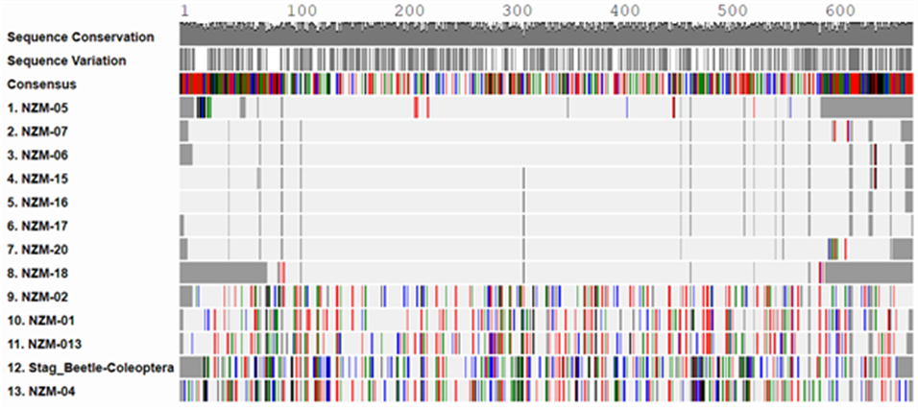
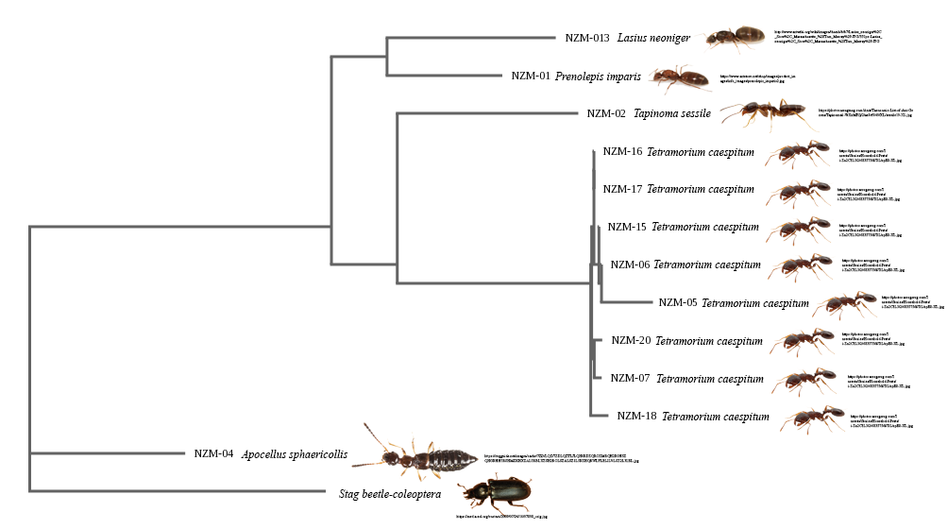
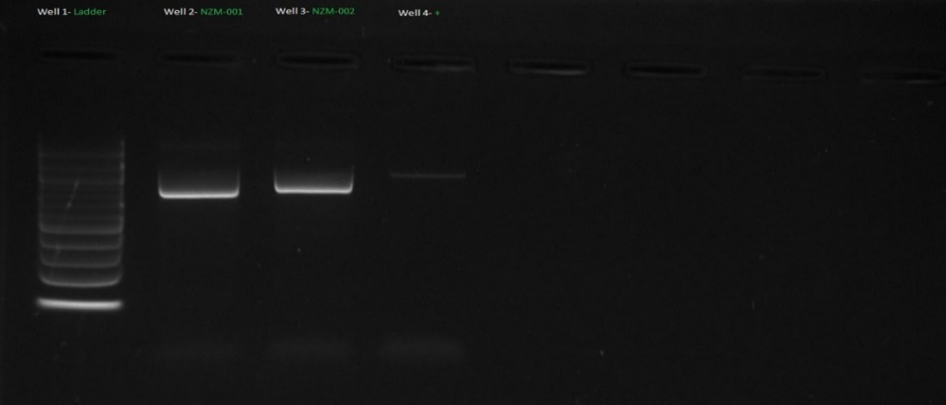
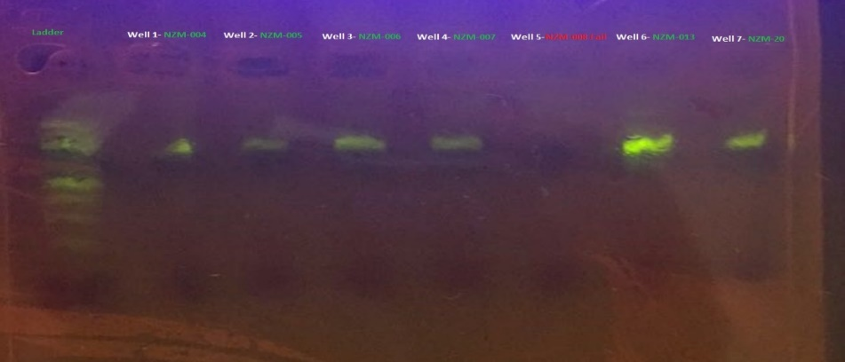
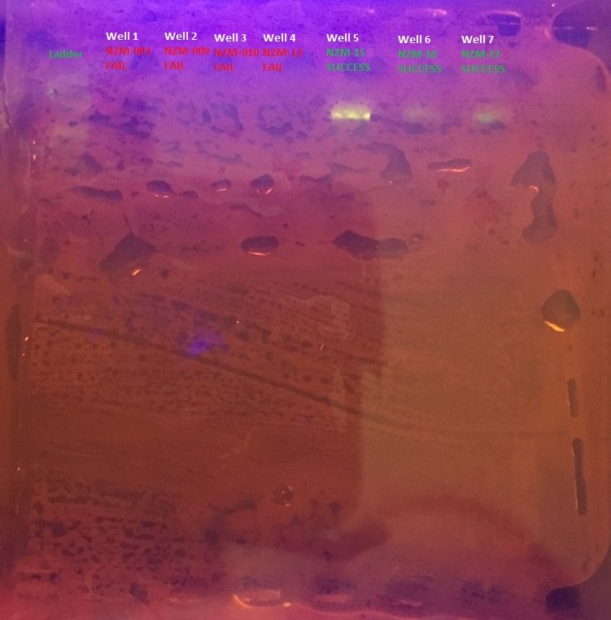
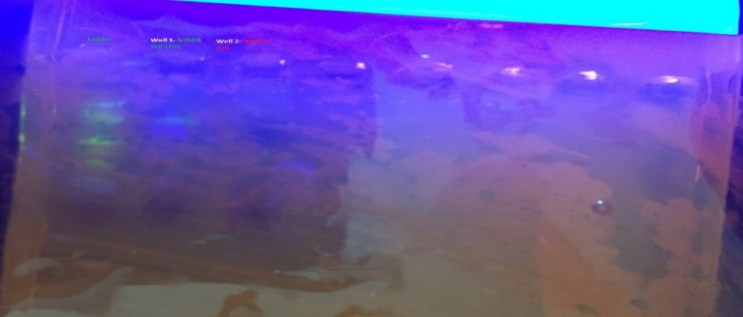
Analyzing the Diversity of Ants at Kissena Park
Abstract
Biodiversity is one of the most important foundations of a healthy ecosystem. The discovery of DNA Barcoding is a valuable tool used to investigate the biodiversity of a particular area. Ants are an intricate part of an ecosystem. They exist by the thousands in communities, and have direct impacts on soil, plants, and other organisms. Kissena Park is a diverse park located in Queens, New York including a large lake ecosystem including snapping turtles, ducks, herons, egrets, and gallinules. Kissena Park does not have much published information on the biodiversity in the area, especially with regard to the ant population. By seeing how many ant species have developed or made their way into Queens as an invasive species, it will further elucidate the question as to the effect invasive species have on native species, plant species, and the ecosystem.
Materials & Methods
The collection site at Kissena Park was 40.7458010 latitude and -73.8085081 longitude. The exact longitude and latitude was determined by an iPhone compass. 20 total ants were collected using honey. The honey was either put on bottle caps to attract the ant or put on a big paper bag. Once the ant was attracted to the honey, it was collected, photographed and placed in a bag.
DNA was isolated from either the full ant, or if the ant was too big, by using a razor, the head or leg areas. COI gene was amplified using PCR and the PCR products run using gel electrophoresis. The samples that produced visible bands were then sent to GENEWIZ for sequencing. The sequences were uploaded on DNA Subway and by using bioinformatics, the sequences were analyzed for quality and blasted in GenBank and BOLD. Once the sequences name was found, Google was used as a basis to see if the species were native to the area. Lastly, a phylogenetic tree was constructed to determine the relationship between the samples.
Authors: Joseph Pasqualicchio, Hao Ze Lin, Kevin Naska, Michael Dimitrov
Teacher: Jessica Cohen, Ph.D.
Francis Lewis High School
Introduction
Deoxyribonucleic acid (DNA) is a biomolecule which carries hereditary information. T DNA barcoding is a taxonomic method that uses a short genetic marker in an organism’s DNA. The DNA barcode pattern obtained after sequencing, is studied thoroughly and published in a publically available database to compare the genetic code of organisms of interest. Based on the results, scientists can determine the biodiversity in a given areas, as well as species interaction.
Kissena Park is a well-known attraction in New York and seeing how ants affect the ecosystem around the area, whether negatively or positively, can predict changes to ecosystem of that area in the near future. By seeing how the native and potentially invasive ant species affect other animals, it can determine which animals survive and die off. Through this analysis, it can determine human resource use in the area of Kissena Park, and since it is a large area it will have an effect on thousands as to what they eat and what resources are available to them.
Understanding the biodiversity of an area is important to human health, as there is a direct correlation between humans and the natural world around them. This brings reason to investigate the biodiversity of ants at the park that this experiment was performed in (Kissena Park) as similar projects have been done around the area of Queens, New York but not the park used in this experiment (Youngstead et al. 2015).
Discussion and Conclusion
While the experiment did reach completion, there were a few variables that provided unforeseen challenges. Collecting samples was difficult because of the weather in Queens, New York. Some days it was sunny and cold while other days it was raining and in some instances even snowing. This limited the period of collection of ants. The ants were all collected within a week in which the weather was suitable. Additionally, other animals (squirrels) were attracted to our bait making it difficult to collect ants.
Another problem that occurred was the mixing up of samples in tubes. The samples were not mixed, and since no novel sequences or invasive species were found, this did not pose a major issue. Moreover, sample 11 was lost; therefore there were only 19 samples in total to account for.
Kissena Park is diverse and contains a variety of native ant species including Prenolepis imparis, Tapinoma sessile, and Tetramorium caespitum. Sample NZM-01 were identified as Prenolepis imparis, sample NZM-02 were identified as Tapinoma sessile, samples NZM-05, NZM-06, NZM-07, NZM-15, NZM-16, NZM-17, NZM-18, and NZM-20 were identified as Tetramorium caespitum. Sample NZM-013 was identified as Lasius neoniger, a species of beetle that was misidentified as an ant during collection. This reinforces the importance of DNA barcoding to properly identify species as the naked eye can misinterpret species for another due to them looking very similar. All identifiable species are found to be native to the area, which suggests that the public does not need to be currently concerned with any population causing a risk to their health or the health of the park they frequent.
Figure 5: Alignment viewer shows where the differences are. While the samples show some diversity, samples such as 7, 6, 15, 16, 17, and 20 are quite similar even though they do show some variation.
Figure 6: The phylogentic tree that was constructed on DNA subway using PHYLIP ML. The beetle that was collected (NZM-04) was mistakenly identified (visually) as an ant.
Results
Resources
Desalle R, Egan MG, Siddall M. 2005. The unholy trinity: taxonomy, species delimitation and DNA barcoding. Philosophical Transactions of the Royal Society B: Biological Sciences 360(1462):1905–1916.
Ditomaso JM, Steenwyk RAV, Nowierski RM, Vollmer JL, Lane E, Chilton E, Burch PL, Cowan PE, Zimmerman K, Dionigi CP. 2016. Enhancing the effectiveness of biological control programs of invasive species through a more comprehensive pest management approach. Pest Management Science 73(1):9–13.
Tsutsui ND, Suarez AV, Holway DA, Case TJ. 2000. Reduced genetic variation and the success of an invasive species. Proceedings of the National Academy of Sciences 97(11):5948–5953.
Youngsteadt E, Henderson RC, Savage AM, Ernst AF, Dunn RR, Frank SD. 2015. Habitat and species identity, not diversity, predict the extent of refuse consumption by urban arthropods. Global Change Biology 21(3):1103–1115.
Figure 1: As seen in the photo, ants 1 and 2 ended up with useable PCR products that were sent out for sequencing
Figure 2: Ant samples 4, 5, 6, 7, 8, 13, and 20 ended up with useable PCR products that were sent out for sequencing
Acknowledgements
We would like to thank the Francis Lewis High School Science Department, Mr. R. Naska, Mrs. L. Naska, Mr. V. Pasqualicchio, Mrs. L. Pasqualicchio, Mr. G.Q. Lin, and Mrs. S. Chen. We would also like to thank Dr. J. Cohen, Dr. L. Wang, Ms. N. Jaipershad. and Dr. D. Marmor, Justin Kleppel, Nina Chen, Daniel Yusupov and the DNA Learning Center.
Figure 3: Ant samples 15, 16, and 17 ended up with useable PCR products that were sent out for sequencing
Figure 4: Ant sample 18 and 19 ended up with useable PCR products that were sent out for sequencing

