Slide 1
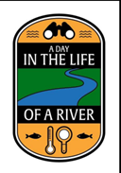
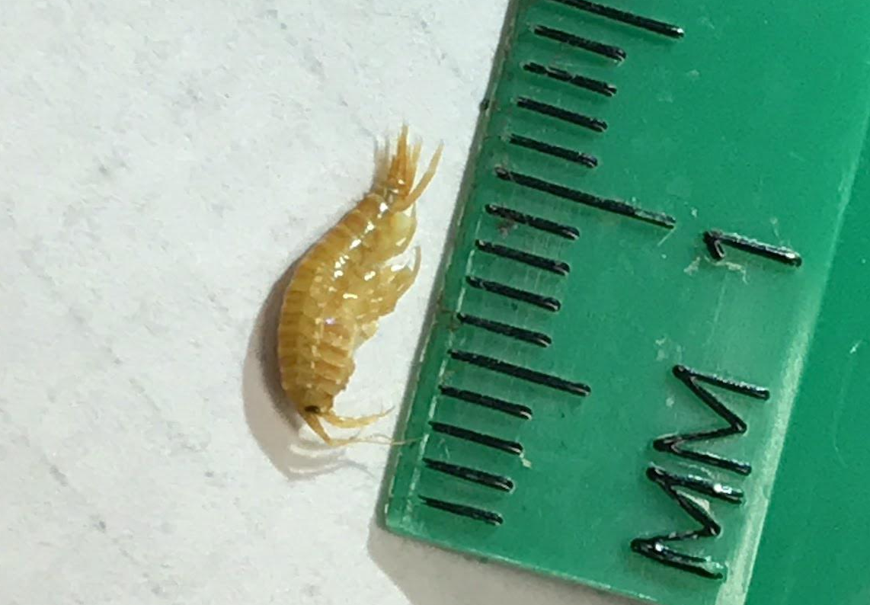
Identifying a Novel Species Through DNA Barcoding
Gavin Fontanez, Marcie Hogan, Ava Saffren, Brendan Virgil
Mentor: Mr. Robert Bolen
Eastport South Manor Junior-Senior High School – Manorville, NY
Abstract
Biodiversity is crucial to the sustainability of an ecosystems resilience. To assess the given biodiversity of an area, we can track the prevalence (or lack thereof) of different aquatic and terrestrial organisms in an ecosystem. We collected 19 specimens from the Peconic River that would later be barcoded. Out of these 19, 11 of the DNA barcodes worked, one of which having the possibility of being a novel species and another one showing absurd results. With our collected species, we can see the biodiversity of the ecosystem and identify any invasive or novel species.
Introduction
With the DNA we collected from the Peconic Estuary, we aimed to answer two main questions: What does a given species’ prevalence mean for the health and biodiversity of the ecosystem? Are any of our DNA sequences novel?
This experiment was conducted with the intent to check on biodiversity in the Peconic River and to find species that could potentially be harmful to humans or to other life in the area. Through the experiment, we collected many samples that proved the continued occupation of normal species, as well as one potentially novel species and one species which we believe was incorrectly sequenced.
Materials & Methods
Samples of invertebrates were collected by 40cm wide dip nets and sorted for specimens. Additional specimens were collected with a 3.5 meter seine net. Post collection from the site, specimens were sorted, photographed, and placed in bags containing 99% ethanol and stored in a non-defrosting freezer. The DNA of each sample will be extracted and examined to produce barcodes in a database following the steps and using equipment and reagents provided by the Cold Spring Harbor Laboratory Barcode Long Island program(7).
We use the process of gel electrophoresis in this lab to separate DNA based on their size and to observe the sequencing of the sample. By doing this, we hope to see bands in the sample. These bands indicate the quality of our DNA amplification.
Results
As presented in our chart of NTJ-008, our possible novel species, and the many different varieties of specimen collected, it is shown that biodiversity and the monitoring of invasive species in and ecosystem is an important part of how they sustain themselves. Considering the condition of the location we collected the specimen, the Peconic River, it is evident that the monitoring biodiversity and invasive species needs to continue to preserve the rivers ecosystem.
Discussion
With the conclusion of the long and strenuous DNA prepping process came the analysis and interpretation of our DNA sequences. Upon entering in our findings into DNA Subway, we met (mostly) anticipated results. We had a diverse population of damselflies and dragonflies which indicates that the Peconic River is relatively healthy since these insects are particularily sensitive to poor environmental conditions. Dragonflies prey on nuisances like mosquitos, which proves to be benefitical for the ecosystem.
Regarding our potentially novel species, NTJ-008, it became very evident in the DNA sequence analysis process that we might have had something novel. When completeling it’s BLAST hit, the best match had 72 mismatches which is abnormally high to have if the species were to have actually been a match. When further analyzing the BLAST hit, the closest match, Amphithoe had only 89% of DNA in common with NTJ-008.
References
Government, S. C. (n.d.). Retrieved October 22, 2017, from http://www.suffolkcountyny.gov/Departments/HealthServices/EnvironmentalQuality/Ecology/MarineWaterQualityMonitoring/PeconicEstuaryProgram.aspx
Priority Issues in the Peconic Estuary. (n.d.). Retrieved October 22, 2017, from https://www.peconicestuary.org/protect-the-peconic/priority-issues-in-the-peconic-estuary/#climate
Huberty, E. (Ed.). (2017, June 3). What Do Millions of Dead Fish Mean For Our Planet? Retrieved October 22, 2017, from https://www.huffingtonpost.com/entry/what-do-millions-of-dead-fish-mean-for-our-planet_us_58bd5ff8e4b02eac8876d0f6
Department Of Environmental Conservation Peconic Estuary Program. (n.d.). Retrieved October 22, 2017, from http://www.dec.ny.gov/lands/31842.html
Dragonfly FAQ. (n.d.). Retrieved November 14, 2017, from http://dragonflywebsite.com/dragonfly-facts.cfm
DNA Barcoding Protocol . (n.d.). Retrieved from www.dnabarcoding101.org/files/using-dna-barcodes.pdf
Barcode of Life. (n.d.). What is DNA Barcoding? How DNA Barcoding Works and What it Will Do. Retrieved September 12, 2017, from http://www.ibol.org/phase1/about-us/what-is-dna-barcoding/
Glacial History of Long Island. (n.d.). Retrieved November 27, 2017, from http://www.garviespointmuseum.com/glacial-history-long-island.php
Acknowledgements
We would like to thank our mentors, Mr. Robert Bolen, Dr. Aleida Perez, Mr. Dan Williams as well as everyone at Brookhaven National Lab. Special thank to our field expert Mr. Scott Bronson.
Figure 1: NCBI BLAST hits for the sample NTJ-008 showing significant mismatches.
Figure 2: DNA Subway BLAST hits for the sample NTJ-008 showing significant mismatches.
Figure 3: DNA Subway BLAST hits for the sample NTJ-008 showing significant mismatches.
Figure 4: Images of potentially novel Amphipod species.

