Slide 1
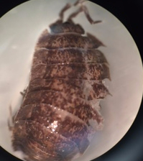
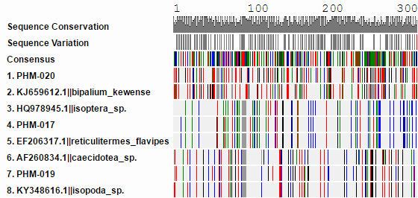
Human Impact on Peconic River Biodiversity
Jason Caesar¹, Veronica Cardeno¹, Molly Heneghan¹, Lia Mangano¹
Mentors: Mr. Robert Bolen¹ and Dr. Natale Spata¹
Eastport South Manor Jr-Sr High School¹
Abstract
Five years ago, a kayak ramp was added to the Peconic River Estuary area in a very diverse, fairly untouched part of the Peconic bay estuary. The increased anthropogenic activity in the area is a major cause of a decrease in biodiversity in the Peconic bay area because of the introduction of invasive invertebrate species. We used methods of DNA barcoding and BLAST programs to identify species in order to achieve the main goals of our research. We identified the species collected, found variation among the species, determined whether the species was invasive or native and assessed its role in the ecosystem. After determining the collected species, we did find that a majority of the species collected were invasive (such as the Deroceras panormitanum or the Exomala orientalis) and were likely transported by human. This shows that the human involvement in the area has increased numbers of invasive species, thus strangling out native species, effectively hurting the delicate stability of the biodiversity of the area.
Methods
25 terrestrial invertebrates were collected from the Peconic River NYS DEC boat ramp in Riverhead, as a part of the “Day in the Life of Peconic River”.
Larger organisms were directly removed from the soil, and placed in a container.
Smaller organisms living in the soil were colected using a Berlese funnel system to extract some of the invertebrates..
Samples were stored in 99% ethanol and frozen in glass
DNA was extracted through a process of DNA barcoding.
The program BLAST was used to identify the DNA sequence, and with this we were able to idnetify the samples.
DNA subway was used to construct a barcode and phylogenetic tree.
Image of sample PHM-002
Image of sample PHM-001
Discussion
Introduction
The Peconic Estuary is considered to be one of the “Last Great Places in the Western Hemisphere” according to The Nature Conservancy(2). Although the Peconic Estuary is relatively pure, the pressure being placed from humans on this pristine estuary continues to increase. This pressure is taking a toll on the biodiversity of the ecosystem. For example, in 1985, humans use of fertilizers, detergents and septic tanks led to eutrophication, or excess of nutrients, in the bay that led to algal blooming which lowered oxygen levels. The excess nutrients created toxic rust tides that have killed many organisms and created anoxic waters(9). These pesticides and other toxins that made their way into the Peconic Bay devastated the environment that many fish species and invertebrates inhabit(2).
The area we took samples from had recently just added a parking area, a kayak ramp and a dock on the water. The anthropogenic activity in the area puts the ecosystem at a higher risk of the introduction of invasive species whether it be from fishermen, hunters or simply people disposing of plants or animals in the river. These invasive species can harm the environment by outcompeting native species and introducing new diseases, effectively killing off species of invertebrates in the area such as earthworms, beetles and pill bugs(7). If these invertebrates are hunted by a predator to a low population, the organisms could experience a population bottleneck, also known as the bottleneck effect. This represents a sharp decline in the size of a population when a disaster occurs(1). The human impact of destroying habitats could, and often does result in a decrease of a population of a species, which decreases the genetic diversity within the population(12). When this population recovers from the damage and replenishes the population, the species as a whole could be less genetically diverse. This is a phenomenon know as the bottleneck effect, which can also be an effect of an invasive species. The lack of genetic diversity caused by the bottleneck effect (8). These invasive species could also directly threaten the humans in the surrounding areas(7).
In the process of barcoding the DNA collected we have identified and categorized the specimen. The species we identified were predominantly terrestrial, invertebrates native to pine barren regions. However, many of the species identified were not originally native to North America, such as Deroceras Panormitanum (native to southwest Europe), Exomala orientalis (highly invasive, native to Asia), and the Deroceras (native to Italy). This provides sufficient evidence to show the effects of globalization on our species biodiversity, as new species are introduced and may grow rapidly without any natural predators, as these organisms were originally found in one region of the world, but were transported to other areas most likely from anthropogenic sources, such as planes, boats and even cars that transport and spread seeds and animals. This is a modern exhibit of the founders effect that can result in speciation, due to the adaption to new environments.
DNA Subway MUSCLE results for PHM-017, 019, 020
References
1)Bottlenecks and Founder Effects. (2013, November 24). Retrieved December 08, 2016, from http://wallace.genetics.uga.edu/groups/evol3000/wiki/fb221/Bottlenecks_and_Founder_Effects.html
2)Peconic Estuary Program - About. (n.d.). Retrieved December 08, 2016, from http://www.peconicestuary.org/about.php
7) Invasive Species: How They Affect the Environment. (n.d.). Retrieved December 08, 2016, from http://www.environmentalscience.org/invasive-species
8) (n.d.). Retrieved December 08, 2016, from http://www.nature.com/scitable/definition/population-bottleneck-300
9) Muir, P. (2012, October/November). Eutrophication. Retrieved December 12, 2016, from http://people.oregonstate.edu/~muirp/eutrophi.htm
12) Evans, Michael. "Habitat Loss and Degradation." Habitat Loss and Degradation | The Earth Times | Encyclopaedia. N.p., n.d. Web. 09 Jan. 2017.
Sequence similarity % of samples PHM-017, 019, 020
Sample Identifications
PHM-017: Reticulitermes flavipes (eastern subterranean termite)
PHM-019: A species of isopod – limited by resolving capacity of CO1 barcoding
PHM-020: Bipalium kewense (Land Planarian) terrestrial flatworm
Acknowledgements
We would like to thank our teachers: Dr. Spata and Mr. Bolen. Dr. Aleida Perez from Brookhaven National Lab, Kathleen McAuley from Barcode Long Island, and Dr. Sharon Pepenella from he DNA Learning Center at Cold Spring Harbor Laboratory.

