Slide 1
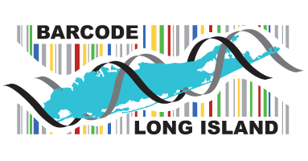
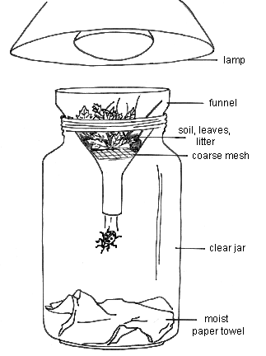
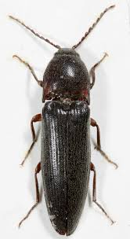
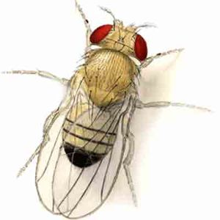
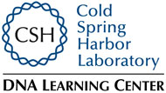
Humanity’s Effects on the Biodiversity of the Peconic River
Grace Kelly¹ , Emily Schwantner¹, Angel Theodore¹
Mentors: Mr. Robert Bolen¹ and Natale Spata, D.C.¹
Eastport South Manor Jr. Sr. High School¹
Abstract
Our goal for this project was to discover how human interference impacts biodiversity in the Peconic River Estuary. We collected and identified specimens as a baseline for the organisms after a kayak ramp is built. We collected 20 different invertebrates from our area 6 of which we were successful in barcoding. Results indicated that our specimens were native to the area and no novel species were found. Our results showed that there was not much biodiversity within this area since most of our specimens came back as click beetles in the genus Melanotus and the fruit fly Drosophila melanogaster. This will help identify changes that occur over time within the environment. These insects also are found in areas with high rates of decay and decomposition. Click beetles larvae may be agricultural pests and will feed on other potentially beneficial insect larvae, therefore their presence may pose a threat to beneficial insect larvae.
Discussion
Our findings of human interference and how it impacts the biodiversity in the Peconic River Estuary are inconclusive. After barcoding and doing several tests like gel electrophoresis, our DNA sequence data indicates that there were no novel species. Most of our recorded specimens appear to be similar. To build on our findings, we would need to do further research. More specimens would need to be collected, and more testing on them using other genes. This is imperative to prove that altering the environment by building a kayak ramp affects biodiversity. Our results showed that there is not much biodiversity within this area since most of our specimens came back as click beetles in the genus Melanotus and the fruit fly Drosophila melanogaster. This will help identify changes that occur over time within the environment. These insects also are found in areas with high rates of decay and decomposition. Click beetles larvae may be agricultural pests and will feed on other potentially beneficial insect larvae, therefore their presence may pose a threat to beneficial insect larvae..
Results
Introduction
Specimen 004 - Drosophila melanogaster (Fruit Fly) – no mismatches
Specimen 001 - Drosophila melanogaster (Fruit Fly) – no mismatches
Specimen 006 - Drosophila melanogaster (Fruit Fly) – no mismatches
Specimen 017 - Exomala pallipennis (Click Beetle)
Specimen 007 - Melanotus hyslopi (Click Beetle)
References
Berlese Funnels - Collecting Methods - Mississippi Entomological Museum Home. (n.d.). Retrieved December 08, 2016, from http://mississippientomologicalmuseum.org.msstate.edu/collecting.preparation.methods/Berlesefunnel.htm
Bottlenecks and founder effects. (n.d.). Retrieved December 08, 2016, from http://evolution.berkeley.edu/evolibrary/article/bottlenecks_01
@. (n.d.). Invasive Species - National Wildlife Federation. Retrieved December 08, 2016, from http://www.nwf.org/wildlife/threats-to-wildlife/invasive-species.aspx
What is DNA Barcoding? (n.d.). Retrieved December 08, 2016, from http://ibol.org/about-us/what-is-dna-barcoding/
Invasive alien species: A growing problem for environment and health. (n.d.). Retrieved December 12, 2016, from http://www.eea.europa.eu/highlights/invasive-alien-species-a-growing
(n.d.). Retrieved December 14, 2016, from http://www.nature.com/scitable/definition/polymerase-chain-reaction-pcr-110
What Is CBOL? (n.d.). Retrieved January 05, 2017, from http://www.barcodeoflife.org/content/about/what-cbol
Science Dictionary: Taxonomic Key. (n.d.). Retrieved January 05, 2017, from http://www.webquest.hawaii.edu/kahihi/sciencedictionary/T/taxonomickey.php
How does human interference impact biodiversity in the Peconic River Estuary? DNA barcoding is a way of identifying and documenting species within an ecosystem. Barcoding organisms allows us to determine and categorize the biodiversity of Long Island’s ecosystems, identify potential novel and/or invasive species, and determine relationships between existing species around Long Island. It is our aim to determine the stability of Long Island’s ecosystems in order to have a greater, more helpful impact on the health of our native species.
As this is the first year that Barcode Long Island has collected specimens from this specific location on the Peconic River, we are establishing a baseline for organisms after altering the environment by building a kayak ramp. This will contribute to identifying changes that may occur over time.
Many of the collected organisms are native to Long Island, however, many potentially invasive species may be present.. It is important that we identify what invasive species are present in the area because it is possible that they are affecting the environment negatively. Invasive species are organisms that originate in one area and spread to other ecosystems via human influence (ie. boating, dumping, or abandoning foreign materials in new environments). Since they are from other ecosystems, their specific niche that they evolved to fulfill within their own habitat may have already been occupied in this new environment. As a result, this species takes over and eventually the environment begins to lack biodiversity to the extent at which it cannot cope leading competing species to extinction.
Increasing trade and tourism in the recent years may have led to increasing numbers of alien species. Climate change can also play a role in the spread of these species, making some areas more favourable to plants and animals originally from elsewhere. Jacqueline McGlade, the Executive Director of the European Environment Agency, said: “In many areas, ecosystems are weakened by pollution, climate change and fragmentation. Alien species invasions are a growing pressure on the natural world, which are extremely difficult to reverse.”
Materials and Methods
We obtained our 20 samples of organisms from Peconic River Estuary as a part of the “Day in the Life of the Peconic River Program.” We used basic techniques such as examining the soil and carefully extracting visible specimens with forceps, and then used a homemade Berlese Funnel to collect smaller specimens from the soil, and placed the Berlese Funnel under a hot light bulb. We then processed and extracted the DNA from the specimens by using equipment from the Brookhaven National Laboratory. The specimens will be mixed with a lysis solution and buffer. We will then use a mortar and pestle to grind the specimens. This will isolate the DNA. The barcode region was isolated and then replicated using a process called PCR amplification. The region that is being utilized is a region of the mitochondrial gene called CO1 that is used for barcoding animals. These genes have been known to evolve quickly and help show differences among the species we collected. They may even show that we have a novel species when compared to those within the database. After the process of PCR has been completed, gel electrophoresis will be performed to ensure the presence of DNA and the specific region of interest. Next, the DNA will be sequenced. We will then compare the DNA sequences of the specimens to native species. Knowing the types of species that occupy a specific area will help determine environmental problems that should be addressed or the impact of the human activity.
Berlese Funnel
Acknowledgements
We would like to thank our teachers: Dr. Spata and Mr. Bolen. Dr. Aleida Perez from Brookhaven National Lab, Kathleen McAuley from Barcode Long Island, and Dr. Sharon Pepenella from Cold Spring Harbor.
Melanotus
Drosophila melanogaster
Photos courtesy of http://schaechter.asmblog.org/schaechter/2009/01/wolbachia-infection-a-good-thing.html

