Slide 1
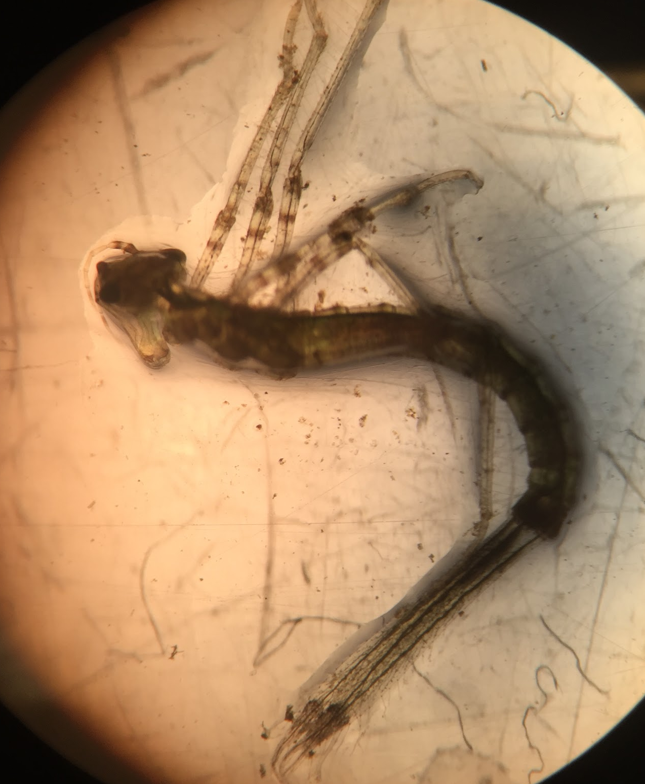
Species Biodiversity in the Peconic River
Karlie Hill, Katie Hill and Palwasha Khan
Mentors: Mr. Bolen and Dr. Spata
Eastport South Manor Junior-Senior High School
Abstract
The purpose of this experiment was to identify the different biological species in the samples collected on October 23, 2016 and later compare genetic diversity between the species. We also sought to discover a connection between species biodiversity and the potential impact of the presence and/or absence of specific organisms on human health. Using DNA Subway, we were able to use our top BLASTN hits and research their impacts on surrounding area as well as human health. We concluded that some of the oligotrophic worms and midges are indicator species if poor water quality. This means that they are present when the water quality is poor, such as high levels of various pollutants and high levels of fecal matter.
Materials & Methods
We collected 20 samples of invertebrates that looked like amphipods, snails, a Hydra, and some small worms, possibly nematodes, from the Peconic River during the “Day in the Life of the Peconic River” program on October 23, 2016.
Samples were placed in 99.9% ethanol with each organism placed in separate plastic microtubes and were cataloged, photographed, measured, and stored in a non-defrosting freezer at Eastport South Manor Junior-Senior High School.
In March of 2017, we performed DNA extraction and PCR on the 20 samples we collected at Brookhaven National Laboratory. DNA samples that produced good PCR results were sent for sequencing by Genewiz.
After getting the results back, we used DNA Subway and analyzed species that had the top BLAST hit for each species.
NXC-014
Top hit;
Menetus dilatatus
Figure One above shows the various invertebrates BLAST hits
Introduction
The Peconic River has been negatively impacted by human activity. With a high amount of nutrients, high levels of nitrogen and phosphorus found in the river due to fertilizer, rain runoff, high temperatures, the algal blooms can grow out of control. (1) The loss of the diverse species can destroy the food chains within the ecosystem. Barcodes can document and confirm known species, some of which lead to the description of new species. (2) What makes CO1 so unique is that it is short enough to be sequenced at a low cost, yet long enough to identify variations among species. The CO1 gene is very common among most organisms and since there are multiple copies of mitochondrial DNA, that means that multiple chances to retrieve the CO1 gene (3). In this experiment, we will be using the CO1 gene to help identify the species of various organisms present in the Peconic River to help determine the degree of biodiversity in this ecosystem.
Some of the species that we have collected have a chance of being invasive, parasitic or pathogenic, which can cause a negative impact on human health. Invasive species that are pathogenic can cause some kind of disease, or parasitic organisms can also be harmful to human well-being. Some invasive species may cause a disruption in the ecosystem and make it unbalanced and harmful for the amphipods and other aquatic life to live in.(4). Disrupting ecosystems offsets the natural balance of energy flow and can permit certain species to become dominant and may promote an increase in pathogenic organisms. (5)
Results
We obtained many high quality DNA sequences
Identified mostly worms and snails that were related to the Gyraulus and Dero genera
No novel species or sequences were identified.
No invasive species were identified.
NXC-013
Top hit;
Dero digitata
References
Department of Environmental Conservation. (n.d.). Retrieved November 29, 2016, from http://www.dec.ny.gov/lands/31842.html
DNA Learning Center Barcoding 101. (n.d.). Retrieved December 01, 2016, from http://www.dnabarcoding101.org/
How does Biodiversity loss affect me and everyone else? (n.d.). Retrieved December 05, 2016, from https://wwf.panda.org/about_our_earth/biodiversity/biodiversity_and_you/
(n.d.). Retrieved February 06, 2017, from http://parasites.probacto.com/what-is-the-difference-between-parasite-and-pathogen/
Ecosystem Change. (n.d.). Retrieved February 06, 2017, from http://www.greenfacts.org/en/ecosystems/millennium-assessment-3/3-human-wellbeing-poverty.htm
Figure two above shows the various snails BLAST hits of the Gyraulus genera
Discussion
Due to the limitations of sequencing the CO1 gene, we cannot determine the exact species of each of our samples. Our top BLASTN hits were the closely related to the Gyraulus and Dero genera commonly know as the freshwater snail and aquatic worm. In future studies, using another gene would allow us to differentiate between closely related species.
Acknowledgements
Dr. Aleida Perez for helping us extract DNA at Brookhaven National Lab, and our teacher mentors for helping us throughout this year of research and with helping us organize this project and poster, Mr. Bolen and Dr. Spata.
NXC-011
Top Hit;
Stylaria fossularis
Figure three above shows the various oligotrophic worm BLAST hits

