Slide 1
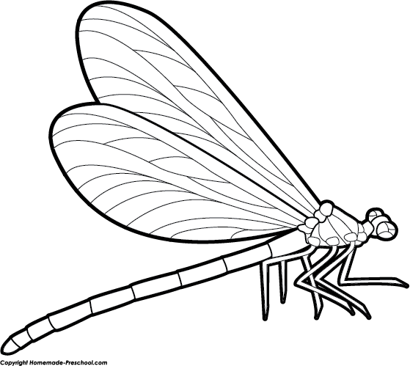
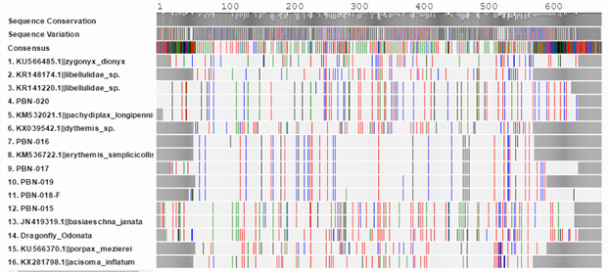
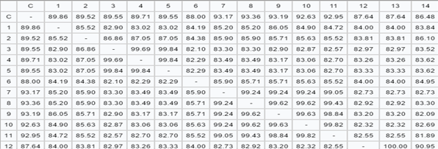
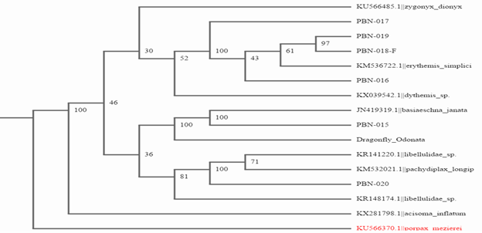
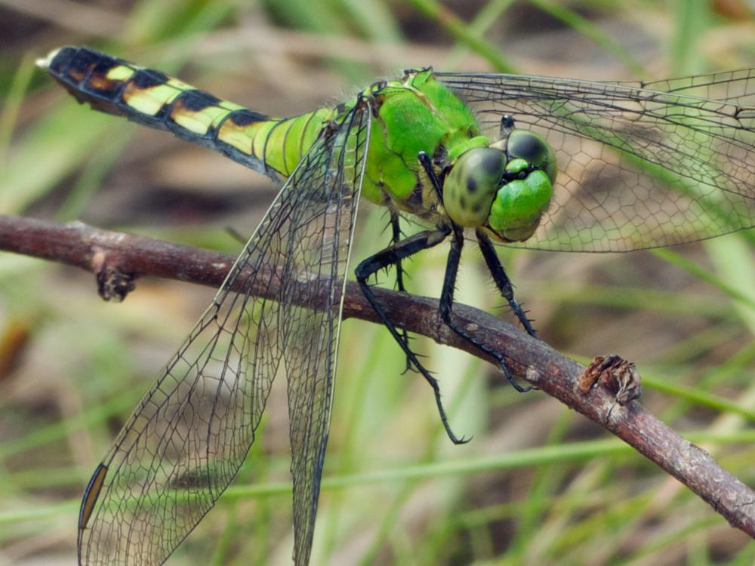
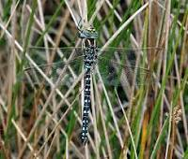
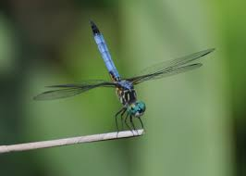
Measuring Dragonfly Biodiversity in the Peconic River
Michael De Somma¹, Matthew De Somma¹
Eastport South Manor Jr-Sr High School¹
Results
Abstract
The purpose of this project was to measure the biodiversity of the Peconic River and establish a baseline for future studies. We collected 20 samples of dragonfly from the Peconic River to barcode. The use of barcoding the CO1 gene can sometimes only resolve down to the genus, however the results allowed us to establish evolutionary relationships between various species and even roughly when they diverged from their common lineage. We also searched for a potential novel species/sequence. The study provides the futher study ofthe effects of human activity on the ecosystem, and the effects of the ecosystem on us by monitoring dragonfly diversity over several years. Human wastes such as sewage directly affect the dragonflies, which control mosquito populations and other such pests. Our studies results indicate the Peconic River currently has a rich diversityof dragonfly species, such as Pachydiplax longipennis (Blue Dasher), Erthemis simpliciollis (Eastern Podhawk), Aeshna juncea (Common Hawker), and Acisoma inflatum. Previous barcode analysis from the last school year confirms the continued presence of the Blue Dasher and Eastern Podhawk.
Figure 2
Figure 1
Introduction
The primary purpose of this project is to measure biodiversity of dragonflies within the Peconic River and establish a baseline of biodiversity for further studies. Dragonflies are an indicator species because they require clean water to thrive because they spend most of their life span in the river. [8] Most if not all life forms play a vital role in the Peconic River, and because of the nature of how dragonflies develop and mature it is important to monitor this species. Dragonflies have a significant and positive role in maintaining ecological homeostasis. Being extremely skilled fliers and having almost a complete 360 view, they keep pesky mosquitoes, disease-spreading horseflies, and other unwanted insects populations from drastically increasing. Ecologists actually use dragonflies to determine the overall health of an ecosystem because their presence is a strong indicator of a freshwater body. Also due to the fact dragonflies are relatively low on the food chain, the observation of their health can reveal changes in water ecosystems much more quickly compared to observing other animals or plants. Ultimately, dragonflies are extremely necessary in the maintenance and study of ecological
homeostasis.[8]
It is important to barcode the DNA of dragonflies in order to establish database and a baseline for further studies. Barcoding is the process of documenting biodiversity in an ecosystems community using the existence of a wide range of different types of organisms in a given place at given time. A high level of biodiversity is desirable because this variation in species can resist rapid environmental changes. Biodiversity is the diversity among and within plant and animal species in an environment. Biodiversity promotes variation in an ecosystem, which is extremely important. because with variation comes differences in how an organism may react to a disease, predator, and environmental changes, perhaps even micro-evolution/adaptation, which is a critical element to a species success. [6] The question we seek to answer is, “How is Human activity affecting the ecosystem and how do changes in the ecosystem affect humans?” The Peconic River is often a victim of various pollutants that kill native organisms. One of these pollutants is nitrogen rich cesspool runoff according to previous proposal about clams. [1] Pathogens and urban storm runoff also pollute the Peconic River according to a government document on the water quality. [2] Dragonflies are particularly vulnerable considering how they are highly dependent on water quality. Therefore clean water means more dragonflies. The primary reason humans would be interested in dragonflies is that they are a predator of mosquitoes. Mosquitoes are parasites that draw blood from their victims to feed themselves. Mosquitoes often prey on humans and during this action of feeding have the potential to transmit disease. However dragonflies reduce the mosquito population because they are predators of these organisms. With less mosquitoes there will be less cases of diseases like West Nile virus. [7] These diseases are potentially life threatening which makes humans inherently interested in having a healthy dragonfly population to control or eliminate these pests
.
Figure 3
Eastern Podhawk
Common Hawker
Blue Dasher
Discussion
The results suggest that the Peconic River has a healthy level of biodiversity considering dragonflies. This means they will continue to help maintain Peconic River homeostasis. A more immediate benefit of this is continued stability in the maintenance of pests via predation. Also curiously, PBN-019 and PBN-018-F have recently diverged, offering the question why? Ultimately, this concludes this group’s dragonfly study measuring biodiversity in the Peconic River and establishing a baseline to future studies.
References
Jordan, A.; Schappert, D., Friedlel, V. (2016) Measuring Freshwater Clam Biodiversity in the Peconic Estuary, Barcode Long Island Project
http://www.dec.ny.gov/docs/water_pdf/wiatllisprpb.pdf
What is DNA barcoding? (2015) Retrieved from http://www.barcodeoflife.org/content/about/what-dna- barcoding(n.d.). Retrieved December 3, 2015, from https://www.dnalc.org/websites/dnabarcoding101.html?gclid=CKjsyMvUzMkCFYIlHwodCz0ANg
McAllister, K., &amp; Pingree, S. (2008). Peconic River Habitat Health.Baywatch, 08-09. Retrieved December 2, 2015, from http://www.peconicbaykeeper.org/siteFiles/News/901176F0FD67C333EE9CEFC31D9B097C.pdf
Suffolk County Government Departments Health Services Environmental Quality Ecology Marine Water Quality Monitoring Peconic Estuary Program. (n.d.). Retrieved December 4, 2015,frhttp://www.suffolkcountyny.gov/Departments/HealthServices/EnvironmentalQualituEcology/MarineWaterQualityMonitoring/PeconicEstuaryProgram.aspx
Marjorie D. Matocq and Francis X. Villablanca. &quot;Low genetic diversity in an endangered species: recent or historic pattern?&quot;Biological Conversation 98.1 (2001): 61-68.
http://www.mosquito.org/mosquito-borne-diseases
http://www.earthtimes.org/nature/dragonflies-indicator-species-environmental-health/2033/
Methods
20 organisms that appear to be dragonfly larvae samples were collected by hand approximately six inches from the dock piers (posts) using dip nets and seine nets and sorted on the dock.
Samples were stored in 99% ethanol in a nondefrosting freezer.
To extract and isolate the CO1 gene, tissue samples were taken from the legs
The tissue sample from each dragonfly larvae was mixed with a lysis and buffer solution to disintegrate the plasma membrane and exoskeleton components.
PCR was used to amplify the target gene CO1 present in the sample for sequencing.
Gel electrophoresis permited identification of sequences of the CO1 gene that were successfully amplifiedusing the PCR.
The PCR samples with the best amplification as indicated by their bright fluorescence were selected for sequencing.
Sequences were compared to the known CO1 sequences catalogued in Genbank, and analyzed using the NCBI BLAST website tool to determine the identity of samples.
The sequences were compared and phylogenies constructed using the DNA Subway webtool.

