Slide 1
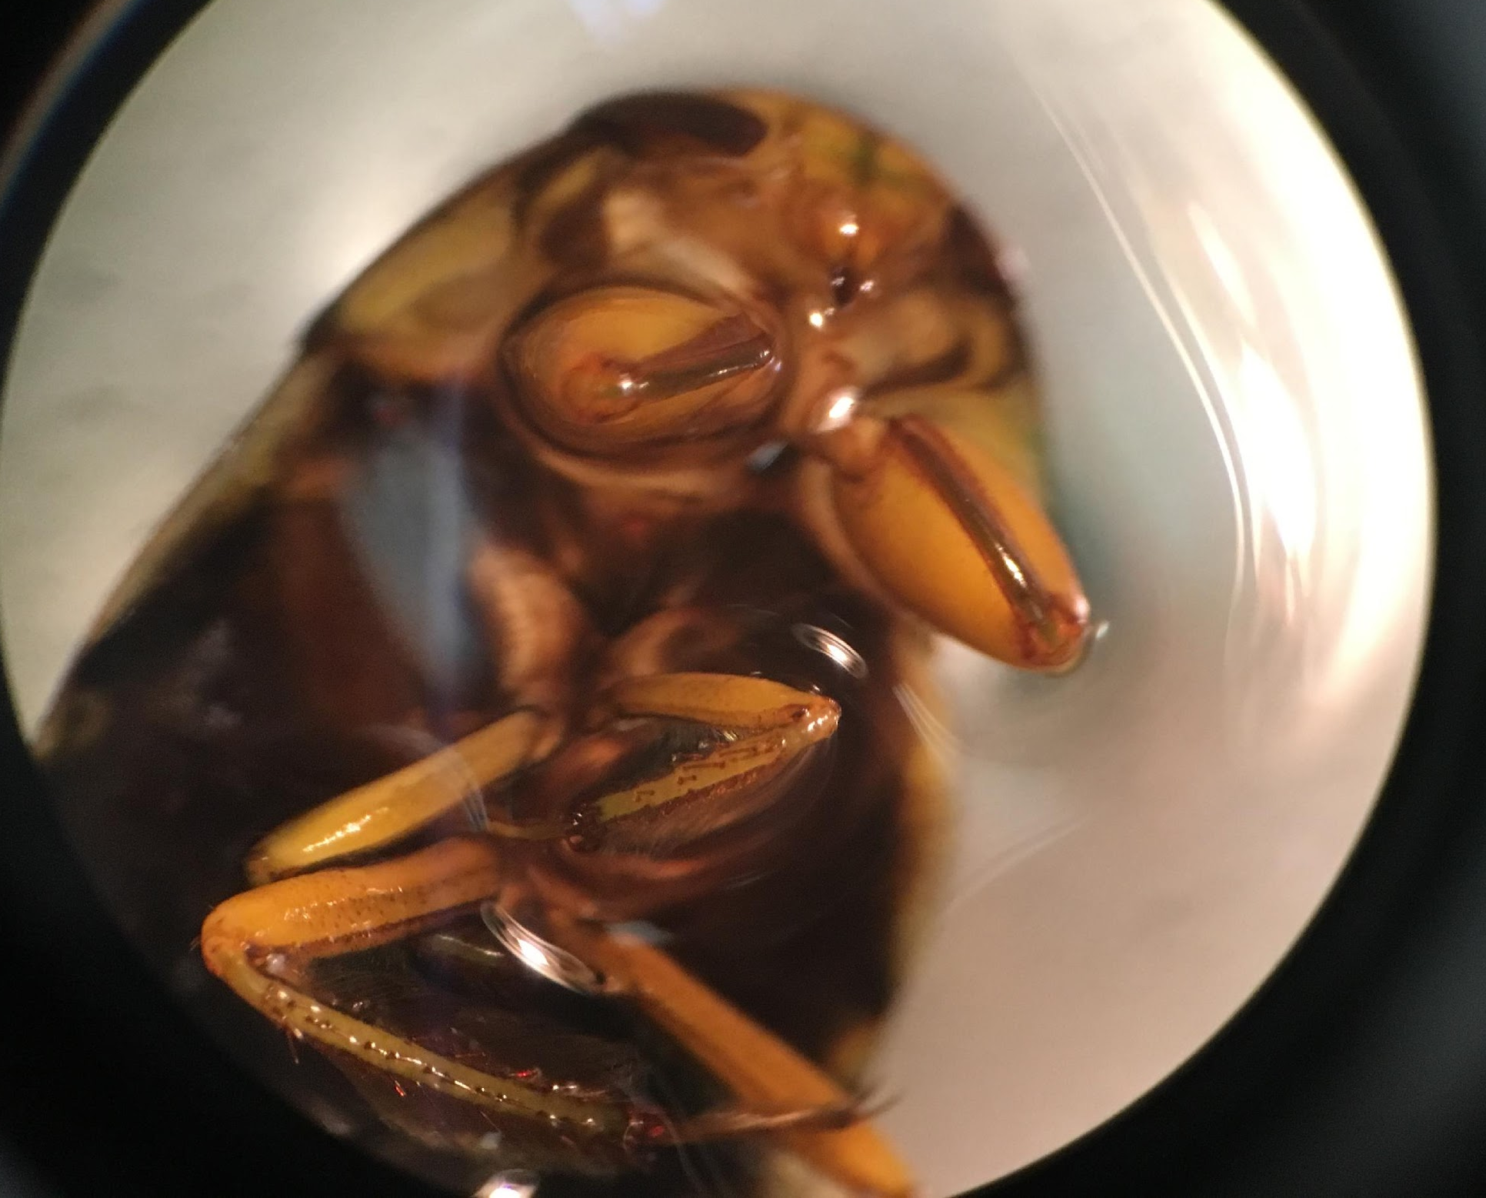
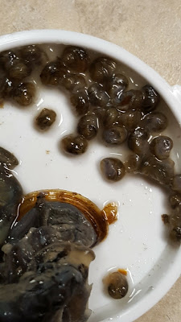
Biodiversity of the Peconic River Estuary
Adam Burk, Brooke Morabito, Erica Sheludenko, David Votteler
Mentor: Robert Bolen
Eastport South Manor Jr-Sr High School
Abstract
Discussion
Seventeen samples were extracted from the Peconic River Estuary in hopes of efficiently barcoding the samples and possibly finding a novel specimen amongst them. The samples yielded impeccable results post PCR analysis. With regard to the results, the sequences were compared with species already in the gene databank. PFG-003 most closely correlates with Paraplea frontalis only containing a 86.70% similarity which exploits the need to further study the specimen and review the results with a taxonomist. Furthermore, PFG-006 correlates with both Radix swinhoei and Physella acuta which are the same species but live on opposite sides of the world. PFG-025 and PFG-026 are Viviparus georgianus which is an invasive species that carries many parasites. Based on the various other organisms that were found at the estuary, it appears that the biodiversity of the Peconic River is quite high.
Results
The barcoding results showed that both samples 25 and 26 were Viviparus Georgianus, or the banded mystery snail. It is a species of large freshwater snail with gills and an operculum, an aquatic gastropod mollusk in the family viviparidae, the river snails. It is dioecious, iteroparous, and oviparous, laying eggs singly in albumen filled capsules. It is a filter feeding detritivore, and can be used as a bioindicator of contaminated sediment. It is an invasive species and carries many parasites.These parasites can be spread to fish and other wildlife. Its native habitat is around the Mississippi river system, primarily Florida, Georgia, Alabama, Illinois,and Indiana. Anecdotal evidence suggests that mallard ducks are adapting to foraging on this species in Lake George.
Figure 1: Barcodes indicating the identity of the leech (PFG-002) and the dobsonfly larvae also known as the hellgrammite (PFG-001)
Methods
First, we collected our 18 species from the Peconic River Forge Pond DEC Boat Ramp.
The samples will be sequenced following CSHL protocols. After a thorough process of washing to remove as much cellular debris from the DNA as possible, primers that are specific to the flanking regions of the CO1 gene will be added to the DNA.
The primer and DNA solution will have dideoxynucleotides added to the tube so that additional copies of the CO1 gene will be produced using Polymerase Chain Reaction (PCR).
PCR will be used to amplify the CO1 gene sequence using primers that will bind to the ends of each sequence. The PCR samples that have the best amplification as indicated by their strong fluorescence will be selected for sequencing.
Introduction
Biodiversity is the variety of plants, fungi, bacteria, and animals that exist within an ecosystem. Biodiversity helps balance out nature in aspects of the food chain, and pollution control due to bioremediation, which is the use of microorganisms in degrading contaminants if they pose environmental and human risks. Biodiversity can be negatively impacted by invasive species that can lead to the elimination of other species. Human impact is one of the most influential factors affecting the species count in the Peconic River, in part because of the introduction of invasive species that alter biodiversity in the river by decreasing it, like what was seen in the Peconic River when Brazilian elodea and Asian clams were introduced. It is important to protect biodiversity in our environment to preserve all other life.
DNA barcoding is a relatively simple process used to analyze the DNA of a specific gene sequence that can be used for biodiversity studies. Barcoding various organisms allows us to identify species around Long Island and determine relationships between them. Barcoding is also used to document the biodiversity of ecosystems and compare different communities. This technique makes it easier to see distinct traits and qualities of varying species. In addition, sequencing a species genetic makeup can help determine whether a species is invasive. We also plan on using barcode sequencing to document any invasive/non-native species.
Figure 2: BLAST results showing the mismatches and the sequence quality (Bit Score). This is the second trial of PCR and sequencing for this sample which yielded the same results.
Figure 3: Barcode of BLAST Results for PFG-003 showing potentially significant differences
References
Center, N. I. (2016, September 28). National Invasive Speation Center. Retrieved November 28, 2016, from https://www.invasivespeciesinfo.gov/index.shtml
(n.d.). Invasive Species - National Wildlife Federation. Retrieved November 25, 2016, from http://www.nwf.org/Wildlife/Threats-to-Wildlife/Invasive-Species Informcies.aspx
(n.d.). What is Biodiversity? - National Wildlife Federation. Retrieved December 02, 2016, from http://www.nwf.org/Wildlife/Wildlife-Conservation/Biodiversity
What Is DNA Barcoding? (n.d.). Retrieved December 05, 2016, from http://www.barcodeoflife.org/content/about/what-dna-barcoding
BIOLOGICAL INDICATORS. BIOLOGICAL INDICATORS. N.p., n.d. Retrieved January 14, 2017, from http://www.ndhealth.gov/wq/sw/Z6_WQ_Standards/WQ_Biological.htm
Benson, Amy. "Viviparus Georgianus." Banded Mysterysnail (Viviparus Georgianus) - FactSheet. U.S. Department of the Interior | U.S. Geological Survey, 26 Jan. 2017. Web. 23 May 2017
Figure 4: Barcode indicating samples PFG-005 and 006 are the same species with different names due to locations in which these were originally first identified.:
Acknowledgements
Figure 6: Our novel sequence PFG-003 is
currently still unidentified
Figure 7: This is a snail sample called the “Mystery Snail” because it gives birth to live young.
Mr. Robert Bolen for helping us through the entire barcoding process; Dr. Sharon Pepenella for re-running PCR and delivering and picking our re-agents and samples; Mr. Michael Doyle for printing out our posters.
Figure 5: Indicates that both PFG 25 and 26 are viviparus georgianus, the banded mystery snail.

