Slide 1
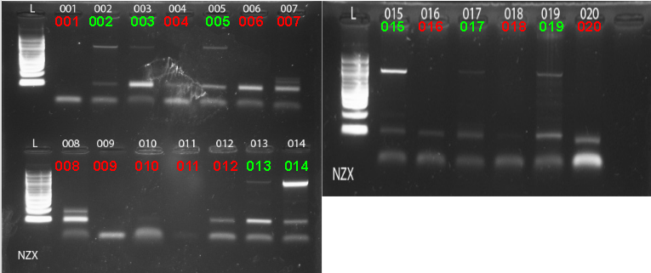
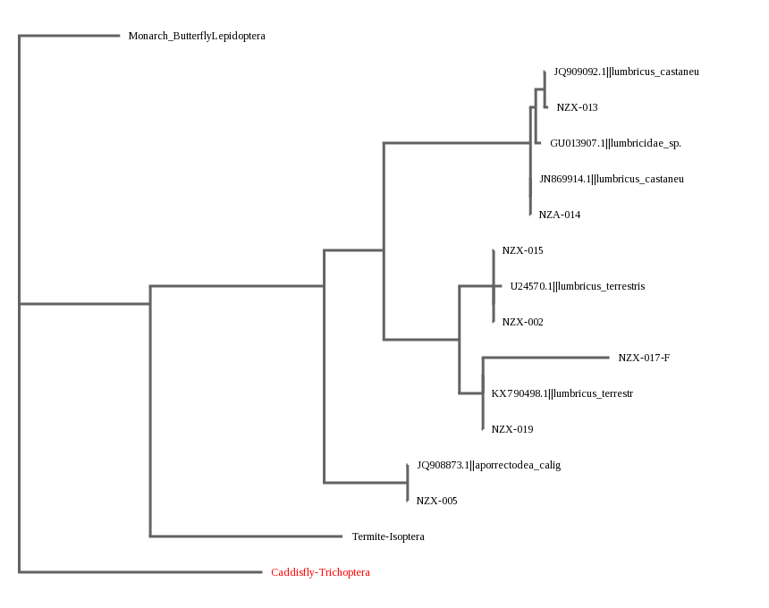
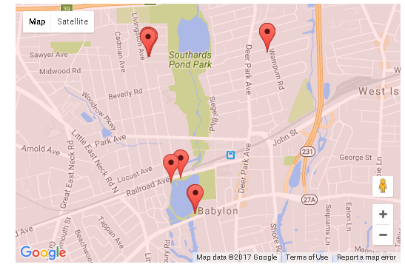
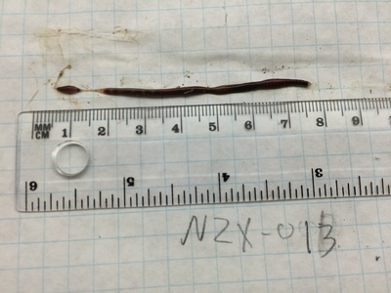
Testing the Biodiversity of Terrestrial Earthworms around Argyle
Authors: Ian Watral, Nick Zukaitis
Mentor: Claire Birone
Babylon Junior-Senior High School
Abstract:
Earthworms have been present in worldwide ecosystems for millennia. No species of earthworm are native to North America, all current living species are native to different areas of Europe, Asia, Africa, and Australia. Earthworms that are here now got to America when the Europeans came in the 1600s. There are about 15 species in the northeast U.S area. The collection of earthworms will be located in Argyle Park and residential areas within a 1-mile radius. This area is in the Suffolk county of Long Island, New York. The earthworms will be identified through taxonomic keys. DNA samples were extracted for all samples, underwent PCR, and then samples with positive amplification were sent to GeneWiz for sequencing. Analysis of the samples on DNA subway indicates low biodiversity in worm population, with most worms being identical.
Methods:
The collection of earthworms was located in Argyle Park and residential areas within a 1-mile radius. Samples were collected from the ground were then placed in separate bags labeled NZX-001 to NZX-020 based on the order in which they were collected and stored in freezers to preserve the samples. Their locations and nearby posts were documented. The samples were stored in a freezer on the second floor of the Babylon Junior-Senior High School.
Cold Spring Harbor extraction and PCR protocol will be followed for each of the 20 samples collected. Gel electrophoresis is the final step. This is important because it will show whether or not he PCR worked. The samples can now be sent to GeneWiz to analyze sequence similarities within the CO1 gene. After these processes, the DNA that was successfully amplified during PCR was sent to GeneWiz for sequencing. The results of that sequencing was analyzed using bioinformatics. Bioinformatics is a computer application used to document biological and genetic information.
Figure 2: The results of PCR of samples run through gel electrophoresis. Green text indicates that the sample was strong enough to be sequenced, while red indicates that the sample was not amplified and could not be sequenced.
Introduction:
Adult earthworms are identified through physical characteristics such as body color, body pattern, and clitellum. The clitellum is the part of the earthworm near the head that protrudes outward (Figure 1). Different species of earthworm are identified by the distinctions in their appearance such as tail shape.
Earthworms can be helpful in gardens by mixing soil layers and enriching nutrient composition. This helps human food supply increasing the nutrient composition in produce. However, in areas like forests, they can harm the local ecosystems. They do this by changing the nutrients of the soil through digestion and compacting it. This makes it harder for plants to absorb nutrients. As stated by the Smithsonian Environmental Research Center, “Earthworms excrete some of the soil they consume in tough pellets called casts. These casts take more time to break down—perhaps making it so the carbon stored there stays in the ground longer. In short, the invading army of earthworms could threaten the planet just as it threatens individual forests.”
In this project, the DNA of 20 earthworms were extracted analyzed. They were collected from under posts, such as cemented garbage cans, and stone formations. The earthworms were collected there because they provide an exact location that is visually identifiable. The goal of this project is to compare the COI sequences of these samples to help determine the biodiversity of the worm population in and around Argyle Lake.
Discussion:
The majority of the samples were classified under the same genus, Lumbricus. The biodiversity of the samples tested was minimal. Based off of this data, it can be implied that the soil in which the soil the samples were located has similar properties. This can be inferred because the samples are mostly similar and therefore behave similarly. This is important because it shows the soil from the different locations tested is fairly consistent. In order to better illustrate biodiversity, it would be helpful to use a larger geographical area, as well as diverse environments (beach versus forest, etc). This then would better serve as an accurate representation of the earthworm population on Long Island.
Figure 3: Phylogenetic tree showing the possible genus, and species of the samples that were sequenced. All of our samples were able to be identified as members of the Lumbricus genus.
References
Earthworm Society of Britain. Earthworm Society of Britain. Retrieved from the World Wide Web on 28 September 2016. http://www.earthwormsoc.org.uk/earthworm-information/earthworm-information-page-3
National Public Radio. The Trouble with Earthworms. National Public Radio. Retrieved from the World Wide Web on 28 September 2016. http://www.npr.org/templates/story/story.php?storyId=9105956
Smithsonian Environmental Research Center. Ecosystems on the Edge. Smithsonian Environmental Research Center. Retrieved from the World Wide Web on 28 September 2016. http://ecosystems.serc.si.edu/earthworm-invaders/
Wood, B. Hulton and James, W. Samuel. Native and Introduced Earthworms from Selected Chaparral, Woodland, and Riparian Zones in Southern California. United States Department of Agriculture. Retrieved from the World Wide Web on 27 September 2016 http://gis.fs.fed.us/psw/publications/documents/psw_gtr142/psw_gtr142.pdf
Wormwatch. Identifying Earthworms. Wormwatch. Retrieved from the World Wide Web on 19 October 2016. https://www.naturewatch.ca/wormwatch/how-to-guide/identifying-earthworms/
Figure 4: Sample NZX-013, identified as Lumbricus castaneus, or the chestnut worm.
Figure 1: A map of the locations used for sample collection.

