Slide 1
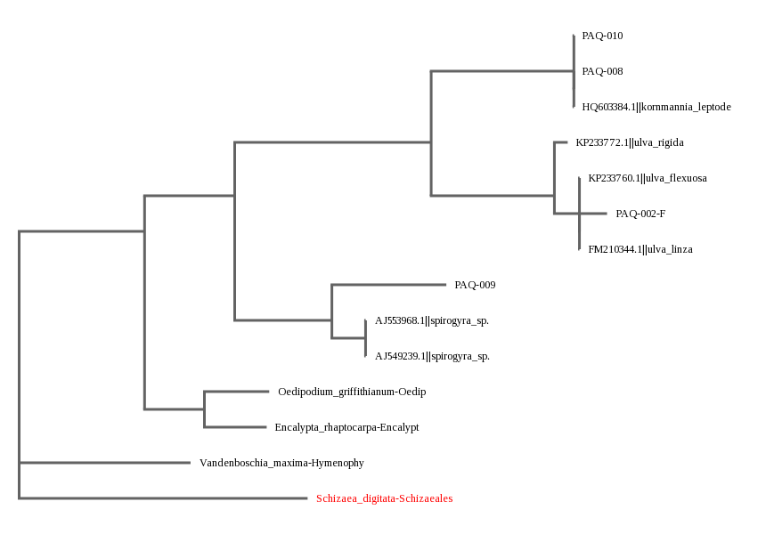
Saltwater Algae vs Freshwater Algae
Madeline Carbone, Valerie Bello, Olivia Berry
Ms. Birone
Babylon Jr-Sr High School
Abstract
Algal blooms occur frequently on Long Island that produce toxins harmful to humans and animals in the area. The genetic makeup of saltwater algae and freshwater algae may vary because of adaptations needed to survive in different environments. Various samples of algae were collected from fresh and saltwater locations. In order to obtain the DNA of algae, we used the Barcode Long Island protocols for extraction and amplification. Our goal was not met, but four samples were successfully identified through sequencing, and further studies will include more sample locations and a larger sample size.
Method & Materials
12 samples of algae were collected from fresh and saltwater locations, then kept frozen until ready for processing. The samples’ physical appearances, masses and locations (latitude/longitude) were recorded. In order to obtain the DNA of algae, we used the Barcode Long Island protocols for extraction and amplification of the rbcL gene. We confirmed sample amplification using gel electrophoresis. We then analyzed the sequences using DNA Subway and were able to identify our samples.
Figure 2: Gel electrophoresis results indicating which samples were amplified (green = able to be sequenced, red = unable to be sequenced)
Discussion
Four of the original ten samples collected were able to be successfully sequenced and identified as different species of algae. However, the original goal to study the biodiversity of freshwater versus saltwater algae was not able to be met due to limitations in the sequencing. Further studies would include more sample locations, a more widespread area of locations, and a larger sample size.
Introduction
Algal blooms are frequent occurrences on Long Island, primarily on the South Shore. Aureococcus anophagefferens is the species of algae that causes brown tides on Long Island. Dense blooms of the Aureococcus anophagefferens is dangerous to marine life and even humans. Algal blooms usually occur once a month in the summer and fall because of the excess amounts of nitrogen from fertilizer in the runoff(2).
On Long Island there are two common types of saltwater algae, Alexandrium spp. and Aureococcus, as well as one freshwater species, blue-green algae. Algal blooms may produce toxins that could be harmful to humans and animals in the area. Even if the algae doesn’t produce harmful toxins, it may create dead zones in the water and raise costs for treating the water. The algae growth may also cause fish kills, and the amount of oxygen decreases due to decomposition (3). The lack of fish specifically affects Long Island's economy, because of the fishing industry.
Salt water algae samples were collected from local areas like the Great South Bay, Carll’s Creek and Ocean Beach jetties. The freshwater algae samples will be from Argyle Lake, Carll’s river and Southard’s Pond (see Fig. 1). Once all the samples have been collected, the DNA will be extracted and compared. This experiment will test the differences in appearance, shape, size, color and DNA between saltwater algae and freshwater algae.
Figure 4: MUSCLE alignment of BLAST results. Banding patterns indicate sequence similarities and allow our 4 sequenced samples to be identified as different algal species.
Figure 5: Sample PAQ-008, collected from Sumpwam’s Creek (freshwater) and identified via DNA Subway as Kornmannia leptoderma
Figure 3: The phylogenetic tree groups the fern and moss reference data on the left side of the tree, showing that these species are less evolved and older. As the tree moves to the right, the algae samples together branch off and become more evolved, more recently. The algae samples’ BLAST matches are indicated on the same branches as our samples.
Figure 1: The various sample sites where the algae was collected, indicating both salt and fresh water locations.
References
1. Harmful Algae Blooms. NYS Department of Environmental Conservation. Retrieved from the
World Wide Web on September, 28, 2016.http://www.dec.ny.gov/chemical/77118.html http://www.dec.ny.gov/outdoor/64824.html
2. Harmful Algal Blooms. Suffolk County Government. Retrieved from the World Wide Web on
September 29, 2016.
http://www.suffolkcountyny.gov/Departments/HealthServices/EnvironmentalQuality/Ecology/MarineWaterQualityMonitoring.aspx
3. Harmful Algal Blooms. U Environmental Protection Agency. Retrieved from the World Wide Web on November
13, 2016 https://www.epa.gov/nutrientpollution/harmful-algal-blooms
4. Holmes-Farley, Randy.Chemistry And The Aquarium: Phosphorus: Algae's Best Friend.
Advanced Aquarist. Retrieved from the World Wide Web on 29 September 2016. http://www.advancedaquarist.com/2002/9/chemistry
5. The Varieties of Algae. Micrographia. Retrieved from the World Wide Web on September 29, 2016 .http://www.micrographia.com/specbiol/alg/alghome/alggen01.htm
Out of these samples collected four were able to be sequenced/identified:
PAQ-008, PAQ-010 Kornmannia leptoderma
PAQ-002 Ulva linza or Ulva flexuosa (similar to Ulva rigida)
PAQ-009 similar to Spirogyra sp.

