Slide 1
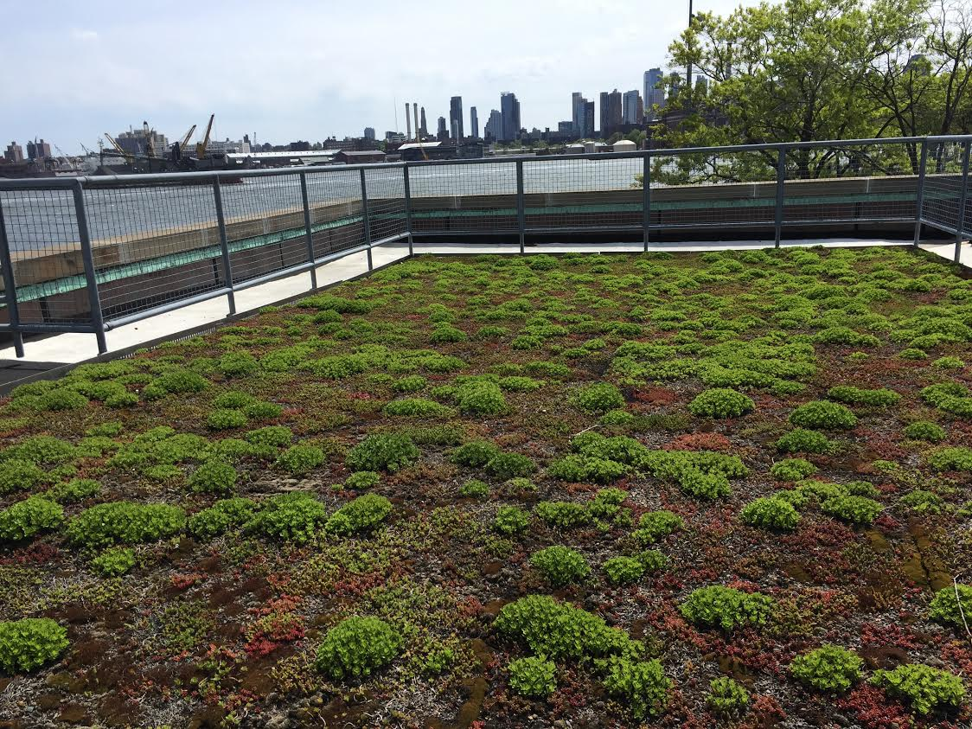
Using DNA Barcoding to Identify Biodiversity: A Soil Invertebrate Survey of New York’s East River Park
Hadja Diallo, Rosemary Wang, Ayse Aydemir, PhD
Bard High School Early College
Abstract
Biodiversity is a measure of the variety of organisms within an ecosystem or habitat. The purpose of this study was to conduct a survey of soil invertebrates from two collection sites at New York’s John V. Lindsay East River Park: green roof and ground level, using taxonomic classification and DNA Barcoding. Using DNA Barcoding, Diptera and Isopoda were correctly identified and matched at the species-level that corresponded to the taxonomic order-level. Several of the organisms taxonomically identified did not yield a DNA match due to low amplification. DNA Barcoding is a powerful tool for citizen science projects for the identification of organisms that are difficult to classify with taxonomy.
Introduction
Biodiversity is a measure of the different kinds of organisms within an area, and is often qualified in terms of high and low relative to variety.^{1, 2} It is an essential aspect of all forms of life, specifically humans, because of the interdependence between all organisms and how they contribute to food supply, medicine, and commodities. It is important to understand biodiversity as it also plays a role in ecological conservation and enables better methodologies to foster genetic diversity in the restoration of ecosystems, such as after flooding or other natural disaster.³
Soil is an ecosystem that is rich in biodiversity.⁴ Soil is made up of a heterogenous mixture of living and nonliving components, and is heavily impacted by the invertebrates that inhabit it. Invertebrates influence nutrient cycling, organic matter dynamics, and microbial activity. Additionally, they facilitate the coexistence of other organisms such as secondary predators in an ecosystem.⁵
The purpose of this study was to use taxonomic classification and DNA barcoding to survey the soil invertebrates from two collection sites at New York’s John V. Lindsay East River Park: a green roof and the ground level.
Materials and Methods
During the months of September 2017 and October 2017, pitfall traps were set up at coordinates 40.712991,-73.976045 (ground level) and 40.712824,-73.976194 (Lower East Side Ecology Center at East River Park green roof) to collect soil invertebrates. Samples were collected two days after setting up traps and frozen/preserved in 10% detergent-salt water solutions.
The collected invertebrates were counted, identified, and classified taxonomically on the Order level using a dissection microscope and a soil invertebrate taxonomic guide.⁷ Soil invertebrates of the same order were placed in labeled microcentrifuge tubes and frozen at -20°C prior to DNA barcoding. DNA was isolated using Qiagen Dneasy Blood and Tissue Kit with Proteinase K digestion. PCR reactions for the COI barcode were set up using PuReTaq Ready-To-Go PCR Beads and NEB Taq Master Mix with Invertebrate CO1 primers under the conditions of 95°C 1 min, 95°C 30 sec, 50°C 30 sec, 72°C 45 sec for 35 cycles. PCR amplification was confirmed with 2% agarose gel electrophoresis using 1% TAE buffer. A total of 16 samples were sent for sequencing (Genewiz Inc.,South Plainfield, NJ).
Sequences were analyzed using the DNA Subway Blue Line program for sequence alignment, trimming, and optimization, as well as BLASTn.⁸ The data from the two collection sites were pooled together for analysis.
Discussion
The goal of this study was to use DNA barcoding to survey the invertebrate biodiversity of East River Park. At least 14 different orders were identified from the collections using the taxonomic guide. However, due to low species abundance, some of the samples could not be successfully barcoded.
Two orders were successfully DNA barcoded matching the taxonomic classification. Previous studies from the same site carried out by students from the same school included a biodiversity index calculation and a comparative assessment of the green roof and ground samples. ⁹
This study supports that there is a need for more specific and accurate species identification and DNA barcoding is a reliable method to identify invertebrates. For citizen science projects or with studies involving young scientists still training in the field, DNA barcoding can also be used for training purposes to correctly utilize existing soil invertebrate guides.
References
"What Is Biodiversity?" AMNH. N.p., n.d. Web. 24 Oct. 2017.
Reece, Jane B., Lisa A. Urry, Michael L. Cain, Steven Alexander Wasserman, Peter V. Minorsky, Rob Jackson, and Neil A. Campbell. Campbell Biology. Boston: Pearson, 2014. Print.
"National Geographic Education." National Geographic Education - National Geographic Society. N.p., n.d. Web. 24 Oct. 2017.
Blair John, M., J. Bohlen Patrick, and W. Freckman Diana. "Soil Invertebrates as Indicators of Soil Quality." Methods for Assessing Soil Quality. N.p., n.d. Web. 24 Oct. 2017.
Breure, Anton M. “Soil Biodiversity: Measurements, Indicators, Threats and Soil Functions” Web. 24 Oct. 2017.
Amy Kraft. “Why Manhattans Green Roofs Don’t Work—and How to Fix Them”. Scientific American. Web. 26 Oct.2017
“Illustrated Guide to Major Groups of Soil Invertebrates, Taxonomic Organization of Terrestrial Invertebrates.” Biodiversity Laboratory.
Cyverse. “DNA Subway”. Cold Spring Harbor Laboratory. Available: https://dnasubway.cyverse.org/
Ezratty, Ella, and Gérard, Sasha. Using DNA Barcoding to Identify Biodiversity: a Comparative Study of the Invertebrate Fauna of an Urban Green Roof and the Ground Level. Urban Barcode Research Project, June 2017.
“Resources,” DNA Learning Center Barcoding 101, www.dnabarcoding101.org/resources/#onlinetools.
Acknowledgements
We would like to thank Kaitlyn Parkins (Lower East Side Ecology Center) for helping us collect specimens from the LESEC greenroof and for guidance and support during the course of the project. We also would like to thank Cold Spring Harbor Laboratory, DNALC for their support. Financial support for this project was provided by the Pinkerton Foundation (UBRP). Research permit for East River Park was approved by the New York City Parks Department.
Results
A total of three collections were made from the ground and green roof sites from Fall 2017 to October 2017.
While not all samples provided sufficient DNA quantity for sequencing analysis, BLASTn results were available for the following taxonomic identifications: Coleoptera, Collembola, Diptera, Homoptera, and Hymenopetra.
From the identified groups, only two were successfully verified through DNA barcoding: Diptera and Isopoda. See Table 1.
Ground level versus green roof collection sites
Table 1:
Taxonomic Identification | Numerical Abundance: | Barcode Identification
Acarina | 1 | [No sequence]
Araneida | 3 | [No sequence]
Coleoptera | 6 | Dermaptera
Collembola | 21 | Diptera
Diptera | 41 | Diptera
Dermaptera | 2 | [No sequence]
Homoptera | 7 | Diptera
Hymenoptera | 15 | Diptera
Isopoda | 31 | Isopoda
Isoptera | 1 | [No sequence]
Mallophaga | 1 | [No sequence]
Odonata | 1 | [No sequence]
Orthoptera | 1 | [No sequence]
Unknown A | 1 | [No sequence]
Unknown B | 2 | [No sequence]

