Slide 1
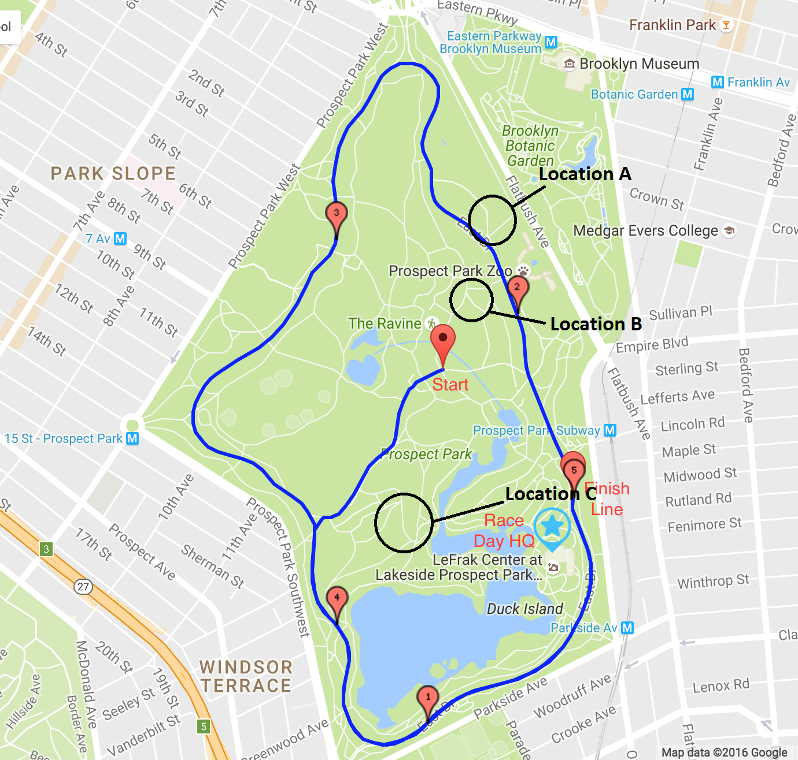
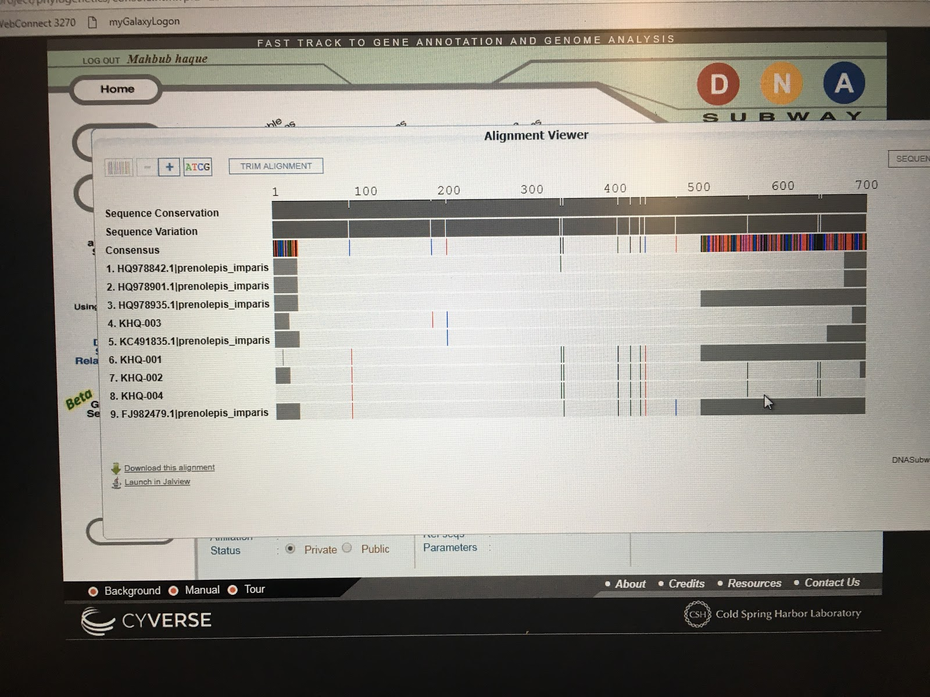
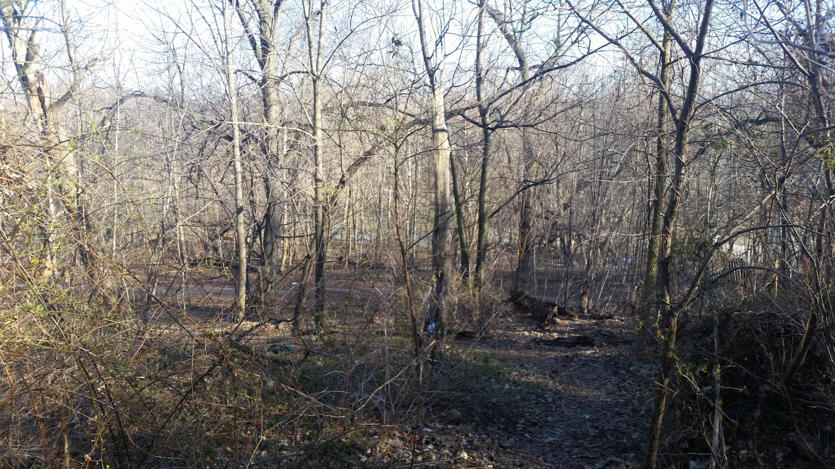
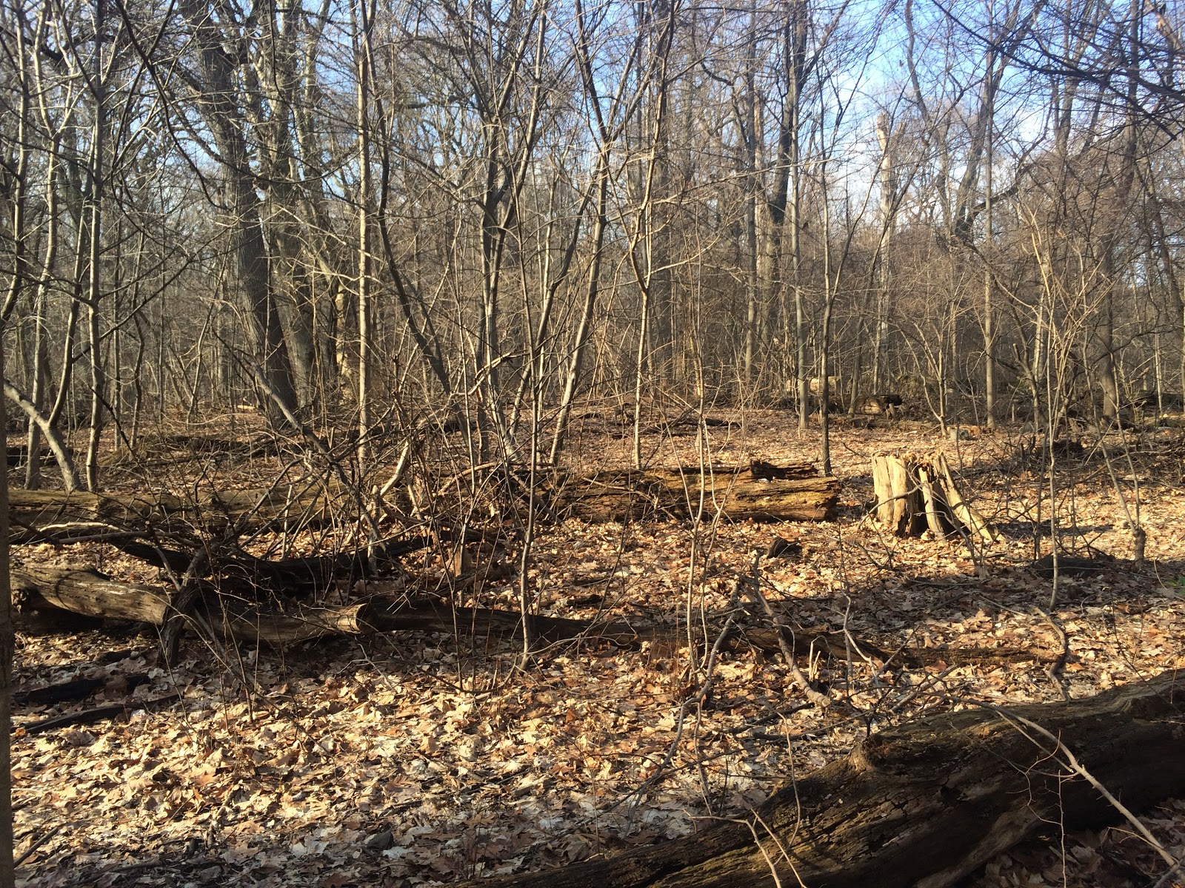
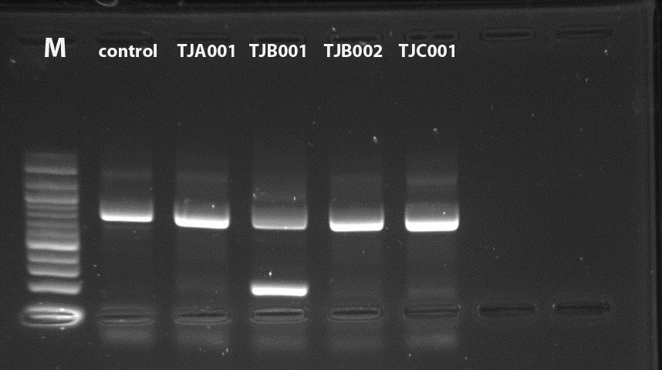
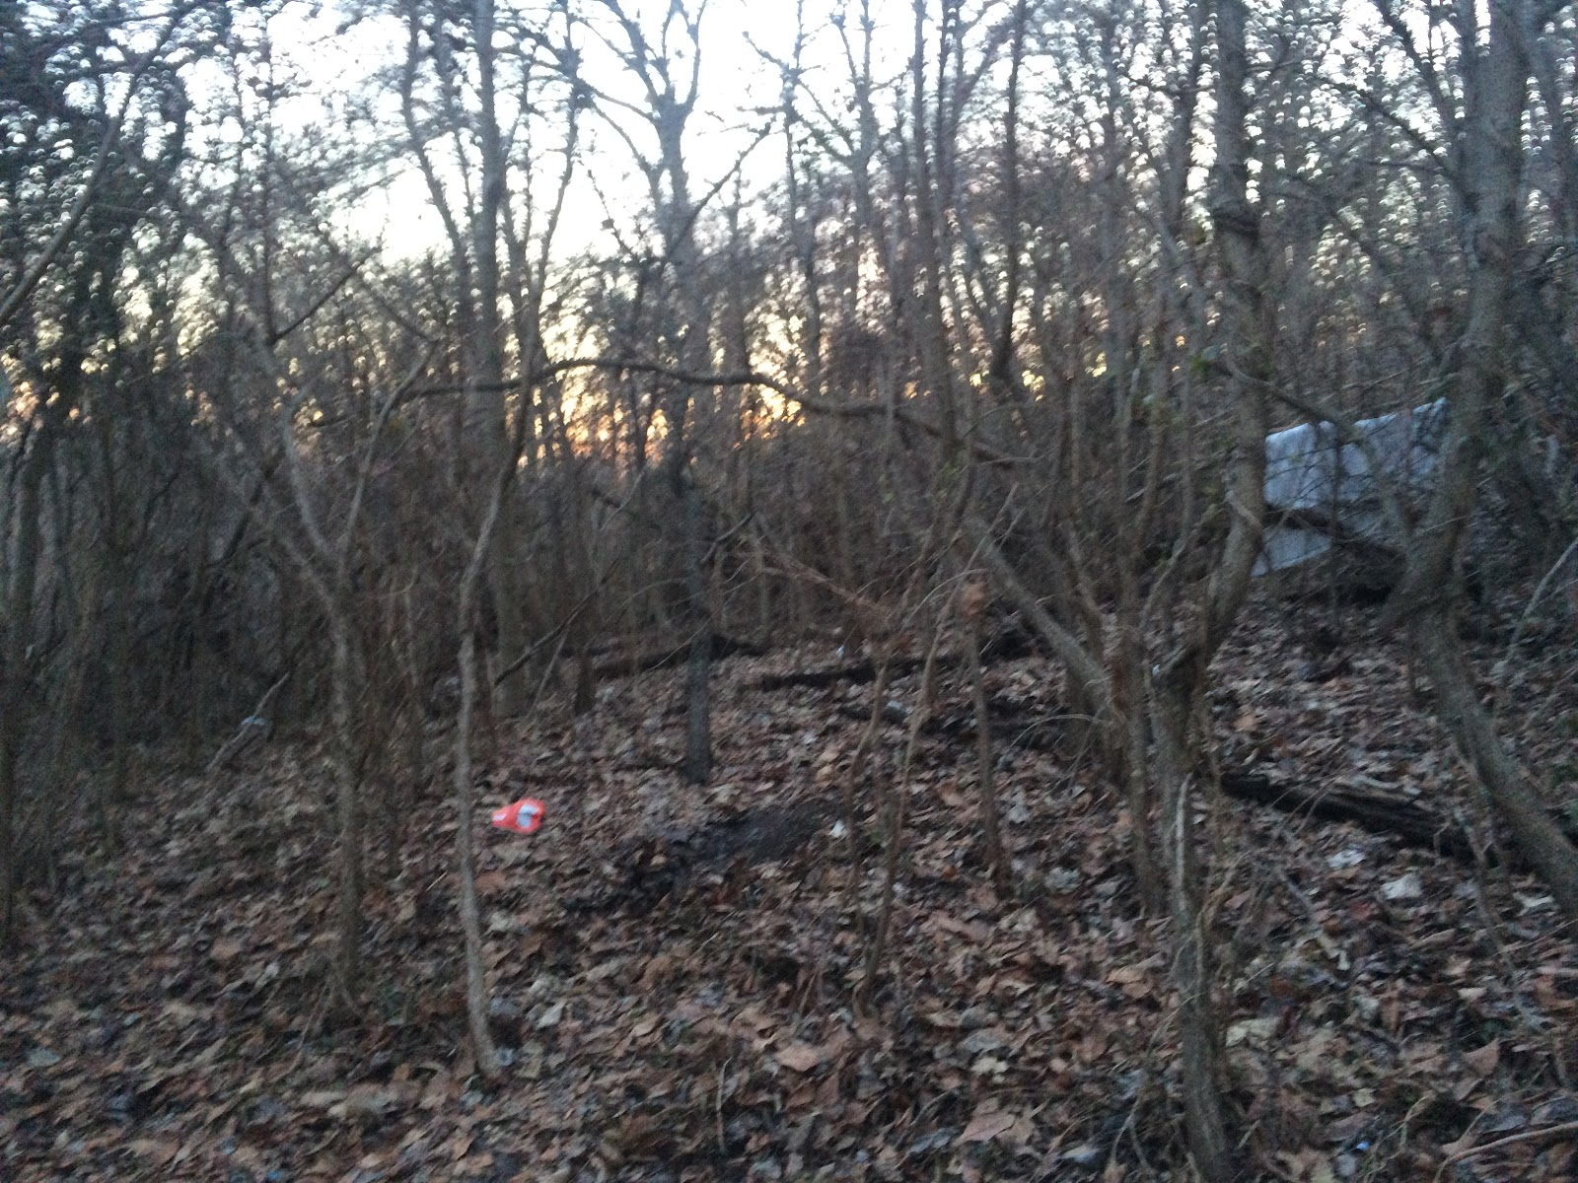
The Biodiversity of Ants in Prospect Park
Hawa Balde, Jhoana Orellana, Mahbub Haque, Tenzin Jangchup
Mentor: Mrs. Apilan
Funded by the
Thompson Family Foundation
High School for Health Professions and Human Services¹, Harlem DNA Lab²
Materials & Methods
The primary question was answered by following the DNA Barcoding protocol. It consisted of several steps that needed to be done in order to obtain the results.
The first step in the protocol is to collect the samples. The next step is DNA sample isolation. Finally the last step is to do a PCR Amplification, and Sequencing the DNA.
Results
The results show that all the ants that were collected were Prenolepis Imparis which is more commonly known as winter ants.
Tables & Figures
Discussion
Based on the results it shows how temperature and weather were a major factor not put to the account of before forming the research. This is because all of the ants were the same species, which only come out during the cold, therefore correlating to the time the samples were collected, late-fall to early-spring. So, the research would have yield varied results if taken during last spring or summer. Another problem was the stretched sample collection time. If the samples were taken at the same time, the data would have been more accurate.
References
Amissah, N. B. (2015, August 5). Could your PCR be affected by contamination? Retrieved May 7, 2018, from http://www.idtdna.com/pages/education/decoded/article/could-your-pcr-be-affected-by-contamination
Biodiversity Background. (2012, March 13). Retrieved from https://sustainableunh.unh.edu/beibackground
Folgarait, P. J. (n.d.). Ant biodiversity and its relationship to ecosystem functioning: A review. Retrieved April 27, 1998, from https://link.springer.com/article/10.1023/A:1008891901953
Introduction to Biodiversity. (n.d.). Retrieved April 09, 2018, from https://sustainability.asu.edu/biodiversityout comes/biodiversity-introduction/
Shah, A. (n.d.). Why Is Biodiversity Important? Who Cares? Retrieved April 09, 2018, from http://www.globalissues.org/article/170/why-is-biodiversity-important-who-cares
Sundquist, T., & Bessetti, J. (2005, September). Identifying and Preventing DNA Contamination in a DNA-Typing Laboratory. Retrieved May 7, 2018, from https://www.bing.com/cr?IG=04EB4AB0E0EC4BEDBF8B88444976BA41&CID=1E2D4A9FCE3868BC167D4176CF9769E7&rd=1&h=TWJQkiqvJe8dvV-xXAICcFjpXWfjs6zQx3IMCPO_Dis&v=1&r=https://www.researchgate.net/post/How_to_purify_contaminated_DNA&p=DevEx.LB.1,5069.1
Ward, R. D., Zemlak, T. S., Innes, B. H., Last, P. R., & Hebert, P. D. (2005, October 29). DNA barcoding Australia's fish species. Retrieved from http://rstb.royalsocietypublishing.org/content/360/1462/1847
Dudu, A., Barbalata, T., Popa, G. O., Georgescu, S. E., & Costache, M. (n.d.). Advantages and limitations of DNA barcoding in identifying commercially-exploited fish species. Retrieved May 12, 2018, from http://spasb.ro/index.php/spasb/article/view/2176
Hebert, P. D., Cywinska, A., Ball, S. L., & DeWaard, J. R. (2003, February 07). Biological identifications through DNA barcodes. Retrieved May 12, 2018, from https://www.ncbi.nlm.nih.gov/pmc/articles/PMC1691236/
Acknowledgements
We would like to thank our mentor Ms. Apilan for her guidance and support throughout this experiment. We would also like to thank the UBP organization because they helped provide the necessary equipment that was needed for this experiment.
Abstract
The research was done to find the balance between ants and the environment to increase the understanding of how the environment affects the ant species in the general area and vice versa by using DNA barcoding. After sequencing the samples they all turned out to be the same species of ants, Prenolepis Imparis.
Introduction
Ants are an integral part of most ecosystems, not only because they form a great part of the animal biomass but also because they are major ecosystem engineers. Therefore, observing the biodiversity of different ant species in different areas is critical. The research question is how are ant species affected by the different environments in Prospect Park and vice versa.
Location | Types of Ants found
Location A | Prenolepis Imparis
Location B | Prenolepis Imparis
Location C | Prenolepis Imparis

