Slide 1
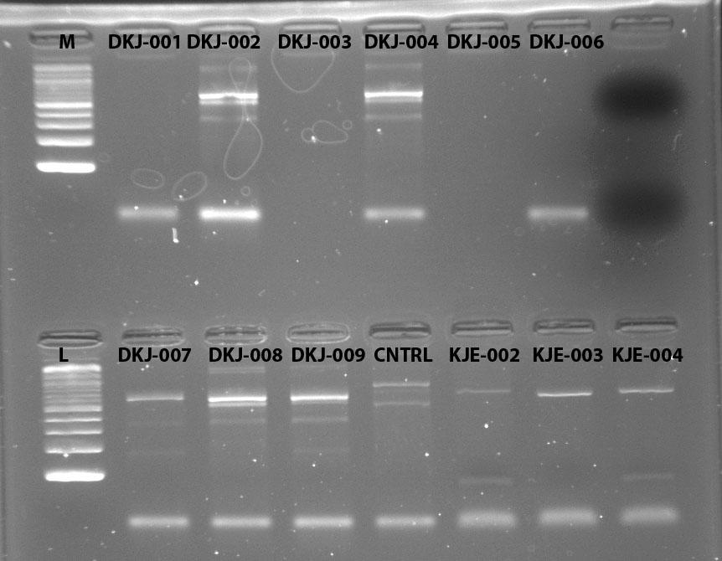
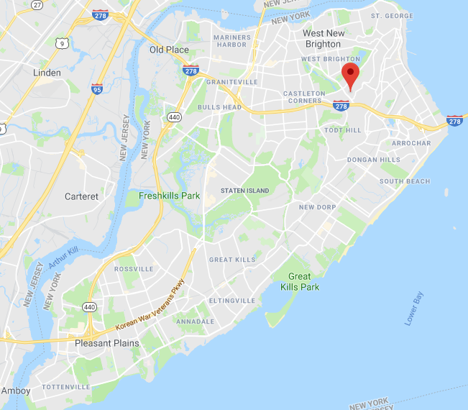
Molds on Our Foods
Jody Peedikayil¹, Sandra Zdunczyk ¹, Rocheli Apilan¹
Funded by the
Thompson Family Foundation
¹High School for Health Professions and Human Services
Abstract
Mold can contain poisonous substances such as mycotoxins which can cause allergic reactions and lead to respiratory problems. They are commonly found on breads because they contain adequate nutrients required for the molds to grow. However, if different types of breads are placed in different environments will different types of molds grow. The study is aimed to identify the different types of mold that might grow on bread in different conditions. Three experimental groups were exposed to cold temperature, warm temperature, and room temperature respectively. Once mold grew it was taken to the DNA Barcoding Lab were the DNA was extracted and sequenced. The whole grain bread in warm temperature, the multigrain bread in cold temperature, and all three breads in room temperature were identified as “penicillium”. The other four samples from the experimental groups were not successful in being sequenced.
Introduction
Molds are eukaryotic microorganisms that are decomposers of dead organic material such as leaves, wood and plants (“What Is Mold,” 2011). As hyphae grow over time on breads the appearance of the organisms become discolored and start to get fuzzy. It is said that “symptoms such as stuffy nose, wheezing, and red or itchy eyes, or skin can occur. Some people, such as those with allergies to molds or with asthma, may have more intense reactions” (“CDC,” 2017). Also, “when a baby breathes in mycotoxins (a toxic substance produced by a fungus), the blood vessels in the baby’s lungs are weakened” (Editor,2017). Due to all these health problems, it is directed for many people to take precautions when handling with any sort of mold, especially on consumable foods like bread.
To understand the different types of mold that can grow on breads, the experiment designed a setup where the three samples of each of the three most common breads where placed in three different locations- a heated room, a cool temperature room, and room temperature. In this research experiment two independent variables were manipulated, while still keeping the results accurate. One of the independent variables tested was the different composition of breads; white grain, multigrain, and whole grain bread were all used. Then that variable was manipulated by placing a slice of each into three different temperature existing environments. By manipulating both variables of temperature and nutrients, the corresponding variable that will respond to these independent variables would be the mold that is grown.
This setup was designed to test if different molds will appear on different types of bread in different environments. Mold comes in all different forms and types, because of this it is hypothesized that the mold that grew on the samples in each environment will be different between each other. Identifying the mold that grows on the bread can help decipher if the molds appeared are harmful to the human body. To measure the type of mold that grew as a result of the change in temperature and composition of the bread can be found in multiple ways. The most effective way, which is used in this experiment is to sequence the DNA and compare the DNA from other known molds to identify and classify the mold. This is the most effective because the actual DNA is being compared instead of just the physical appearance of the mold on the bread.
Materials & Methods
The first step was to purchase the three different breads; whole grain, white grain, multigrain bread which was used in this experiment. Each slice was placed into Ziploc bags, and placed in their designated environment. For the first experimental group take one of each type of bread and place them in a room of a temperature around 80℉, then for the second experimental group place another slice of each type of bread in a cooler temperature of 60℉. For the control group place each type of bread is placed into a room temperature area. For the next six days, record and observe the growth of any mold on each bread at the same time. Once each sample of bread has mold on it, take it to the DNA Barcoding Lab 101. While wearing a lab coat and gloves, use a scraper to get as much mold from the bread into a fresh tube for each sample of bread. Then use the DNA Barcoding Lab protocol to extract the DNA from the mold properly. This will include using and mixing many solutions with your DNA to clean and isolate the DNA sample by itself.
Then after storing it in an ice bath for given time, the DNA should be amplified following the protocol. This includes placing it in the thermal cycler for three hours, where the DNA will be able to amplify. After that is complete electrophoresis the samples at 130 volts, 400 mA, and for 30 min, for those 30 minutes store the PCR tubes in ice these samples will be used for sequencing. Once the electrophoresis is finished, photograph and upload the picture of the gel, where the samples that were successful will be used in the sequencing section. The successful samples will be sent to another lab where it will be sequenced.
Using the DNA Subway application, the relationships of the sequences was determined using the blue line portion. In this section, the uploaded sequences are trimmed and paired, and then it is blasted to determine the species of each sequence. The program also generates two phylogenetic trees that can be used to help analyze the similarity and differences of the sample’s sequences and their consensus sequence.
Results
Preparing the data was accomplished by using the online program DNA Subway. This program inserted the sequence of each sample that was found in the lab. With the sequences uploaded, the program was able to trim the sequence to where only the needed codes were being used. Then the program blasted the sequence in a way that each sequence was compared to ones already in the database and used to identify the mold. In the last step on the program they used two types of phylogenetic trees (PHYLIP ML and PHYLIP NJ) found in figure 4 and 5, to help analyze the data. As for the results found at the end of the program setup, the five successful samples that were sequenced were all classified as penicillium. Referring to figure 1, figure 2, and figure 3 the only four successful samples in all three environments were able to be identified. As shown in figure 6, the gel electrophoresis in row one for well numbers 2,4,6, and 7 were unsuccessful because when comparing it to the ladders on the first well the bars were not similar or didn’t appear.
Discussion
The hypothesis was not supported because the mold that grew on the successful samples were all classified as penicillium. This may have occurred because of many reasons, which include how the type of grain in the breads did not have an effect because they all contained similar ingredients of salt and sugars. Another reason can be because of how temperature does not affect the type of mold growth but just elongates the process of the growth.
Even though each bread was composed of either white grain, whole grain, or multigrain compositions they could have all contained the same amounts and types of sugars and salts. This can play a major role in the type of mold that grows, because mold needs nutrients to prosper. These nutrients do not specifically rely on the type of grain, but more on the other ingredients such like salts and sugars. It is said that molds need nutrients such as sugar or salts because the molds use this food source to thrive and grow throughout the surface of the bread. On each packaging of bread used, they all contained 3 grams of sugars which can explain why on each bread sample penicillium was the only mold that grew. Each type of bread was placed in three different environments, but they all resulted in the growth of penicillium. This may have occurred because the change in temperature didn’t affect what type of mold will grow but how long it will take the mold to actually grow. It is stated that If the temperature is too cold, like in the freezer, the little spores will not be able to grow and will shrivel up. This can explain why in each location they grew at different rates but all were classified as penicillium. For example, on the sixth day the three samples of bread in the warmer conditions spread massively over the surface of the bread. While the three samples of bread in the cooler temperatures only started to grow at the corners of the breads.
One limitation to these results is that not all nine samples of bread mold were able to be sequenced and identified. This impacted the general results that was trying to be obtained, because four samples from the warmer and cooler environments were not successful when being gel electrophoresis. Due to this four samples were not able to be sequenced causing inconclusive results for them. Without these results a general statement of the research could not be properly concluded. However, with the classification of the successful samples we can conclude that specific types of breads and its environment would not entirely change the type of mold that will grow, but it can change the time it takes for the mold to grow. With the understanding of these results to better improve this research experiment, the breads should now differ in the other ingredients composed of the bread and when it comes to extracting the DNA be very careful to follow each step clearly so that the gel electrophoresis would be successful for all testing samples.
References
Editor. “Mold and Babies: How Mold Can Affect Your Baby.” American Mold Experts, American Mold Experts, 12 June 2017, americanmoldexperts.com/mold-and-babies/.
Mold 101: Effects on Human Health. (n.d.). Retrieved April 22, 2018, from https://www.poison.org/articles/2011-oct/mold-101-effects-on-human-health
Mold. (2017, December 20). Retrieved from https://www.cdc.gov/mold/faqs.htm
What Is Mold? (n.d.). Retrieved from http://www.intuitiveenvsol.com/what-is-mold-.html
Reynolds, L. (2018, April 17). How Does Mold Grow on Bread? Retrieved from https://sciencing.com/mold-grow-bread-5403099.html
Acknowledgements
We would like to acknowledge Mrs. Apilan for her mentorship. We would like to also acknowledge the Urban Barcoding Program, including the Cold Spring Harbor Laboratory and the Thompson Family Foundation for supplying us with equipment and the instructors expertise to help us successfully extract and sequence the DNA of the mold samples.
Figure 6 (above) shows the gel electrophoresis result of all nine samples
Figure 1 (above) Classification of the Samples in the Warmer Temperature Room
Figure 2 (above) Classification of the Samples in the Cooler Temperature Room
Figure 3 (above) Classification of the Samples in the Room Temperature Area
Figure 7(above): Map of where samples were collected in Staten Island
Figure 4 and 5 (above): Phylogenetic Tree showing the relationship between the mold species found on the five successful samples

