Slide 1
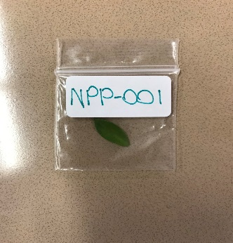
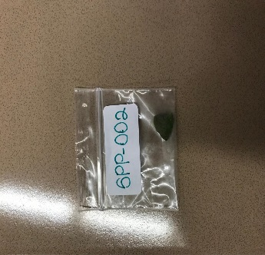
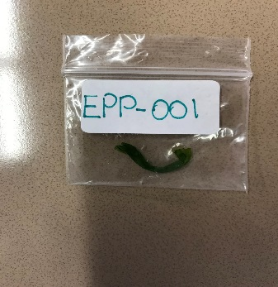
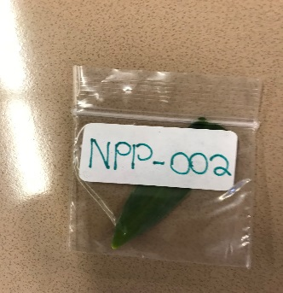
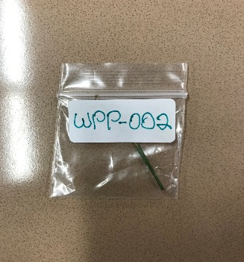
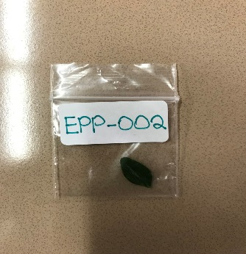
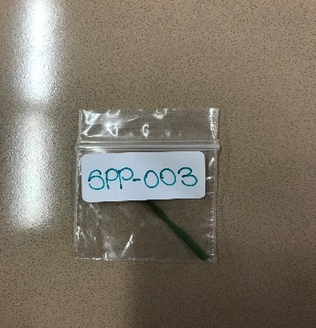
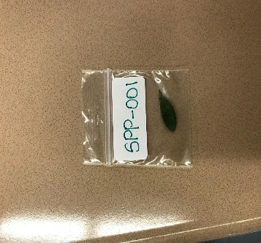
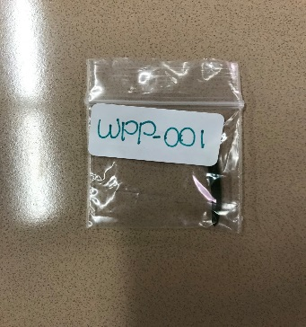
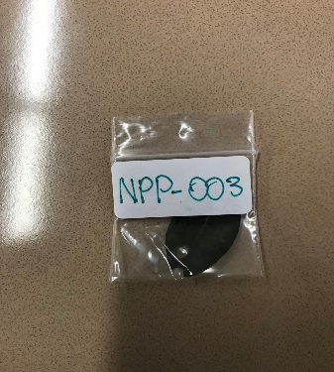
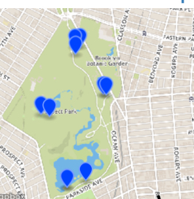
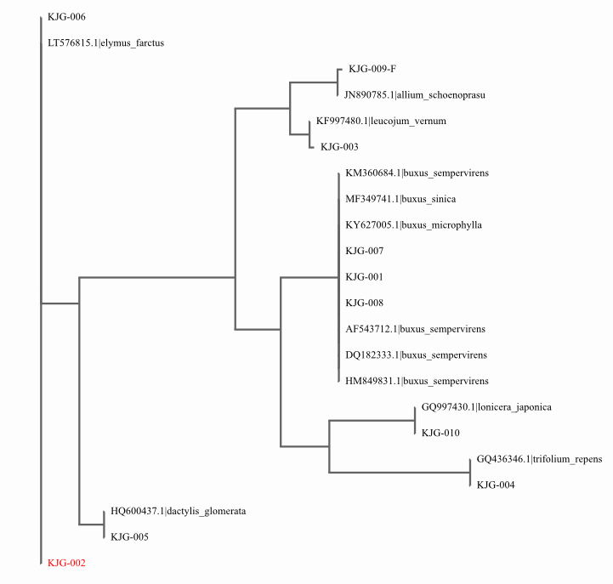
DNA Barcoding of Ground Plants in Prospect Park
Keith Chen¹, Isaiah Osei-Gyening¹, Mareelin Teolopez¹ , Rocheli Apilan¹
Funded by the
Thompson Family Foundation
¹ High School for Health Professions and Human Services
Abstract
Prospect Park is known for their diversity in life, with about 30,000 trees which represent more than 200 species in the park. We wanted to conserve the biodiversity of plants in Prospect Park by using DNA barcoding to identify the different species of ground plants in different locations of the park. We collected the samples from the north, south, east and west parts of Prospect Park. Afterwards we took them to the Harlem Labs to barcode the samples. Using the DNA Barcoding procedure we isolated the DNA, amplified the DNA through PCR, passed the samples through gel electrophoresis and identified the species using DNA Subway as a tool to match our samples to their database. Overall, there was more diversity at the north and south than there is in east and west. The team sighted two Lonicera Japonica which is rare to the U.S. since its native to Asian countries.
Introduction
We decided to do DNA barcoding on the plants of Prospect Park because of its diversity of plants it has in the park. There are about 30,000 trees, which represent more than 200 species in the park. Some of these plants include Sycamore Maple, London Plane Tree, American Holly, Sweetbay Magnolia and etc… these are only some of the most commonly plants that are seen all over the park.
The reason we decided to analyze the Genetic Components of the leaves located at Prospect Park is to observe the Biodiversity in that certain area. It will be important to identify the plants in the certain area because it will help us understand how to conserve the plants to balance the ecosystem, so it will not disturb the food chain. We hypothesized that the DNA of the samples will show a large diversity among the four different locations
Materials & Methods
We located four areas of Prospect Park on a sunny day after it snowed (February 20 2018). We had plants representing the North, South, East and West and collected a few samples from that area and placed them in plastic bags. Afterwards, we separated the repeated samples and placed them in smaller bags and labeled accordingly based on location (According to table 1). The DNA was extracted following the DNA Barcoding protocol. We then amplified the DNA through PCR. Following PCR, we did the gel electrophoresis. Afterwards we sent our samples to be sequenced. Using the DNA Subway website, we were able to match our samples to a sample in the database and identified what our samples were. Finally we compared the different samples to find the diversity of the area compared to other areas and to find any unusual plants.
Results
In the west side of Prospect Park we found that the two samples collected had similar characteristics to Elymus Siribias and Elymus Farctus. In the East side we found that the two samples collected were most similar to Allium Schoenoprasum and Buxus Sempervirens. Towards the North side, we found the samples being closely related to Buxus Micropylla, Leucojum Vernum and Lonicera Japonica. The samples collected in the south were found to be similar to Buxus Sempervirens, Trifolium Repens and Dactylis Glomerata.
Tables & Figures
Table 1: Samples obtained from different locations at Prospect Park
Table 2: Scientific names of the samples collected in Prospect Park
Discussion
The results showed that there isn’t much diversity in the west. The north and the south on the other hand showed three distinct species not part of the same family. We expected more diversity among the samples, but it was sort of expected since we collected our samples after a snow storm. We also found a sample not native to the United States (Lonicera Japonica). We only sighted two of Lonicera Japonica in the whole park. For future studies we would collect the samples during the spring times to see the different plants that would’ve grown.
References
Group1, C. P., Hollingsworth, P. M., Forrest, L. L., Spouge, J. L., Hajibabaei, M., Ratnasingham, S., . . . Little, D. P. (n.d.). A DNA barcode for land plants. Retrieved December 03, 2017, from http://www.pnas.org/content/106/31/12794.short
Kress, W. J., Wurdack, K. J., Zimmer, E. A., Weigt, L. A., & Janzen, D. H. (n.d.). Use of DNA barcodes to identify flowering plants. Retrieved December 03, 2017, from http://www.pnas.org/content/102/23/8369.short
Lahaye, R., Bank, M., Bogarin, D., Warner, J., Pupulin, F., Gigot, G.,... Savolainen, V. (2007). DNA barcoding the floras of biodiversity hotspots. PNAS, 105, 8, 2923-29228. https://doi.org/10.1073/pnas.0709936105
Smith, M. A., Rodriguez, J. J., Whitfield, J. B., Deans, A. R., Janzen, D. H., Hallwachs, W., & Hebert, P. D. (2008, August 26). Extreme diversity of tropical parasitoid wasps exposed by iterative integration of natural history, DNA barcoding, morphology, and collections. Retrieved April 11, 2018, from http://www.pnas.org/content/105/34/12359.short
Vences, Miguel, et al. “Deciphering amphibian diversity through DNA barcoding: chances and challenges.” Philosophical Transactions of the Royal Society B: Biological Sciences, The Royal Society, 29 Oct. 2005, www.ncbi.nlm.nih.gov/pmc/articles/PMC1609216/.
Acknowledgements
We would like to thank the people in the DNA Harlem lab for giving us the opportunity to conduct our research with them. I would also like to thank our teacher for helping us and encouraging us in our research study.
Latitude | Longitude | Location | Sample # | Name
40.661 | -73.972 | West | 1 | Elymus Siribias
40.661 | -73.972 | West | 2 | Elymus Farctus
40.663 | -73.963 | East | 1 | Allium Schoenoprasum
40.663 | .73.963 | East | 2 | Buxus Sempervirens
40.668 | -73.968 | North | 1 | Buxus Microphylla
40.668 | -73.968 | North | 2 | Leucojum Vernum
40.668 | -73.968 | North | 3 | Lonicera Japonica
40.653 | -73.966 | South | 1 | Buxus Sempervirens
40.653 | -73.966 | South | 2 | Trifolium Repens
40.653 | -73.966 | South | 3 | Dactylis Glomerata

