Slide 1
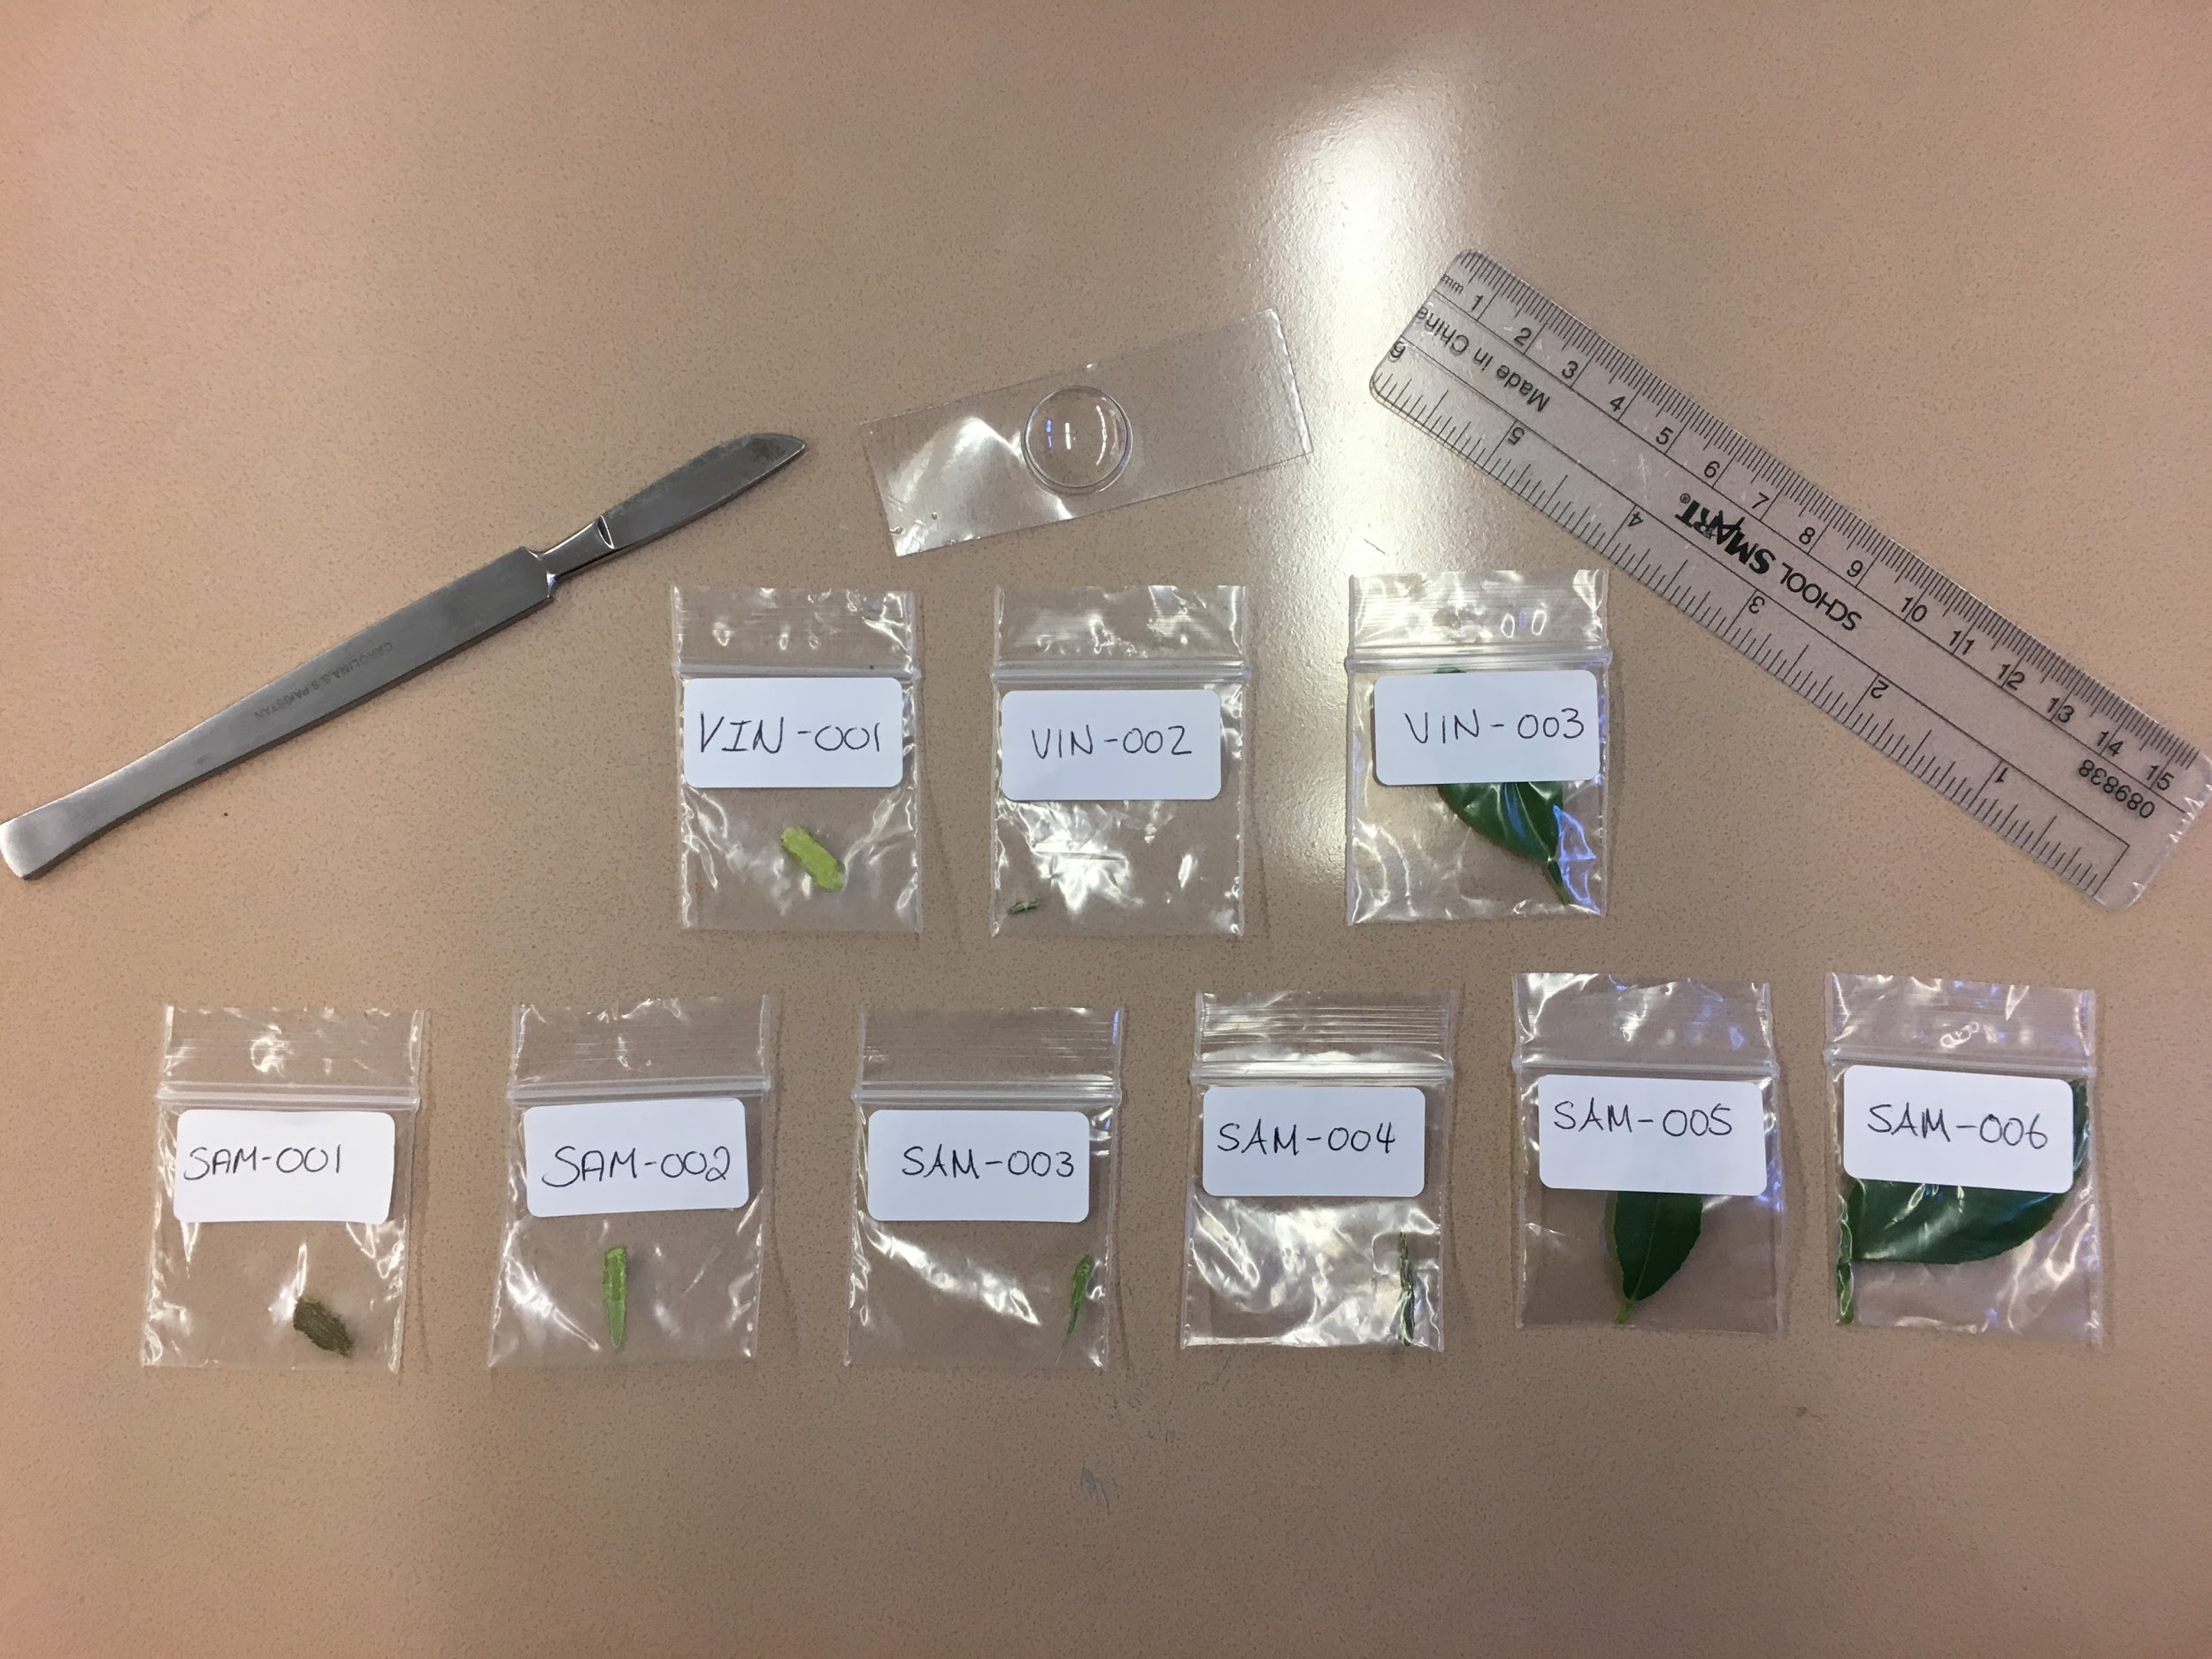
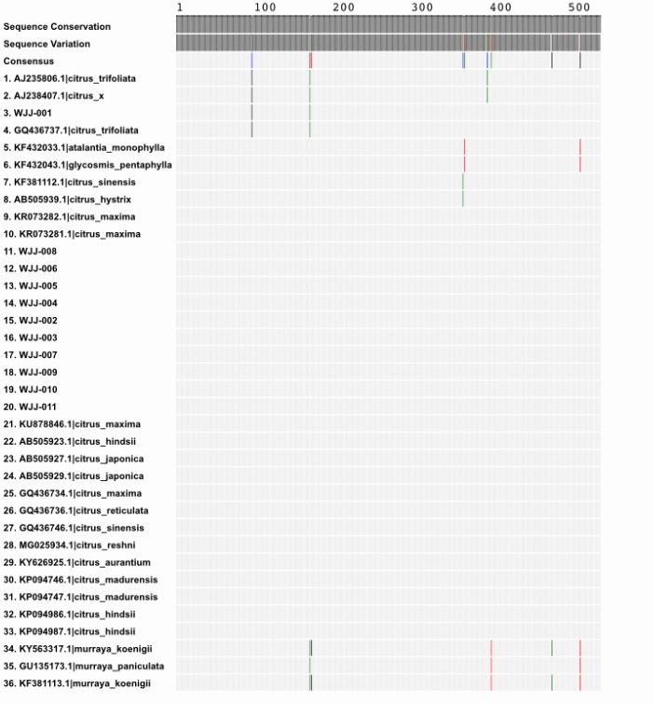
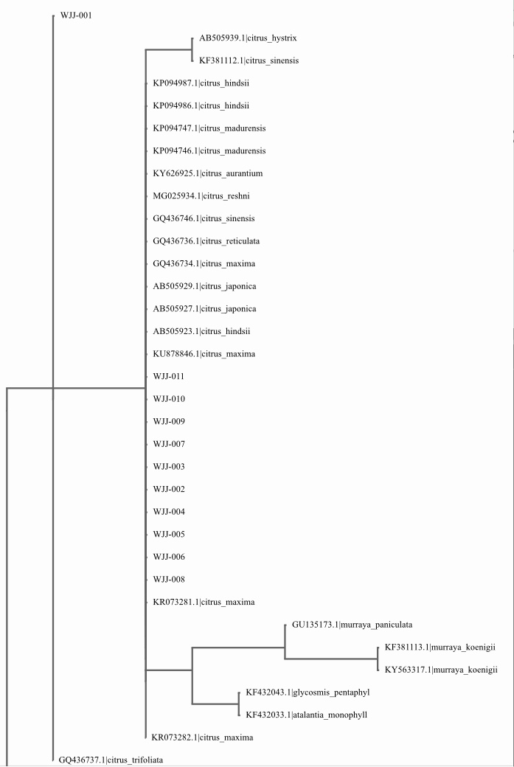
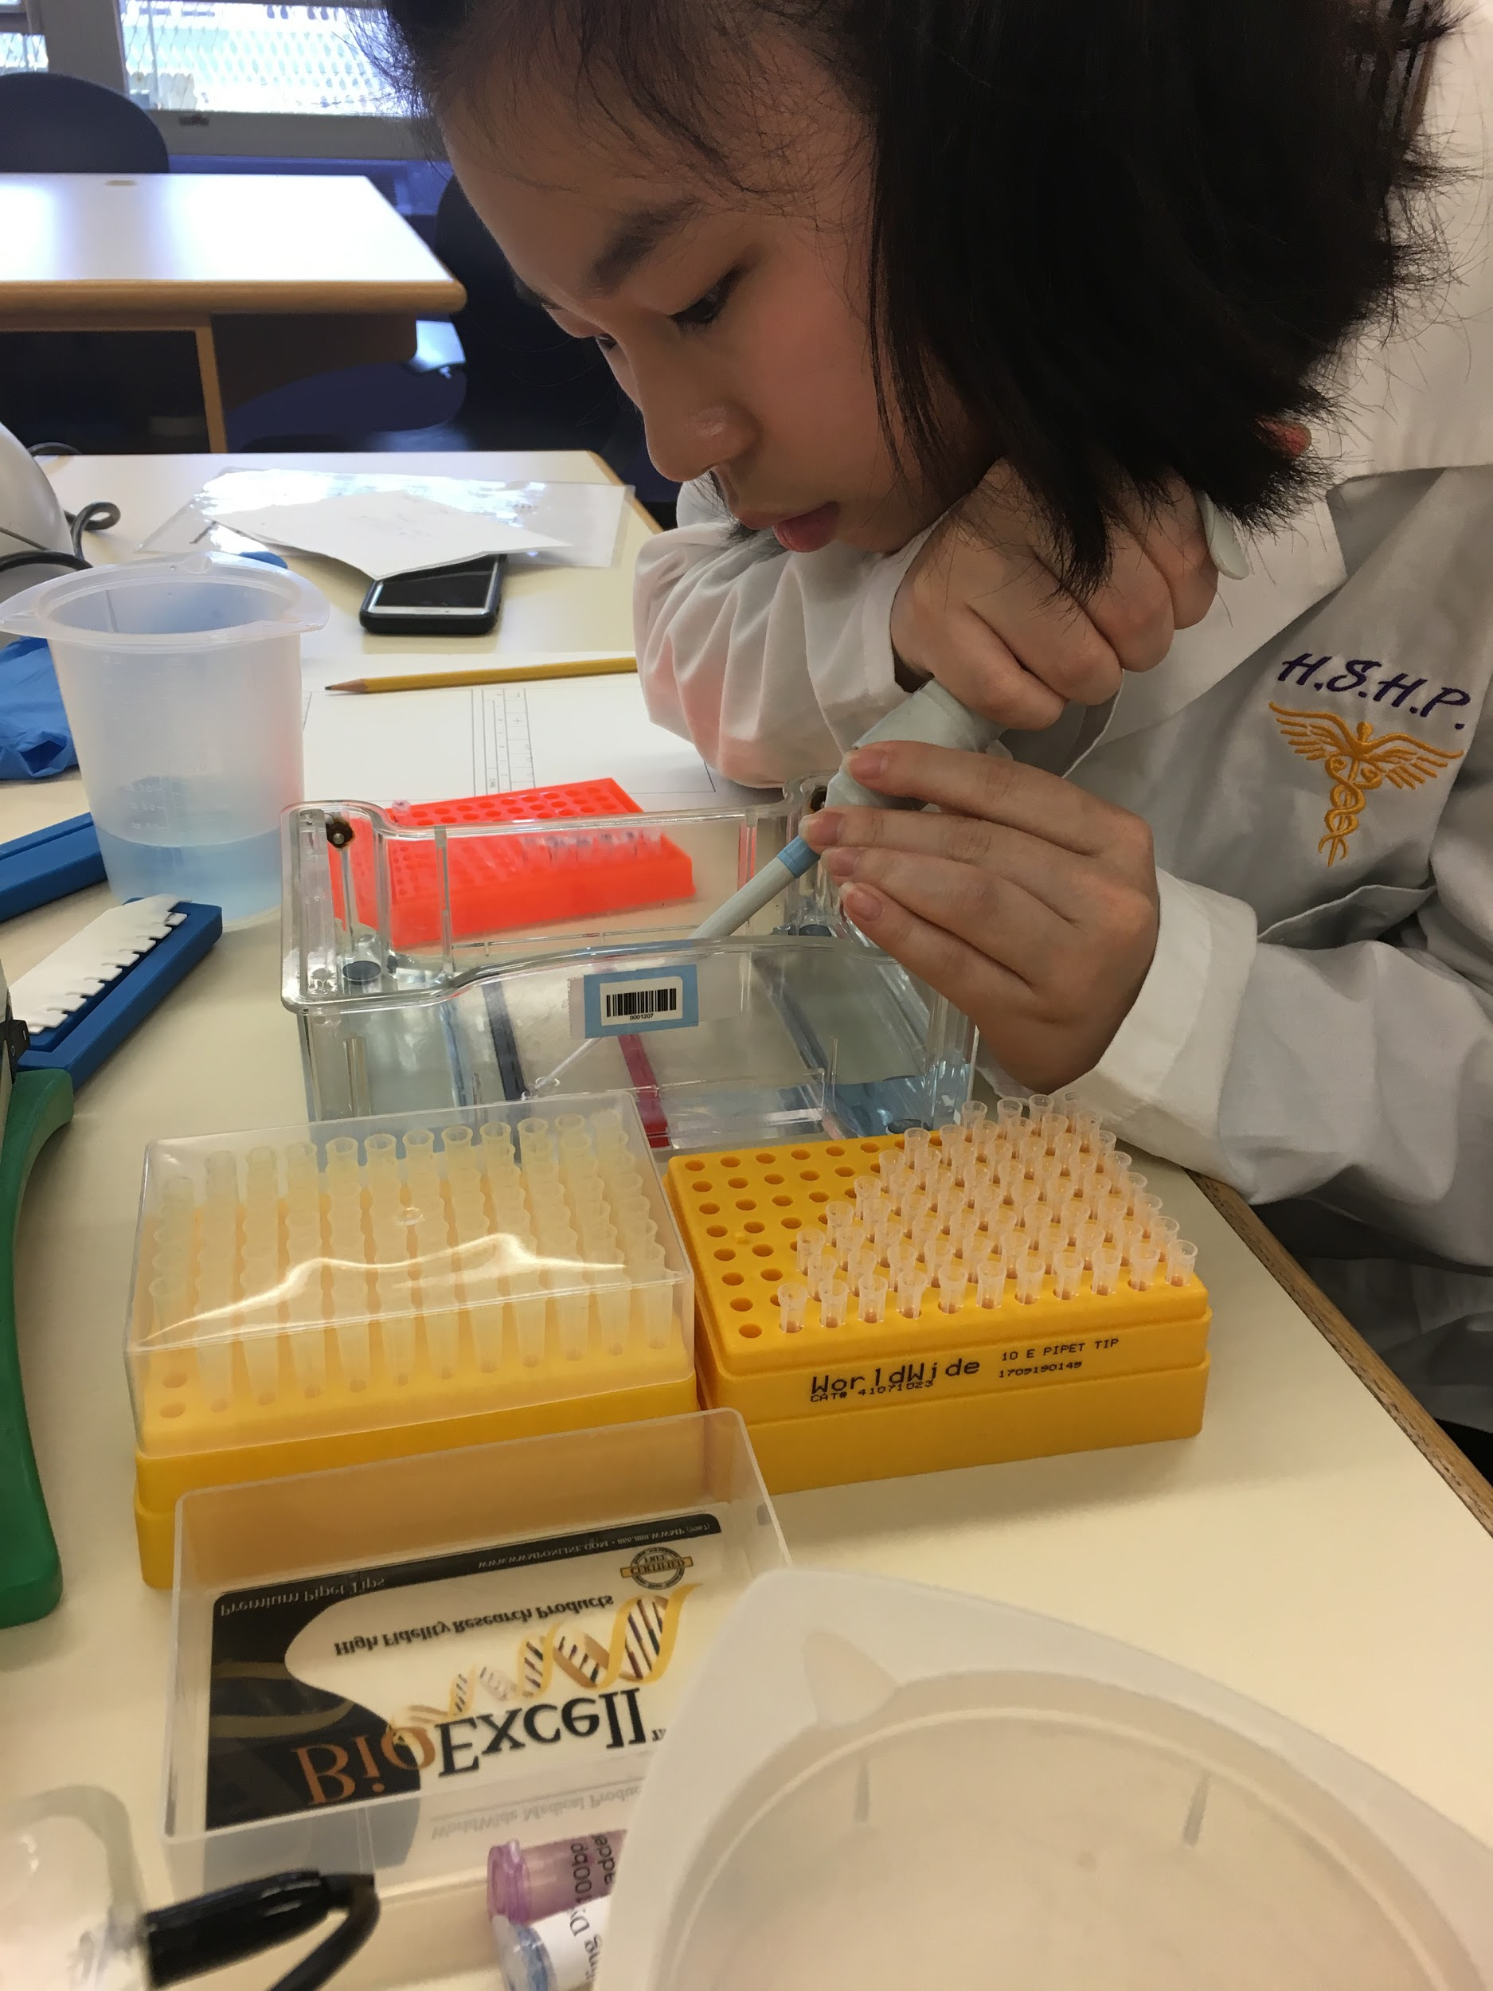
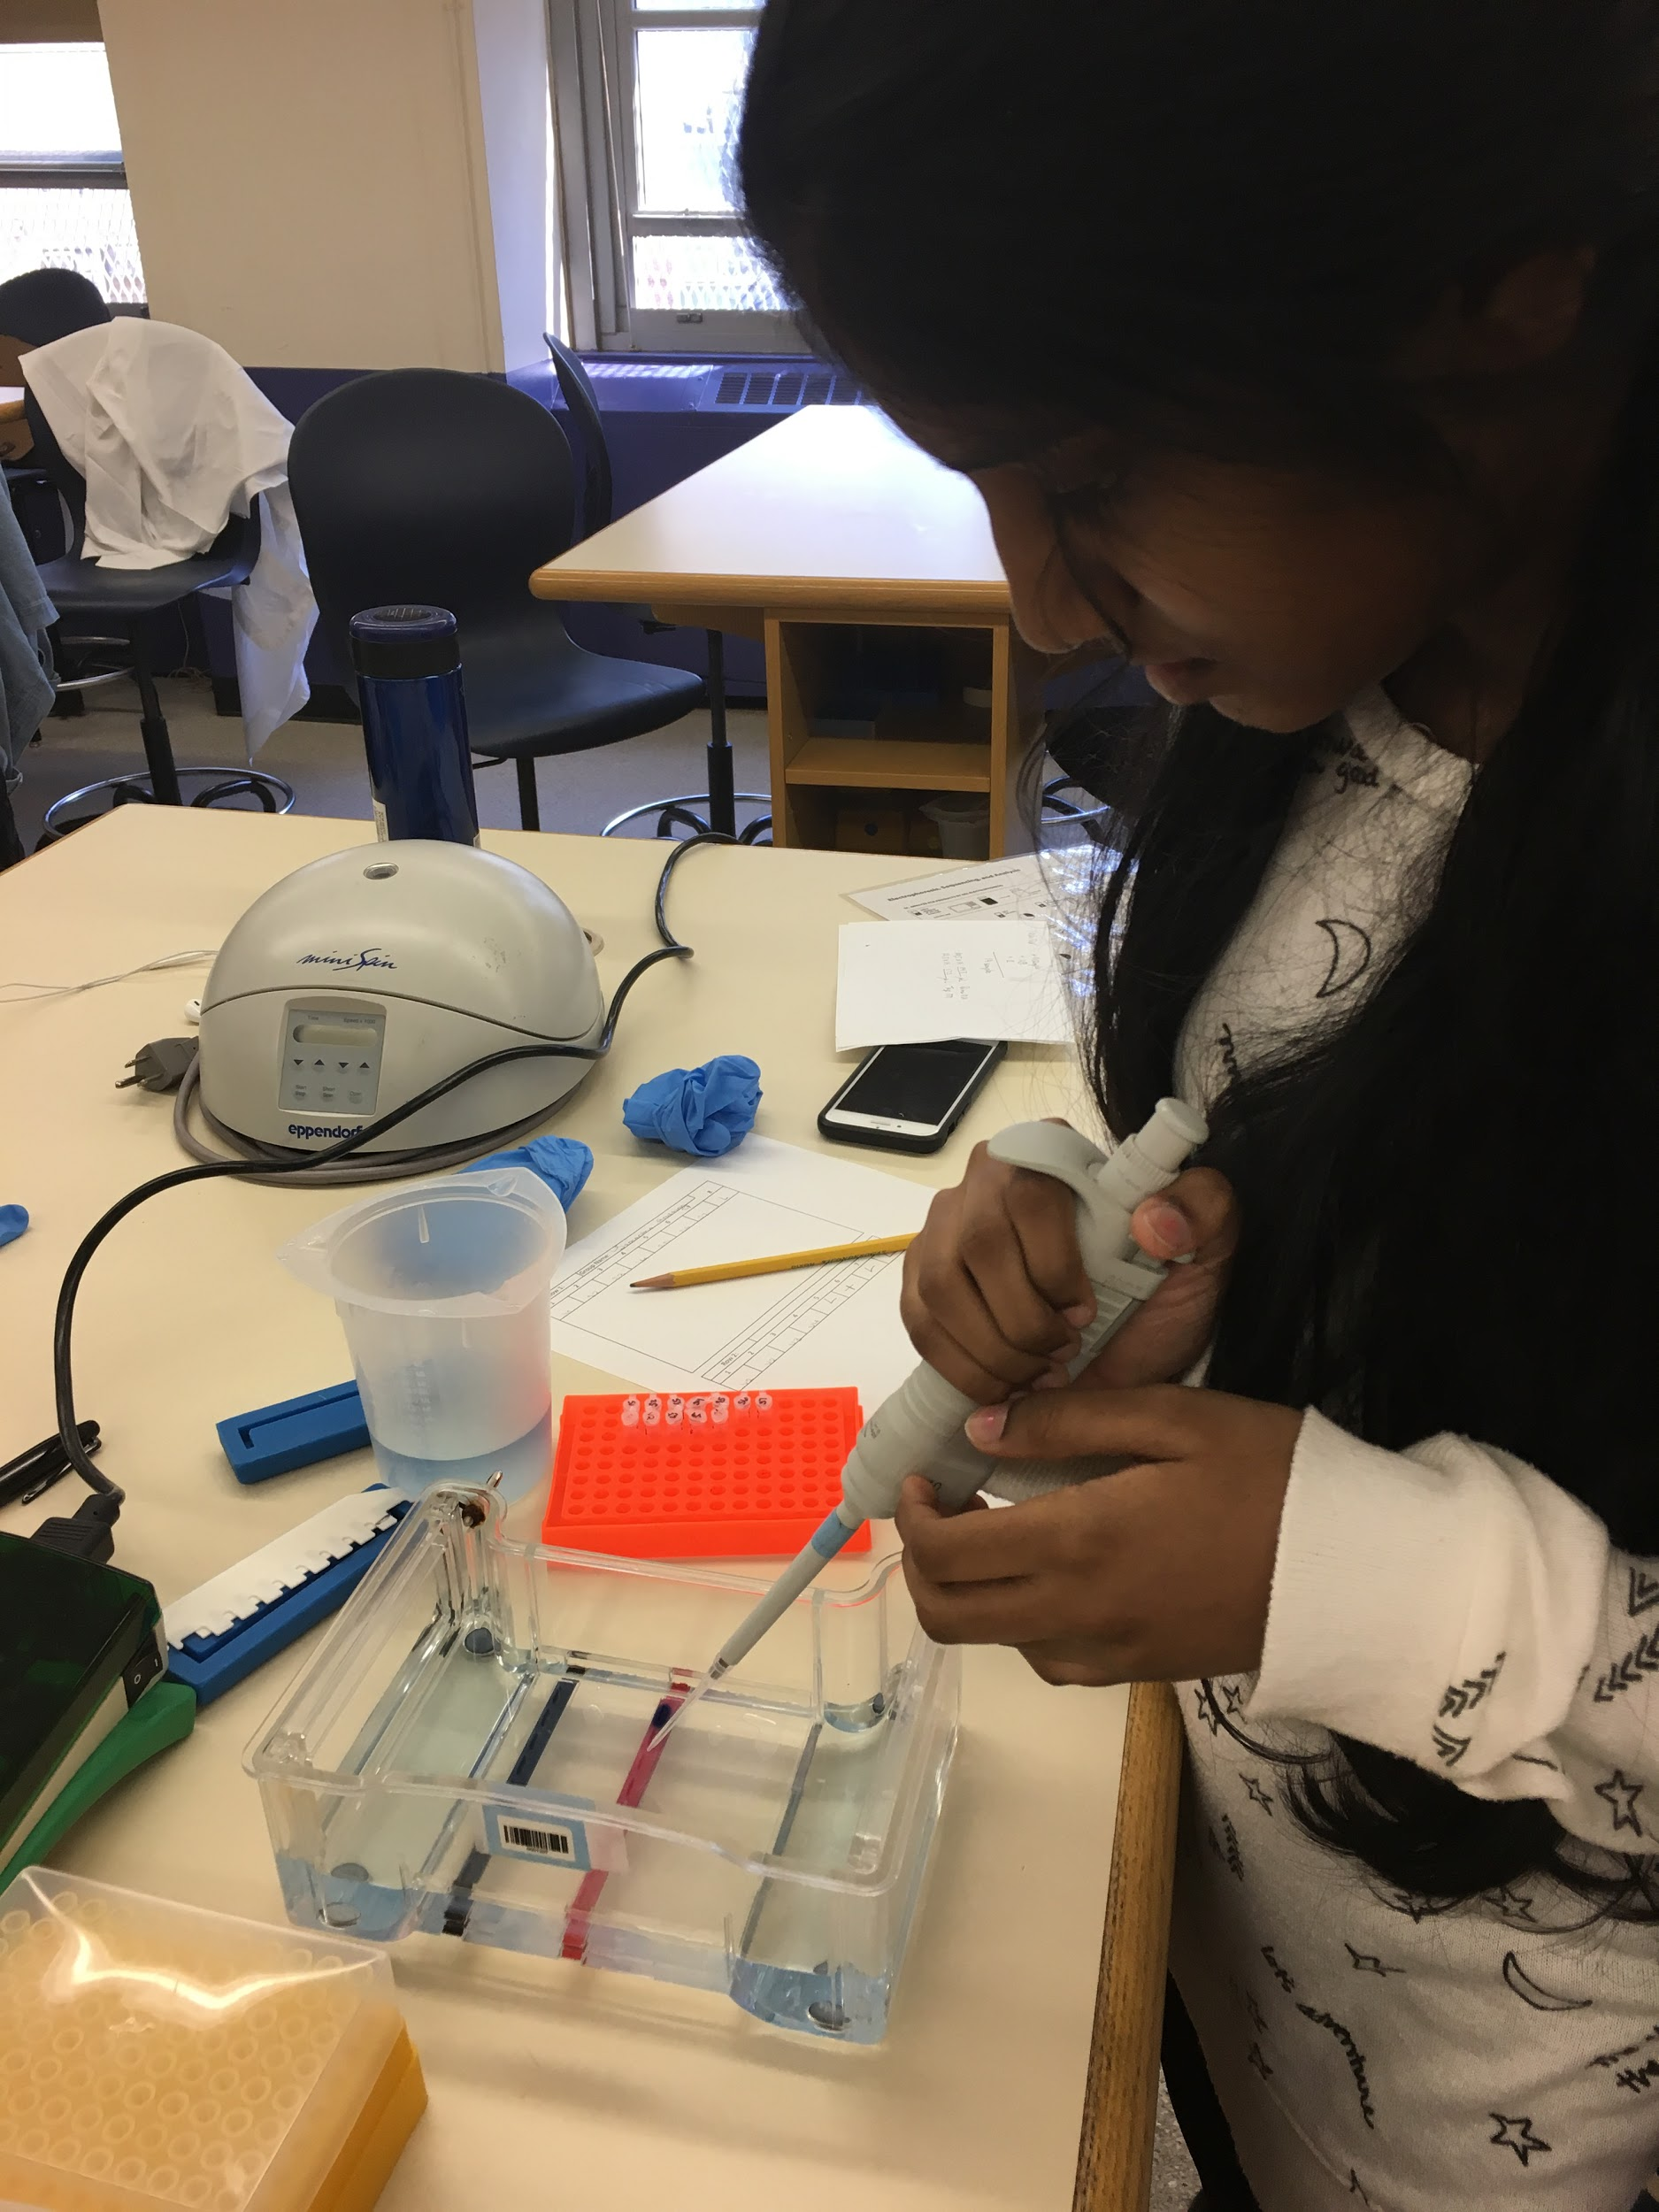
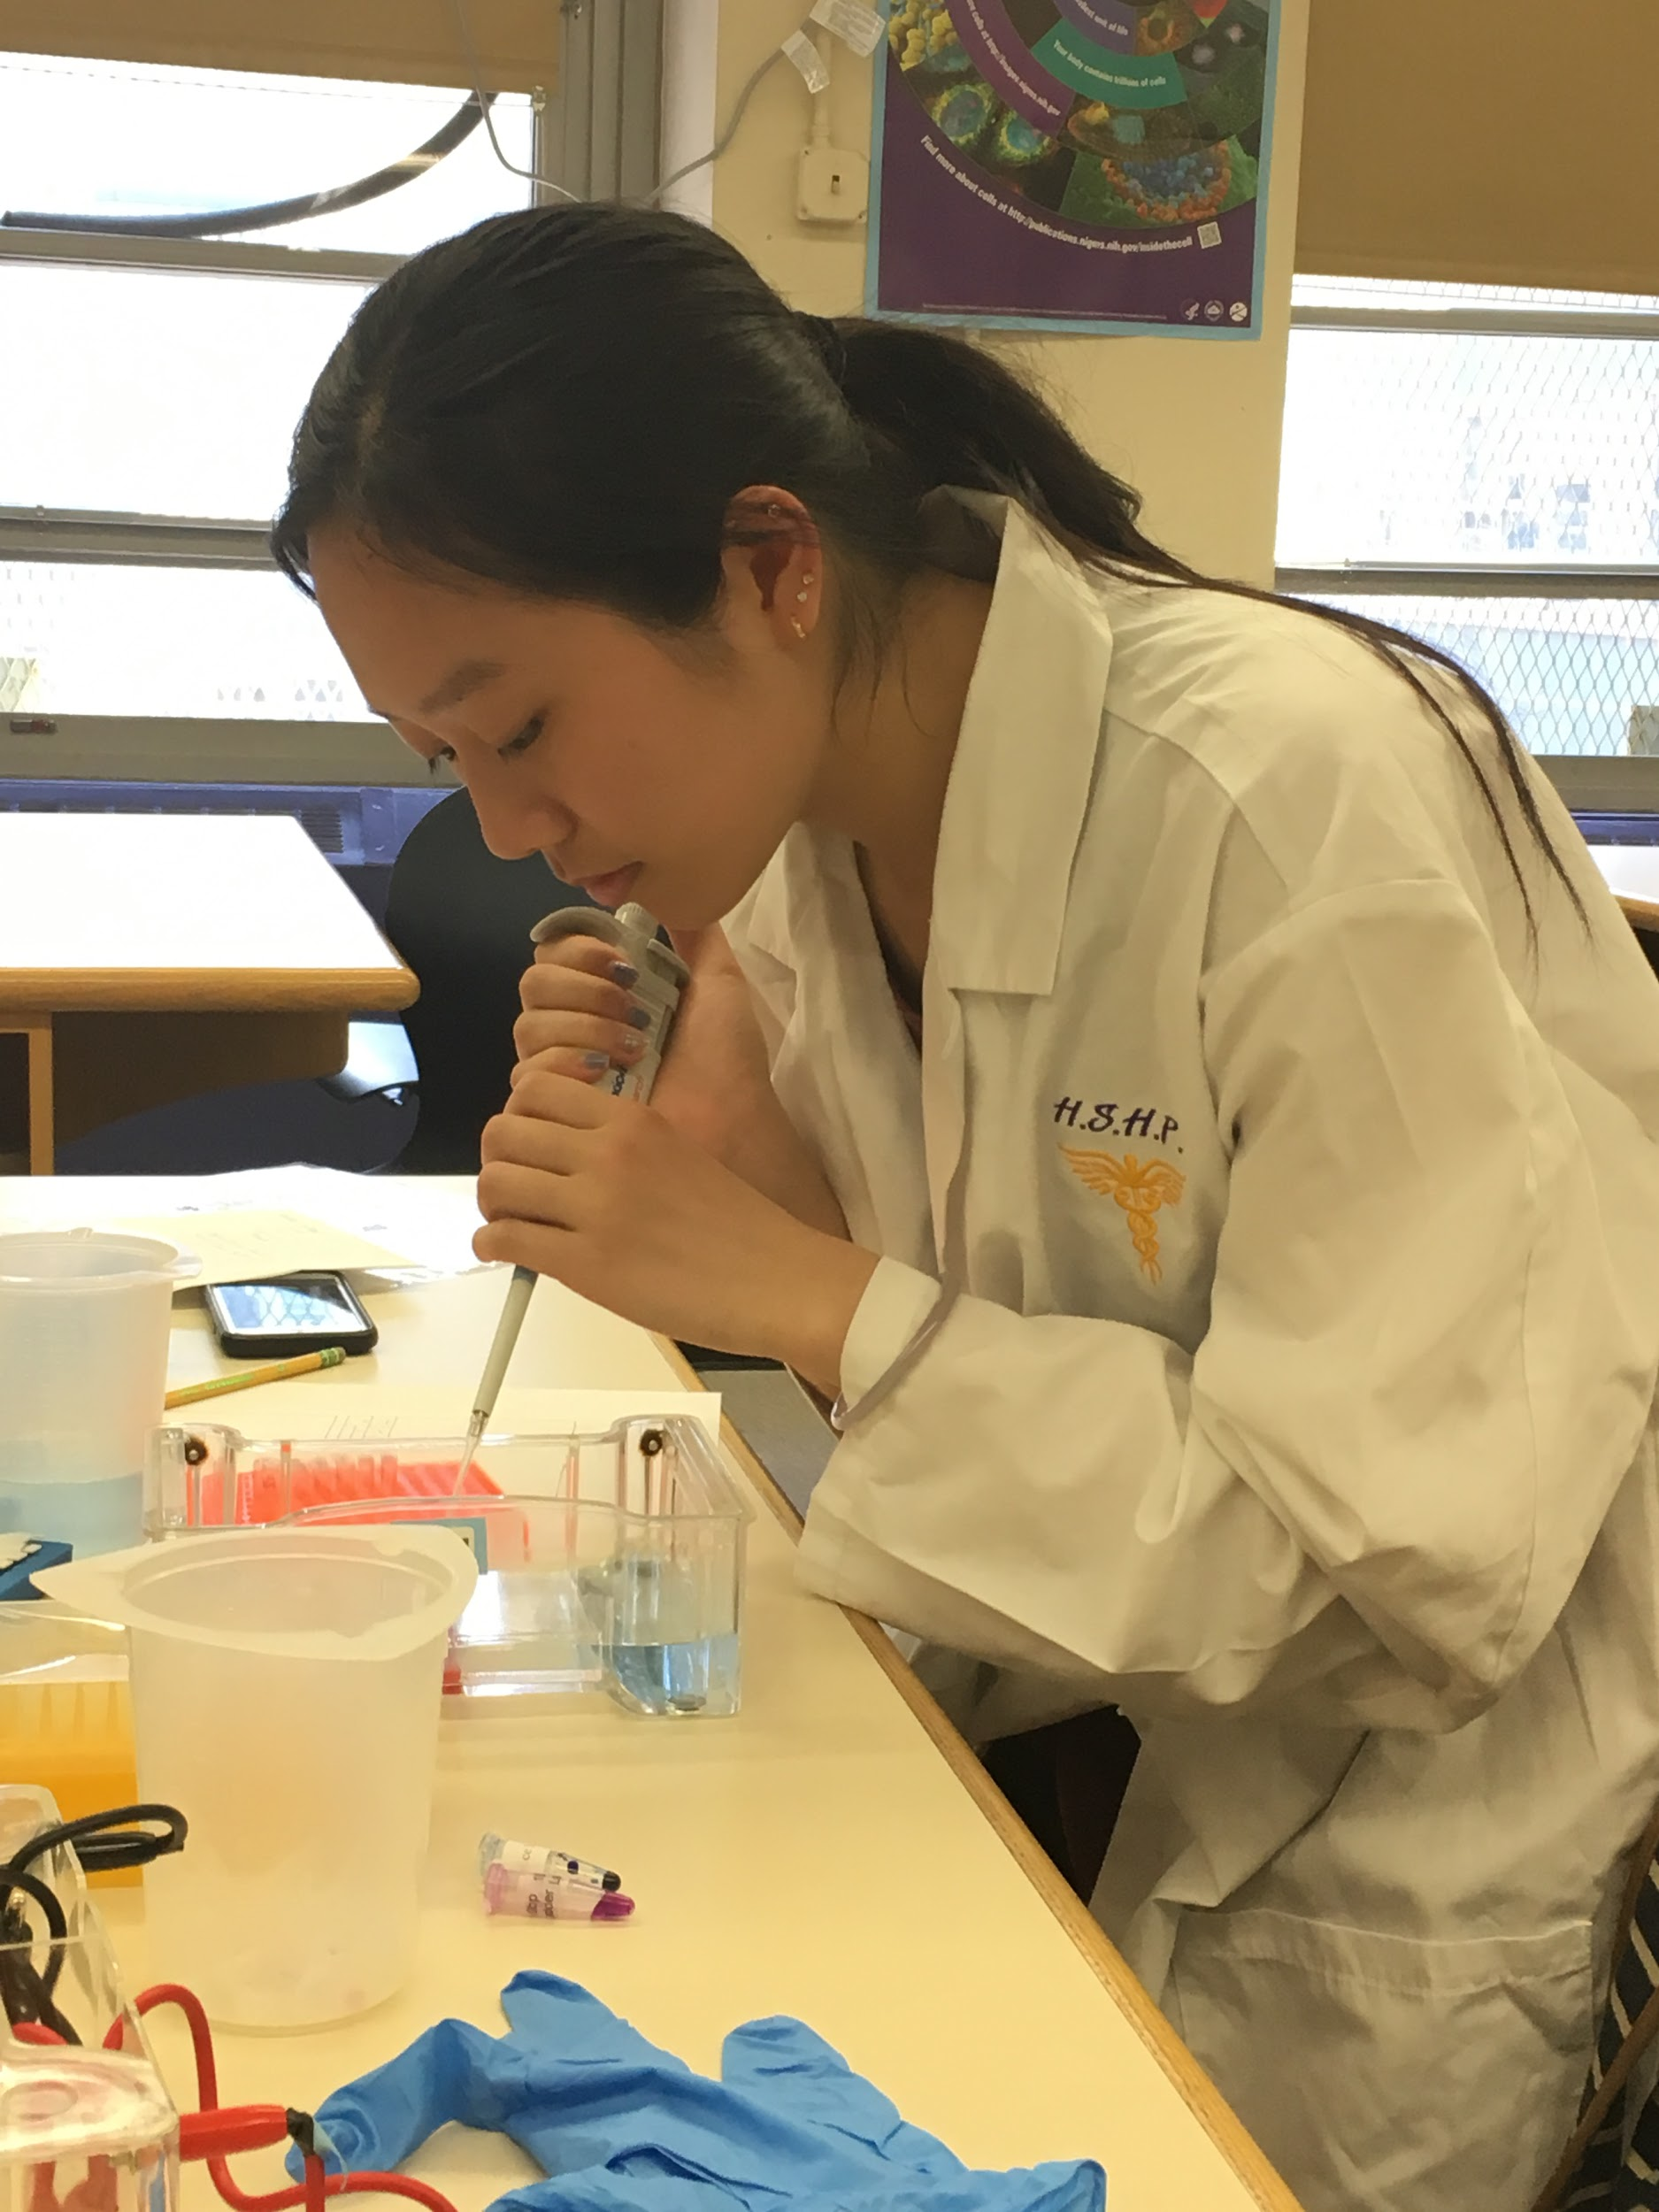
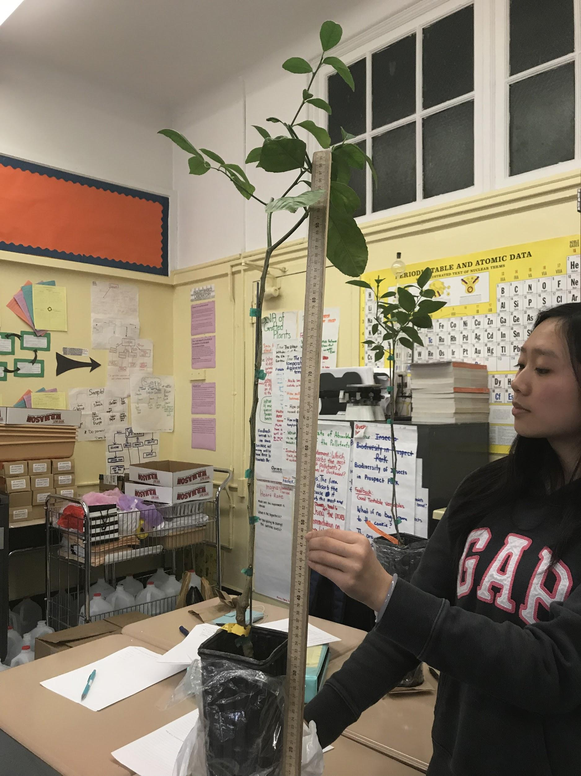
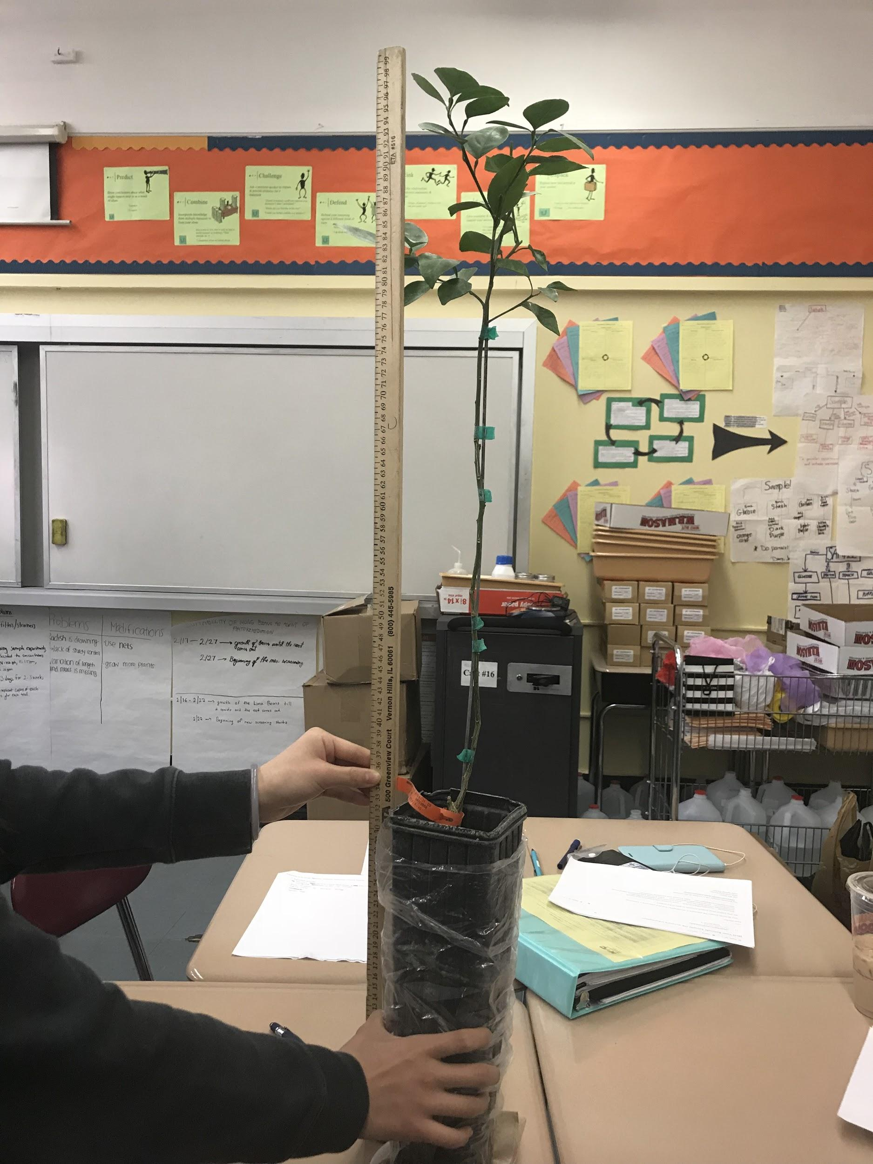
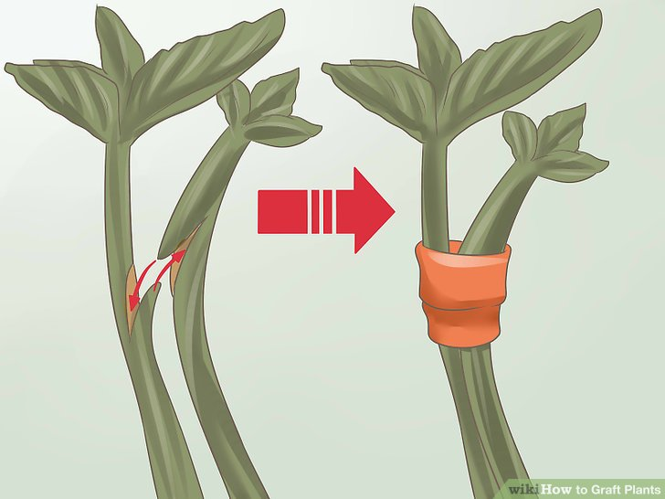
DNA Barcoding of Grafted Plants
Jean Lin¹, Samantha Poon¹, Vinipta Sabbithi¹
Mentor: Rochelli Apilan¹
¹High School for Health Professions and Human Services
Funded by the
Thompson Family Foundation
Abstract
Grafting plants is a method that enables one root source to produce a particular variety of plants. The team studies two grafted plants, Lemon Meyer and Minneola plants, in order to verify if the online source is viable in its claim of the plants being a certain crossbreed. The team proceeded with the samples following the DNA Harlem Lab’s protocol for extracting the DNA; isolating the DNA, amplifying the DNA through polymerase chain reaction (PCR), separating the DNA mixture using gel electrophoresis, and identifying samples using electronic PCR.
Introduction
The grafting of plants has been a trend in producing a variety of plants with one source of root. From utilizing techniques in farms to experimenting at home, there are a number of ways to graft plants. Researchers Yetisir and Sari (2003), grafted a number of melons keeping the rootstock the same for every scion and used a control group that wouldn't be grafted for comparison. The results revealed some of the grafted plants produced less offsprings than the control group, and some yielded more melons giving reason to look into grafting for a higher quantity of vegetation. But what does this process of grafting do to the genetic making of the scion? Yang et al. (2015) states that grafting causes an exchange in the mRNA, modeled by grapevines as the change in mRNA sequence occurred. In the study conducted by Kollmann and Glockmann, two plants of varying species were grafted to evaluate how the plasmodesmata would react. Despite the differences in the plants’ structures, the cell walls of the stock and root were able to fuse. Stegemann and Bock (2009) states that grafting of plants can result in the exchange of genetic information and these combinations of genetic material may cause implications for grafting techniques.
Materials & Methods
Due to the lack of availability of grafted plants within the team’s access, the two plants used in the study were purchased from an online source. The first plant was the Lemon Meyer, which is a cross of a lemon and orange plant. The second grafted plant is the Minneola, a cross with a tangerine and a pomelo plant. The tam had decided in the dress to sample based on where the graft has occurred. So samples were taken from below (rootstock) and above (scion) the graft. Seven samples were collected from the Lemon Meyer; the rootstock stem, the left branch of the scion, right branch of the scion, leaf from the left scion branch, another leaf from the right scion branch, and a baby leaf on the scion as well. Four samples were scraped off the Minneola; one from the rootstock stem and one from the scion stem, a leaf and a baby leaf from the scion.
To isolate the DNA of the plant samples the team followed the protocols given by DNA Harlem Lab for every sample. When grinding the samples, the lysis solution was added to dissolve the nucleus, mitochondria, and chloroplast. Then the incubator allowed the DNA to replicate itself and the centrifuge to separate the solids and liquids. The silica resin was used to bind the DNA, which created a pellet after placing it into the incubator. With the pellet remaining inside the tube, the wash buffer was used to remove the contaminants from the sample. Than dH2O was added into the tube, mixed, and the liquid was collected into a new tube. While we chilled these solutions the staff the lab aided the team with melting and cooling agarose made of rbcL, and primer to prepare for the Gel Electrophoresis step. The team then poured the agarose into a gel tray, and waited for the gel to set. After which the team loaded the gel with ladders and the teams samples. The UV transillumination allowed the team to look at the results of the electrophoresis. Lastly, the data was approved and the team was able to find samples with similar fasta to the teams own samples.
Meyer Lemon Plant Minneola Plantt
(Lemon and Orange) (Pomelo and Tangerine)
Results
When determining the DNA sequences, it was found that the Lemon Meyer plant has four matches: Citrus Maxima, Citrus Hindsii, Citrus Madurensis, and Citrus Aurantium. As for the Minneola Plant, the sample of the rootstock is similar to the DNA of a Citrus Trifoliata. The rest of the samples of the Minneola Plant was found to have similar DNA to the Citrus Maxima, Citrus Hindsii, Citrus Madurensis, and Citrus Trifoliata.
Tables & Figures
Samples collected
Alignment Viewer phylogenetic tree
Discussion
The results revealed that the DNA were the same within the samples that we collected from the scion, rootstock, stem, and leaves. The Lemon Meyer and Minneola Plant, purchased through an online source had described the plant as a Lemon and Orange hybrid where the Lemon Meyer plant was grafted onto the dwarfing rootstock. The source also described the plant, Minneola, as a Duncan and Dancy Hybrid grafted onto dwarfing rootstock. Based on previous researches, when hybridizing a plant, you must use the process of cross pollination. Recent studies have found a transfer of plastid and nuclear genome between distinct Nicotiana species within a tissue culture system at the grafted area (Goldschmidt, 2014). When grafting different plants, the tissues would combine as the connection between the plants transporting nutrients maintains going up from the roots and down from the leaves. This would cause the DNA to combine hence explaining the reason for the plants having oddities within the samples. To better understand the individual sequencing to identify the distinction between the species of plants we analyzed, future studies could examine the genome sequencing of the samples.
References
Goldschmidt, E. E. (2014). Plant grafting: New mechanisms, evolutionary implications. Frontiers in Plant Science, 5. doi:10.3389/fpls.2014.00727
Kollmann, R., & Glockmann, C. (1985). Studies on graft unions. I. Plasmodesmata between cells of plants belonging to different unrelated taxa. Protoplasma, 124(3), 224-235. doi:10.1007/bf01290774
Stegemann, S., & Bock, R. (2009). Exchange of genetic material between cells in plant tissue grafts. American Association for the Advancement of Science, 324, 649. DOI: 10.1126/science.1170397 URL: http://hos.ufl.edu/sites/default/files/courses/PCB6528/Stegemann&Bock09.pdf
Yang, Y.Z., Mao, L.Y., Jittayasothorn, Kang, Y., Chen, J., Fei, Z., Zhong G.Y. (2015). Messenger RNA exchange between scions and rootstocks in grafted grapevines. BMC Plant Biology, 15, 1-14. URL:http://web.b.ebscohost.com.i.ezproxy.nypl.org/ehost/pdfviewer/pdfviewer?vid=11&sid=e88cfcc8-f3b0-4bf6-bdf9-a638150ac905%40sessionmgr120
Yetisir, H., & Sari, N. (2003). Effect of different rootstock on plant growth, yield and quality of watermelon. Australian Journal of Experimental Agriculture, 43(10), 1269. doi:10.1071/ea02095
Acknowledgements
We are grateful to the DNA Harlem Lab for giving us the opportunity to conduct our own research. The expeience has given us an understnading of barcoding and enticed our intereast from start to finish. lastly, we are tankful for our mentor, Ms.Apilan, for guiding us through the process and encouraging us.

