Slide 1
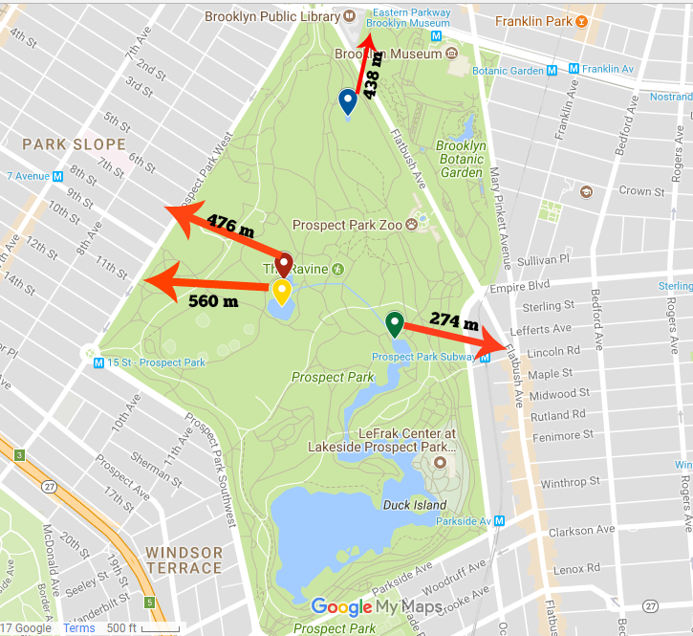
How Can We Use DNA Barcoding In Determining the Biodiversity of Aquatic Plants Within Prospect Park?
Shahryar Rahat and Victor Roy Mrs. Apilan
Funded by the
Thompson Family Foundation
High school for Health Professions and Human Services
Abstract
Between seventy to eighty percent of the world’s oxygen is generated by marine plants and most of this comes from algae. Therefore, understanding the biodiversity of aquatic plants is as essential as conserving the balance of our ecosystem. Our study is focused on the determination of the biodiversity of aquatic plants found at Prospect Park using DNA barcoding. Samples were collected from four different locations within Prospect Park in January. These samples were taken to the Harlem DNA Lab center for DNA barcoding. Extensive procedure involved the isolation of DNA, amplification of the DNA by polymerase chain reaction (PCR), separation of DNA mixture by gel electrophoresis, and identification of sequences in databases. The sequence alignment search tools revealed that one uncultured eukaryote and Musca ammoniate were present in our samples. Interestingly, there were two sequences of our samples that were not available in the database and thus were not identified.
Introduction
The wildlife in prospect park hosts a variety of species within its lakes and rivers. Prospect park is the home of several different species from birds, mammals and insects. However what often gets overlooked includes the plant life and fish inside the lakes and other bodies of water in prospect park. The conservation of the ecosystem within the lakes of prospect park is vital to the maintenance of an expansive food web and the thriving of diverse wildlife. One very essential plant is algae for the sole reason that they produce more oxygen than anything else. Their is a variety of different algae that look almost identical to one another. We will use DNA barcoding in order to determine the different algae located in the waters of prospect park. DNA barcoding is a method that uses a short genetic marker in an organism's DNA to identify it and the species it falls under. The DNA barcoding will help us categorize and identify the algae.
The algae in the ponds of prospect park appear to look almost identical to one another. However there is the chance of the algae located in the park to have subtle differences. Algae, being such an important part of the food web in the ecosystem of Prospect Park, must be identified and preserved. DNA barcoding is a helpful way to determine the biodiversity within the ponds of Prospect Park and the different types of algae in Prospect Park. This will ultimately help in identifying the algae and preserving it so animals that rely on the production of oxygen will not be harmed. If the algae were to vanish then it would have a dramatic impact on the food chain.
We hypothesize that there will most likely be different varieties of algae and other organisms in the pond, despite most ponds in prospect park having algae that look alike with the use of DNA barcoding we will be able to determine if there are different varieties.
Our goals are to determine the biodiversity, specifically, at prospect park pond and help maintain the biodiversity of microorganisms there. Biodiversity boosts ecosystem productivity where each species, including microorganisms, all have an important role to play. For example, A larger number of plant species means a greater variety of crops. We will ultimately attempt to identify the species of aquatic plants in prospect park and help in maintaining it.
Materials & Methods
The first step of the procedure is to collect the specimens. The samples we gathered were quite small and we choose our samples in order to find subtle differences in variety of aquatic plant. We gathered data from four different locations in prospect park consisting of algae. The ponds are shallow and the samples were collected from the edge of the ponds. Then we collected the specimen in a large container for each location. In order to determine the specific location we used GPS enabled phone or camera which stores latitude, longitude and altitude coordinates. We then documented the specimen by taking a picture. The picture contained metadata which consists of the exact location of the plant. This was located in the sample database. The samples were then taken to a lab in four containers. Then we isolated the DNA from the aquatic plant and fungal samples. After this the DNA is amplified by PCR. The samples were then analyzed by gel electrophoresis. After this we added an ITS primer specifically used to identify algae and fungi. The sample was then sent for sequencing and analyzed. Blasting was used to find DNA sequences in the database with the use of DNA subway.
Results
Results where gathered within a couple weeks after all the procedures had been done. A tracking number was received which was found on the website which had our database(www.dnabaroding101.org). The tracking number was then used in the DNA subway where we found only three of the eight samples which did not have a low score quality. These three had been further examined in order to find matches. Only one of the three samples had matches. The closet match possible was called the musa acuminata for samples KJE-003 another really close match was uncultured eukaryote which is a single celled organisms. Above is a map of the locations the samples were taken from. KJE-001 was taken from the blue indicator close to Brooklyn museum. While KJE-002 was taken from the red indicator. KJE-003 was taken from the yellow indicator which was both around the ravine area. KJE-004 was gathered from the green indicator around the prospect park subway.
Discussion
The purpose of the results we gathered was supposed to answer how DNA Barcoding could be used on determining the biodiversity of aquatic plants within prospect park? Our results were quite fascinating. This is due to the fact that musa acuminata is a plant related to banana leaves found in Southeast Asia. So the sample KJE-003 was highly unlikely to be Musa Acuminata but it may have been uncultured eukaryote, which is a single celled organism in other words bacteria. It had several matched to choose from which can be seen in the appendix in figure 1. While KJE-004 had no matches. KJE 001 was low quality and KJE-002 also had no matches. KJE-002 and KJE-004 probably had low matches due to the fact that many microorganisms sequences are not recorded in the database. We predicted that there would be a variety of different algae samples and we would be able to identify them. But our results did not determine this. Our study had not worked as intended this could have been the cause of several factors such as cold weather. The lakes were frozen thus gathering samples was difficult . For future studies one should try to gather samples at an ideal time since algae can not survive in the winter.
References
1.Chapman, R. L. (2013). Algae: the world’s most important “plants”—an introduction. Mitigation and Adaptation Strategies for Global Change, 18(1), 5-12.
2.Gelpi, E., Schneider, H., Mann, J., & Oro, J. (1970). Hydrocarbons of geochemical significance in microscopic algae. Phytochemistry, 9(3), 603-612.
3.Hebert, P. D., Penton, E. H., Burns, J. M., Janzen, D. H., & Hallwachs, W. (2004). Ten species in one: DNA barcoding reveals cryptic species in the neotropical skipper butterfly Astraptes fulgerator. Proceedings of the National Academy of Sciences of the United States of America, 101(41), 14812-14817.
4.Palmer, C. M. (1980). Algae and water pollution: the identification, significance, and control of algae in water supplies and in polluted water. In Algae and water pollution: the identification, significance, and control of algae in water supplies and in polluted water. Castle House Publications.
5.Romera, E., González, F., Ballester, A., Blázquez, M. L., & Munoz, J. A. (2007). Comparative study of biosorption of heavy metals using different types of algae. Bioresource Technology, 98(17), 3344-3353.
6.Will, K. W., Mishler, B. D., & Wheeler, Q. D. (2005). The perils of DNA barcoding and the need for integrative taxonomy. Systematic biology, 54(5), 844-851.
7.http://www.dnabarcoding101.org/files/using-dna-barcodes.pdf
Acknowledgements
Harlem Lab
Tables and Figures
Sample | Closest matches
KJE-001 | Low quality score
KJE-002 | No Matches
KJE-003 | Uncultured eukaryote/Musa acuminata
KJE-004 | No matches
Figure 1 located above
Shows that only KJE-003 had possible matches .
Figure 2 is located above
The figure shows the four locations where we gathered our samples
Figure 3 is located above
The figure is one of our four samples

