Slide 1
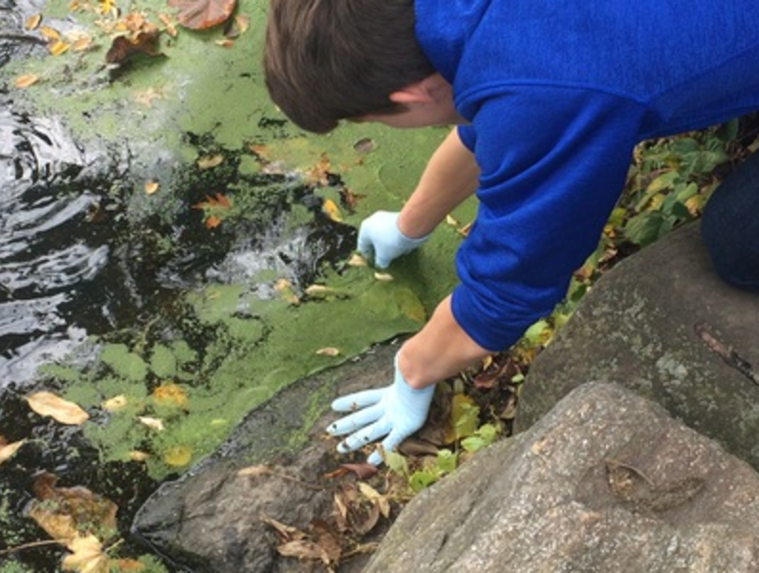
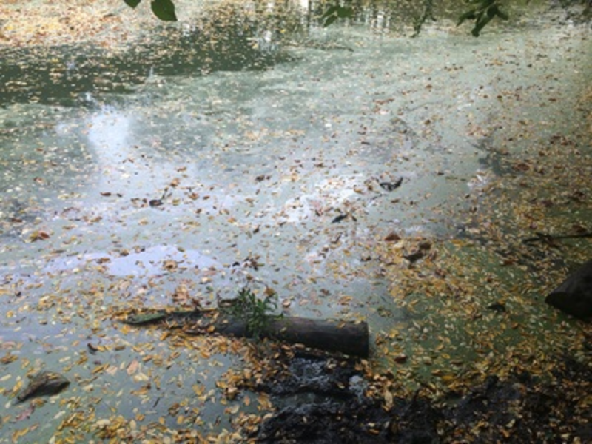
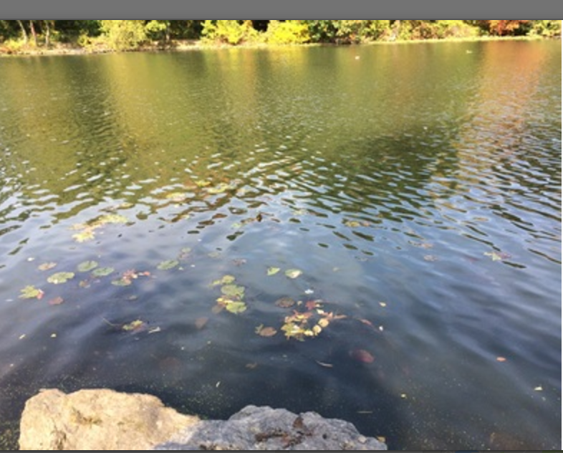
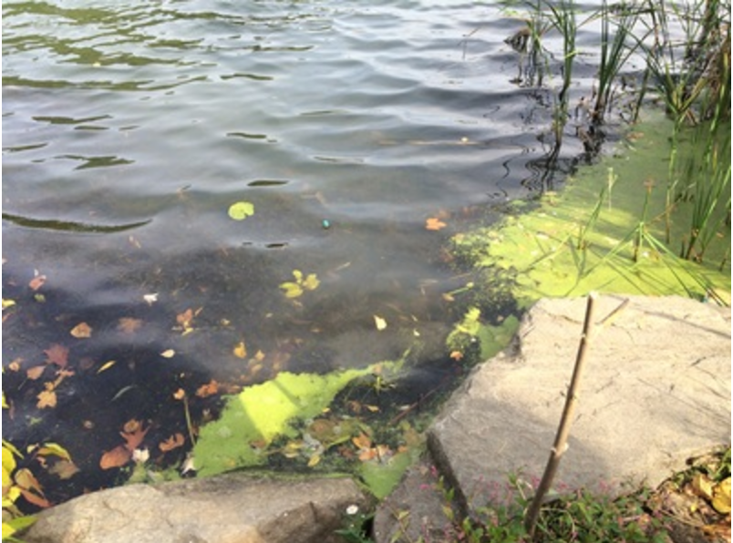
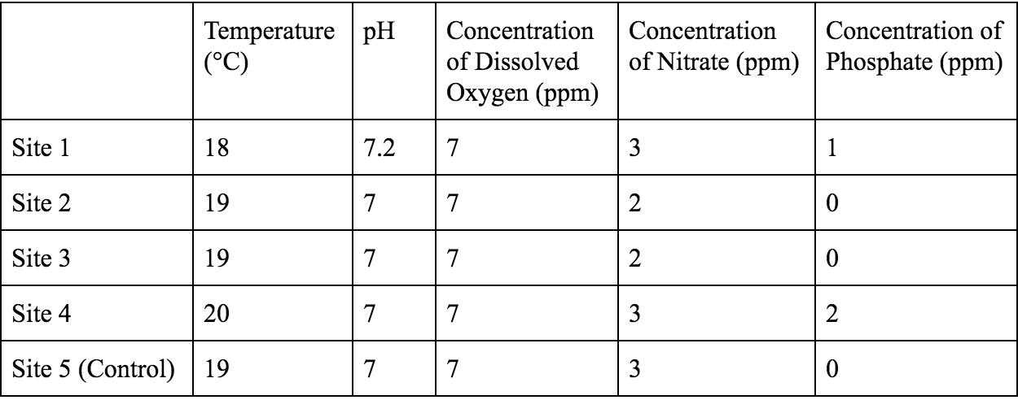
Coding the Surface: Examining the Composition of a Recurring Unknown Culture of Organisms in Van Cortlandt Lake
Ryan Conard,¹ David Goldberg,¹ Zander Harpel,¹ Cormac Thorpe,¹ Dr. Adriana Andrade¹
Ethical Culture Fieldston School¹
Abstract
Materials and Methods
Discussion
Our project identified the scum on top of Van Cortlandt Lake and determined what organism it is and its effect on the environment. We collected 27 samples at multiple sites and processed them. We also tested the water quality of each site. We found that the majority of our findings fall under the Lemna, Wolffia, Wolffiella, and Spirodela genera, part of the Lemnaceae (duckweed) family. The uniformity of our findings and the water quality compared to the control group indicated that the scum was all similarly composed and generally unharmful to the pond.
Samples were obtained from lake using plastic jars in 5 sites and water quality was tested for each site
The DNA was extracted according to protocol
The rbcL and ITS genes were amplified using PCR
The Presence of Bands was determined using gel electrophoresis and sent to lab for processing
The organisms were identified using DNA Subway and Bioinformatics
The DNA that was isolated from the collected samples can be almost exclusively categorized under the Lemnoideae subfamily (the genera found were Lemna, Spirodela, Wolffia, and Wolfiella), otherwise known as the duckweeds. These are floating plants that grow rapidly and form colonies on the surface of freshwater.
The species is most likely not invasive; rather, it follows, an annual growth cycle that doesn’t cause significant harm to the pond. Therefore, our hypothesis was supported by our experiment. Additionally, our results support the idea that pond scum is solely a natural part of a freshwater system’s development and should not be a concern.
All of the sites had similar readings for each of the water quality measurements; comparing the water quality of Site 5, which didn’t have significant pond scum growth, to water quality of the other sites did not yield any significant differences.
However, our experiment was flawed in ways that can be improved in the future. In order to actually analyze the contents of the pond and its effects, we should have collected more samples, done more water quality tests, and used the ITS gene.
Pictures of all five sites
Results
Introduction
After BLASTN using the DNA sequences, it was discovered that out of the seventeen samples that could be analyzed, (based on the top hits), fourteen were Lemna minor, one was Lemna obscura, one was Wolffia brasiliensis, and one was Spirodela polyrhiza. All of the samples also had e-values for each match at 0.0 and most had Bit Scores above 1,000 for at least a few species. Along with the genera mentioned above, various species of Wolffiella, another type of duckweed, were also matched (with lower Bit Score).
Pond scum often forms on the surface of freshwater systems during the summer and fall. It often emerges as a result of nutrient enrichment in ponds, especially of the elements phosphorus and nitrogen, which stimulate plant growth. The composition of the scum can often be a mystery, as it can be composed of protozoans, algae, lichens, duckweed, or zooplankton, among other things. Van Cortlandt Park during the previous summer and fall dealt with a large film of pond scum that had accumulated on Van Cortlandt Lake as well as other small bodies of water in the park. Our basic research question was “What are the organisms that make up pond scum in Van Cortlandt Lake and how do they interact with or affect the ecosystem?” The Hypothesis was that the unknown organisms were a type of algae or part of the duckweed family.
SFigure 1: Water quality of sites, including temperature, pH, concentration of dissolved oxygen, nitrate, and phosphateAM
Acknowledgments
We would like to thank Van Cortlandt park scientists who originally made the observation and allowed us to take samples. We would like to acknowledge the people at the lab for processing our data and PCR our samples. We would also like to thank Fieldston for providing with us with equipment to carry out this project. Finally, we would like to thank our wonderful mentor, Dr. Andrade for helping us execute this project and helping us get such good results.
References
“Using DNA Barcodes to Identify and Classify Living Things” Cold Spring Harbor Laboratory DNA Learning Center Copyright 2014
Kannan, M. S. (n.d.). Field guide to algae and other “scums” in ponds, lakes, streams and rivers. Retrieved October 12, 2016, from http://www.townofchapelhill.org/home/showdocument?id=28866
Julia, D. M., & Laybourn-Parry, J. E. (n.d.). Protozoan. Retrieved October 12, 2016, from https://www.britannica.com/science/protozoan
Vidyasagar, A. (n.d.). What are algae? Retrieved October 12, 2016, from http://www.livescience.com/54979-what-are-algae.html
W. (n.d.). What are lichens? Retrieved October 12, 2016, from http://www.fs.fed.us/wildflowers/beauty/lichens/whatare.shtml
Harmon, P. J. (n.d.). Pond Scum. Retrieved from http://www.wvdnr.gov/wildlife/magazine/archive/06summer/pondscum.pdf
K. (2012, June 29). How to Test Your Pond for Blue-green Algae. Retrieved October 12, 2016, from https://www.youtube.com/watch?v=ZRNWzFwKKjE
How to Get Rid of Pond Scum With Natural Ingredients. (n.d.). Retrieved October 12, 2016, from http://homeguides.sfgate.com/rid-pond-scum-natural-ingredients-44663.html

