Slide 1



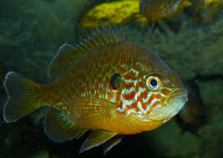
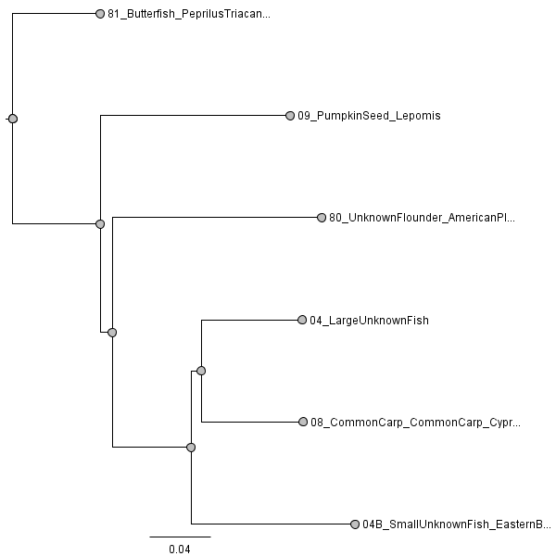
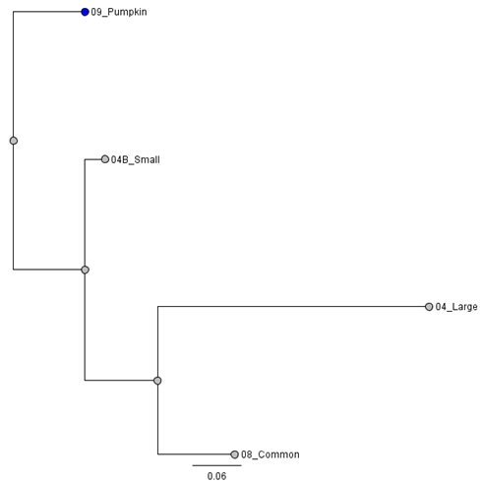
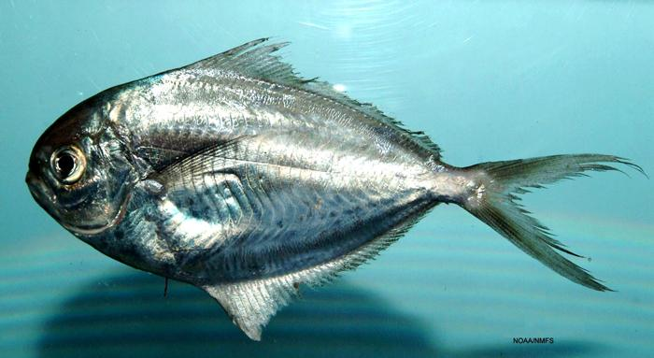
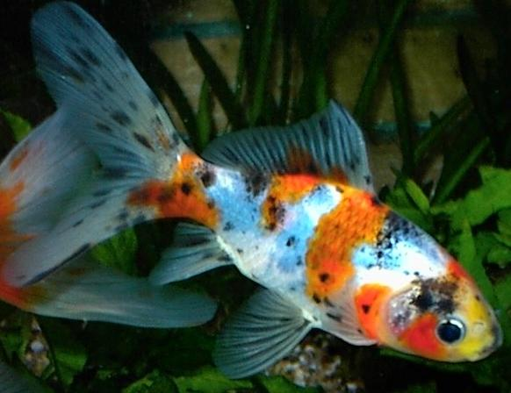
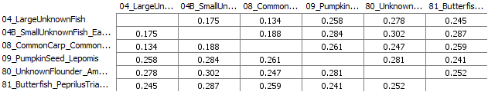

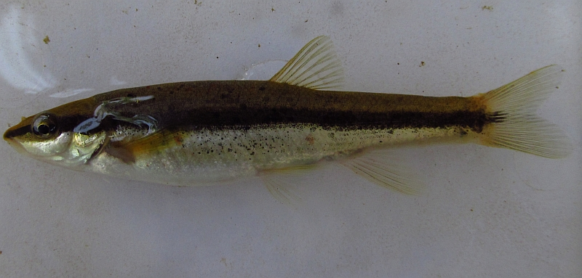
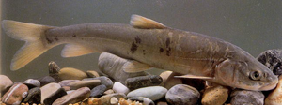
Building a System of DNA Barcodes for Aquatic Species in the Bronx River
Jessica Fong Ng¹, Lina Liu², Nathan Morris^{3,4}, Sam Chew Chin^{3,4}, Elizabeth Alter^{3,4,5}
¹High School for Construction Trades, Engineering and Architecture, ²Manhattan Center for Science and Mathematics, ³York College, ⁴CUNY Graduate Center, ⁵American Museum of Natural History, Sackler Institute for Comparative Genomics
Abstract
Our project focused on building a system of DNA barcodes for the fish species in the Bronx River for further environmental research. We collected 11 samples and used two specific primer sets to target two mitochondrial loci, one on the COI gene and one in the 12S locus to amplify the DNA of our samples. 10 out of 11 samples were sent to sequence, however only 6 samples had high quality DNA sequences that can be used for identification. This project can benefit scientists interested in exploring the fish species or the biodiversity in the Bronx River. Our follow-up project focuses on completing the DNA barcode data for the all fishes Bronx River and reporting new DNA sequences to the NCBI database.
Tables & Figures
Pumpkin Seed Sunfish
Chart 1: Sequences that were successfully extracted from this study using CO1
Image 1: Evolutionary Tree - Neighbour Joining (Using CO1 Primers)
Image 3: Evolutionary Tree (Using 12S Primers)
Sample ID | Sequence 5’ → 3’ | Common Name | Scientific Name
09_Pumpkin Seed | CAGAGCTCAGTCAACCCGGCGCCCTCCTTGGGGATGACCAAA | Pumpkin Seed | Lepomis gibbosus
04_Large Unknown Fish | CTTAGTCAACCCGGATCACTTCTAGGTGATGACCAAATTTAC | Goldfish Carassius auratus OR Prussian Carp | Carassius auratus OR Carassius gibelio
04B_Small Unknown Fish | TGGATCACTCTTAGGAGATGACCAGATTTATAATGTTATCGTC | Eastern blacknose dace | Rhinichthys atratulus
08_Common Carp | GGTCGCTTCTAGGTGATGACCAAATTTATAACGTTATCGTCA | Common carp Cyprinus carpio | Cyprinus carpio
80_Unknown Flounder | GCAGAACTCAGCCAACCCGGGGCTCTCCTGGGAGACGATCAA | American Plaice | Hippoglossoides platessoides
81_Butterfish | CTGAACTAAACCAACCAGGCGCCCTTCTTGGGGACGACCAGA | Butterfish | Peprilus triacanthus
Butterfish
Chart 2: Sequences that were successfully extracted from this study using 12S
Sample ID | Sequence 5’ → 3’ | Common Name | Scientific Name
09_Pumpkin Seed | GGCGGGCAGTGAGAGGGGTTCTTATTTTTTGGATTCT | Brook Stickleback | Culaea inconstans
04_Large Unknown Fish | ATAATAGCACTGACAAGGGGAGGCAAGTCGTAACATGGTA | Qinghai Lake Naked Carp OR Goldfish | Gymnocypris przewalskii OR Carassius Auratus
04B_Small Unknown Fish | GGTAGCTTTACTGCATTTTGACAGGGGAGAAGTGACGGGCG | Gold Shiner | Notemigonus crysoleucas
08_Common Carp | GGCGGGCAGTGANGAGGGGACAGTTTTGCGTGGTTTTTATGT | Common carp Cyprinus carpio | Cyprinus carpio
80_Unknown Flounder | This sample was not amplified by 12S primer. | N/A | N/A
81_Butterfish | This sample was not amplified by 12S primer. | N/A | N/A
Introduction
The Bronx River is the only freshwater river in NYC, and it is an important location for aquatic species to thrive; however it has subjected to industrialization, flood control and urbanization.
The most recent database for aquatic species in the Bronx River is from 2005. However, human intervention has caused degradation in species diversity over time and research needs to be done to verify the current species diversity.
Utilizing genetic techniques for identification of species, DNA barcodes, we created specific genetic identification markers for each individual species using a DNA sequence that is approximately 700 nucleotides in length.
For this project, we used a two primers targeting the region of the mitochondrial gene coding for cytochrome c oxidase subunit 1 (COI) and a locus at the 12S gene.
Our goal is to create a genetic identification for every species in the Bronx River using DNA barcode and discover new barcodes for species that have not been identified.
Gold Fish
Image 2: Distance Chart - Neighbour Joining (Using CO1 Primer)
Image 4: Distance Chart- Neighbour Joining (Using S12 Primer)
Discussion
Through DNA extraction and sequencing, we identified the specimen (Sample 81) as American Plaice (Hippoglossoides platessoides), a species that is not known to occur in the Bronx River. “Large unknown fish sample 4” has an ambiguous result with COI(Table 1.) Through NCBI BLAST, it matches equally well to Carassius auratus (goldfish) and Carassius gibelio (Prussian Carp.) They have a 100% identity match.
The primers that were used to target the 12S locus amplified a small fragment with only 65 bases, much less than COI. It also yields some ambiguous results. For example, the sample 04B, through BLAST at the NCBI database, it gives us the Mylocheilus caurinus (which is not found in the U.S) and Notemigonus crysoleucas (found in the US, NY Hudson River and Texas). We make an educated conclusion that this sample is Notemigonus crysoleucas. Since primers that target 12S locus amplify a short piece, we should use blocking primers to improve the quality and accuracy of the results. Like the BLAST result in COI with sample 4, the amplification with 12S locus also yields the possible results of Gymnocypris przewalskii (Qinghai Lake Naked Carp) and Carassius auratus (goldfish.) We can see the contradiction of the results with different primers in table 1 and 2. We conclude that the results that used COI is more definite than 12S due to the length of the primers.
This study can allow environmental scientists to refer to a specific database of Bronx Fish DNA. We will continue to extract DNA from the species found in the Bronx River, and we can upload new DNA sequences to the NCBI if any new DNA codes are found. In addition, we are also interested in comparing the biodiversity and species composition from the records in 2005 and explore the environmental changes that caused the population change in the Bronx River.
Prussian Carp
Eastern blacknose dace
Materials and Methods
A total of 12 tissue samples were used in this case study: 9 of the 12 samples originated from the Bronx River, and the other 3 samples were from specimens of fish believed to inhabit the Bronx River that were purchased at fish markets. DNA was extracted from each of the samples using the DNeasy Tissue protocol.
After the DNA extraction, we used the Nanodrop spectrophotometer to determine the concentration of the sample.
PCR was performed to amplify DNA using fish cocktail primers to target the cytochrome c oxidase subunit 1 gene region.
To verify the success of the amplification of DNA, we performed gel electrophoresis. Then, the gel was placed in a Bio-Rad Gel Doc gel imager to observe the presence of amplified DNA
Finally, the samples were sent out for Sanger sequencing. The sequences of the CO1 gene (chart 1) for the successfully sequenced samples were compared with the sequences on the locus of the Valentini 12S(Chart 2).
Qinghai Lake Naked Carp
Acknowledgements
This project was supported by the Urban Barcode Research Program and funded by the Pinkerton Foundation. We thank Melissa Lee, Alison Cucco, Elizabeth Alter, Nathan Morris and Sam Chew Chin for their assistance.
References
"An Evaluation of the Ichthyofauna of the Bronx River, a Resilient Urban Waterway." BioOne. N.p., n.d. Web.
Kochzius, Marc, C. Seidel, A. Antoniou, S. K. Botla, D. Campo, A.Cariani, E. G.Vazquez, J. Hauschild, C. Hervet, S. HjÃrleifsdottir, G. Hreggvidsson, K. Kappel, M. Landi, A. Magoulas, V. Marteinsson, M.d NÃlte, S.Planes, F. Tinti, C.Turan, M. N. Venugopal, H.Weber, and D. Blohm."Identifying Fishes through DNA Barcodes and Microarrays." PLoS ONE 5.9 (2010): n. pag. Web.
Kress, W. John, C. GarcÃ­a-Robledo, M. Uriarte, and D.L. Erickson. "DNA Barcodes for Ecology, Evolution, and Conservation." Trends in Ecology & Evolution 30.1 (2015): 25-35. Web.
Shokralla, Shadi, R.S. Hellberg, S. M. Handy, I. King, and M.Hajibabaei. "A DNA Mini-Barcoding System for Authentication of Processed Fish Products." Scientific Reports 5.1 (2015): n. pag. Web.
J.W. Rachlin, B. E. Warkentine, and A. Pappantoniou. “An Evaluation fo the Ichthyofauna of the Bronx River, a Resilient Urban Waterway.” Northeastern Naturalist (2007): n. pag. Web.
A.Valentini, P. Taberlet, C. Miaud, R. Civade, J. Herder, P. F. Thomsen, E. Bellemain, A. Besnard, E. Coissac, F. Boyer, C. Gaboriaud, P. Jean, N. Poulet, N. Roset, G.H. Copp, P. Geniez, D. Pont, C. Argillier, J. Baudoin, T. Peroux, A. J. Crivelli, A. Olivier, M.Acqueberge, M. Le Brun, P. R. Mø Ller, E. Willerslev And T. De Jean. “Next-generatino monitoring of aquatic biodiversity using environmental DNA metabarcoding.” Molecular Ecology (2016)25, 929-942. Web.
"Watershed Restoration: Principles and Practices." American Fisheries Society. N.p., n.d. Web.
Notes:
References
1. DNA Learning Center Barcoding N.p., n.d. Web.
2."An Evaluation of the Ichthyofauna of the Bronx River, a Resilient Urban Waterway." BioOne. N.p., n.d. Web.
3. Kochzius, Marc, C. Seidel, A. Antoniou, S. K. Botla, D. Campo, A.Cariani, E. G.Vazquez, J. Hauschild, C. Hervet, S. HjÃrleifsdottir, G. Hreggvidsson, K. Kappel, M. Landi, A. Magoulas, V. Marteinsson, M.d NÃlte, S.Planes, F. Tinti, C.Turan, M. N. Venugopal, H.Weber, and D. Blohm."Identifying Fishes through DNA Barcodes and Microarrays." PLoS ONE 5.9 (2010): n. pag. Web.
4. Kress, W. John, C. GarcÃ­a-Robledo, M. Uriarte, and D.L. Erickson. "DNA Barcodes for Ecology, Evolution, and Conservation." Trends in Ecology & Evolution 30.1 (2015): 25-35. Web.
5. Shokralla, Shadi, R.S. Hellberg, S. M. Handy, I. King, and M.Hajibabaei. "A DNA Mini-Barcoding System for Authentication of Processed Fish Products." Scientific Reports 5.1 (2015): n. pag. Web.
6. "Watershed Restoration: Principles and Practices." American Fisheries Society. N.p., n.d. Web.
7. "What Is DNA Barcoding?" Barcode Of Life. N.p., n.d. Web. 10 May 2017.
8. J.W. Rachlin, B. E. Warkentine, and A. Pappantoniou. “An Evaluation fo the Ichthyofauna of the Bronx River, a Resilient Urban Waterway.” Northeastern Naturalist (2007): n. pag. Web.
9. A.Valentini, P. Taberlet, C. Miaud, R. Civade, J. Herder, P. F. Thomsen, E. Bellemain, A. Besnard, E. Coissac, F. Boyer, C. Gaboriaud, P. Jean, N. Poulet, N. Roset, G.H. Copp, P. Geniez, D. Pont, C. Argillier, J. Baudoin, T. Peroux, A. J. Crivelli, A. Olivier, M.Acqueberge, M. Le Brun, P. R. Mø Ller, E. Willerslev And T. De Jean. “Next-generatino monitoring of aquatic biodiversity using environmental DNA metabarcoding.” Molecular Ecology (2016)25, 929-942. Web.
Acknowledgements

