Slide 1
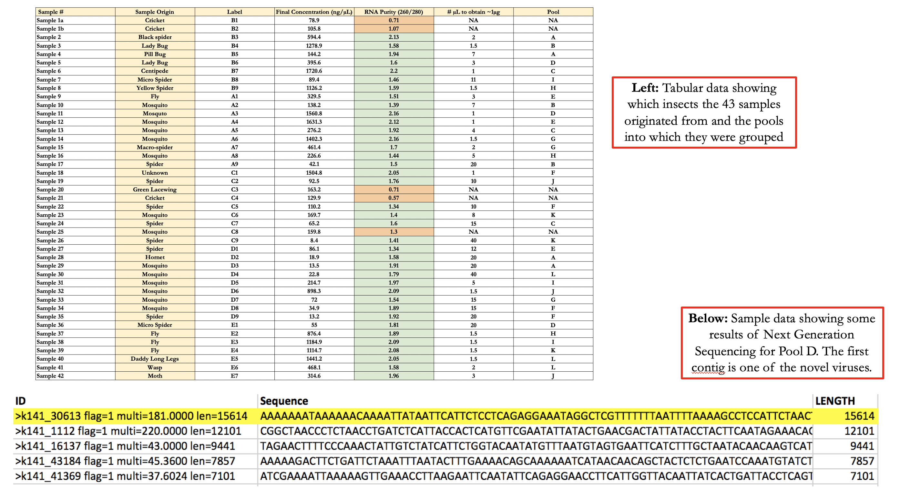
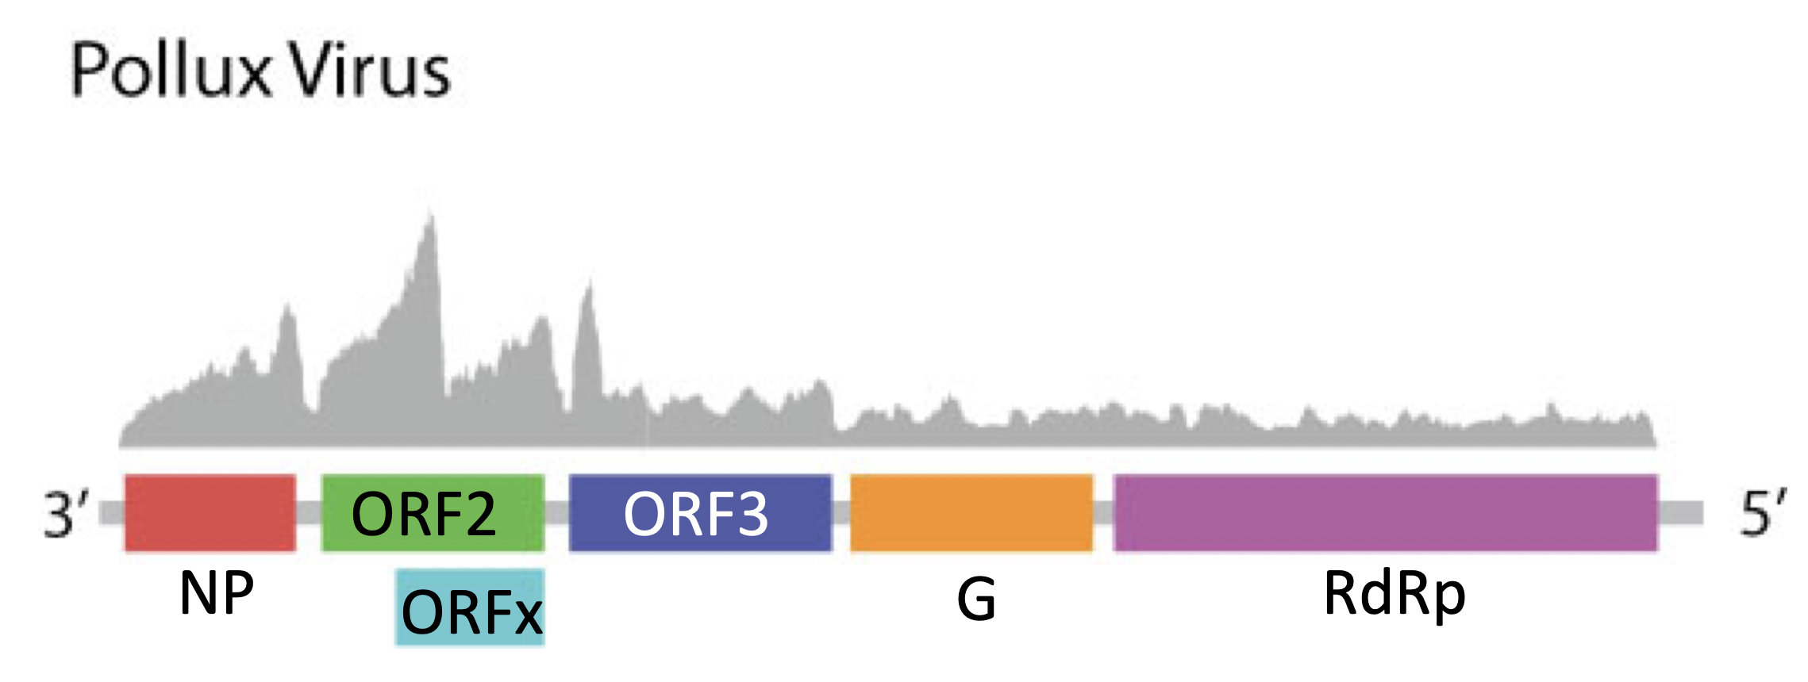
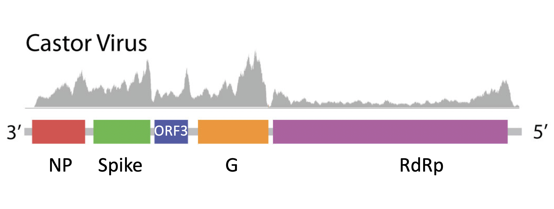
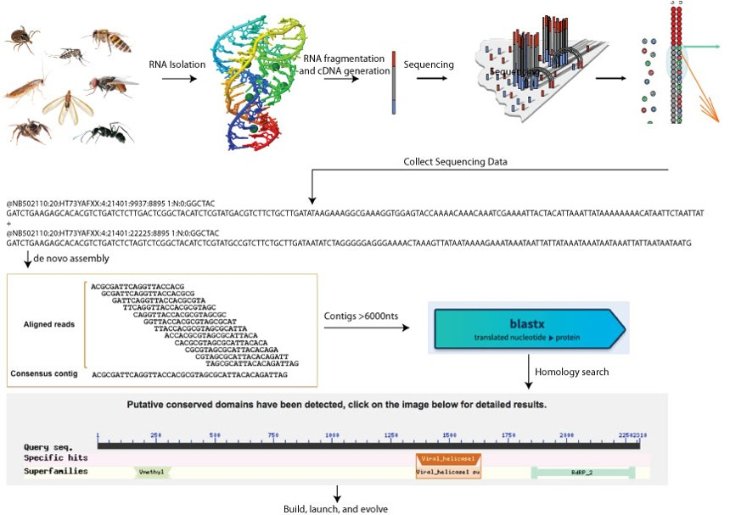
Expanding, Characterizing and Repurposing The Invertebrate Virosphere
Bryce Demopoulos¹, Ethan Lin², and Benjamin tenOever³
¹Hunter College High School; ²Stuyvesant High School; ³Icahn School of Medicine at Mount Sinai
Abstract
Samples
The Dioscuri
Medicine demands the capability to deliver genetic cargo to specific cell types. Past efforts have relied on the engineering of a small subset of vertebrate viruses with limited success. Challenges with regards to in vivo delivery include finding novel viral vectors that can both achieve different targets and are more amenable to being synthesized de novo.
Diverse invertebrate species were collected and sampled to isolate and identify RNA viruses associated with them.
As the invertebrate virosphere remains largely unknown, novel viruses whose components can be characterized and repurposed to build a new suite of viral-based tools were hypothesized to be able to be identified.
To this end, RNA from a diverse library of invertebrates will be isolated and sequenced by next-generation sequencing and subsequently de novo genome assembly will be performed.
Captured reads will then be analyzed for signatures of RNA dependent RNA polymerases (RdRps) – a necessary component of all RNA viruses. Putative novel virus genome assemblies will be named, characterized, and independently confirmed by quantitative PCR.
Small RNA viruses or their RdRps (less than 5kB) will then be synthesized and artificially launched in mammalian cells to ascertain whether they can be selected via guided evolution to function and deliver a desired genetic cargo.
Figure 1
Figure 4
Background
Results
With recombinant DNA technology, science has witnessed the development of tools to generate antibodies from a plasmid, silence messenger RNA, deliver genes, and even edit DNA with single base pair resolution. However, to capitalize on these discoveries, the scientific community needs the ability to deliver the necessary cargo to the cells of interest. Thus far, the issue of delivering genetic material to cells has come in the form of either repurposed viral vectors or the direct delivery of genetic material (Thomas et al. 2003).
Viral vector research has largely focused on the use of lentiviruses such as HIV, adenovirus, or the adeno-associated virus. While each of these viral vectors have demonstrated promise, each has inherent issues preventing its widespread use.
These vectors are still used despite these limitations, but the scientific community is simultaneously looking for other solutions. Over the past few years, many have focused on various lipids or synthetic nanoparticles to deliver recombinant DNA to cells. However, this has proven difficult, largely owing to the inability to breach the barriers required to reach the nucleus.
More recently, a promising technology is the direct use of RNA. The use of RNA as a therapeutic is promising in that it can be easily manufactured and it neither integrates nor is immunogenic. However, a remaining limitation of RNA is its inherent instability.
In this regard, the identification of novel RdRps may also enable the engineering of self-replicating RNAs, thereby overcoming this limitation. In an effort to find a small RdRp that will not show any prevalence in the human population, sampling from invertebrates was proposed to identify novel RNA viruses from which we can build.
The Dioscuri: Castor and Pollux the Greco-Roman deities are what we named our viruses because they are like twins with they have a high homology.
Reconstruction of the viruses yielded three novel receptors that can be reengineered as a new vector in gene therapy. Two are from Castor and one of them is from Pollux.
The structure of the Pollux Virus is very similar to a rhabdovirus found in the venom-gland of a parasitic wasp Diachasmimorpha longicaudata. Figure 1
Integration with the Semlicki Forest Virus has proven successful. Proving that the receptors are capable of being used in gene therapy.
Depiction of the Overall Strategy for the Project
‘
DNA Ladder
Castor Virus RT-PCR (A. Aegypti Mosquito)
NP
Spike
ORF3
G
RdRp
Discussion
Viruses are omnipresent, and yet many viral genomes are unrecognized and undocumented. This project has demonstrated, first and foremost, the potential of next-generation sequencing and de novo genome assembly to expand the invertebrate virosphere. With the discovery of two novel viruses, comes the introduction of a new suite of tools that could be repurposed for gene editing. Initially, we thought that we had one virus discovery in our hands, but a closer look showed that the viruses had a high homology. We theorized that they may have an interdependence, but we are yet to prove it with significant data. The negative stranded character of the virus suggests the promise of cloning the polymerase into a plasmid, so PCR amplification and subcloning into a plasmid suitable for in vitro transcription and/or eukaryotic expression is a direct next step. Enabling such host production and then introducing the genomic RNA will allow for determination of the existence of self-amplifying properties. Successful replication will, in the long term, be followed by additional analysis of the putative ORFs and isolation of the RdRp to qualitatively determine the potential of guided evolution to achieve a functional enzyme in mammalian cells.
Specific Aims
Figure 2
Figure 3
The goal of this project was to sample diverse invertebrates, process their RNA, and identify putative viruses within each sample.
Deep sequencing of total RNA enabled the de novo assembly of both mRNA from that species as well as putative viral genomes.
Assembled contigs were sorted by size and were used to perform a BLASTx search against known viral polymerases.
Putative virus genomes were then used a reference to assess mRNA abundance as it related to each open reading frame (ORF).
Following the identification of each ORF, reverse transcription and PCR (RT-PCR) was performed to corroborate expression.
Analysis
Acknowledgements
The RNA of 43 individual insects were sampled and analyzed. (Figure 3)
Of these, five samples were rendered impotent and the RNA sequencing could not be performed. These results could have been due to human error in the isolation process, or the lack of a quantifiable amount of RNA in the insect genome.
The 38 remaining samples were split into twelve different pools for sequencing, labeled A through L. The methodology behind splitting the samples consisted of organizing groups of samples with no overlap between insect types and pairing samples with lower RNA yields to those with higher yields.
Loose approximations were made to mix ~1µg of each sample into each pool, for a total of ~3µg in a 100µl solution.
The subsequent sequencing results were organized in an excel spreadsheet by length, and nine out of twelve pools contained genetic code of greater than 6000 nucleotides.
However, BLASTx revealed that the vast majority of the contigs had a high homology to known viral or other RNA-containing species.
Analysis of all the results revealed two novel viruses contained within Pool D. (Figure 4)
Subsequent homology searches for related viruses showed that the novel viral sequences were single-stranded, negative sense viruses with a morphology that resembles the common Rabies virus.
We thank Urban Barcode Research Program of Cold Spring Harbor Laboratory, Dr. Christine Marizzi of the Harlem DNA Lab, the Pinkerton Foundation and Simons Sandbox for providing us with this great opportunity. Thank you to Icahn School of Medicine at Mount Sinai for laboratory facilities. We would also like to thank Dr. tenOever for his unparalleled guidance throughout the research process.
References
Ehrhardt, Thomas A. “Progress and Problems with the Use of Viral Vectors for Gene Therapy.” Nature Reviews Genetics, Scientific Research Publishing, 2003, www.scirp.org/reference/ReferencesPapers.aspx?ReferenceID=1725267.
Dobson, J. “Gene therapy progress and prospects: Magnetic nanoparticle-based gene delivery.” 2006, https://www.nature.com/articles/3302720.
Shi, M., et al. “Redefining the invertebrate RNA virosphere.” 2016, https://www.nature.com/articles/nature20167.
“Viral Vectors for Gene Therapy.” 1999, https://www.sciencedirect.com/science/article/pii/S0163725898000205.

