Slide 1
Distributed Research with DNA Barcoding
Democratizing Species Identification
DNA Learning Center, Cold Spring Harbor Laboratory

Slide 2
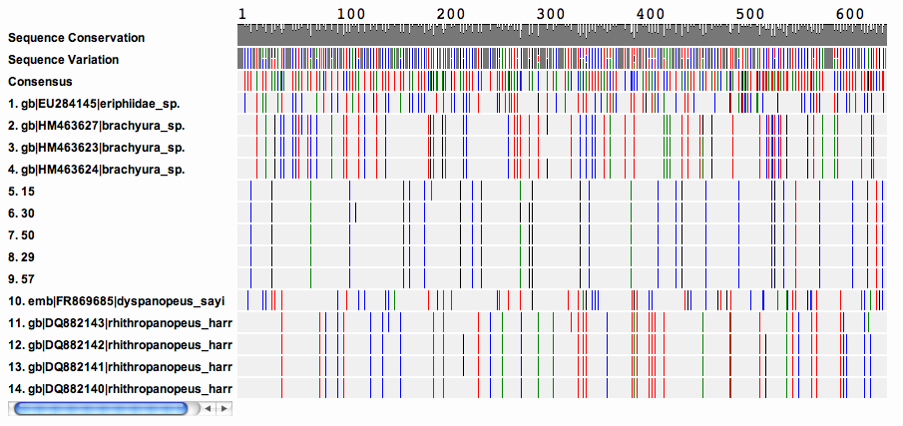
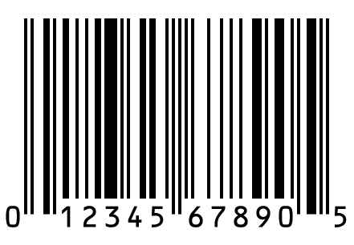
A “DNA barcode” is a unique pattern of DNA sequence that can identify a species like the unique patterns in universal product codes identify products.

Slide 3
DNA Barcoding The “Do Everything” Lab
Real science
Scalable, distributed projects
Teaches many important biological concepts
Integrates genetics and ecology
Combines lab work with bioinformatics
Enables discovery and publication
Accessible to students who normally have no access to research
Notes:
3

Slide 4
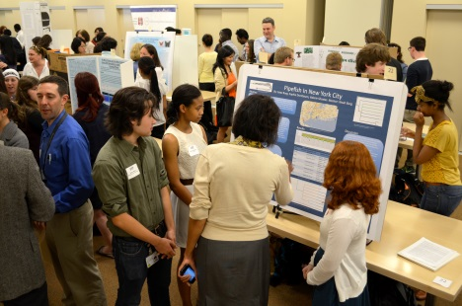
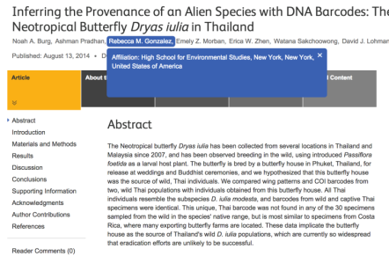
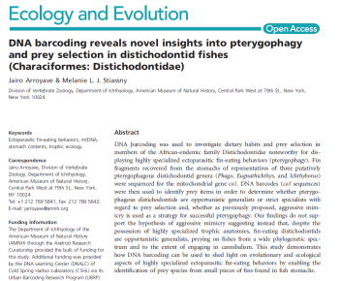
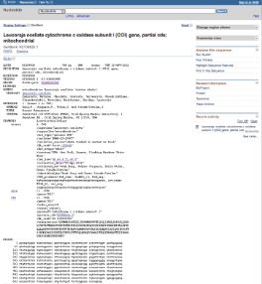
Urban Barcode Project, 2012-16
Student DNA barcoding in New York City
873 student scientists in 322 teams
First research experience for most
>30% underrepresented minorities
193 mentors from 146 schools in 5 NYC Boroughs
>5,800 DNA samples
>9,900 DNA sequences and > 2,6 Million Next Gen Sequencing reads
125 novel barcodes
Publications with student authors or contributions

Slide 5
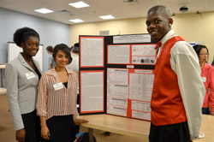
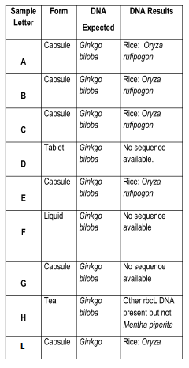
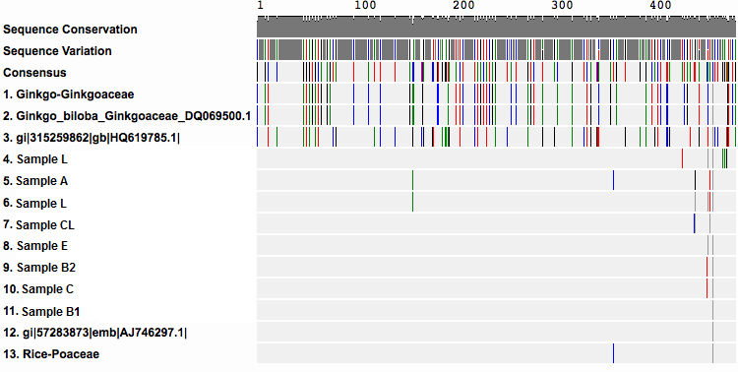
Student Project
Ginkgo products contain rice – not Ginkgo
Mary Acheampong, Bobby Glover, and Marisa VanBrakle
Mentor: Allison Granberry
Hostos-Lincoln Academy of Science, The Bronx
2012 UBP Grand Prize Winners

Slide 6
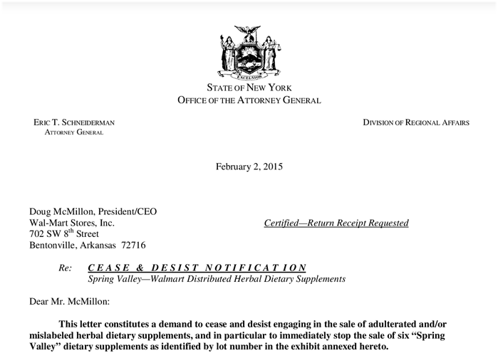
Hot Off the Press
NY Attorney General confirms herbal supplement fraud

Slide 7
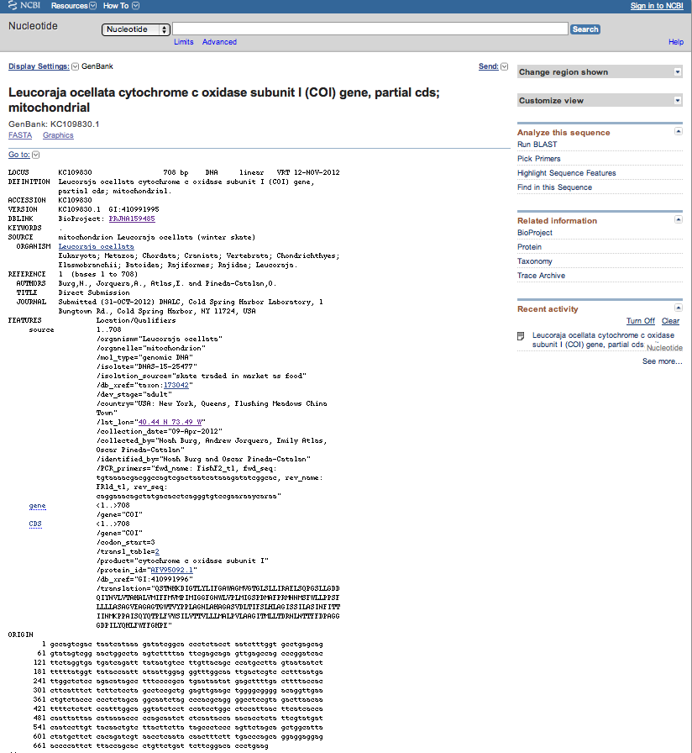
Barcoding Projects, 2012-14
Genbank publications with students authors

Slide 8
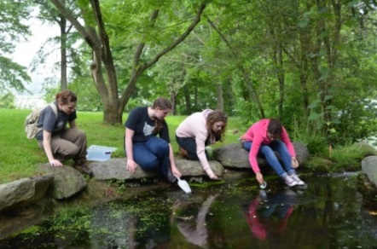
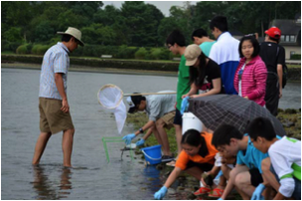
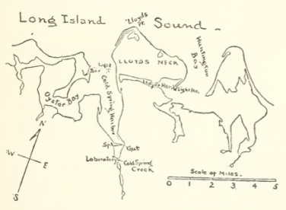
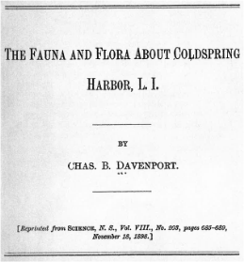
Barcoding Projects, 2012-14
Targeted Biodiversity Research of Cold Spring Harbor
166 student scientists
>780 samples processed
>1500 barcode sequence reads
>53 novel sequences
20/126 “historic species” identified – evidence of change
Charles Davenport
Director, Brooklyn Institute of Arts and Sciences

Slide 9
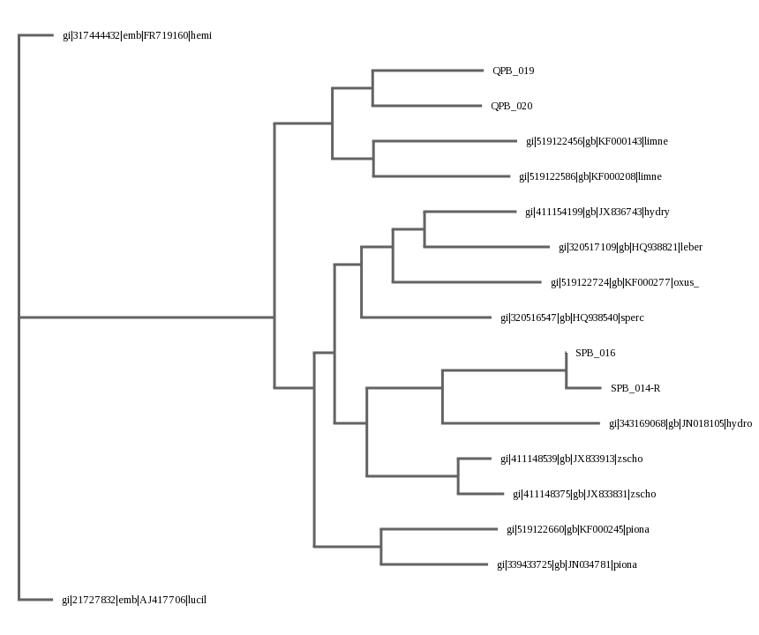
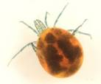
Student Results
Three novel water mite barcodes
Jiaolizhuo, Yangtianyu, Xiaxinyi, and Fanlitian from Beijing 166 High School
Hydryphantadae sp.
Limnesia sp.
Oxus sp.
Notes:
Two different types of “water mite.”
Three new barcodes
two new mites related to limnesia sp.
one new species related to hydrodoma

Slide 10
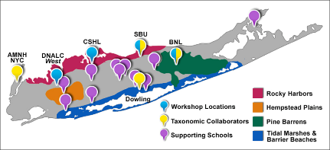
Barcode Long Island
Student-driven Biodiversity Research
Support 600 student biodiversity projects with 1800 students
Train 240 teachers as student mentors
Study impact on students and teachers
Study biodiversity and changes in biodiversity
Example: compare current species to 126 species in surveys of Cold Spring Harbor, circa 1900

Slide 11
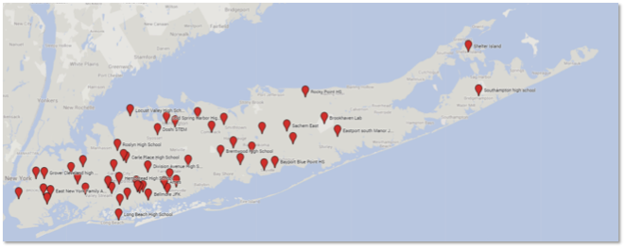
Barcode Long Island, 2014-16
Student DNA barcoding on Long Island
144 teachers trained as mentors
141 student teams with 400 students
54 mentors from 41 Long Island schools
>2,440 DNA samples
>4,000 DNA sequences
10 potentially novel barcodes
2014-16 Participants
(school locations)

Slide 12
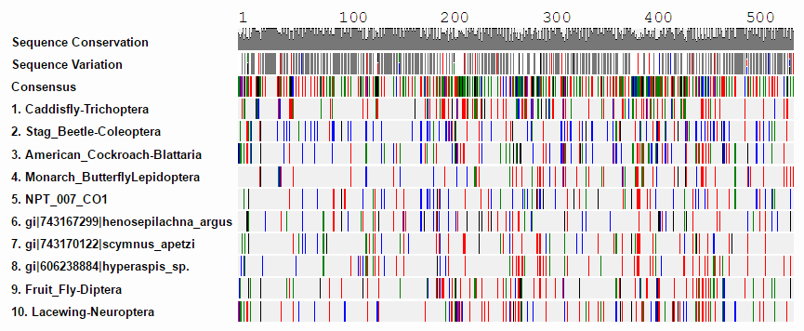
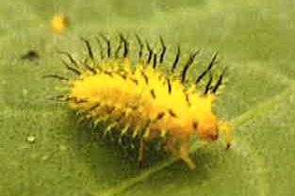
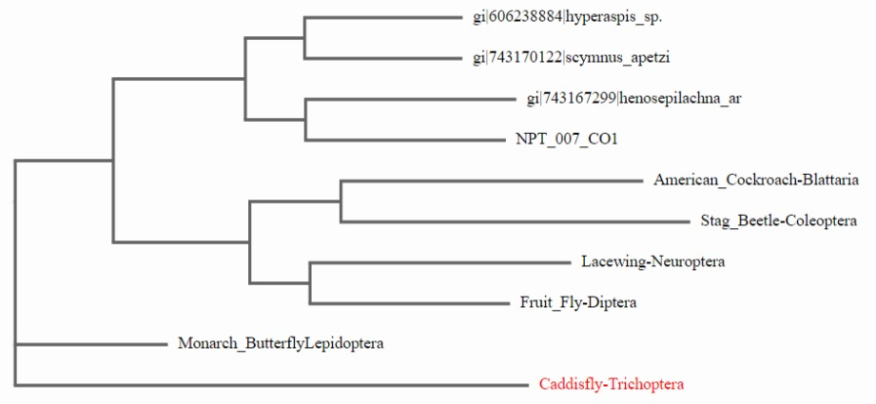
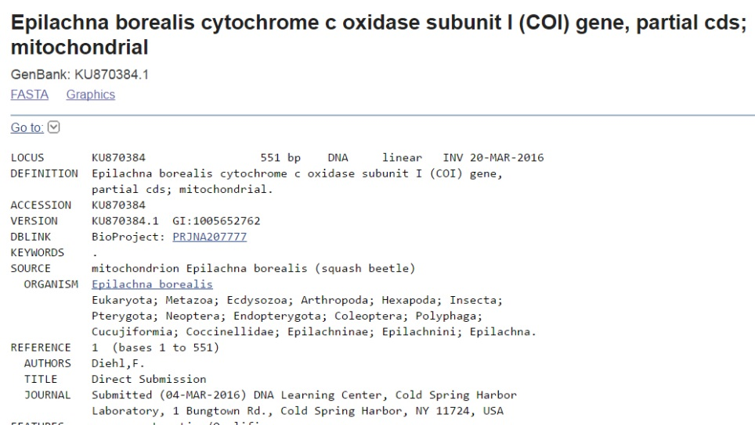
BLI Results
First published Squash Beetle barcode
Westhampton Beach Senior High School
Epilachna borealis
larva
Notes:
Two different types of “water mite.”
Three new barcodes
two new mites related to limnesia sp.
one new species related to hydrodoma

Slide 13
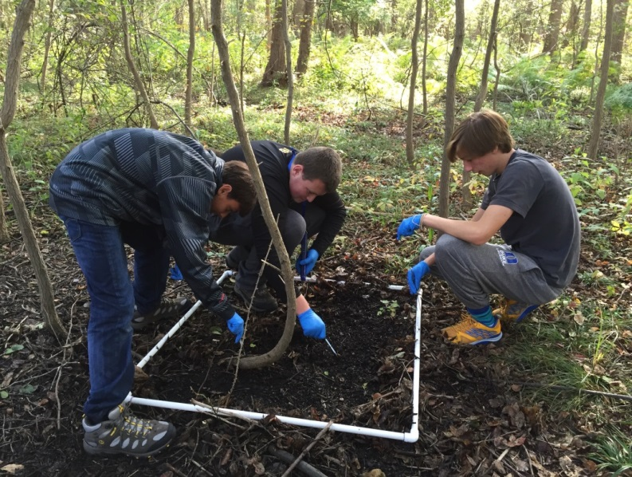
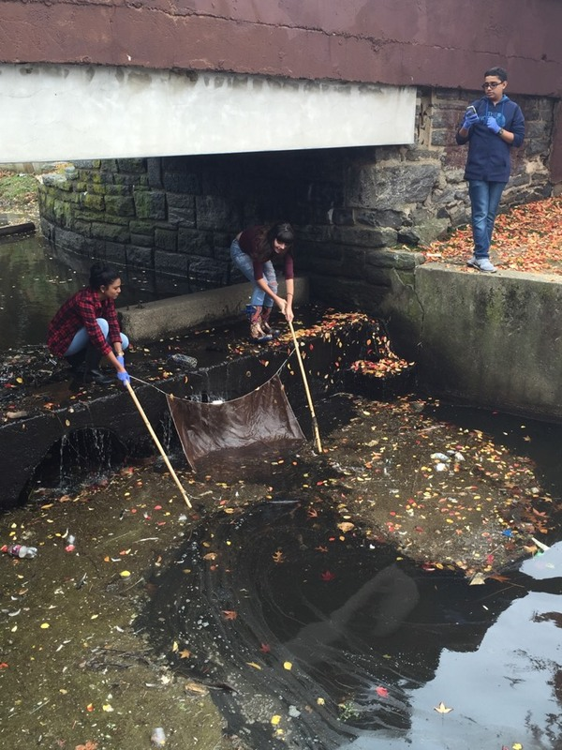
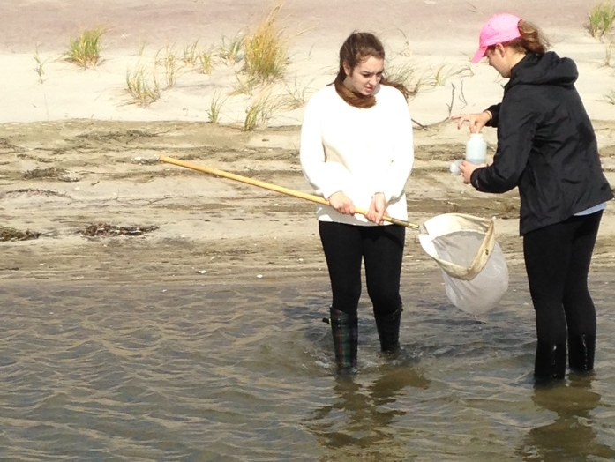
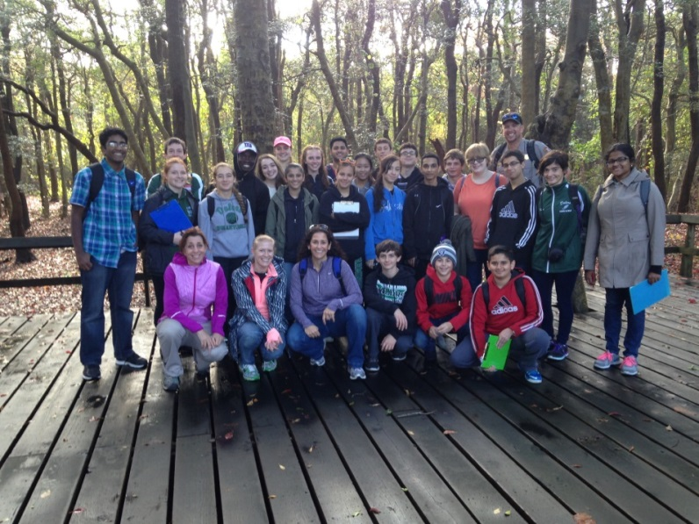
Student Sample Collections
Notes:
Two different types of “water mite.”
Three new barcodes
two new mites related to limnesia sp.
one new species related to hydrodoma

Slide 14
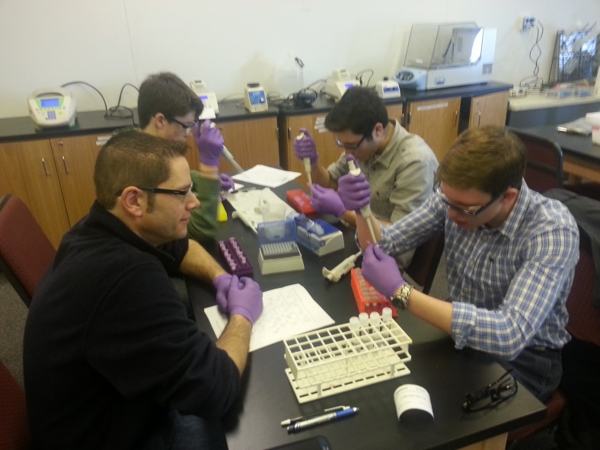
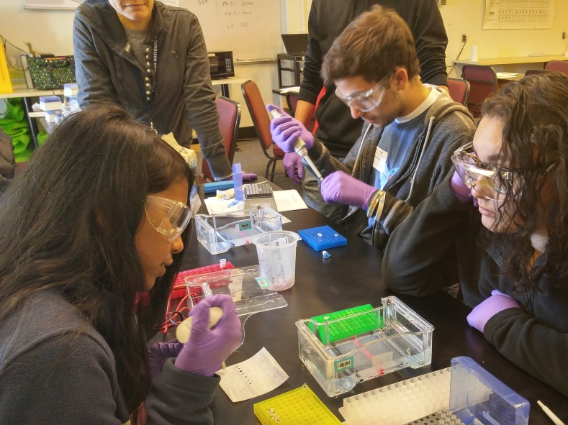
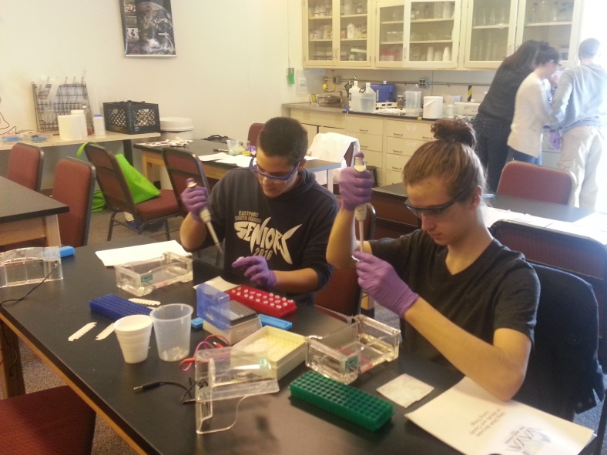
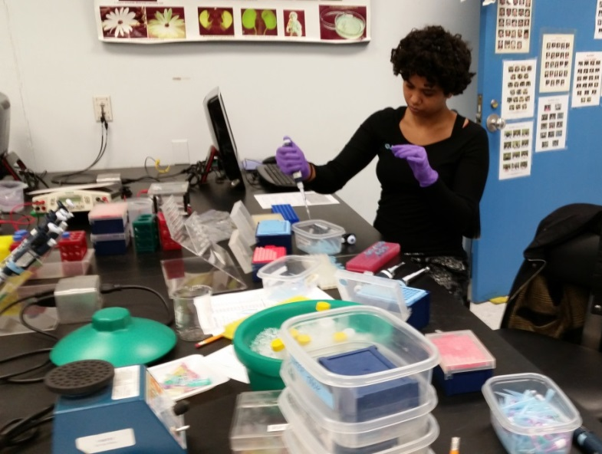
Open Labs with Collaborators
Students working with samples at Brookhaven National Laboratory and Stony Brook University
Notes:
Two different types of “water mite.”
Three new barcodes
two new mites related to limnesia sp.
one new species related to hydrodoma

Slide 15
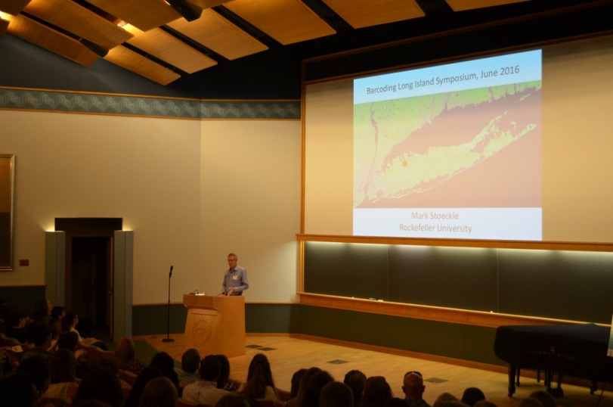
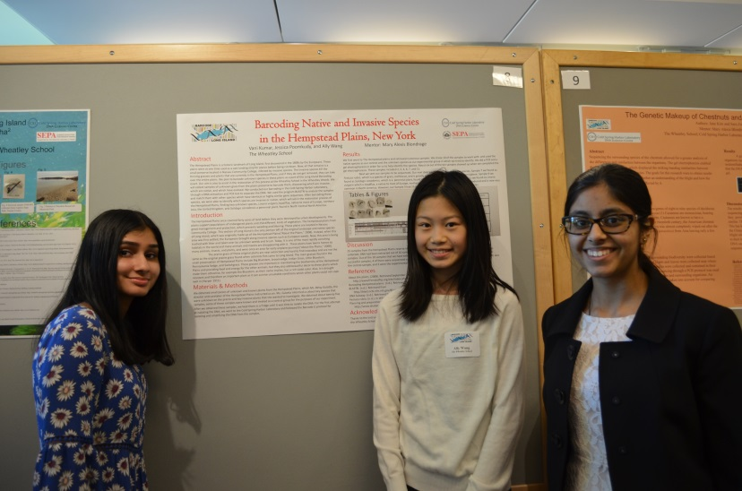
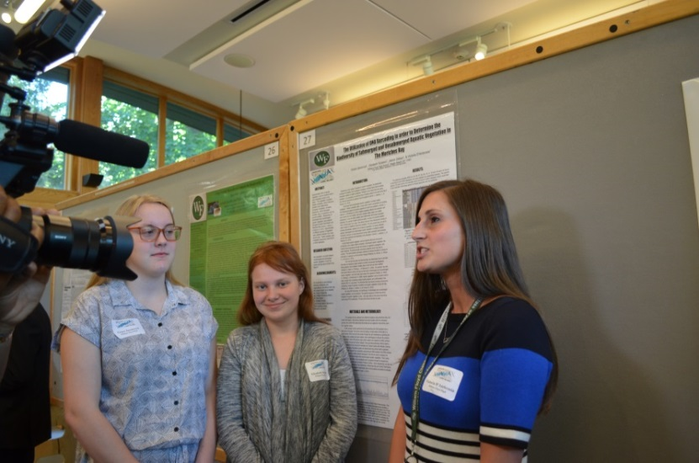
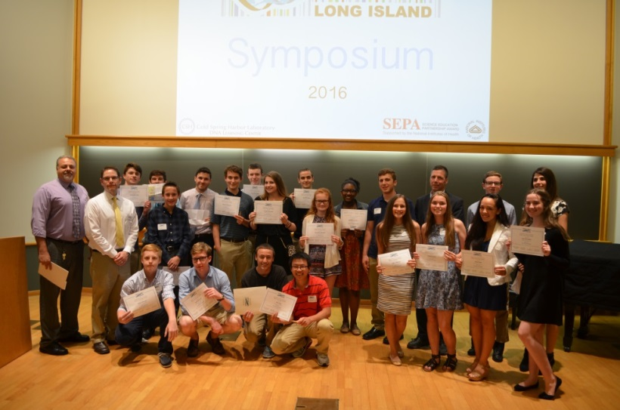
Barcode Long Island Symposium
Friday, June 10th

Slide 16
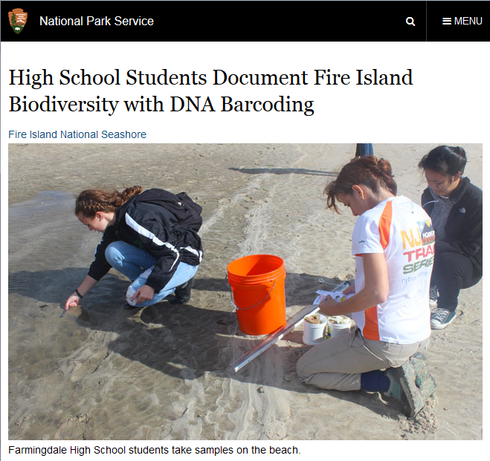
BLI in the News

Slide 17
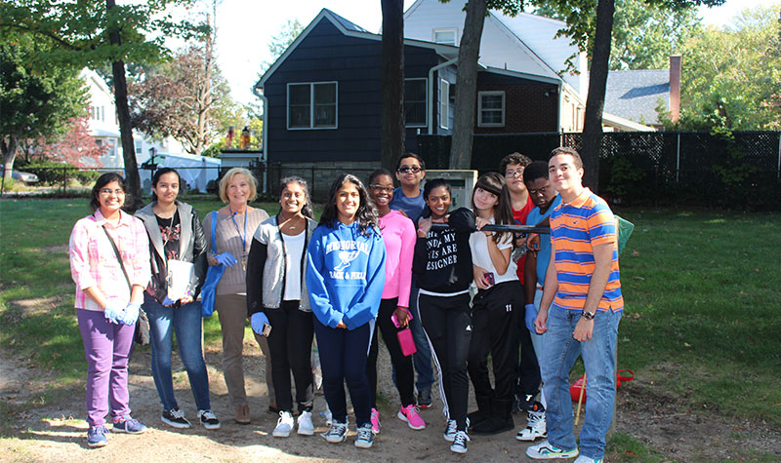
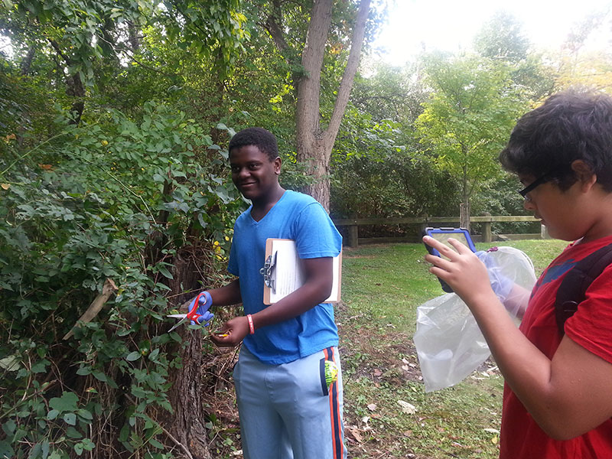
BLI in the News

Slide 18
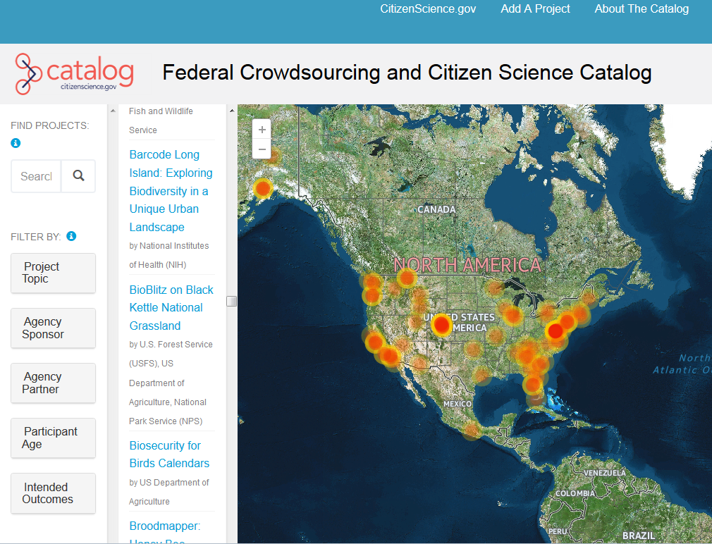
BLI in the News

