Slide 1
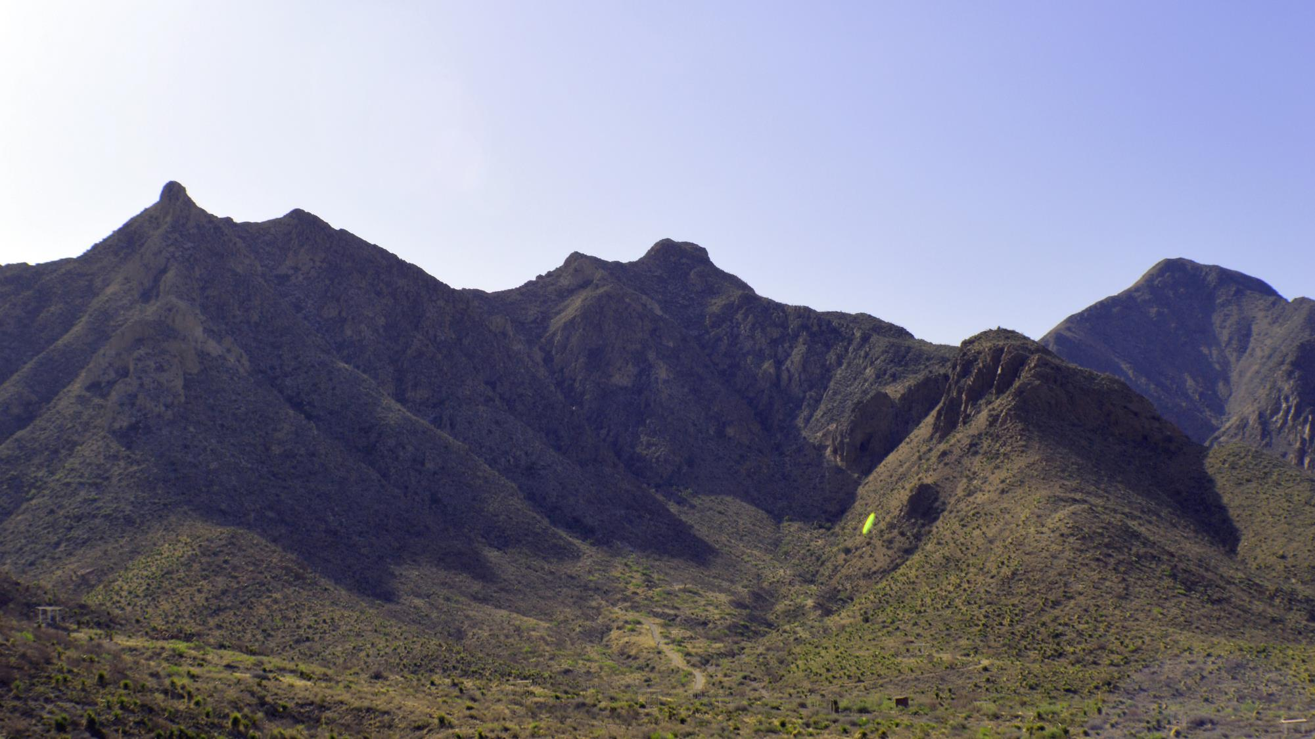
Barcoding USAnts
Getting Started with Ants
O9.July.2020

Slide 2
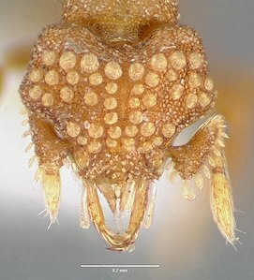
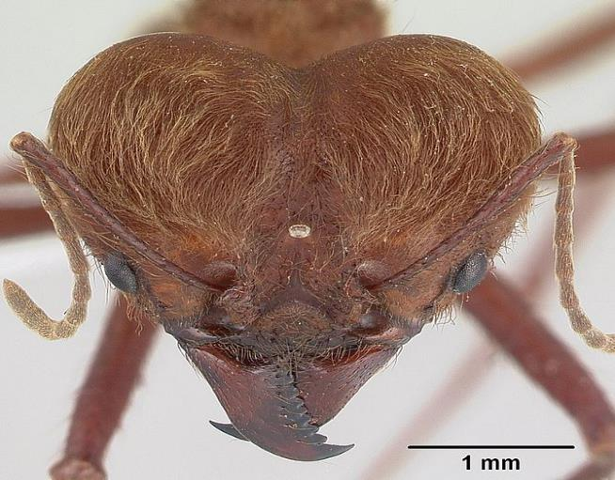
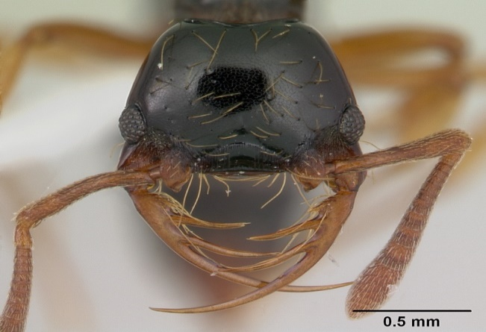
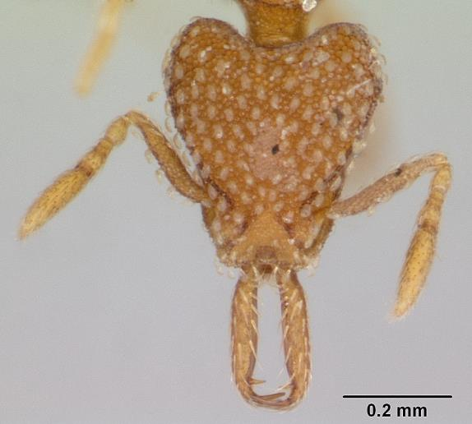
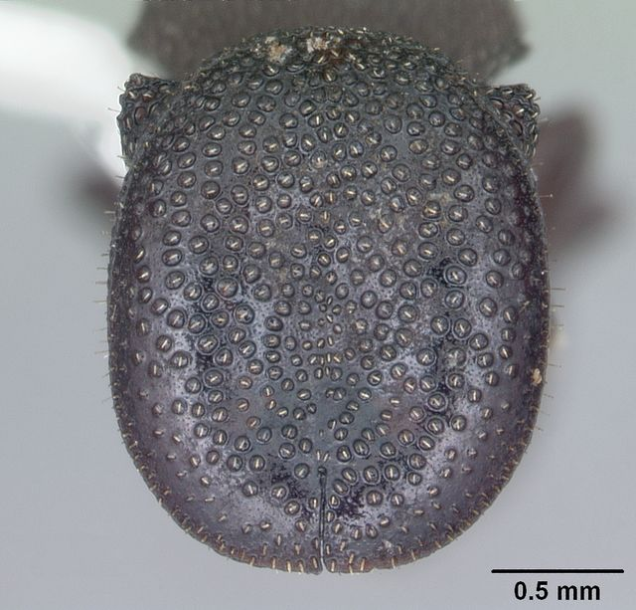
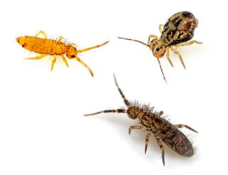
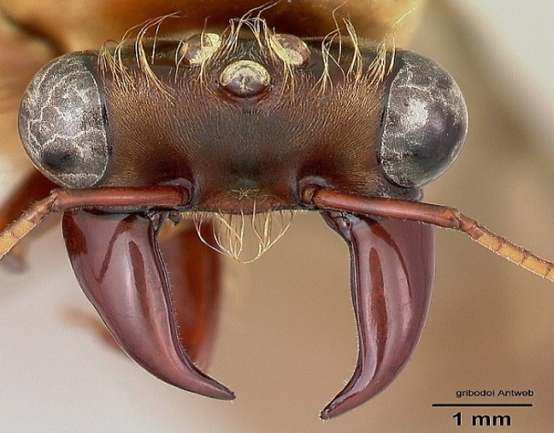

Slide 3
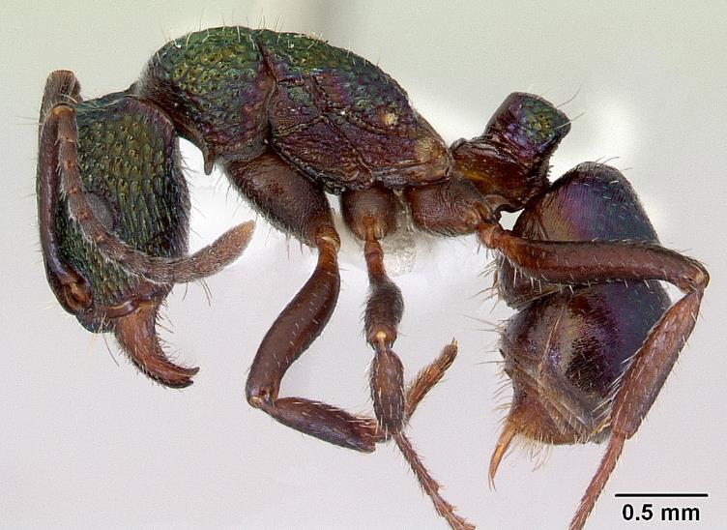
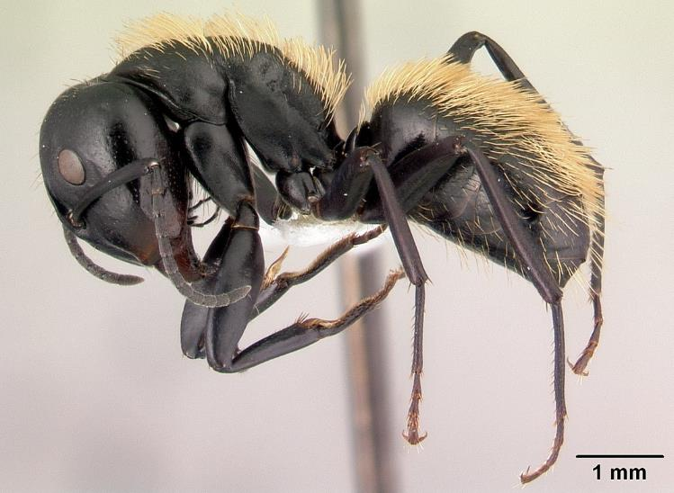
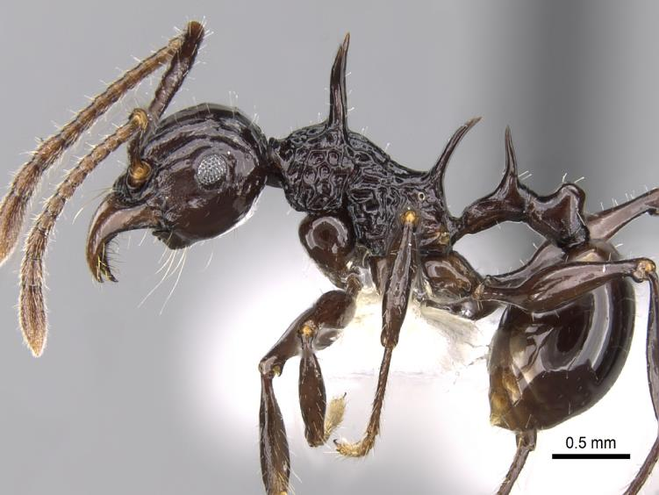
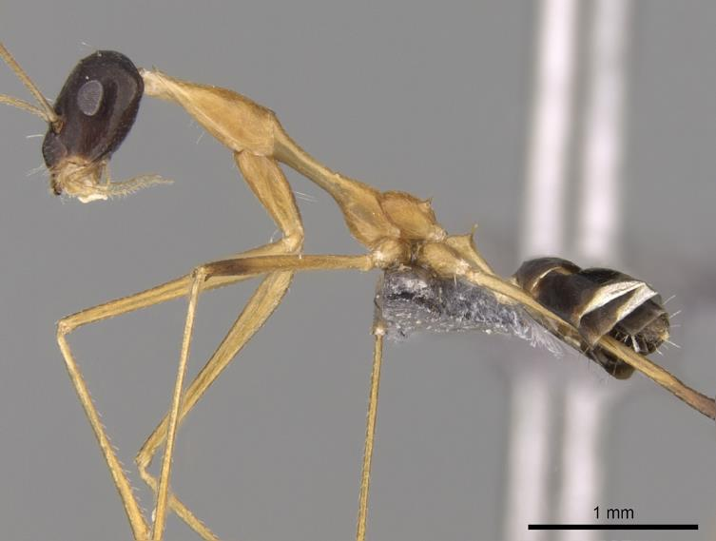

Slide 4
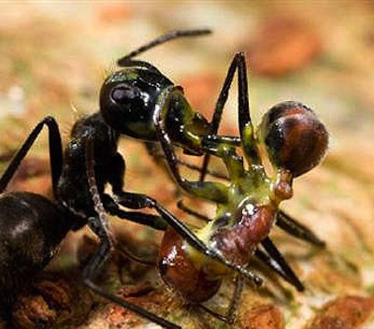
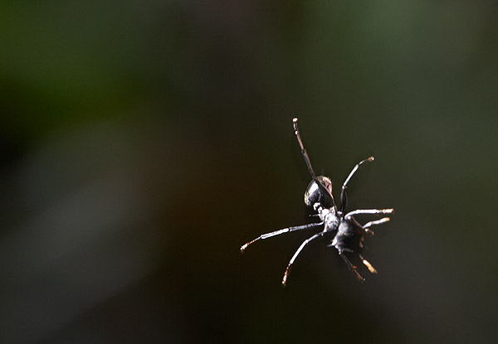
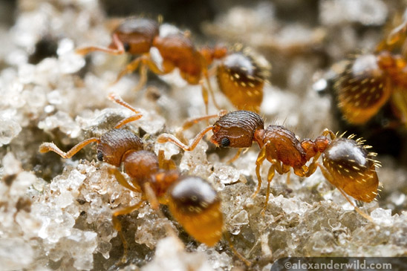
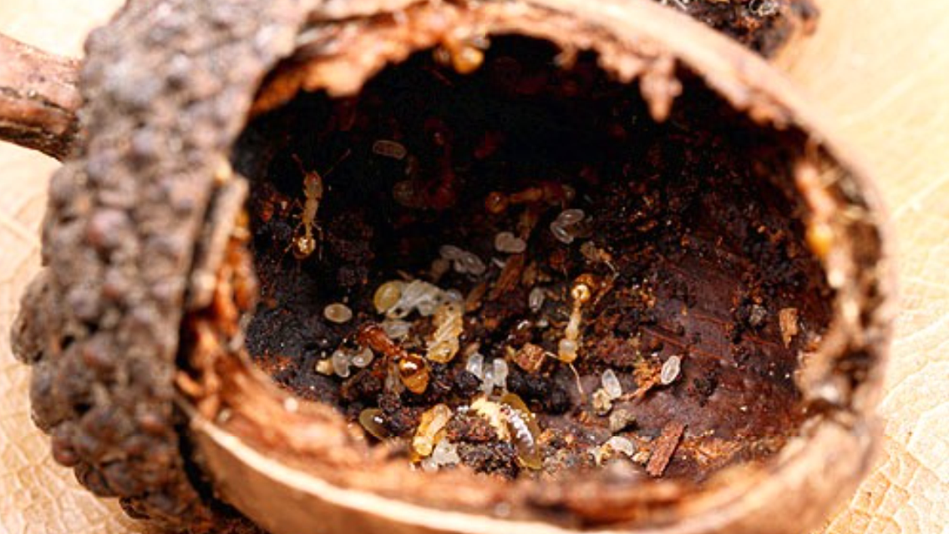
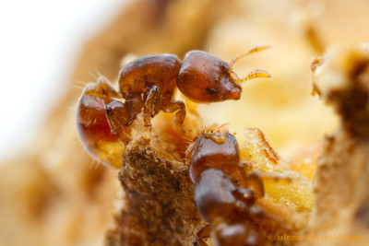
`

Slide 5
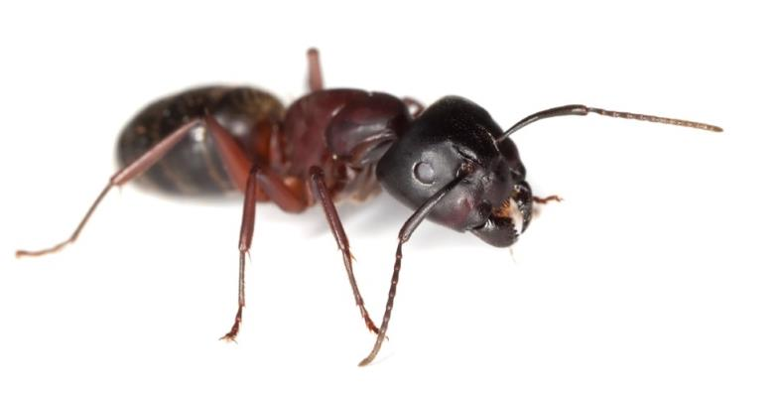
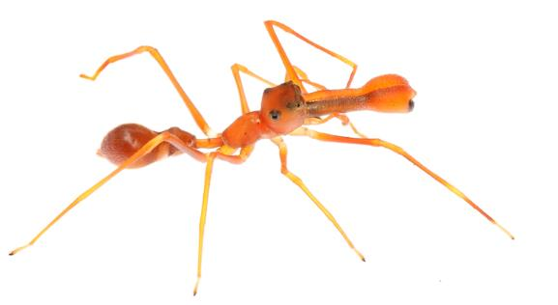
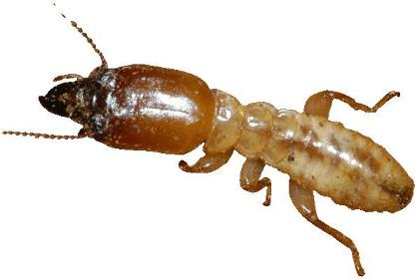
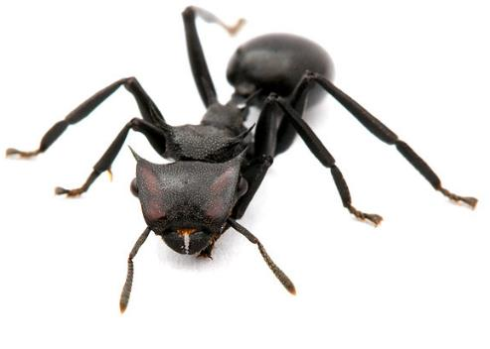
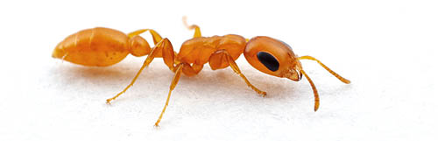
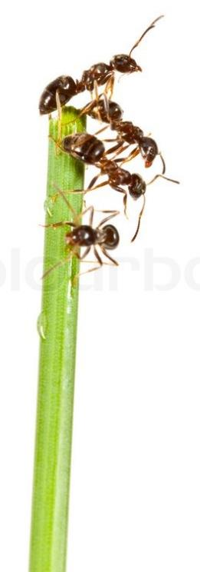
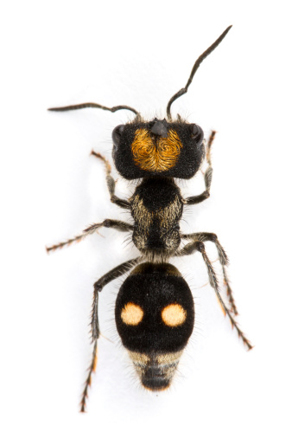
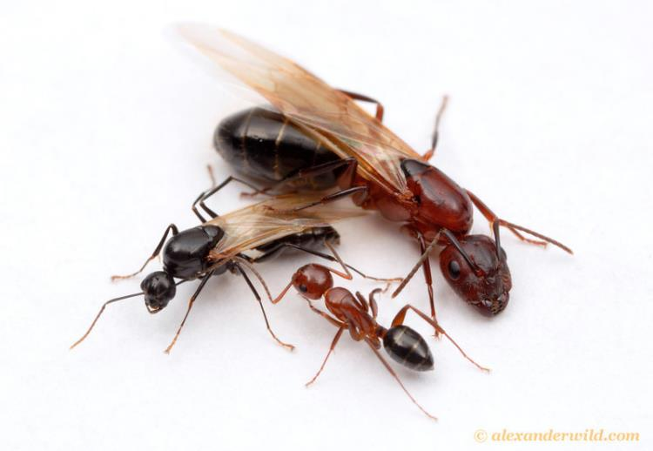

How many ants do you see?
11

Slide 6
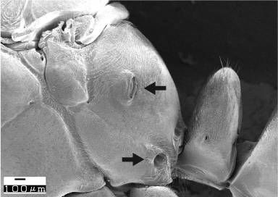
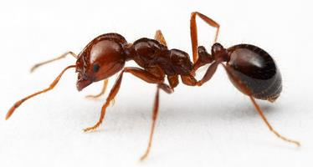

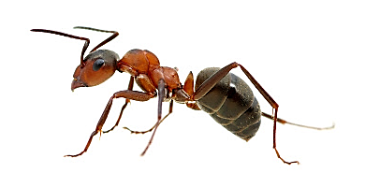



What is an ant?
Antenna 4 – 12 segments and elbowed (9-13♂)
Metapleural gland easily seen
Abdominal segment #2 = petiole; Abd. Seg #3 = postpetiole form scale
Wings of ♀ deciduous

Slide 7
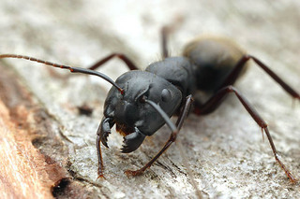
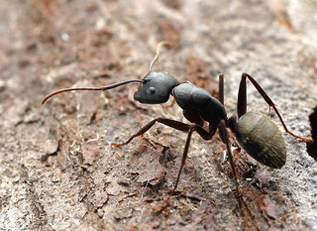
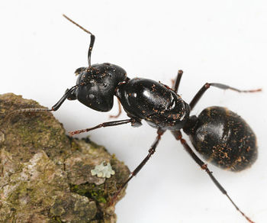
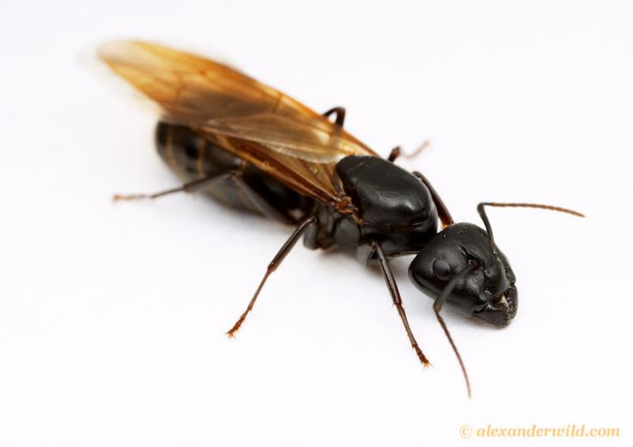
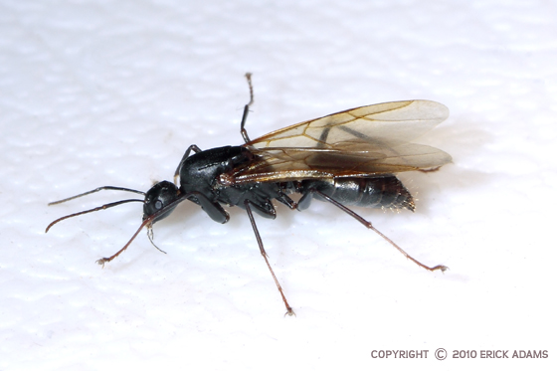
Queen
Male

Slide 8
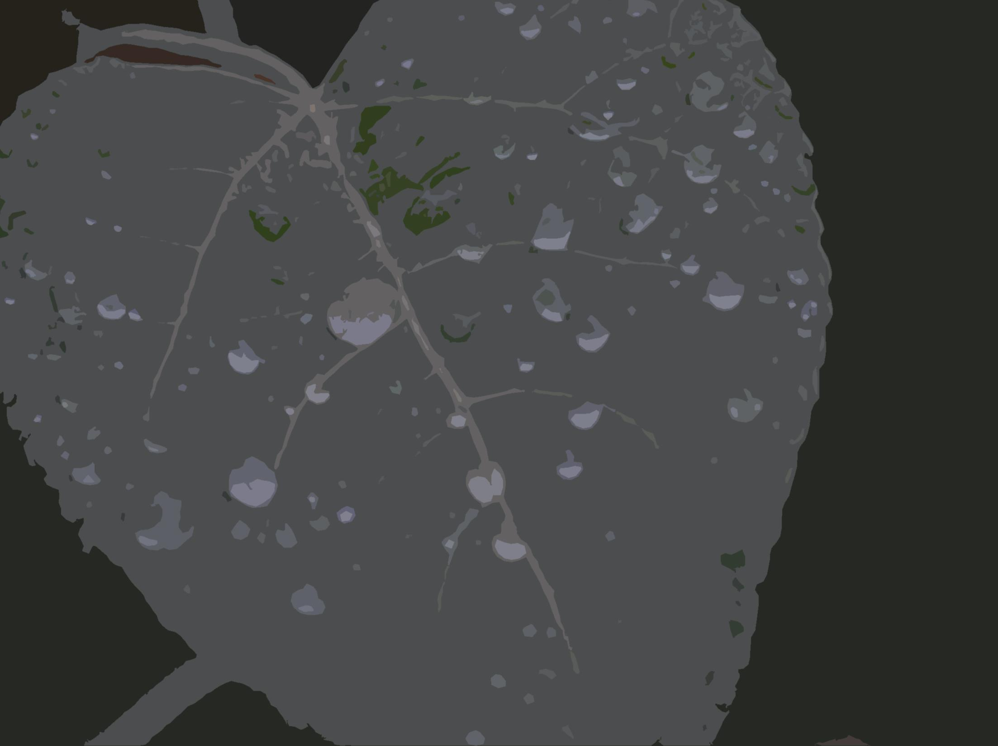
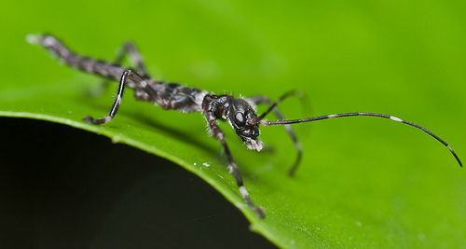
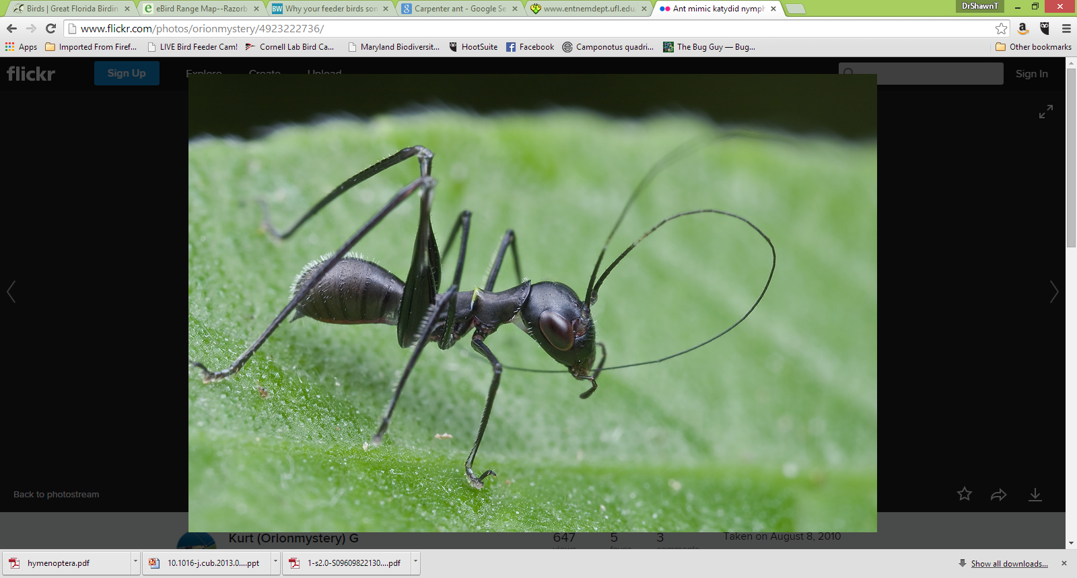
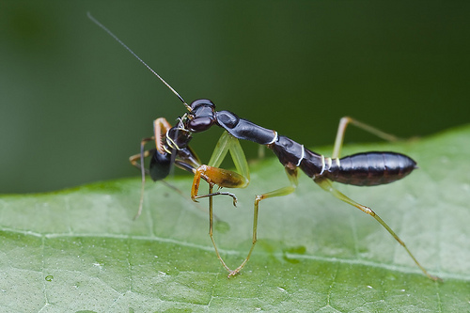
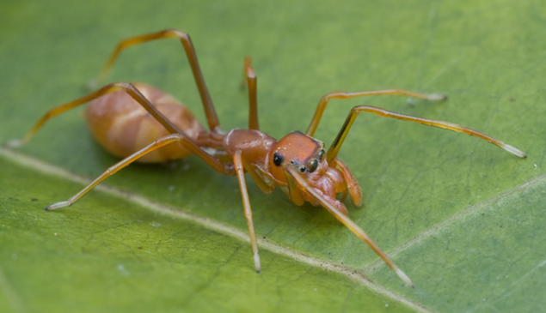
Why mimic ants?
Walkingstick
Cricket
Mantis
Spider

Slide 9
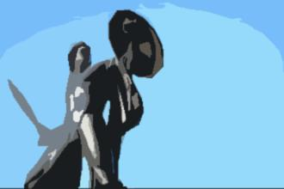
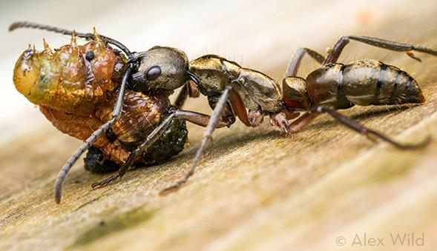
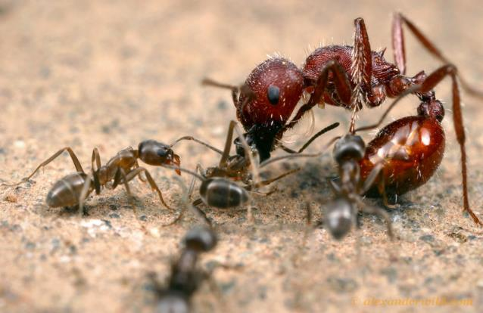
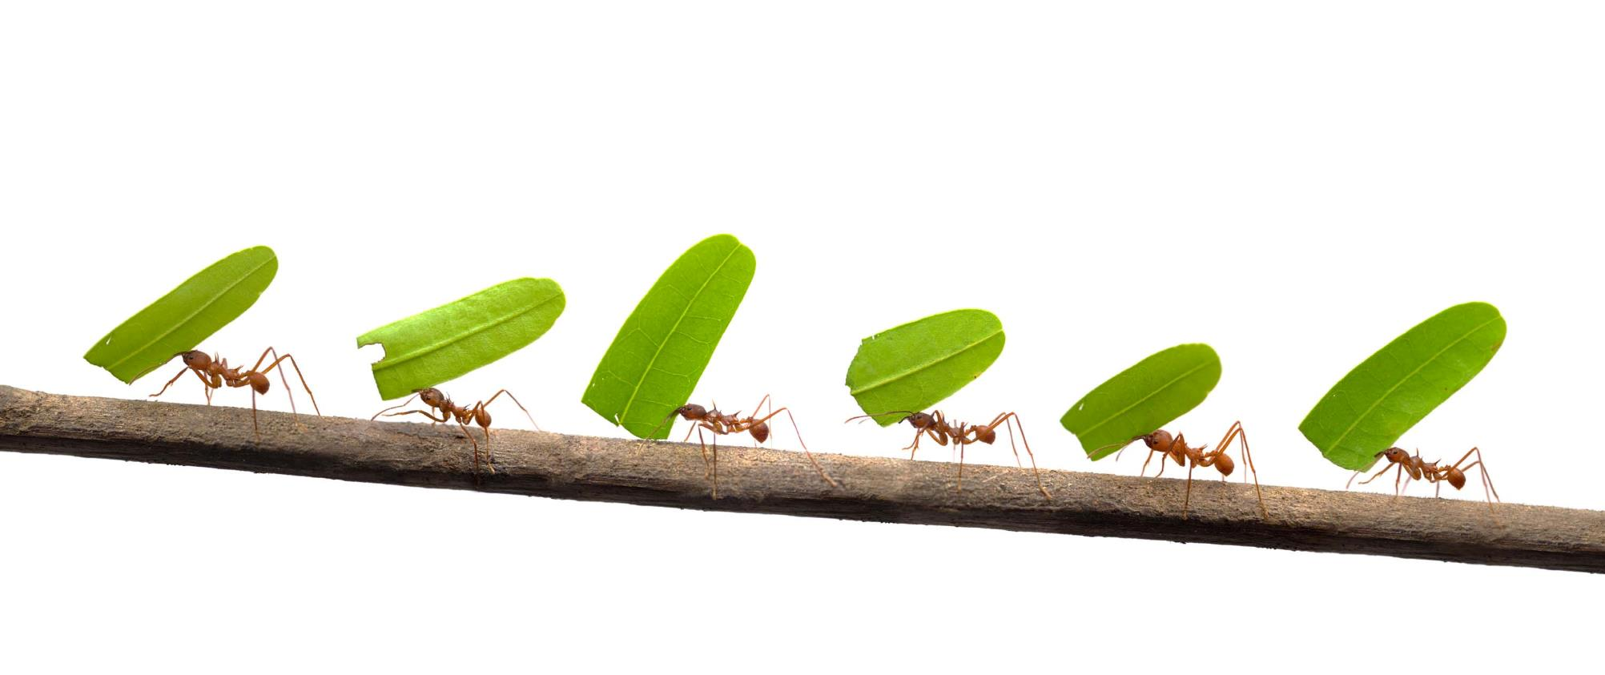
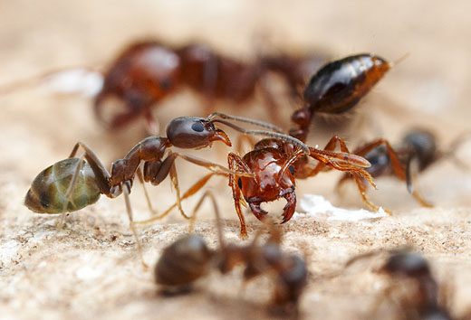
Myrmeco=“ants”
the Myrmidons were the followers of Achilles
Ants are associated with “battle”
We are on a Mission
100 new barcode
sequences

Slide 10
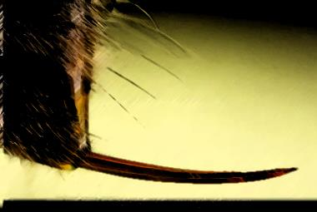
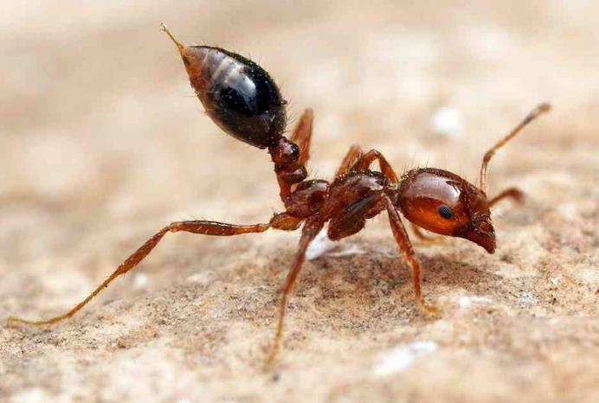
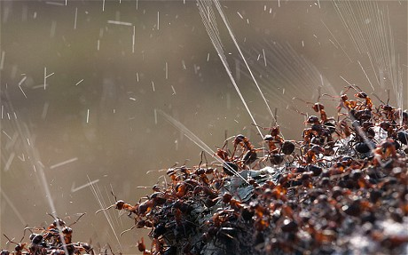
Stinger and sprays contain a cocktail of chemical products.
Over 46 proteins
Pepperdine
Proteases
IgE-binding proteins
Simple organic molecules
Alkane
Formic acid
Hydrocarbons

Slide 11
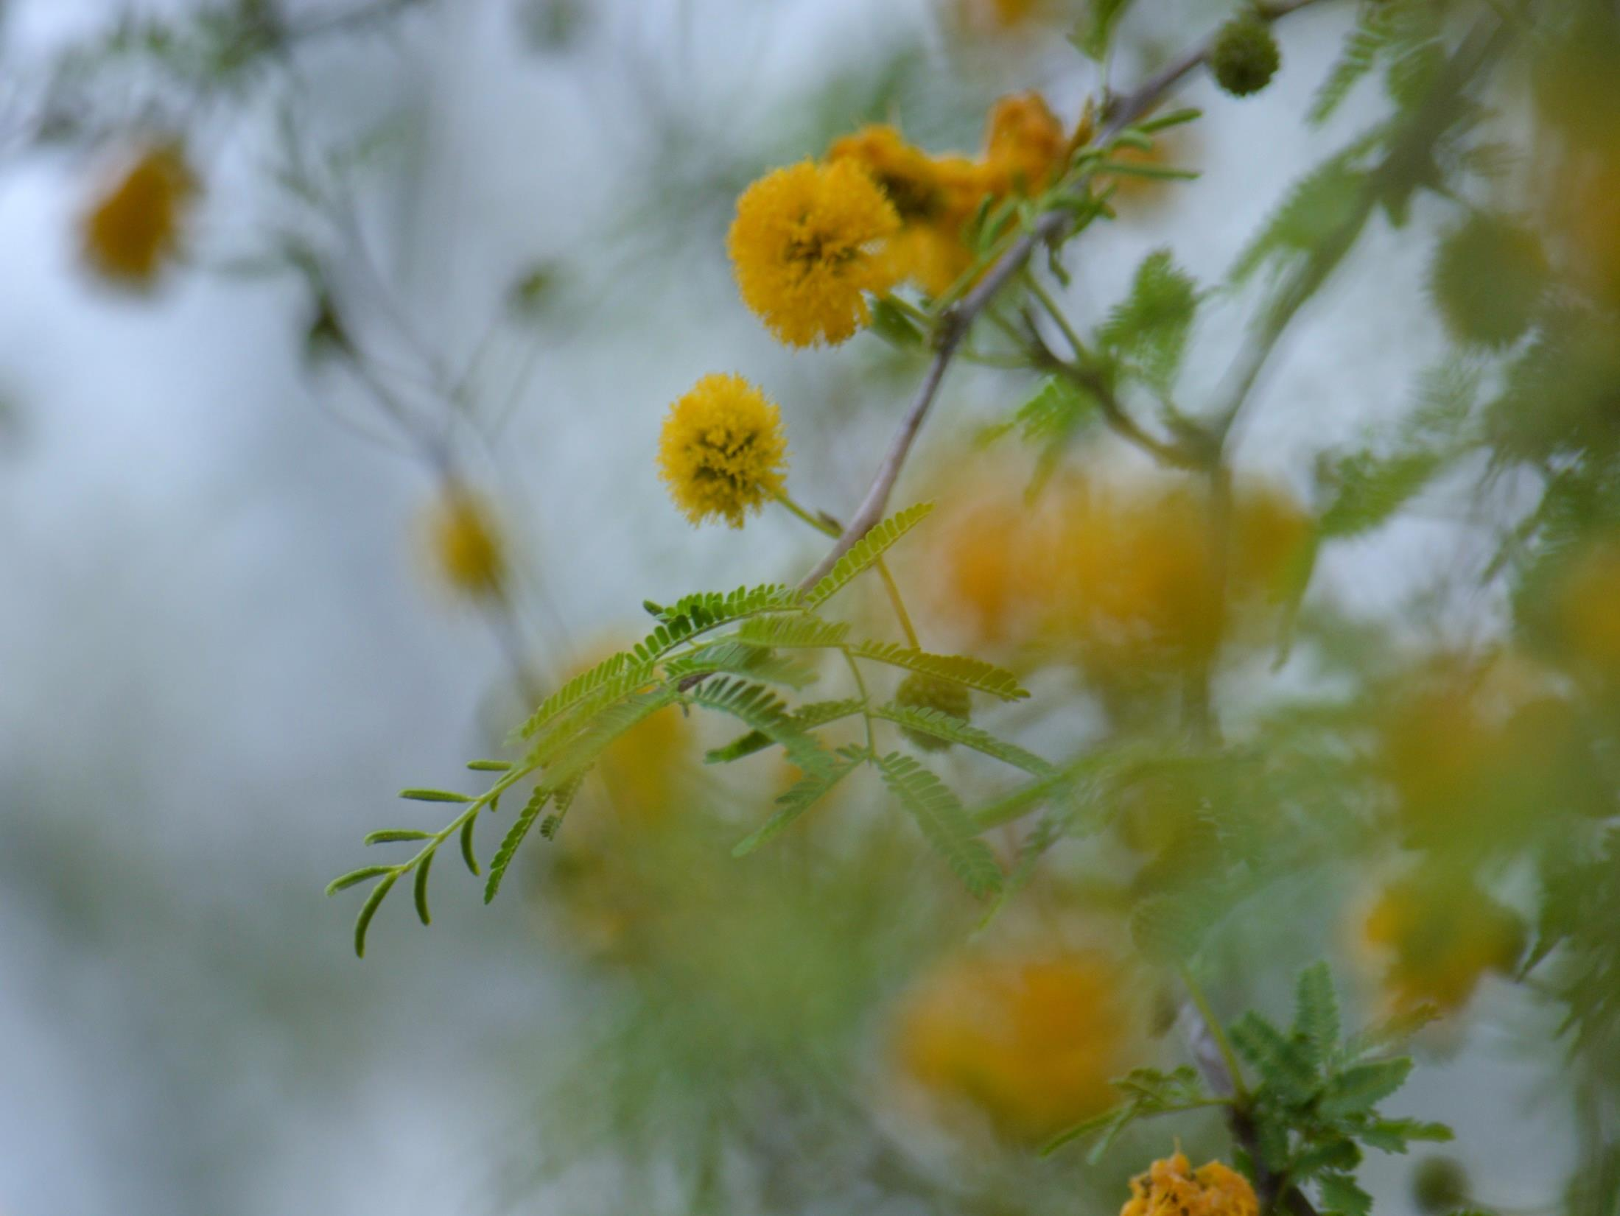
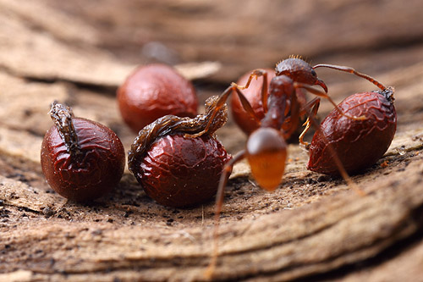
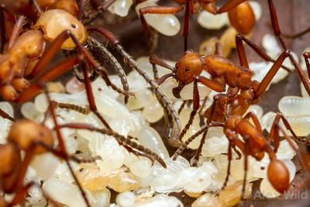
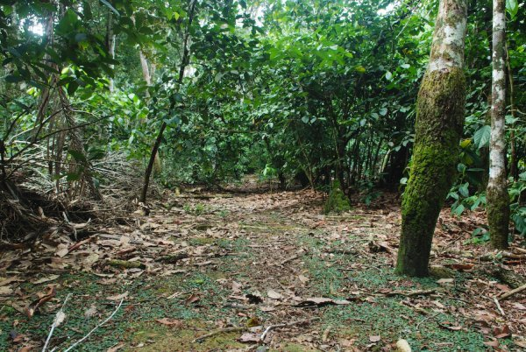
Protecting Resources
Such compounds all allow for colony defense of:
Food (seeds, insects, & nectar)
Brood (eggs, larvae, & pupae)
Prey Acquisition

Slide 12



Why Study Ants ?
They are AWESOME
Significant roles regarding ecosystems goods and services
Proportionally large biomass in terrestrial communities
Keystone species
  Predators
  Mutualists
  Resource species
Speciose
Image by and use with Permission by Alex Wild
Image by and use with Permission by Alex Wild

Slide 13


Ant-Ecosystem Interaction
Improve Soils
Shaping Plant Communities
Plant
Propagules
Ant-Plant Interactions
Mutualisms
Indirect
Interactions
Direct
Interactions
Shape Plant Communities
Myrmecophytes
Myrmecophilly
Seed Transport
Pollen Transport
Ant Protection
Floral Antagonists
Ecosystem
Engineers

Slide 14




Plant Propagules

Slide 15



Feeding on Plants
Fungus Growing Ants
Major Ag pest in S. Am. as well as TX and LA
Opening Canopy
Nutrient movement

Slide 16




Slide 17






Studying and Enjoying Ants

Slide 18



Slide 19



Slide 20


Slide 21


Slide 22


Formica neorufibarbis
14,269 ft. on Mt. Evans in Colorado
12,160 ft. on Boundary Peak, Nevada.

Slide 23


Crematogaster
vermiculata
Cypress dominated bottomatland

Slide 24


Slide 25




Shifting leaf litter
Active
Main method used by many
Some Bias-dominate ants
Require supplies (home made)
Acanthostichus arizonensis
associated with termites

Slide 26



Directed Hand Collection
Active
Main method used to target species
Lasius murphyi
Lasius neoniger
Social parasite Lasius neoniger
nests under or adjacent to stones in open woods or on their edges; it shows a preference for sandy soil.

Slide 27




Pitfall Trap
Passive
Extended time
Some Bias
Require supplies
May capture infrequently collected species
Subterranean pitfall traps
Wong, M. K. L. and B. Guénard. 2017. Subterranean ants: summary and perspectives on field sampling methods, with notes on diversity and ecology (Hymenoptera: Formicidae). Myrmecological News. 25:1-16. doi:10.25849/myrmecol.news_025:001

Slide 28



Bait Traps
Passive
Extended time (60 mins)
Select proper bait
Some Bias-dominat ants
Require supplies

Slide 29



Sweeping and Beat Sheeting
Active
Procure arboreal foraging or nesting species
Break branches, open galls, nuts on sheets/into nets
Require supplies

Slide 30
General
Vials (some prefilled 90-95% EtOH)
Field notebook, pencil
Trowel
Forceps (plus extra pair)
Knife or pick to break up material or flip rocks logs, lift bark
Aspirator
Data sheets
Mobile photo/camera photos
Pitfall materials
Trowel
Cups (inner & outer)
Preservative (discuss)
Lid
Print research note
Bait
Vials filled with pecan short bread cookies
Transect
PLEASE DO NOT DISTURB
SCIENTIFIC STUDY IN PROGRESS
Permit ######
Contact name@someplace.come

Slide 31

Collected Specimens
Take field notes
Collect material (freeze to kill) or place directly into vials of alcohol
All material should have temporary label in pencil or pigma pen
COUNTRY: State, County
Larger Locality, Locality, GPS
Habitat, ecology collection method
Date and collectors
USA: Virginia, Albemarle Co.,
Charlottesville, Ivy Creek, Red trail
38.093105, -78.492602 dec. forest
col under rock large colony 23.V.2019
STDash & KMDash

Slide 32



Slide 33




Ant Wiki
Ants of New Mexico (full book)
Antweb
Barcodinig USAnts Hand Out

Slide 34
(Bio)Geographical Regions
Break-out Rooms
Northern Rockies/Pacific Coast (MT, WA, AK), 5 teams: Dave Micklos
San Francisco Bay (CA), 3 teams: Bruce Nash
Great Basin (NV, UT), 3 teams: Catherine Zhang
Sonoran (AZ), 3 teams: Jeffry Petraca
Texas, Puerto Rico, 3 teams: Shawn Dash
Ozarks (AR, MO), 4 teams: Cristina Fernandez-Marco
Great Lakes (NY, IL, IN, MI), 5 teams: Allison Mayle
Northern Coastal Plain (NY, NJ, MA, RI), 6 teams: Sharon Pepenella
Southern Piedmont and Appalacia (MD, WV, NC, GA), 4 teams: Louise

Slide 35
(Bio)Geographical Regions
Break-out Rooms
Introduce one another
Discuss interesting habitats you can access
Discuss lab methods
Gauge current lab resources you have
Discuss your level of expertise and comfort with lab methods

Slide 36
Follow-up After this Meeting
Participant contact list
Profiles of teams and participants by region
Target species for your region
Collection procedures and Metadata
Specific instructions
Live clinics
Lab methods: DNA extraction, PCR, and gel electrophoresis
Specific instructions
Live clinics
Bioinformatics Analysis (later!)
  Specific instructions
  Live clinics
Continuing Support
Access to mentors
Office hours

