Slide 1
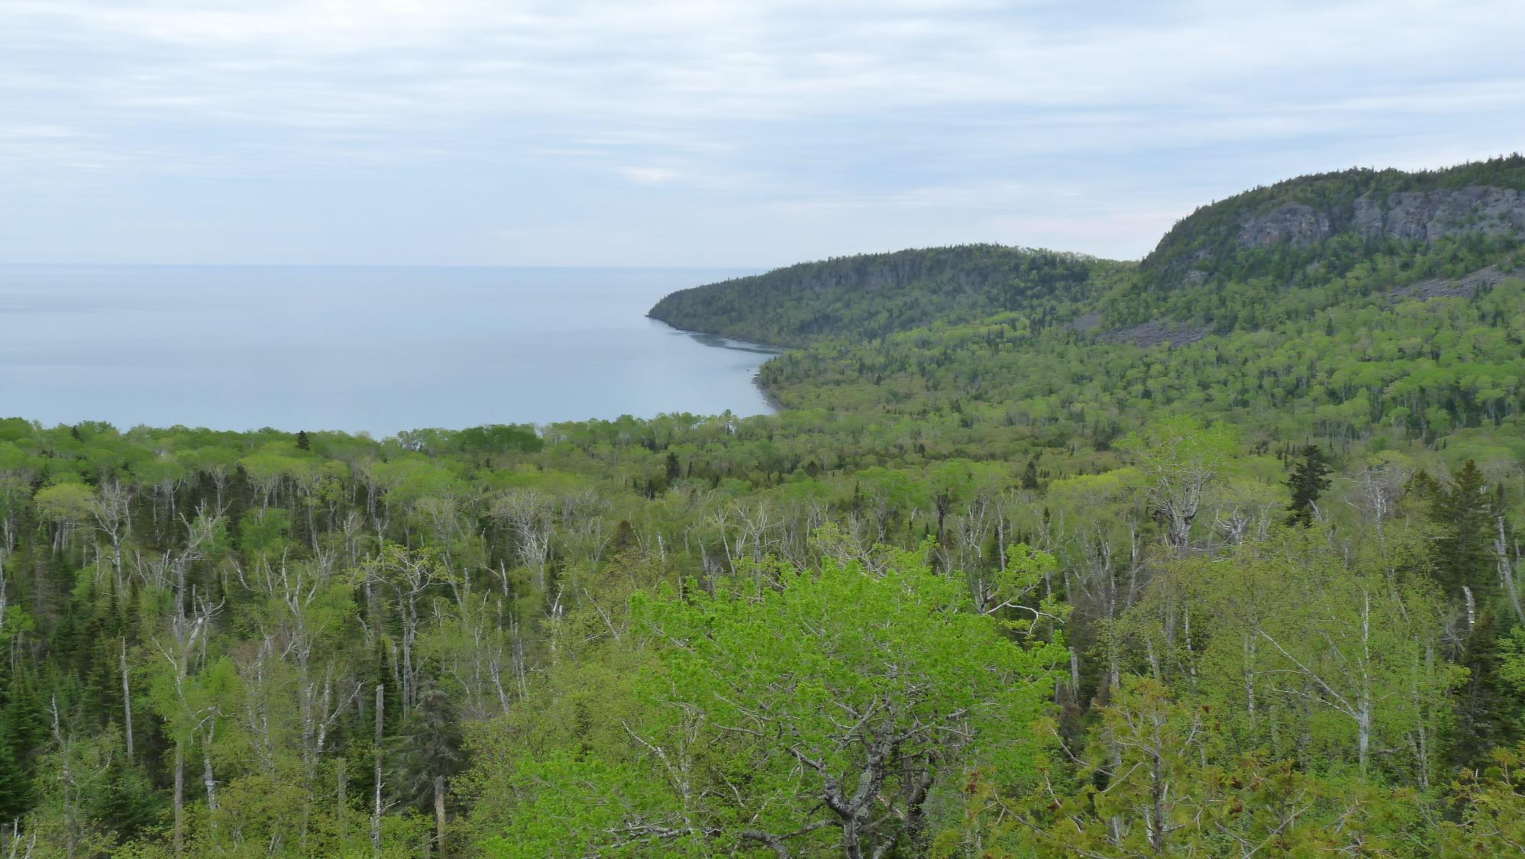
Collecting Ants

Slide 2
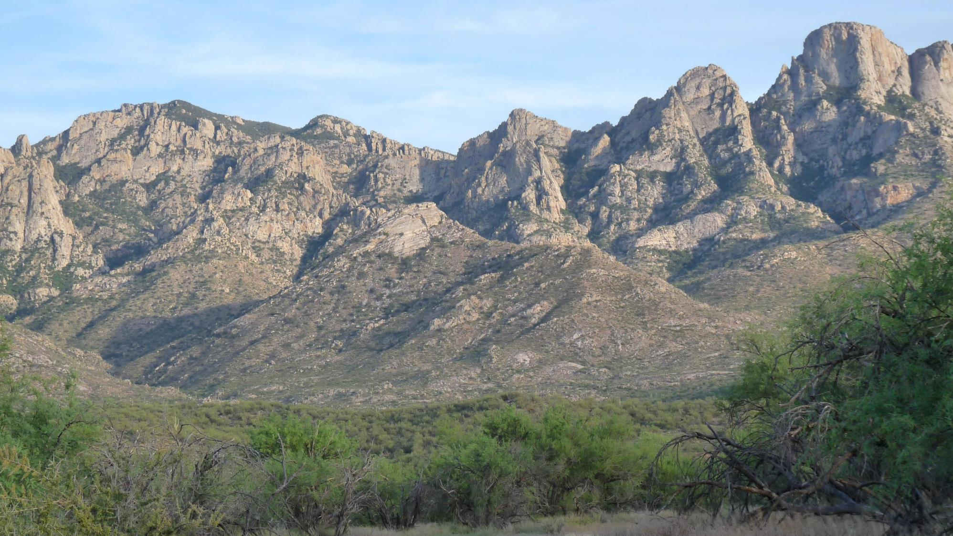
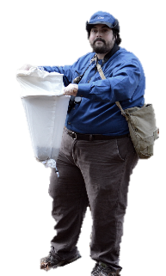
Where would you start looking for ants?

Slide 3
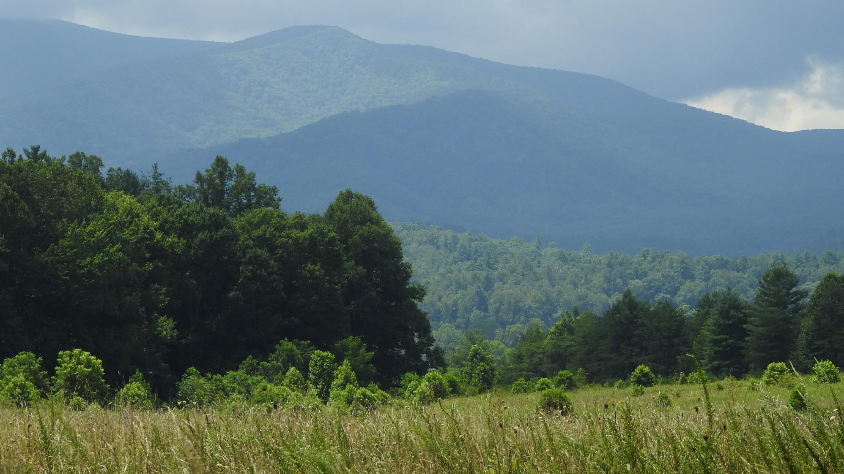
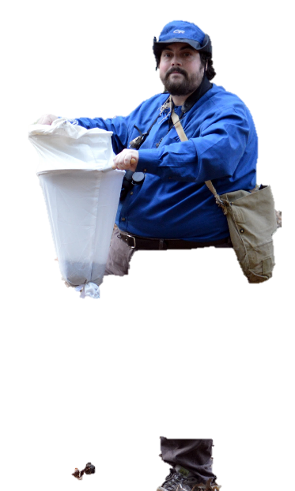
Where would you start looking for ants?

Slide 4
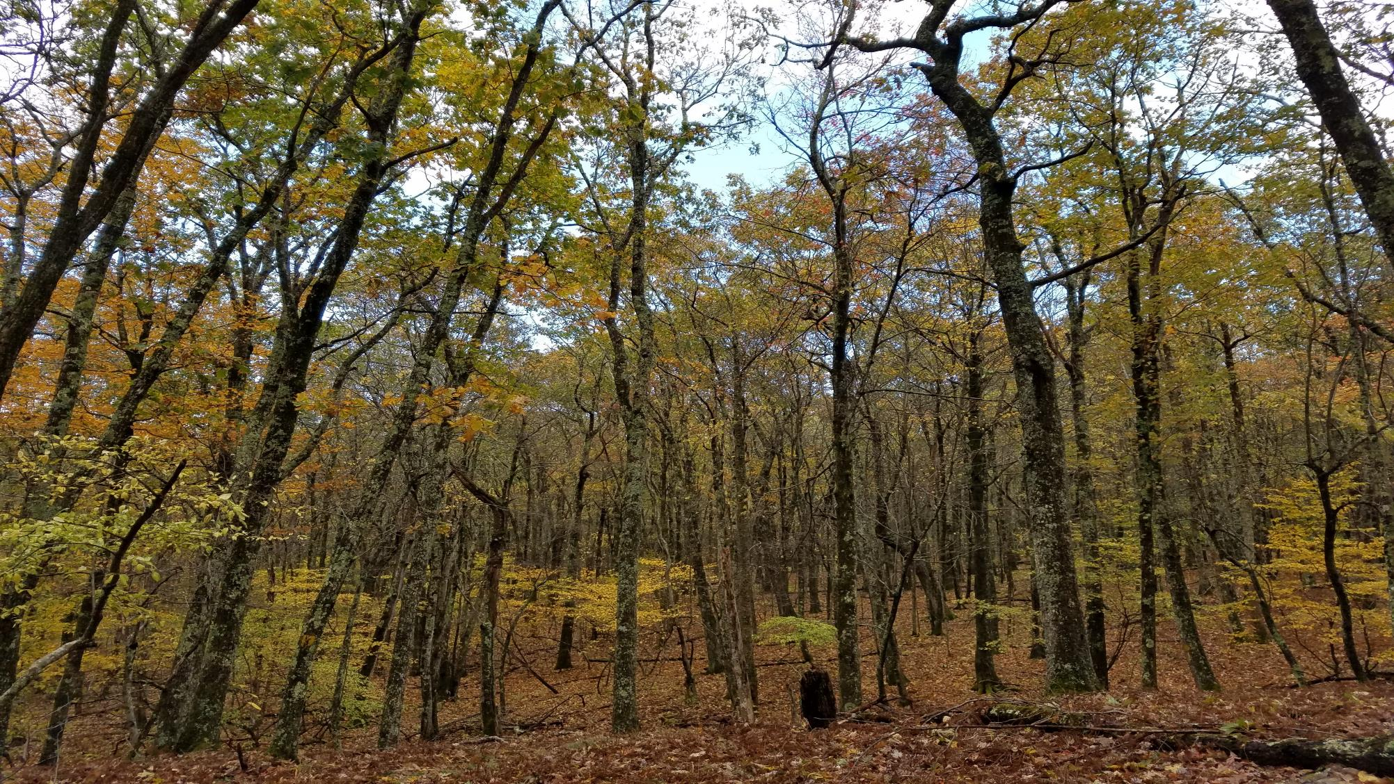
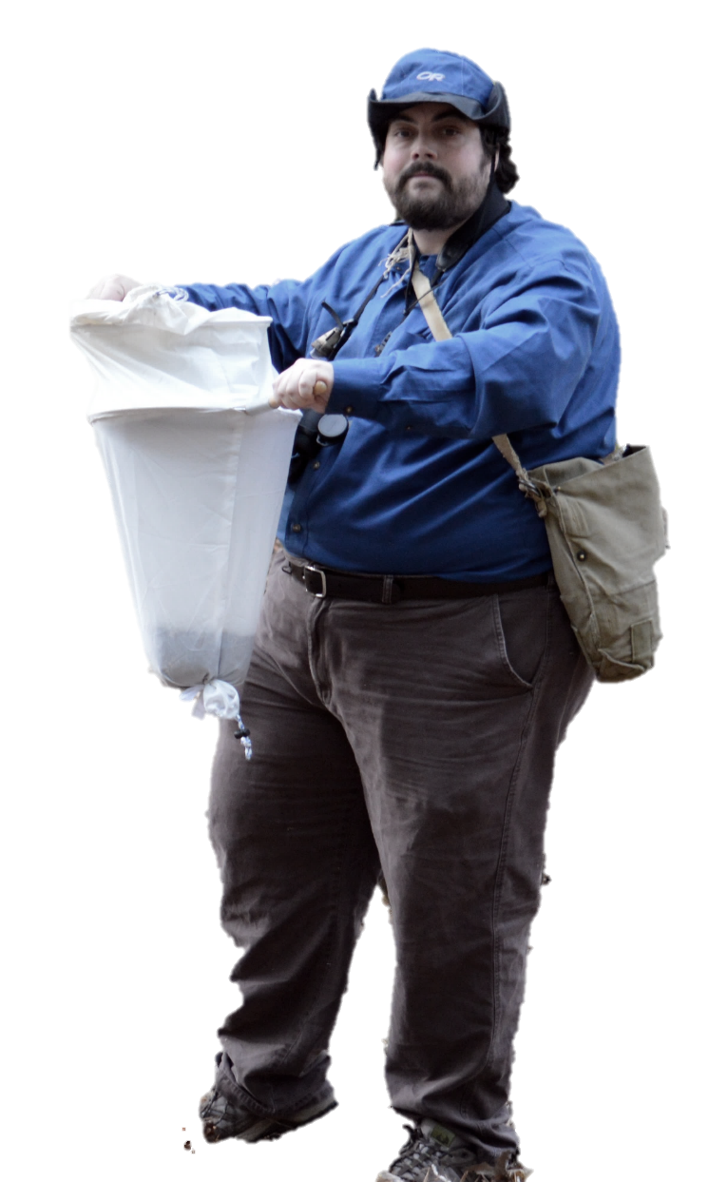
Where would you start looking for ants?

Slide 5
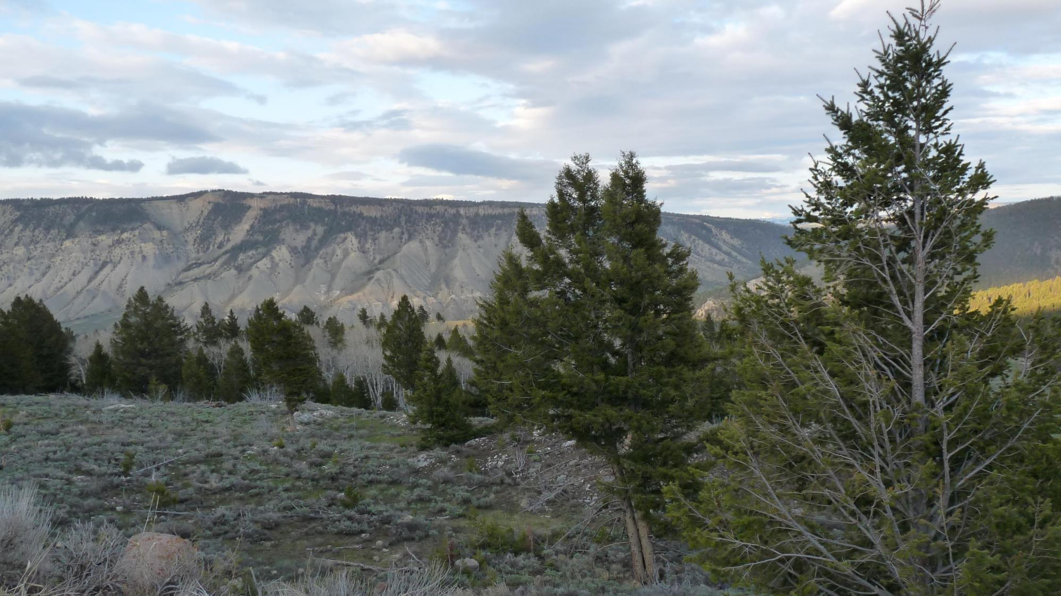
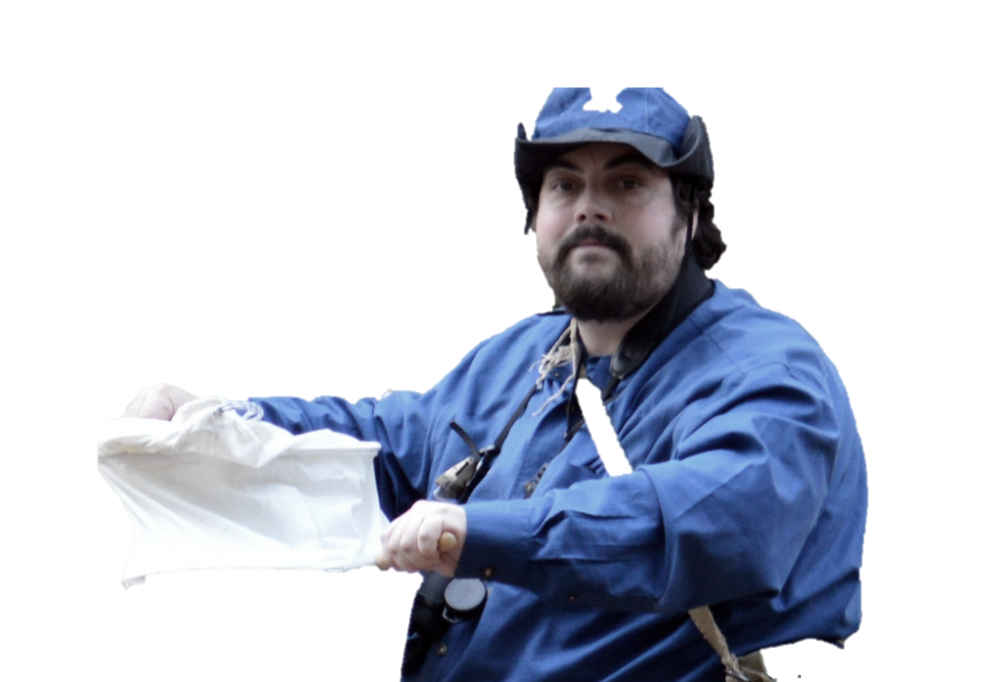
Where would you start looking for ants?

Slide 6
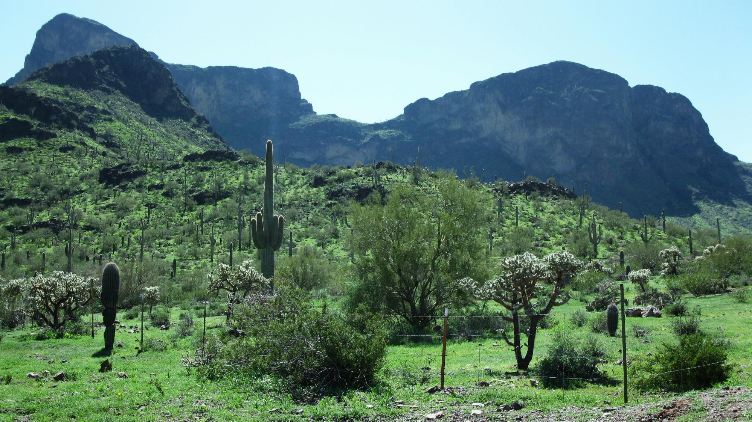

Where would you start looking for ants?

Slide 7
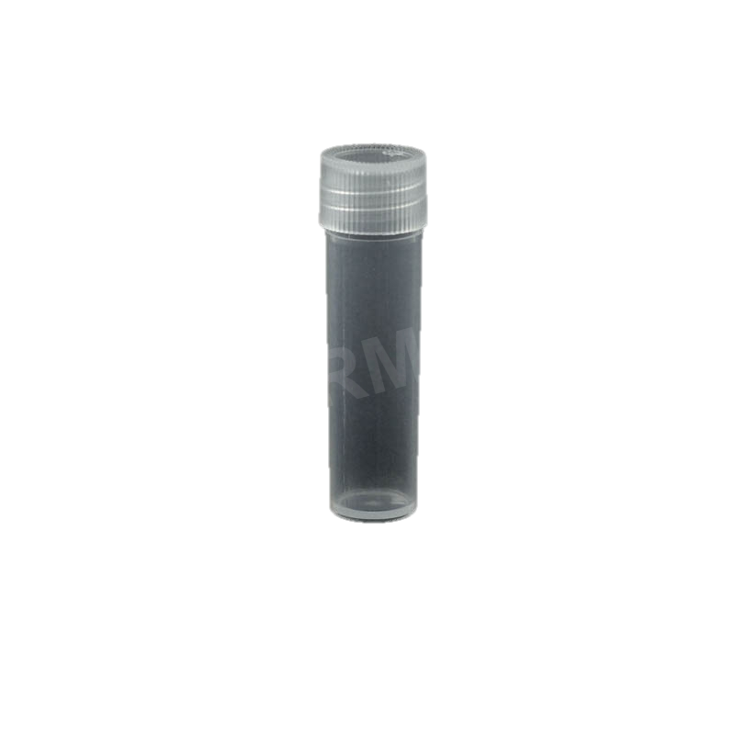
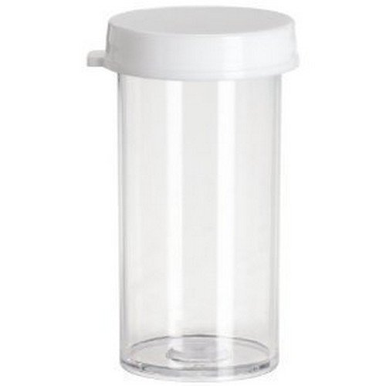
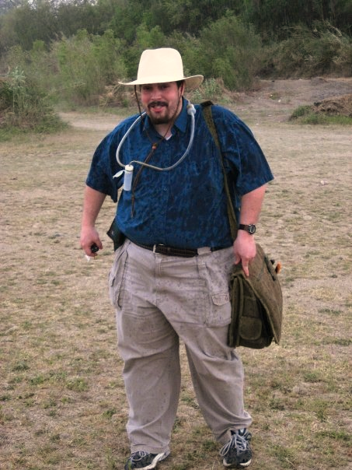
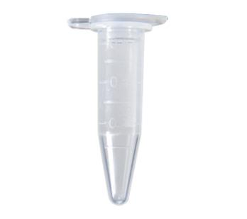
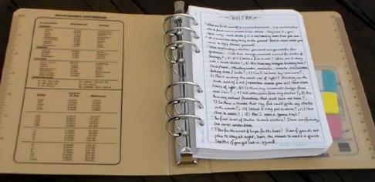
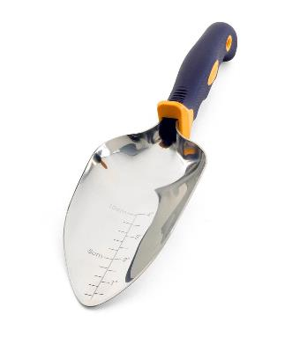
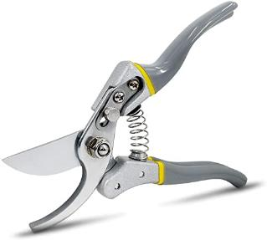
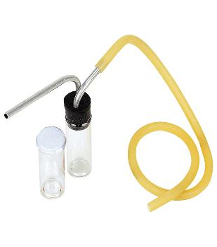
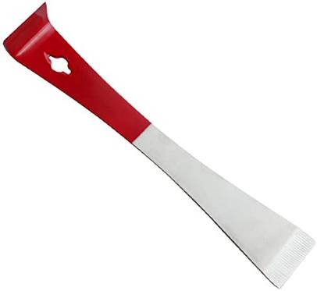
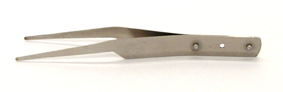
General
Vials (some prefilled 90-95% EtOH)
Field notebook w/datasheets, pencil
Trowel, gardening shears
Aspirator
Forceps (plus extra pair)
Knife, hive tool or pick to break up material or flip rocks logs, lift bark
Mobile photo/camera photos

Slide 8
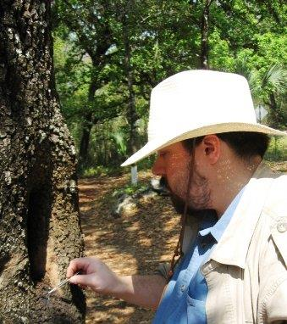
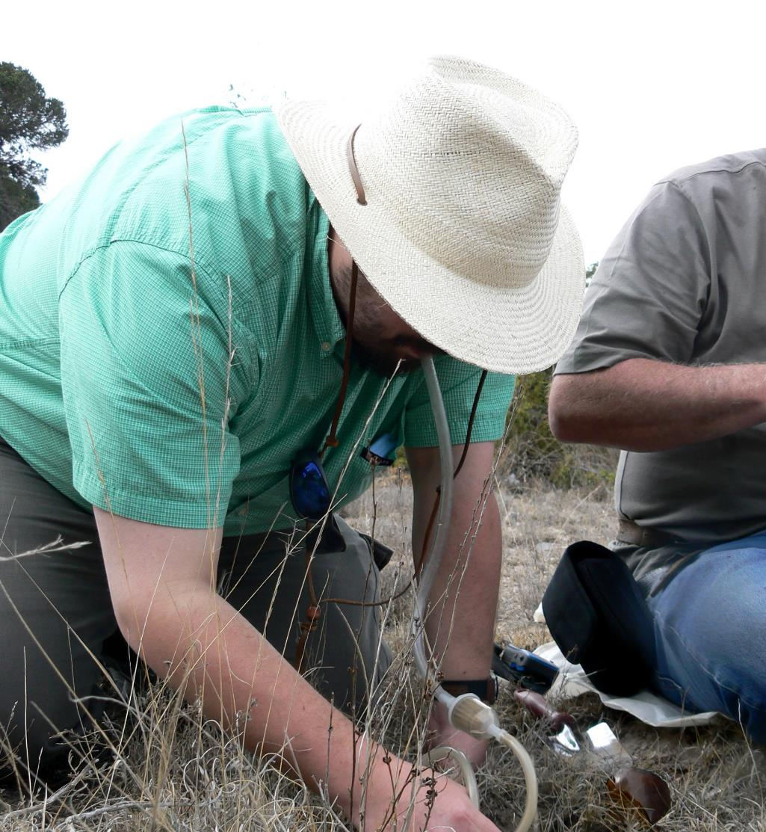
Directed Hand Collection
Active
Collect targeted species
Collect castes need for ID
Social nest parasite
Shy ants

Slide 9
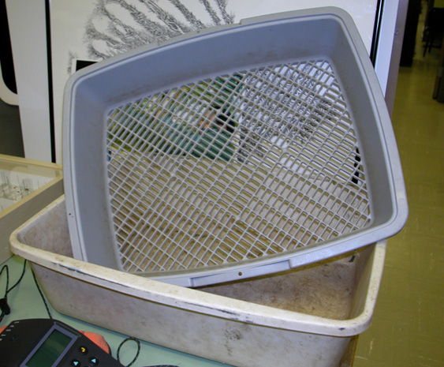
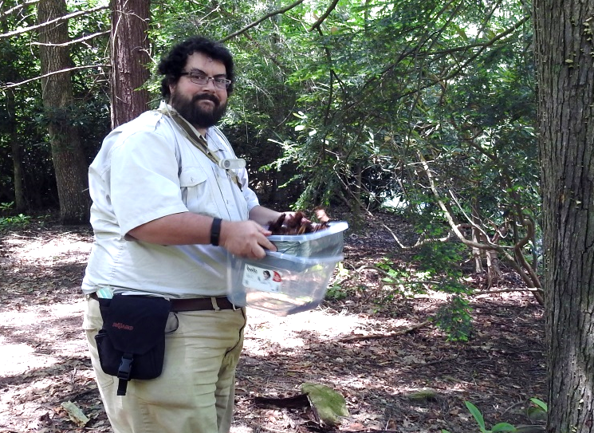
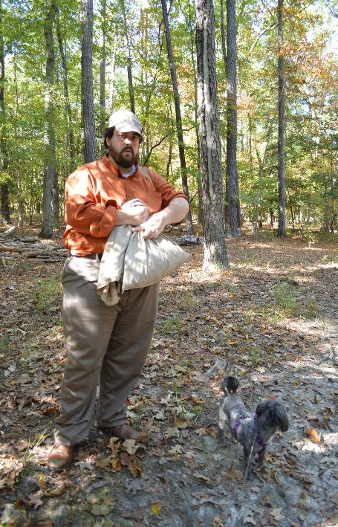
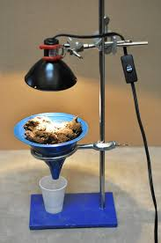
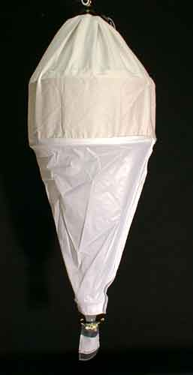
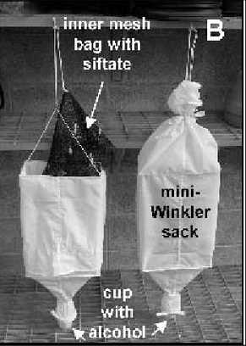
Shifting leaf litter
Sifter
Bags
Berlese Funnel
Winkler Extractor
Active
Main method used by many
Some Bias-dominate ants
Require supplies (home made)

Slide 10
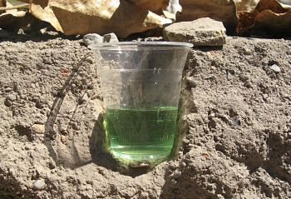
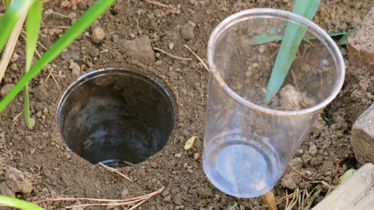
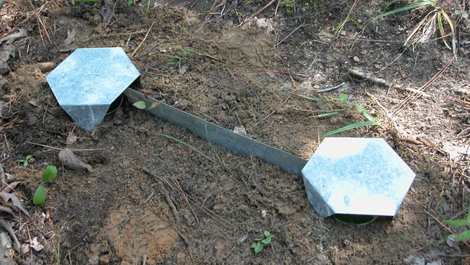
Pitfall materials
Trowel
Cups (inner & outer)
Preservative (discuss)
Lid
Flashing
Print research note
PLEASE DO NOT DISTURB
SCIENTIFIC STUDY IN PROGRESS
Permit ######
Contact name@someplace.come

Slide 11
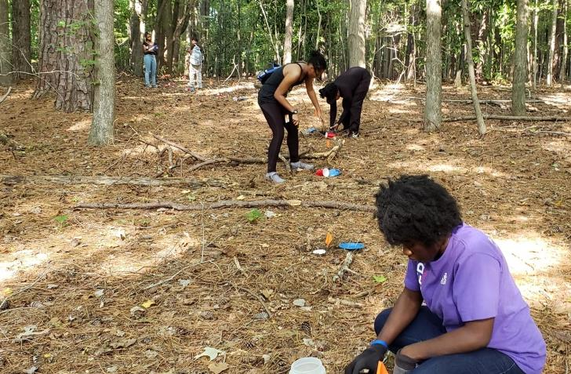
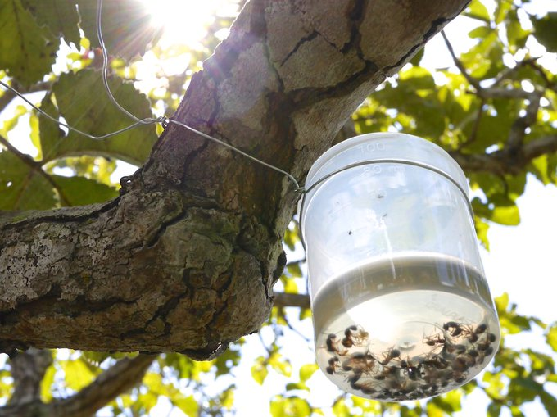
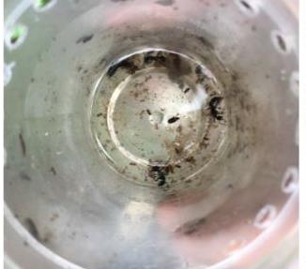
Pitfall Trap
Passive
Extended time
Some Bias
Require supplies
May capture infrequently collected species
Subterranean pitfall traps
Wong, M. K. L. and B. Guénard. 2017. Subterranean ants: summary and perspectives on field sampling methods, with notes on diversity and ecology (Hymenoptera: Formicidae). Myrmecological News. 25:1-16. doi:10.25849/myrmecol.news_025:001

Slide 12
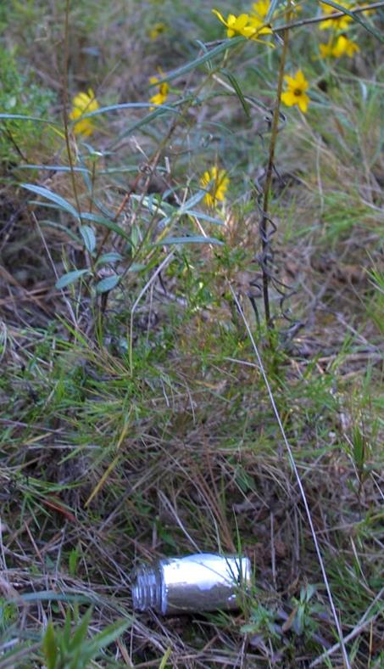
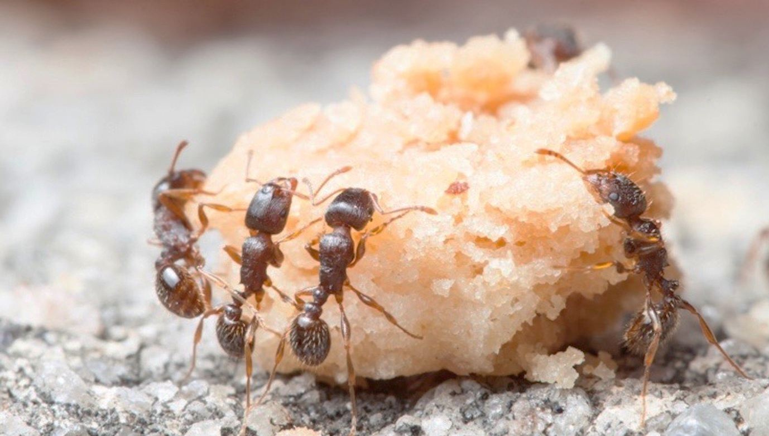
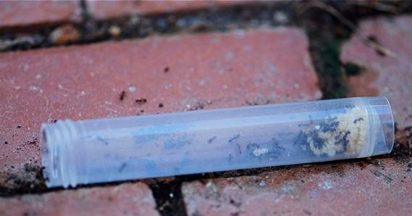
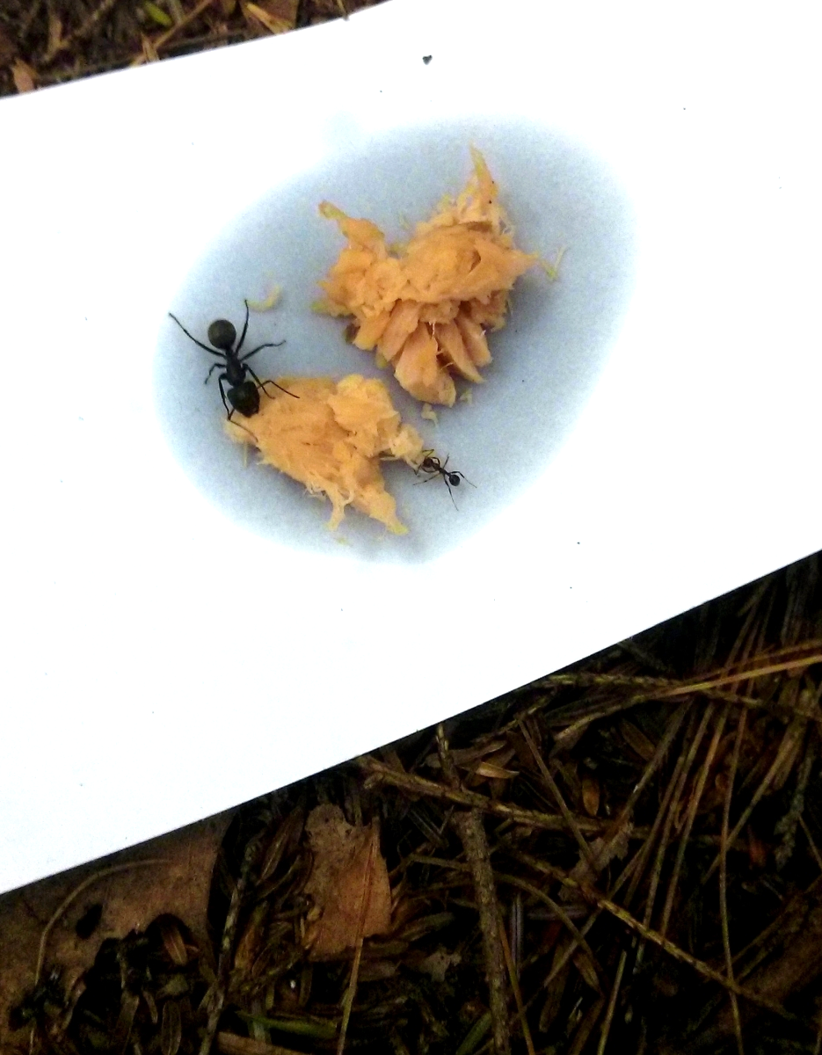
Bait Traps
Bait
Vials filled with pecan short bread cookies
Transect
Flags
Passive
Extended time (60 mins)
Select proper bait
Some Bias-dominat ants
Require supplies

Slide 13
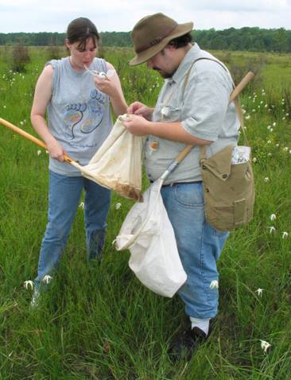
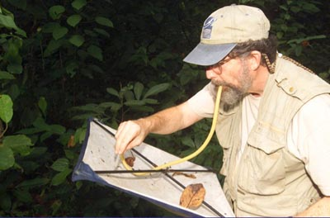
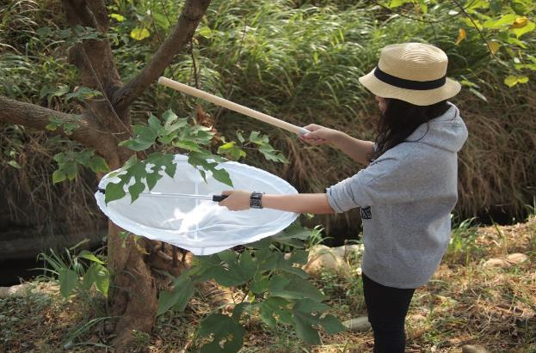
Sweeping and Beat Sheeting
Sweep Net
Beat Sheet
Active
Procure arboreal foraging or nesting species
Break branches, open galls, nuts on sheets/into nets
Require supplies

Slide 14
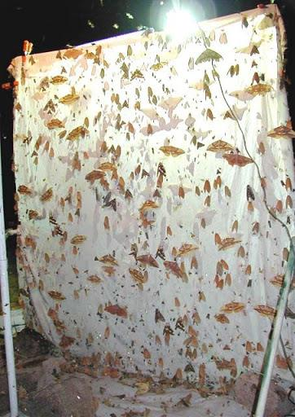
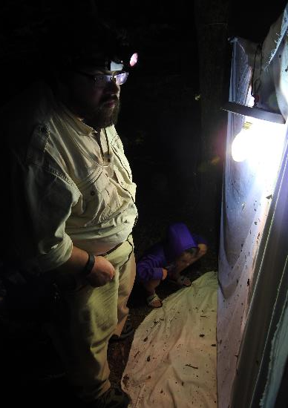
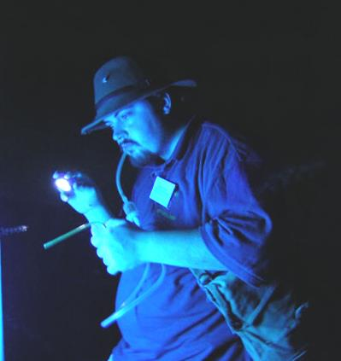
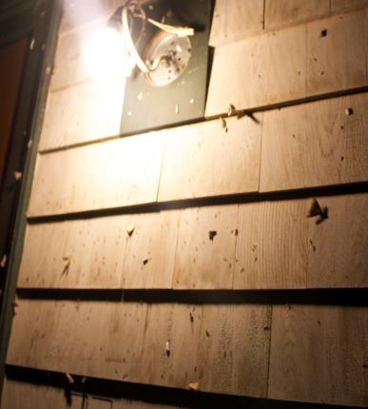
Nocturnal Collecting
Lights
Porch lights – Incandescent light bulbs (may be replaced by UV lights)
Hg vapor – lights and cotton sheet
Black light – light and cotton sheet

Slide 15
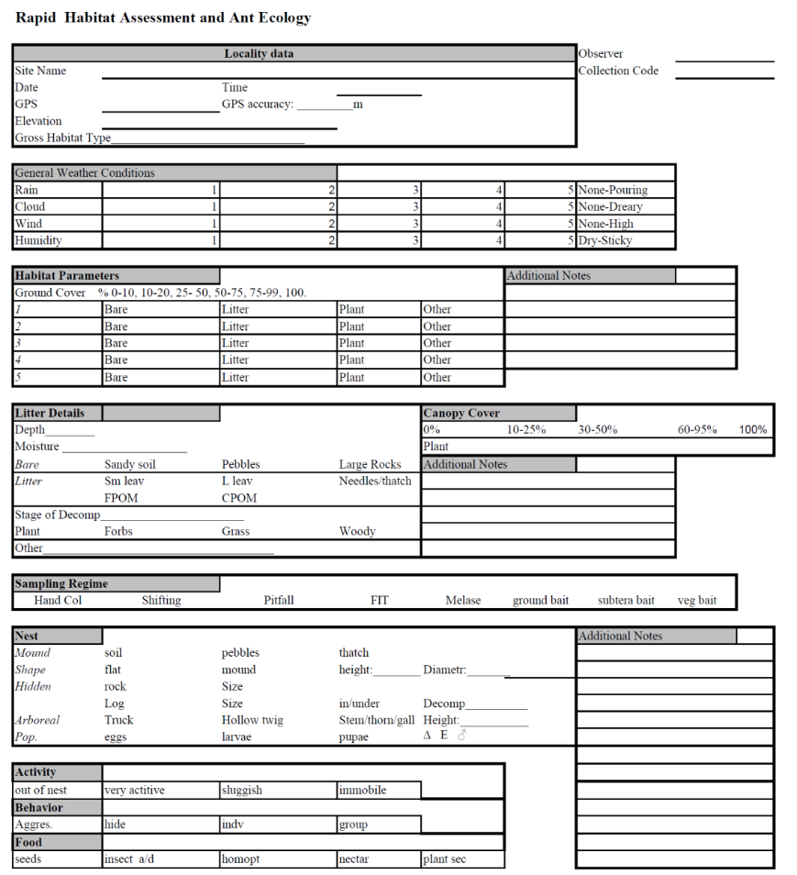
Collected Specimens
Take field notes
Collect material (freeze to kill) or place directly into vials of alcohol
All material should have temporary label in pencil or pigma pen
COUNTRY: State, County
Larger Locality, Locality, GPS
Habitat, ecology collection method
Date and collectors
USA: Virginia, Albemarle Co.,
Charlottesville, Ivy Creek, Red trail
38.093105, -78.492602 dec. forest
col under rock large colony 23.V.2019
STDash & KMDash

Slide 16
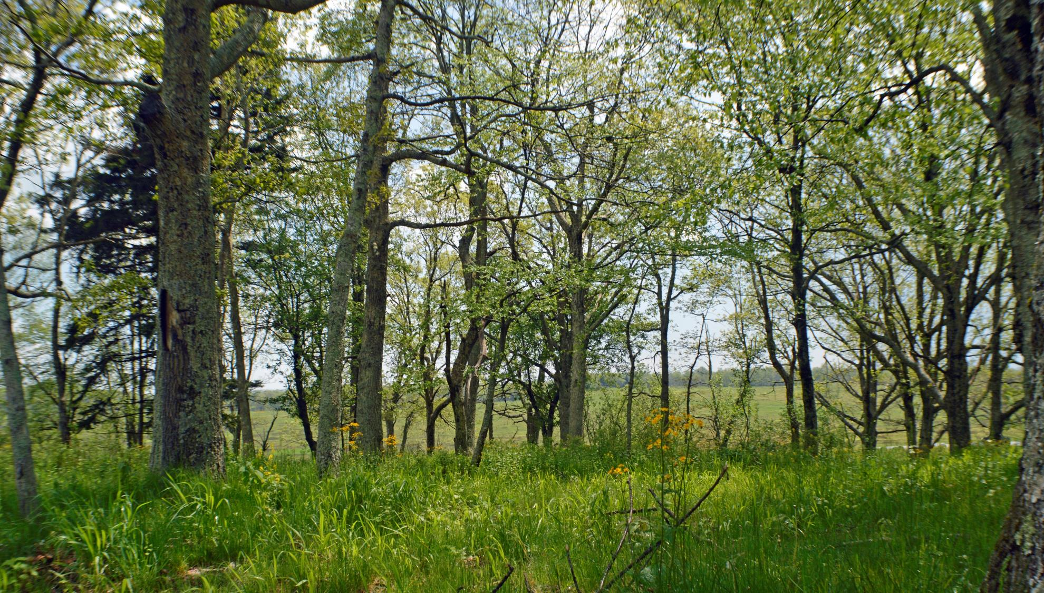
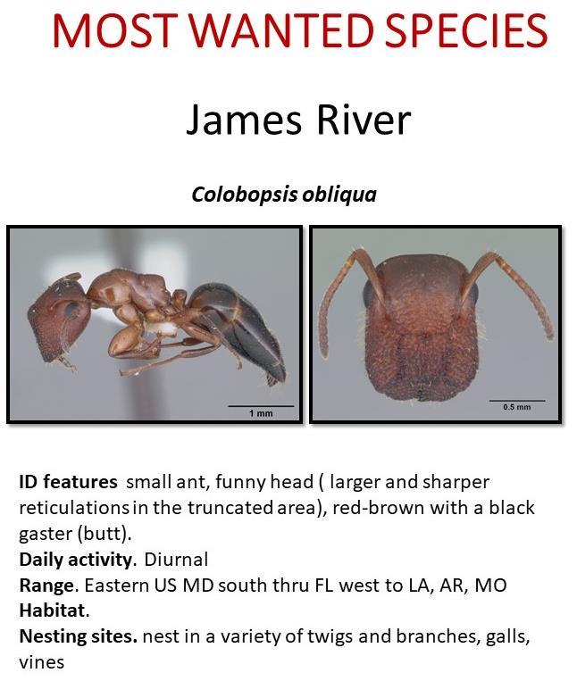

Slide 17
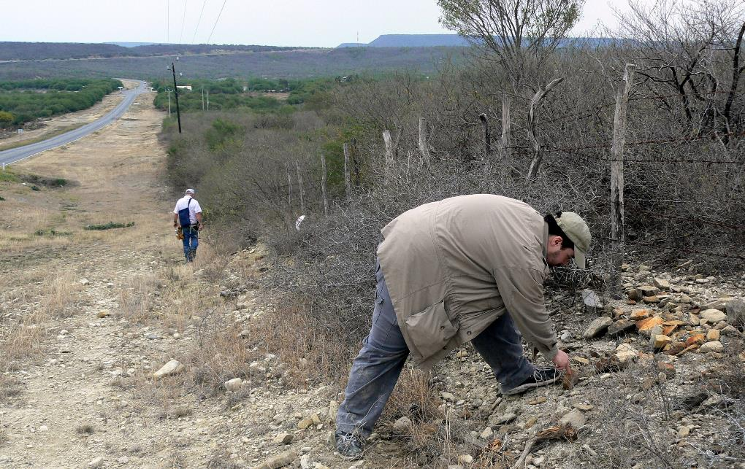
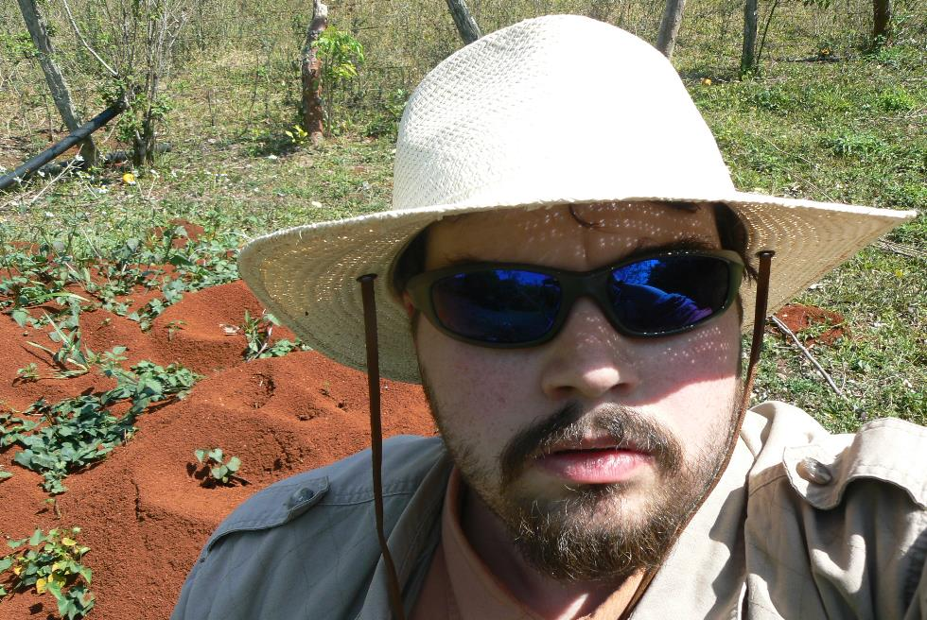



Slide 18





Ant Wiki
Ants of New Mexico (full book)
Antweb
Barcodinig USAnts Hand Out

Slide 19





Set-out bait transect 60 mins
Sweep Veg while baits are out
Opportunistic Hand Collecting
Sift litter/soil
Extend time (>3 days ) Pitfall line

