Slide 1
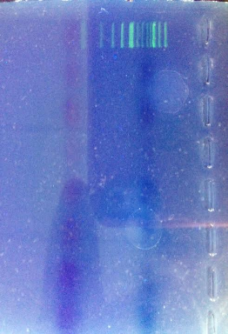
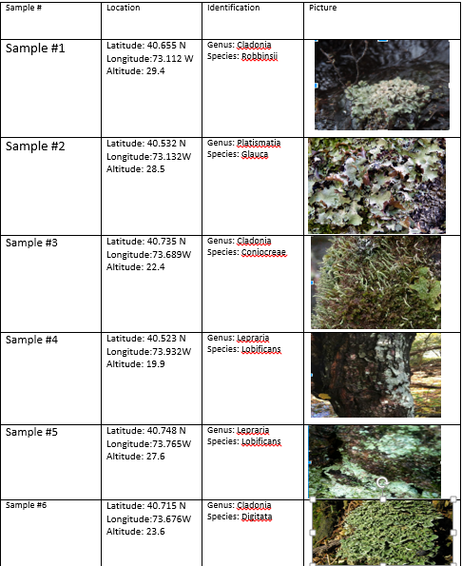
Examining Lichen Biodiversity in Fire Island through DNA Barcoding
Authors: Urooba Abid, Samuel Croes, Danielle Hofmann, and Hamza Malick
Mentor: Lorie Sheinwald
Farmingdale High School
Abstract
Lichen are the symbiotic combination of a fungus and a photosynthetic organism. Because of this, they are difficult to classify. Due to their remarkable ability to survive in wide ranging environments, lichen are found in almost all terrestrial locations. For our project, we collected and classified lichen from Fire Island. Fire Island is unique for many reasons. Its seashore is 26 miles, and consists of beaches, a maritime forest, and wetland habitats. We predicted, that due to Fire Island’s distinctive habitat, the lichen found on the Island would be genetically different from other known species. However, the DNA results from the gel electrophoresis were inconclusive. Nevertheless, we continued our analysis by classifying the collected lichen based on the physical characteristics of the samples. In conclusion, we classified five species within the samples, including, Cladonia robbinsii, Platismatia glauca, Cladonia coniocreae, Lepraria lobificans, and Cladonia digitata.
Introduction
Lichen are not a single entity, but rather, a composite of a fungus and a photosynthetic organism. Lichen fungi can partner with green algae or cyanobacteria and this special relationship is referred to as symbiosis. Factors that need to be taken into account when identifying lichen include genetic information, morphological traits such as color and shape, reproduction patterns, and growth forms. These growth forms characterize the appearance of the lichen such as whether they are branched or flat as well how tightly clustered they are. Fire Island is home to extensive, and often times rare and diverse communities. The maritime deciduous forest are rare natural communities found in North America. Lichen are a prevalent species found in the maritime forest. Lichen, because of their relatively great surface area, may function in mineral-ion sorting and uptake of ocean-derived salts. Therefore, we inquired on whether there would be undiscovered species of lichen in Fire Island, because of how unique the environment is. Our group hypothesized that because Fire Island is a unique environment, new species of lichen would be collected.
Materials & Methods
To collect the samples we measured out transects of 10 meters by 5 meters in the maritime forest in Fire Island. Before each collection we documented the location, time, length and width of the sample, the longitude and latitude, altitude and any morphological features. Then, to identify the lichen, the field guide, Lichens of North America (Brodo) was used to classify the samples collected. We then continued our procedure and performed the DNA extraction. We first added lysis to each tube to burst the cell and nuclear membranes. Next, we placed the tubes in water at 57 degrees Celsius and incubated them for ten minutes. Each tube then was placed in a centrifuge for 30 seconds. This allowed lysed material to gather into a pellet at the bottom of each tube, which was then transferred into the new 1.5 mL tubes. Next we placed the PCR reagents, ITS and RBCL primers, which mark for the fungal and algal symbionts, into our samples to isolate the specific DNA segments necessary for electrophoresis. After incubation we placed the DNA samples in the PCR machine, which amplified the DNA in our sample. Then, the PCR products were analyzed via gel electrophoresis. Then, a micropipette was used to transfer 5 µL of each PCR product along with 2 µL of SYBR Green DNA stain.. The remaining PCR product was stored on ice. The gel was then run for 30 minutes
Results
There were no DNA bands that appeared on the gel electrophoresis (Figure 1). Therefore, we had to resort to strict morphological data to determine the species of the lichen. Through lichen field guides, the species were identified as Cladonia robbinsii, Platismatia glauca, Cladonia coniocreae, Leparia lobificans, and Cladonia digitata (Table 1).
Figure 1: Gel electrophoresis results
Table 1: Lichen samples identified
Discussion
Our results do not support our hypothesis that the unique environment of Fire Island would harbor genetically distinctive lichen. The lichen were identified as either Cladonia robbinsii, Platismatia glauca, Cladonia coniocreae, Lepraria lobificans or Cladonia digitata, no new species of lichen were identified. Lichen are known to retreat into a dormant state when surrounded by harsh conditions. Their adaptable characteristics prevent them from experiencing any surmountable genetic changes, in the case of Fire Island.
We predict that the reason we did not observe any DNA in our gel, is because we had stored our sampled in a freezer for months before performing the extraction. This prolonged storage could have affected our results. Another step that may have contributed to our inconclusive results was human error throughout the DNA extraction. When working with DNA it is important to perform all the steps accurately in order to results. It is possible that mistakes in the lab affected our outcome. If we were to repeat this experiment in the future we would be more careful about storing our samples, as well as work more precisely in the lab when performing the DNA extraction. Another source of error, may have been in the type of primers used for DNA amplification. Since lichen is a composite organism of an alga and a fungus, it may have been difficult for the primer to
attach or recognize a sequence. A future experiment may investigate the effectiveness of the primers we used, (rbcL and ITS), or we could try other primers.
References
Brodo, Irwin M., Sylvia Duran Sharnoff, and Stephen Sharnoff. Lichens of North America. New Haven: Yale UP, 2001. Print.
"Experiment Protocol | DNA Barcoding 101." DNABarcoding101. Cold Spring Harbor Labratory, 4 Apr. 2014. Web.
Flenderson, Michael. "Plant Science 4 U." Difference between Isidia and Soredia. Plant Science 4 U, 3 July 2013. Web.
"HOW TO COLLECT LICHENS." HOW TO COLLECT LICHENS. N.p., n.d. Web.
"Lichen." Lichen Vocabulary. Lichen of North America, 30 Nov. 2012. Web. 13 May 2016.
Nash, Thomas H. Lichen Biology. Cambridge: Cambridge UP, 1996. Print.
Wickers, Nancy. "What Are Lichens?" Country Side Info. Lichen Informatives, 3 July 2010. Web.
Acknowledgements
We would like to thank the Farmingdale High School Science Department for assisting us with our research. We would also like to thank the DNA Learning Center at Cold Spring Harbor Laboratory for the use of their laboratory.

