Slide 1


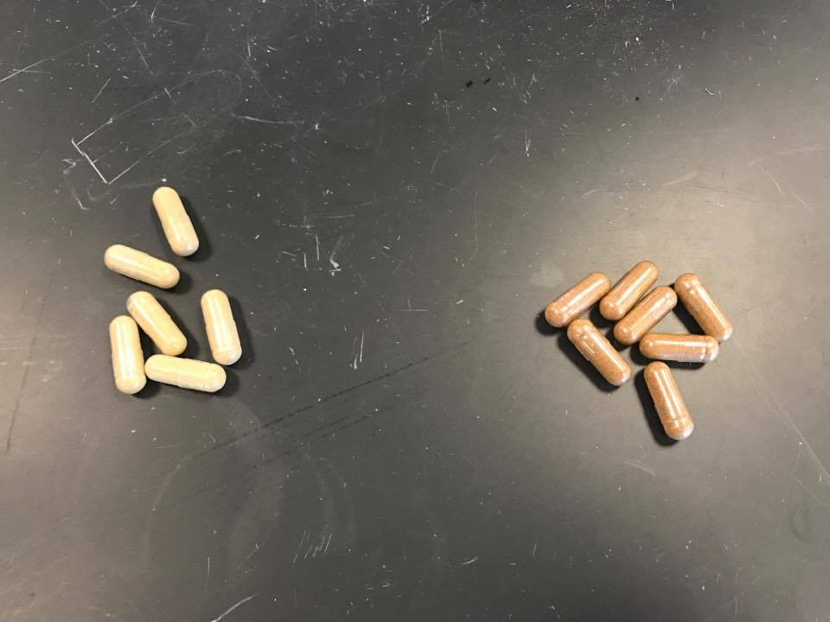
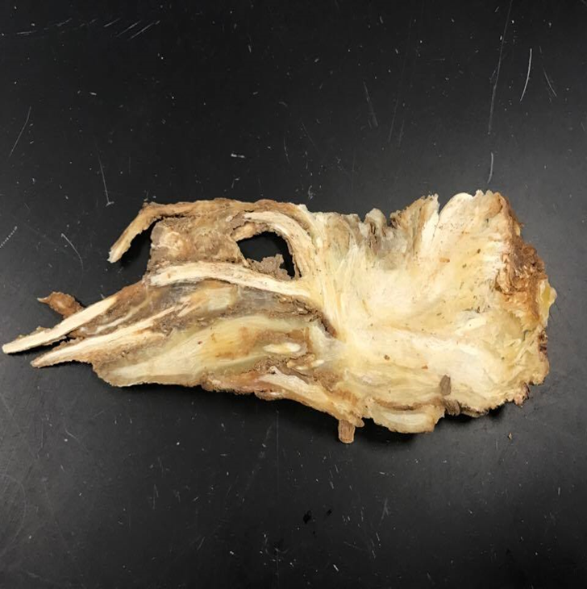
Does It Have Dong Quai-lity: DNA Barcodes of Herbal Supplements Collected in Two Different Retailers in Brooklyn, New York
Authors: Bilal Choudhry,¹ Janine Golovanevskiy,¹ Comeal Haider,¹ and Sophia Lee¹
Mentors: Shubha Sarode,¹ Cristelia Naanos¹
Funded by the
Thompson Family Foundation
¹Leon M. Goldstein High School for the Sciences
Abstract
Dong quai root is often used in Chinese herbal remedies as a way to relieve pain; it is commonly used to treat premenstrual cramps. Dong quai belongs to the same family as two very well known plant species: Petroselinum crispum (parsley) and Coriandrum sativum (coriander). The experiment tested to see whether or not traces of dong quai could actually be found in herbal remedies that advertise its use of the root. The samples tested included two name brand drugs, parsley, coriander, and dong quai root; the gene sequences would be compared to discern what is actually used in dong quai drugs. The results indicated high percentages of genetic similarity between drug A and coriander and drug B and A. sinensis. This indicates that rather than using actual dong quai root in herbal remedies, drug companies often use herbs that have high genetic similarities to dong quai. Consumers that buy these products are not actually getting the herbal remedy that is advertised on the label. This begs the question: how often do drug companies omit the ingredient that is advertised on drug labels?
Introduction
Angelica sinensis or the “female ginseng” (root) is a popular Asian herbal ingredient used in cooking and medicine. Its popularity dates from the Golden Age (approximately 1000 years ago) and was commonly used as a spice (Ehrlich 2015). It is native to China, but trade and commerce allowed it to grow in the eastern parts of China, Korea, and Japan. They are perennials, blooming in the months of July and August and come in “umbrella-shaped clusters of white flowers” (Ehrlich 2015, para 3). However, the part that is derived for human consumption and medicine is the thick brownish roots, which can be consumed in either powder or solid form.
In China, the dong quai’s popularity comes from its versatility in medicine. One such study (Ross 2001, pg. 67-68) noted how the entire dried plant can be used for external burns, and how the hot water extract from the root, is used as an emmenagogue (a substance that increases menstrual flow) for “…menstrual disorders, amenorrhea, dysmenorrhea, constipation, cancer, sterility, thromboangiitis obliterans (Buerger’s disease) and other thrombolytic diseases” in China. In other words, one can grasp that Angelica sinensis has components (e.g. ligustillide) which allows it to be useful in traditional Chinese medicine (Zuo and others (2012). While Ross (2001) listed how A. sinensis is used to treat various gynecological, gastrointestinal, and thrombolytic disorders, there is no sufficient (and reliable) information to authenticate A. sinensis’s effects to the human body. Ulbricht (2010, pg. 299) observed the aforementioned problem by stating:
Although dong quai has many historical and theoretical uses based on animal studies, there is little human evidence supporting the effects of dong quai for any condition. Most of the available clinical studies have either been poorly designed or reported insignificant results. Also, more have examined combination formulas containing multiple ingredients in addition to dong quai, making it difficult to determine which ingredient may cause certain effects.
To some, this herbal ingredient seems to be the next “Garcinia cambogia” for gynecological and thrombolytic problems. When Ulbricht (2010) stated that “… examined combination formulas containing multiple ingredients in addition to dong quai,” it brings up the question whether or not pharmaceuticals worldwide are actually using A. sinensis. The length of the plant’s maturity and the specific cold, mountainous environment, limits the amount of A. sinensis being used as an ingredient. Also, due to its rarity in many Asian countries, there is a chance that A. sinensis is not actually the main ingredient. The primary purpose of the project is to determine if companies that sell dong quai actually contain A. sinensis as their main product.
Two drugs that contain A. sinensis as their main ingredient and two genetic relatives of A. sinensis were compared using DNA barcoding. The information obtained will help determine the validity of commercialized dong quai.
Materials & Methods
Samples of dong quai, were obtained from various drug stores and grocery stores. Also, relatives of A. sinensis cilantro/coriander (Coriandrum sativum) and parsley (Petroselinum crispum) were used to compare the relationship between commercialized dong quai and its related plant species. Each sample was entered into the Barcode Sample Database and labeled using different letters (A, B, C, and so on); photos of each container were taken and uploaded onto DNA Subway as well. In the process of extracting DNA from the samples, 10 mg of each sample were placed into their corresponding, labeled, micro tubes. 300 µL of lysis solution was then added to each tube. Pestles were used to grind the tissue and break it down further. Then, the samples were placed in a water bath, heated to 65 degrees Celsius, for ten minutes. After the ten minutes were up, all tubes were placed into a centrifuge for one minute so that the DNA was able to separate from the debris. Then, 150 uL of the supernatant, from each sample tube, were transferred over to sterile 1.5 mL tubes. Later, 3 uL of silica resin was added to each tube and mixed into the solution by pipetting the solution repeatedly. The tubes were then incubated for five minutes in a water bath set at 57 degrees Celsius. After time was up, the tubes were placed into a centrifuge for 30 seconds followed by an extraction of the remaining supernatant. Wash buffer, 500 uL, was mixed in with the resin to create a solution. Then the tubes were placed in the centrifuge for another 30 seconds. The supernatant in each tube was extracted and 100 uL of distilled water was added to each sample. All of the samples were incubated in a water bath set at 57 degrees Celsius for five minutes. Once again, the tubes were centrifuged for 30 seconds in order to separate DNA from other debris. 90 uL of supernatant were transferred from each tube into corresponding, empty, 1.5 mL tubes. These tubes were then to be stored on ice until the PCR machine was ready. This entire process was repeated three times.
23 uL of rbcL primer was added to PCR tubes containing Ready-To-Go PCR beads. Then, 2 uL of each of the dong quai and its relative’s samples were added to their corresponding, labeled PCR tubes. The tubes were then be put into a thermal cycler where a particular protocol, specific to plants, was programmed into it.
All the samples were loaded into each well of the gel and their positions were recorded, the gel ran for 30 minutes at 130V. The gel was then viewed under UV light and the results were photographed.
The actual DNA sequence of dong quai was found in an online database called BLAST. The results of the DNA processing were uploaded onto DNA Subway and were further processed so that a match could be made between the samples and those that are contained in the database.
Results
Discussion
In figures 1.1 and 1.2, the phylogenetic trees of the sample data revealed that Drug B (004) was closely related to A. sinensis, whereas coriander (KXB-001) and Drug A (KXB-003) were also identical because they stem from the same clade. In figure 1.3, genome analysis of the samples revealed that A. sinensis (8) and Drug B (7) were precisely 99.79 percent identical in terms of DNA sequences, whereas coriander (KXB-001) and Drug A (003) were a hundred percent consistent with each other in terms of DNA sequences. Unfortunately, the DNA sequencing for A. sinensis root (KXB-005) resulted in an error and thus no DNA analysis proceeded with the other collected DNA samples. The results displayed in the diagrams implicate that dong quai drugs (e.g. Drug A) with labels directly stating that they contain the dong quai plant, are most likely fraudulent. Drug A may not contain A. sinensis as their ingredient, but instead its relatives. Thus, the outcome of this experiment stimulates additional interest in the validity of ingredients contained in other commercialized products on the market.
References
Classification for Kingdom Plantae Down to Family Apiaceae [Internet]. Amityville, NY: USDA; n.d; Available from: https://plants.usda.gov/java/ClassificationServlet?source=display&classid=Apiaceae
Ehrlich, S. D. Dong Quai [Internet]. College Park, MD: University of Maryland Medical Center; 2015 March 25; Available from: http://umm.edu/health/medical/altmed/herb/dong-quai
Johnson, R. L., Foster, S., Dog, T. L., & Kiefer, D. 2010. National Geographic Guide to Medicinal Herbs: The World's Most Effective Healing Plants. D.C.: National Geographic. 400 p.
Ross, I. A. 2001. Medicinal Plants of the World, Chemical Constituents, Traditional and Modern Medicinal Uses (Vol. 2). New York: Humana Press. 487 p.
Ulbricht, C. E. 2010. Natural Standard Herb & Supplement Guide: An Evidence-Based Reference. Missouri: Elsevier/Mosby. 896 p.
Zuo, A. H., Wang, L., & Xiao, H. 2012. Research progress studies on pharmacology and pharmacokinetics of ligustilide [Abstract]. Dalian (Liaodong): Dalian Institute of Chemical Physics. Available from: PubMed; 23373200
Acknowledgements
We would like to thank the Environmental Study Center for training Ms. Sarode, Bilal, and Sophia for the program. A thank you to Harlem DNA Lab for providing us materials that were necessary for the project. A special thank you to Dr. Christine Marizzi for overlooking the project for both groups and assisting the groups when needed. We would also like to thank Ms. Naanos for revising our research paper and providing constructive criticism. And finally to Ms. Sarode, who convinced us that we had the potential to partake in this program.
Figure 1.5 Drugs that claim to have dong quai as their main ingredient. Drug A (right) and Drug B (left)
Figure 1.6 Dong quai root

