Slide 1
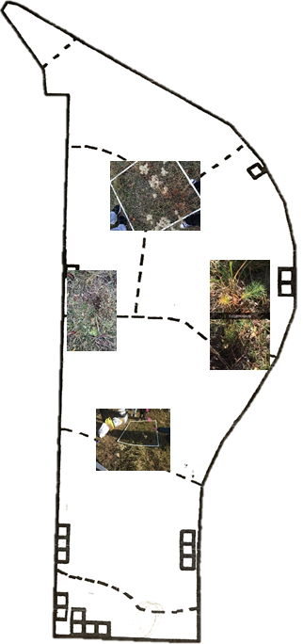
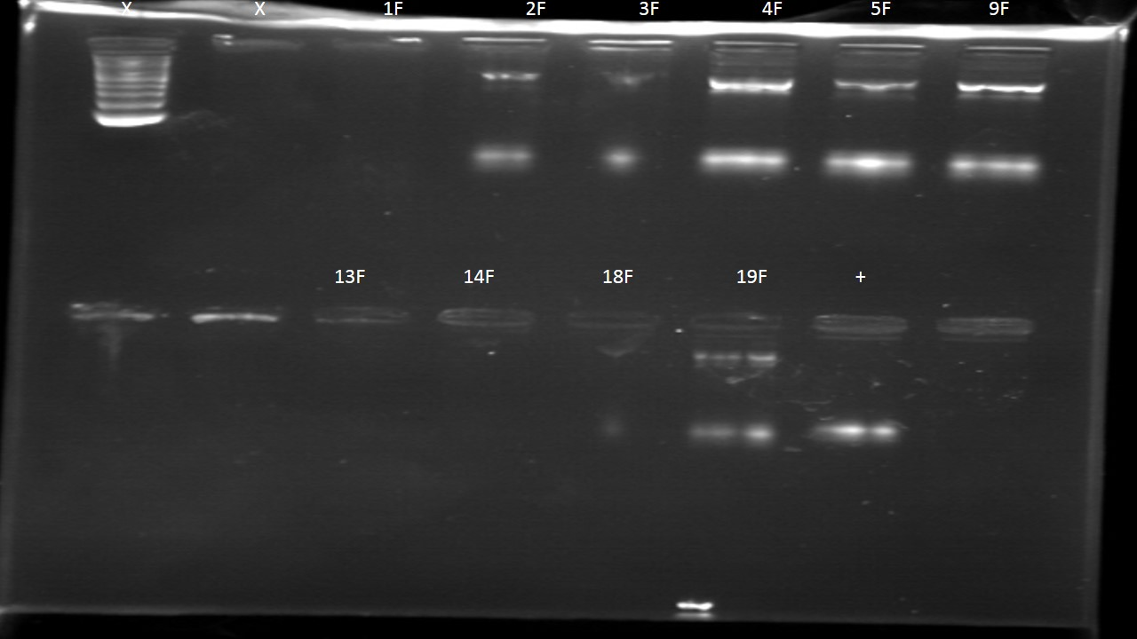
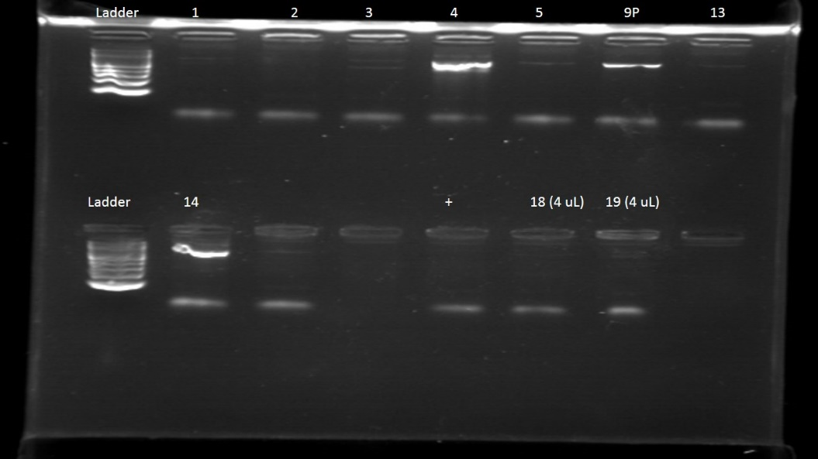
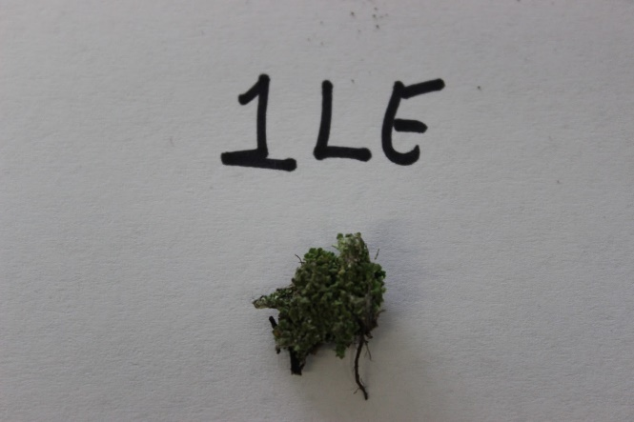
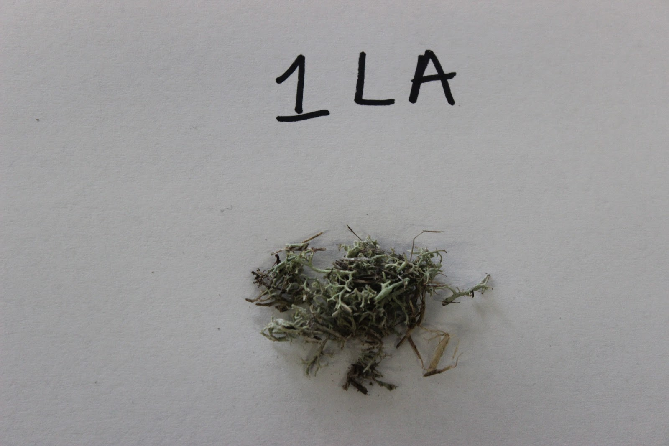
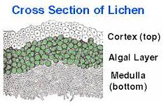
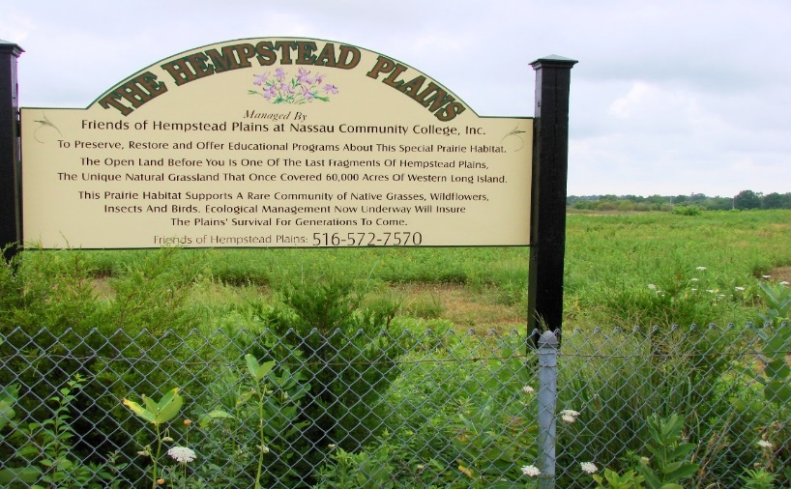
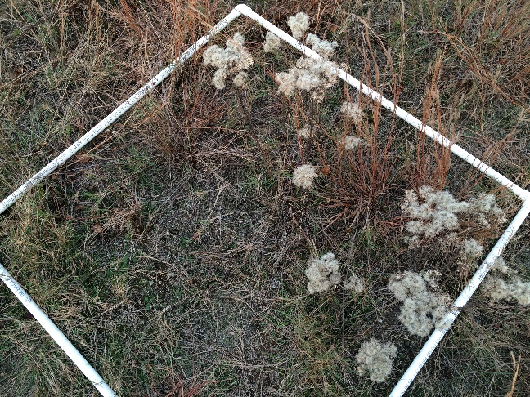
Abstract
The Relationship Between Lichens, Soil, and Native Species
Materials and Methods
Lichens have recently been observed at the Hempstead Plains in areas near native flora. We hypothesized that there will be a relationship between the presence of lichens, the composition of soil, and the presence of native plants. Plant samples, lichens, and soil were collected from four sites at Hempstead Plains. The DNA barcoding was performed at the Cold Spring Harbor DNA Learning Center in order to identify unknown lichens and plants and determine whether they are native or nonnative species. The results of the soil analysis showed that the pH level, soil composition, and soil classification were all similar regardless of the presence of lichens. For the locations where lichens were present, there was a slight increase in the number of native species suggesting the possibility of a relationship. While this does not fully support the hypothesis, further testing is indicated.
We collected soil, lichen, and plant samples from the Hempstead Plains
We isolated DNA from each sample and it required extensive adding and removing lysis solutions, various buffers, mixing and incubation periods.
In order to amplify the DNA by PCR, rbcL primers were added to the plant samples. Both rbcL and ITS primers were added to the lichen samples. All samples were amplified in the thermal cycler.
To analyze the PCR products by gel electrophoresis, a gel was prepared and set.
The plant samples were all run together, while the lichen samples with the rbcL primer were run together and the lichen samples with the ITS primer were run together.
The remaining PCR product for each sample was sent for sequencing. The results were analyzed using a database.
Authors: Edilynn Clermont, Nandini Jojode, Areej Moghni, Feyisayomi Otegbade
Advisors: Ginna Gabalski, Sondra Polan
East Meadow High School
Acknowledgements: Friends of Hempstead Plains, Cold Spring Harbor DNA Learning Center
Introduction
Lichens are slow growing organisms that form a crust-like growth on the ground, and are composed of two different types of plants, a fungus and an algae or cyanobacteria.
Author Generated: Sample Lichen Google Images: Cross Section of a Lichen
The alliance between the fungi and algae that form the lichen help colonize soil and make the soil hospitable for other plants.
The alga contributes to the food supply through photosynthesis, and the fungus protects the alga from desiccation, harmful solar radiation and provides the alga with water and inorganic nutrients.
A study done by Jayne Belnap et.al investigated the effects of precipitation, invasion and temperature on the lichen cover in biological soil crusts and determined that lichen cover may decrease with invasive species.
The Hempstead Plains at Nassau Community College is a 19 acre preserve which was established to protect the original native grassland habitat of Long Island from industrial development.
Lichens were observed in close proximity to native grasses and plants.
Based on this information, our hypothesis states: If lichens are present in the soil, they could change the chemical composition of that soil, thus creating a more conducive environment to the growth of native species.
Author Generated: Diagram of Site Locations
Results
Author Generated: Lichen Gel Pictures
Author Generated: Plant Gel Pictures
Discussion
Sample Lichen
DNA Barcoding Process for sample lichen 1LE
In general, the results of the soil analysis showed that the PH level, soil composition, and soil classification were all similar regardless of the presence of lichens.
When lichens were present, at sites 1, 6, and 9, there was a higher level of native plant species. When lichens where not present such as site 2, there was a higher majority of non-native plants indicating the possibility of a connection between the presence of lichens and the growth of native flora.
The results and conclusions of this study had limitations. We could not identify all of the species that were barcoded due to a variety of factors. Some species’ DNA sequences may have been novel sequences that the dnasubway.com database did not have.
We could have contaminated the individual test tubes, or failed to prepare the samples properly for PCR and DNA barcoding.
In the future, to expand this study, samples from additional sites should be collected. The increase in data would allow for more statistical testing and analysis to be done to show more meaningful relationships in the results.
Site 1
Site 2
Site | Sample # | Identification | Native or non-native
1LA | NPN-01 | Cladonia rangiferina (Reindeer Lichen) | Native
1LB | NPN-02 | Cladonia asahinae (Pixie Cup Lichen) | Native
1LC | NPN-03 | Potentially Cetraria aurescens | Native
1LD | NPN-04 | Polypogon fugax, or treubouxia irregularis | Both non-native
1LE | NPN-05 | Trebouxia irregularis or Asterochloris glomerata | Both non-native
1F | NPN-06 | Unknown, still investigating
1G | NPN-07 | Little Bluestem, Schizachyrium scoparium | Native
1H | NPN-08 | Pennsylvania Sedge, Carex pensylvanica | Native
Site | Sample # | Identification | Native/Non-Native
2A | not in database | Mugwort | Invasive
2B | not in database | Cypress Sburge | Invasive
2C | NPN-020 | Chrysanthemum maximum | Naturalized
2D | NPN-021 | Error
2E | NPN-022 | Unknown, Still investigating
2F | NPN-023 | Rudbeckia hirta | Native
TABLE 1 SOIL ANALYSIS
 | Site 1 (Native) | Site 2 (Non-native) | Site 6* (N/A) | Site 9 (Native)
Average pH Level | 6.042 | 6.083 | (N/A) | 5.833
Nitrogen Layer 1 Layer 2 Layer 3 | 10-20 20 20-40 | 80 40 20 | (N/A) | 20 40 40
Phosphorus Layer 1 Layer 2 Layer 3 | 10 50 50 | 50 20 20 | (N/A) | 20 20 20
Potassium Layer 1 Layer 2 Layer 3 | 600 600 400 | 400 400 50 | (N/A) | 600 400 400
Classification of soil type | Silt | Silt | (N/A) | Silt
Lichens present and native plants | Yes | No | (N/A) | No
Site 6
Site | Sample # | Identification | Native or Non-Native
6LA | NPN-09 | Cladonia gracilis or Polytrichium Juniperium | Both Native
6B | NPN-010 | Most likely Common Dandelion | Native
6C | NPN-011 | Pennsylvania Sedge, Carex pensylvanica | Native
6D | NPN-012 | Andropogon Virginicus | Native
6LE | NPN-013 | Unknown, still investigating
6LF | NPN-014 | Leucobryum Glaucum (plant) | Native
References
Belnap, Jayne, Susan L. Phillips, and Tonya Troxler. "Soil Lichen and Moss Cover and Species Ricess Can Be Highly Dynamic: The Effects of Invasion by the Annual Exotic Grass Bromus Tectorum, Precipitation, and Temperature on Biological Soil Crusts in SE Utah." Applied Soil Ecology 32.1 (2006): 63-76. Web.
Brodo, Irwin Murray. "A Study of Lichen Ecology in Central Long Island, New York." 1961. Web. 01 June 2016.
"Lichens Are Surprisingly Precise Air Quality Monitors, BYU Father­Son Team Finds." Web. 01 June 2016.
Löbel, S., Dengler, J., & Hobohm, C. (2006). Species richness of vascular plants, bryophytes and lichens in dry grasslands: The effects of environment, landscape structure and competition. Folia Geobotanica Folia Geobot, 41(4), 377-393. doi:10.1007/bf02806555
Nearing, G. G. (1947). The lichen book; handbook of the lichens of northeastern United States. Ridgewood, NJ.
"Notes on the Lichens of Eastern New York City: Kings and Queens Counties, Long Island, New York." Web. 01 June 2016.
Pennsylvania Sedge (Native and Invasive Plants). (n.d.). Retrieved June 01, 2016, from http://extension.psu.edu/plants/gardening/eco-friendly/using-natives/bee-wise-plant-natives/pennsylvania-sedge
Polytrichum juniperinum. (2008). Retrieved June 01, 2016, from http://www.fs.fed.us/database/feis/plants/bryophyte/poljun/all.html
Ryder, C. N. (2014). Result Filters. Retrieved June 01, 2016, from http://www.ncbi.nlm.nih.gov/pubmed/24415063
Wu, L. (2011). Small-Scale Vertical Distribution of Algae and Structure ... Retrieved June 1, 2016, from http://link.springer.com/content/pdf/10.1007/s00248-011-9828-5.pdf
Site 9
Site | Sample # | Identification | Native/Non-Native
9LA | NPN-018 | Unknown lichen | Invasive
9LB | NPN-019 | Uncultured Fungus | Invasive
9C | NPN-015 | Unknown, Still investigating | Native
9D | NPN-016 | polytrichum juniperinum | Native
9E | NPN-017 | Unknown, Still investigating | Unknown
 | NPN-024 | Agalinis acuta | Native
 | NPN-025 | Agalinis paupercaula or Agalinis purpurea | Native
Parts Per Million Equivalency Chart- Luster Leaf Products, INC
Nitrogen | 10 → Deficient | 20 → Adequate | 40 → Sufficient | 80 → Surplus
Phosphorus | 10 → Deficient | 20 → Adequate | 50 → Sufficient | 100 → Surplus
Potassium | 50 → Deficient | 400→ Adequate | 600 → Sufficient | 900 → Surplus
Source: Google Images
Author Generated: Site 6 location

