Slide 1
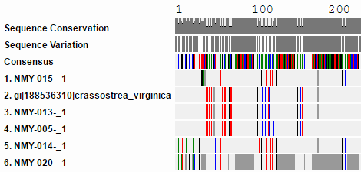
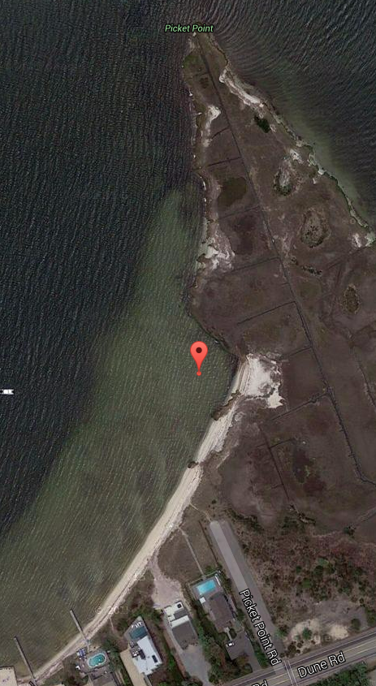
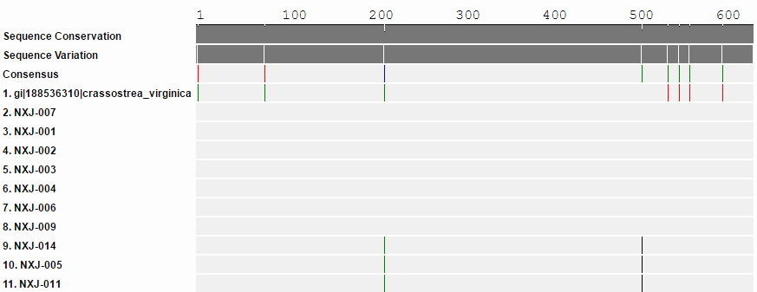
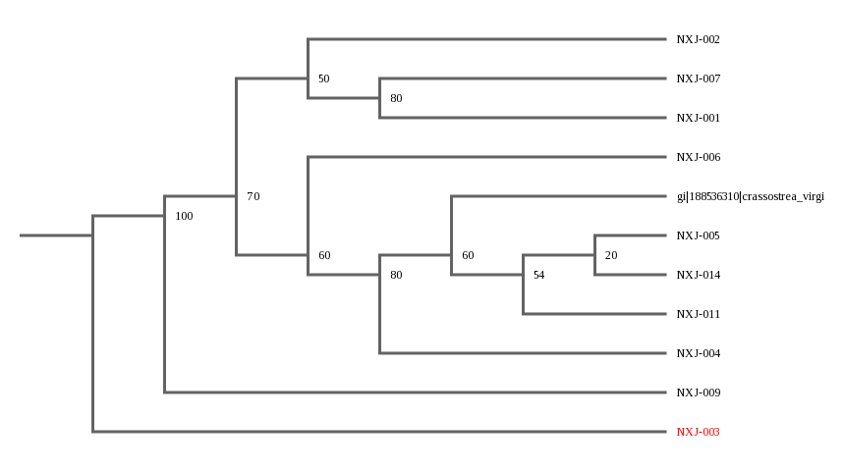
Abstract
Over the past several decades, the shellfish in the bays surrounding Long Island have suffered severe decreases in population. As a result a key natural resource for water quality has been lost and events of red and brown tide have begun to occur in the bays, causing further damage to the ecosystem. Our project sought to determine the species diversity of the oysters being used by the Moriches Bay Project, one of many organizations seeking to repair the water quality of the bays by restoring the populations of shellfish which once existed, and predicted that species diversity would be lacking. Our objectives were to determine the species diversity of seeding populations in Moriches Bay and to establish a novel barcode for the area. This project followed standard CSHL protocol using materials and lab space provided by Stony Brook University. Our resulting barcodes were of a high quality, and were all of the species Crassostrea virginica, as predicted. What this shows is that the seeding population may be susceptible to environmental change should some major ecologic disruption occur, however because barcoding can only distinguish diversity down to the species level, further work is necessary to establish the genetic diversity of the bay before this can be determined for sure.
Introduction
Extensive work over the last several years, by many organizations, has been dedicated to the restoration of shellfish in the waters of Long Island in order to raise water quality and prevent algal blooms which harm the ecosystem of the bays. Many of these efforts have focused on the seeding of new shellfish populations, which raises an important question regarding the biodiversity of the shellfish being seeded into the bay: Does the presence of biodiversity in the bay’s species have an effect on the bay’s environmental resilience? Non-diverse populations are far more likely to be eliminated by environmental or ecologic changes in the bay, and in order to bring the overall reseeding effort to a close sturdy populations are necessary. The purpose of our project was to determine the diversity of species in the seeding population of the Moriches Bay, as well as to create a barcode database for the area. We also planned to compare our barcodes to oysters from Shinnecock Bay done by another research group, however this was impossible due to the low quality of the barcodes (Figure 1).
Species Diversity of Moriches Bay
James Bonanno¹, Brett Biersach¹, Kenneth Cortes¹, Nicholas Riccardelli¹, Samuel Riley¹
Robert Bolen¹, James Ostensen¹, Dan Maloney², Dan Williams
Eastport South Manor Junior Senior High School¹, Stony Brook University²
Methods
We first obtained our samples from the Moriches Bay Project at their location on Dune Road (Figure 2). We obtained 20 adult oysters, and extracted their DNA using standard Barcode Long Island extraction protocol at Stony Brook University. DNA analysis was then carried out using the tools available on the DNA Subway website.
Results
High quality barcodes were obtained
All samples were found to be of the species Crassostrea virginica
Few differences were noted between the samples
Discussion
What our results show us is that the future species diversity of Moriches Bay oysters is likely to be low, and can incur all the issues that come along with that. However, our objective is nonetheless achieved as we have built a novel barcode of the oysters in the bay and established a baseline for biodiversity going forward. Had we had higher quality Shinnecock samples a wider comparison could have made, so redoing these barcodes may be a useful next step in this study.
Acknowledgments
We would like to thank the Moriches Bay Project for providing the oysters used, Mr. Daniel Williams and Mr. Dan Maloney for aiding us with the lab procedures, Stony Brook University for providing lab space, and especially Mr. Bolen and Mr. Ostensen, for being great teachers and mentors and helping us make the most of our research opportunities.
References
What Is DNA Barcoding? « Barcode of Life. [accessed 2016 May 10]. http://www.barcodeoflife.org/content/about/what-dna-barcoding
Why Is Biodiversity Important? Who Cares? - Global Issues. [accessed 2016 May 10]. http://www.globalissues.org/article/170/why-is-biodiversity-important-who-cares
Why Is Biodiversity Important? Who Cares? - Global Issues. [accessed 2016 May 10]. http://www.globalissues.org/article/170/why-is-biodiversity-important-who-cares
What is a red tide? What is a red tide? [accessed 2016 May 10]. http://oceanservice.noaa.gov/facts/redtide.html
Figure 1 - Low Quality Shinnecock Comparison Samples; could not be used for cross-bay comparison.
Figure 4 - Location where Oysters were obtained, coordinates are 40°47'29.1"N 72°39'52.1"W
Figure 2 - Moriches Bay Sample Results; showing minimal differences and showing near perfect matching to the Crassostrea virginica Barcode.
Figure 3 - A phylogenetic tree displaying the relationships between our samples and the standard.

