Slide 1
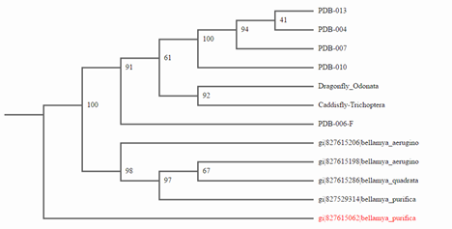
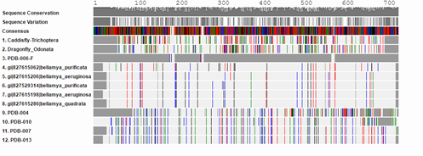
Genetic Diversity Of Freshwater Snails in The Peconic River Using the DNA Barcoding Method
A lack of biodiversity affects all organisms and, if there is not a lot of diversity, extinction may occur. In this experiment, the question was the amount of genetic diversity in the Peconic River. The objective was to determine sequence of the CO1 gene to see the genetic diversity within the samples. Another objective was to determine the species of the snails. While the species of the snails was not to be identifed, the genus of snails collected is Bellamya.
By: Nicholas Morello and Bobby Spiciati
Abstract
Research Mentors: Mr. Ostensen and Mr. Bolen
Overall, there were not that many complications to the results. But some that may have occured were pipetting errors, which could create erratic and inconsistant measurements. Also, the type of primers that were used could have skewed our results by not working. Another issue that may have occured is background DNA from prolonged PCR, which may leave incomplete copied DNA.
The implications of our research to the scientific community would be that little DNA differences among our samples could lead to a disease that could wipe out the snail population. In return, the water quality in the Peconic would drastically drop.The genus of the snails revealed that the snails are not native to Long Island. This means that the snails were an introduced species to Long Island. It is currently unknown if the snails are actually disrupting the ecosystem of the Peconic River. If this does happen, the snails can become invasive instead. The implication of this experiment is that the snails have genetic variation. This means that the snails have a better chance of surviving a population-ending diseases.
Discussion
Introduction
Biodiversity refers to the amount of genetic diversity in ecosystems. A lack of biodiversity, can lead to extinction of a species.
Our study sought to sequence the DNA of Peconic River snails (CO1 gene).
The Biodiversity in the Peconic River is understudied. If there is a lack of genetic diversity the species could be wiped out by a disease and be detrimental to the ecosystem in the area.
The objective of this experiment was to code the DNA of the CO1 gene in freshwater snails to study the diversity of these species. By following the barcode protocol the DNA was sequenced and the snail’s genus was identified.
Figure 1: Picture of samples 006 and 013.
Figure 2: DNA s results. Sample numbers 004, 006, 007, 010, 013 were the most successful.
Results
The sample of snails that was collected from the the Peconic River in Suffolk County on Long Island was put through the barcode protocol. Once the DNA was interpreted and analysed the genus was identified as Bellamya. This genus is a genus for freshwater snails that are native to Northeast Asia; particularly China. The snails were an introduced species to Long Island. Although most of the DNA base pairs did not match up, out of about six-hundred twenty-five base pairs there were over one hundred mismatches. All of the snails we obtained from the Peconic River are the same genus due to the similarity of the genetic variation between our samples.
Materials and Methods
The snails were obtained from the Peconic River on October 23, 2015. A Seine net was used to collect the samples. There were fourteen snails collected.
The snail's DNA was extracted and placed in a tube with added lysis solution. After grinding the sample, it was incubated for ten minutes. The samples were then centrifuged for one minute then the supernatant was transferred to another tube. Silica resin was added, then mixed and incubated for five minutes, then centrifuged for thirty seconds. Next, the supernatant needed to be removed so wash buffer could be added and mixed as a vortex and centrifuged for thirty seconds. Then, the last four steps were repeated. Next, the supernatant was to be removed, distilled water was added and mixed. By pipetting in and out, then incubated the samples for five minutes, and after incubation, centrifuge them. After that process, the supernatant was put into a fresh tube and stored at negative twenty degrees celsius.
Then, gel electrophoresis; which allows for the DNA to be properly viewed. To process the DNA of this group, the method of PCR was used to copy and analyze the DNA of the CO1 gene of the samples.The samples with the most success were to be sent to the DNA subway. Then,“Genewiz” was used to compare the DNA to other freshwater snails.
When the sequence was completed, the DNA was compared to the DNA to that of other wild-type freshwater snails on DNA subway.
Figure 4: This is the are where the 14 snail samples were collected.
Figure 3 Phylogenetic tree of the samples. It shows how the snails are related to other species.
The main contributors for this research project are Eastport South Manor HIgh School for allowing this project, Stony Brook University for allowing use of the instruments for PCR and gel electrophoresis, and Cold Spring Harbor for sponsoring this experiment. Also thanks go out to SEPA for contributining to the process.
Acknowledgments
References
1.http://www.in.gov/dnr/files/CHINESE_MYSTERY_SNAIL.pdf
2.http://nas.er.usgs.gov/queries/factsheet.aspx?SpeciesID=1045
3.http://www.caryinstitute.org/sites/default/files/public/reprints/Kroiss_2005_REU.pdf
Figure 5: Muscle results. This is the DNA of our samples compared to the other samples of DNA and related species.

